Slide 1
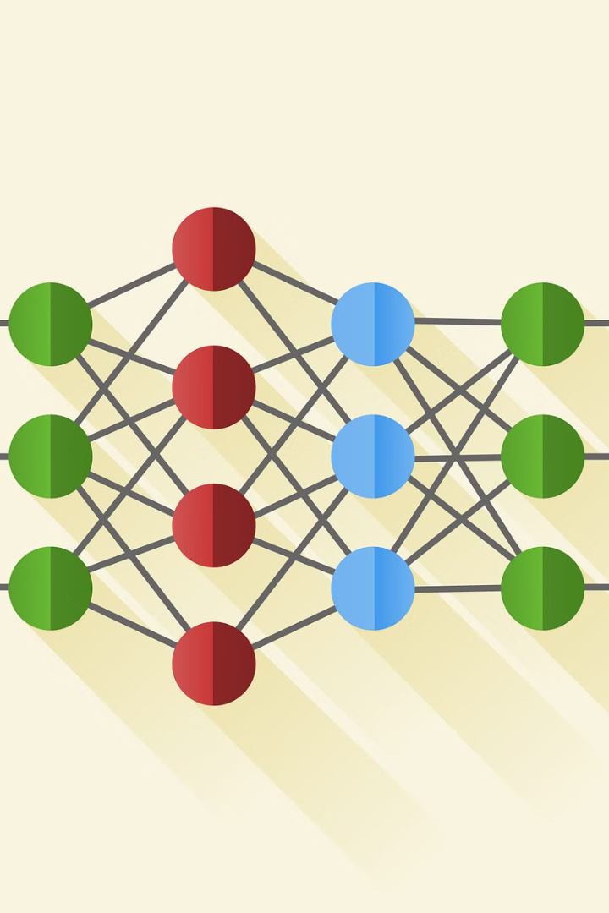
AI-Based Plant Disease Classification System
This project report focuses on the development of an AI-based system for classifying plant diseases. The system utilizes advanced technology to accurately identify and classify various plant diseases, contributing to the enhancement of agricultural practices and crop management.

Slide 2

CHAPTER 1
INTRODUCTION
The "AI-Based Plant Disease Classification System" is a cutting-edge tool in the field of agriculture that uses deep learning and artificial intelligence to automatically identify and categorise plant diseases.
This technology aims to transform agricultural practices, improve crop output, and encourage sustainable farming for a better agricultural future by offering timely insights about crop health.
The primary objective is to empower farmers with a reliable tool for early disease detection, thereby enhancing crop management practices and optimizing agricultural productivity.
This introduction clarifies the significance of early disease identification and lays the groundwork for a thorough examination of the disease classes and their descriptions.

Slide 3

CHAPTER 2
PROBLEM STATEMENT
AI Based Smart Plant Disease Classification System for Indian Farmers. The project addresses the challenge of manual identification and classification of plant diseases, which is labour-intensive and prone to errors. By automating this process using AI, the system aims to provide a more efficient and accurate solution for farmers and agricultural experts.

Slide 4
CHAPTER 3
WORKING
The methodology section outlines the development process of a plant disease classification system using a convolutional neural network (CNN). It begins with data preprocessing, including resizing images, augmentation, and splitting into training and validation sets. Next, a CNN model architecture is designed, featuring convolutional and max-pooling layers, dropout regularization, and softmax activation for classification. The model is trained using the Adam optimizer and categorical cross-entropy loss function, with performance monitored using metrics like accuracy. After training, the model is evaluated on unseen data, and performance metrics such as accuracy, precision, recall, and F1-score are computed. Finally, the trained model is deployed using a Flask API for real-time inference, enabling users to upload images of plant leaves and receive disease predictions, thus facilitating practical agricultural monitoring and management.

Slide 5
CHAPTER 4
HARDWARE AND SOFTWARE REQUIREMENTS
Hardware Requirements
Software Requirements
Processor: Intel Core i5 10th generation or equivalent
Programming Language: Python 3.10, JavaScript
RAM: Minimum 8GB
IDE used: VS Code
Storage: Minimum 512GB SSD or HDD
Libraries: TensorFlow, Keras, PIL, Flask (for web application development), Numpy, Pandas (for data manipulation)
Dataset: PlantVillage
OS: Windows 11

Slide 6
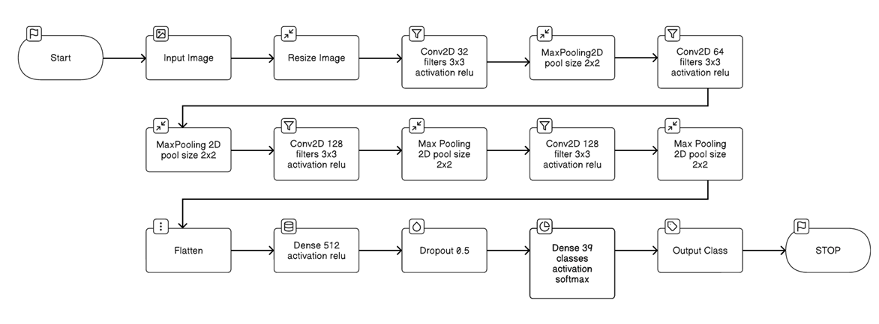
CHAPTER 5
FLOWCHART
The model flowchart illustrates the sequential steps involved in preprocessing the dataset, designing and training the convolutional neural network (CNN) model, and deploying the model for inference.

Slide 7
CHAPTER 6
Advantages
Improved Disease Detection Accuracy
Efficiency and Speed
Cost-Effectiveness
Implementing automated disease detection systems minimizes labour expenses related to manual inspection and reduces the need for pricey chemical treatments.
Applying deep learning methods, specifically Convolutional Neural Networks (CNNs), improves the accuracy of plant disease identification, resulting in faster and more accurate disease detection.
CNN-driven automated plant disease classification systems provide quick analysis of massive plant image collections, speeding up the decision-making process in agricultural activities.
Scalability
Remote Monitoring
Deep learning-based plant disease categorization systems can be implemented in a variety of agricultural contexts, from small-scale farms to massive commercial plantations, due to their scalability.
Plant disease categorization systems facilitate remote crop monitoring through the integration of IoT devices and remote sensing technologies, making it easier to manage plant health in real time.

Slide 8

CHAPTER 7
Results and Discussions
The plant disease classification model achieved 96.44% accuracy on the validation dataset. It effectively diagnoses various plant diseases with high precision and recall scores. The model's ability to generalize to new data was confirmed. Discussion highlights the role of Convolutional Neural Networks (CNNs) in detecting minor disease patterns. Training techniques like data augmentation, oversampling, and preprocessing addressed challenges such as overfitting, data imbalance, and image quality variability. The results demonstrate the model's efficacy in diagnosing plant diseases, paving the way for practical applications in agriculture. Further refinements can enhance its performance in real-world scenarios.

Slide 9
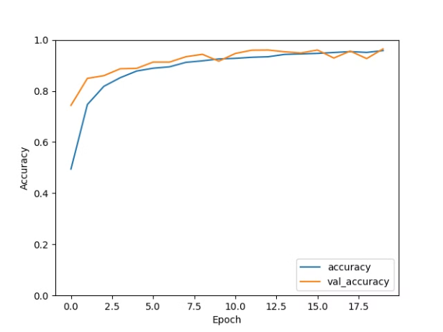
CHAPTER 8
Training Accuracy Graph
The graph indicates a generally positive trend in accuracy, suggesting that the model is learning and improving as it progresses through training epochs.
We can see a sharp increase in accuracy in the early epochs, which is typical for machine learning models.
Till the end of training, after 20 epochs model came up with accuracy of 96.44%.

Slide 10

Thank You!
Thank you for your attention and for being a part of this presentation. We hope you found the information valuable and insightful.
If you have any questions or would like to learn more, please feel free to reach out to us. We appreciate your time and interest.

