Slide 1

Sales Forecasting System
Academic Project Presentation
Bhagat Poonam, Tekale Pranjal, Pawar Akanksha, Tupe Manisha
Parikram College of Engineering, Kashti
June 2025

Slide 2
Agenda
1
Introduction & Motivation
2
Data Source & Feature Engineering
3
Modeling Approach & Validation
4
System Architecture & Implementation
5
Mobile App Interface
6
Results & Performance Metrics
7
Conclusions & Future Work
8
Q&A

Slide 3
Introduction & Motivation
Project Objective
Business Need
Academic Relevance
Predict 7-day and 30-day retail sales per SKU.
Reduce stockouts and overstocking costs.
Time-series feature engineering, gradient boosting.
Support inventory, promotions, resource allocation.
Enable data-driven pricing and promotions.
End-to-end pipeline from data to mobile.

Slide 4
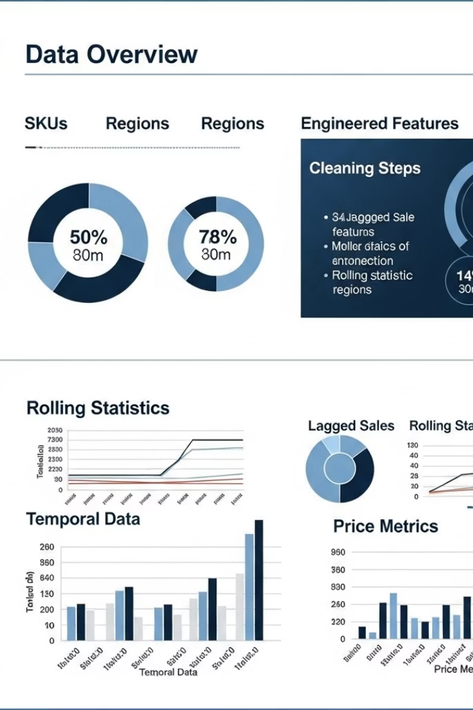
Data Source & Feature Engineering
Data Overview
Cleaning Steps
Two years of daily retail transactions.
Schema validation, type enforcement.
20 SKUs × 4 regions; 14,620 rows.
Categorical domain checks.
Engineered Features
29 total features.
Temporal, lagged sales, rolling statistics, price metrics.

Slide 5





Modeling Approach & Validation
Dataset Construction
Shift Sales by –7 or –30 as targets.
Train/Test Split
Chronological 80% train / 20% test.
Cross-Validation & Tuning
TimeSeriesSplit, Grid Search for XGBoost.
Final Model Training
Fit two XGBoost regressors.
Evaluation Metrics
MAE, RMSE, MAPE, MPE, R².

Slide 6
System Architecture & Implementation
Data Layer
1
Raw CSV, Product store, Audit logs.
2
Processing & Feature Engineering
Pandas-based modules.
Modeling & Training
3
XGBoost, TimeSeriesSplit CV, model serialization.
4
API & Deployment (Flask)
JWT auth, endpoints, inference pipeline.
Client Layer (Flutter App)
5
Authentication UI, Forecast Dashboard.

Slide 7

Mobile App Interface
Authentication Flow
Forecast Dashboard
Product Management (Admin)
Login screen, JWT via /login.
Choose horizon: Week/Month-Ahead.
Product List: ListView with Edit/Delete.
Secure storage: Flutter Secure Storage.
Interactive line chart, tooltips, pan/zoom.
Create/Edit screens: Form fields, validation.
Offline mode: cached data banner.
Confirmation dialogs, snackbars.

Slide 8

Results & Performance Metrics
0.781
0.723
Week-Ahead R²
Month-Ahead R²
MAPE = 8.19%
MAPE = 12.47%
125ms
99.7%
Median Latency
API Uptime
Meets target < 200 ms.
Error rates < 0.5%.

Slide 9
Conclusions & Future Work
Conclusions
Future Work
End-to-end sales forecasting pipeline built.
Advanced Models: XGBoost + LSTM/RNN, Bayesian optimization.
High accuracy: week <10% MAPE, month <15% MAPE.
Low-latency inference met (<200 ms).
Scalable Deployment: Kubernetes, autoscaling, managed hosting.
Intuitive mobile app, offline support, admin CRUD.
System design meets goals.
Explainability & Monitoring: SHAP/LIME, Prometheus/Grafana.

Slide 10

Questions & Answers

