Slide 1

Team 2
Retail Analysis
Retail Sales Optimization
TEAM MEMBERS:
OM DHAGE
VANSHIKA KOTAGIRWAR
SAMPADA KHOND
ARIF SHAHNAWAZ
YASH BHOYAR
ALFIYA SHEIKH
Institute : Jhulelal Institute of Technology, Lonara, Nagpur
Department : Computer Science Engineering (Third Year)

Slide 2

Project Overview
Objective: Analyze retail sales data to identify loss-making products
Dataset: Superstore Sales Dataset
Goal: Improve profitability through data-driven insights
Approach: Data cleaning → EDA → Insights → Recommendations
Problem Statement
Company has high sales but inconsistent profits
Some products generate negative profit
Discounts may be affecting profitability
Why is the company losing money despite strong sales?

Slide 3
Dataset Description
Each row = order item
Total Rows = 9994
Key Columns:
Sales
Profit
Discount
Quantity
Category & Sub-Category
Region

Slide 4
Tools & Technologies
Project Workflow
Python (3.11)
VScode
Git/Github
Jira
Virtual Environment
Libraries:
pandas, numpy
matplotlib, seaborn
Environment management using Conda
Data Understanding
Data Cleaning
Missing Values Handling
Outlier Analysis
Exploratory Data Analysis (EDA)
Loss Analysis
Insights & Recommendations

Slide 5

Data Cleaning
Outlier Detection
Removed duplicates
Handled missing values
Converted date columns
Verified data types
Method Used: IQR (Interquartile Range)
Findings:
Profit has many extreme values
Sales also contains outliers
Discount and Quantity have minor outliers
Outlier Analysis
Used boxplots to detect outliers
Observed extreme values in Sales and Profit.
Decision:
Outliers were retained
Because they represent real business scenarios
Outlier Handling Strategy
Approach:
Sales → Outliers capped (data noise)
Profit → NOT modified (business insight)
Reason:
Profit outliers represent real gains/losses and are important for decision-making

Slide 6
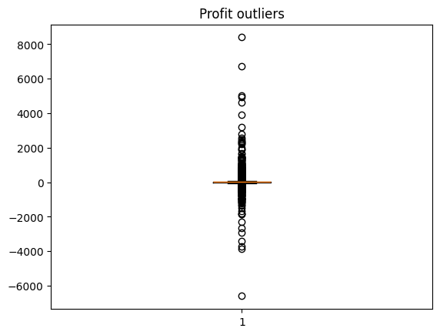

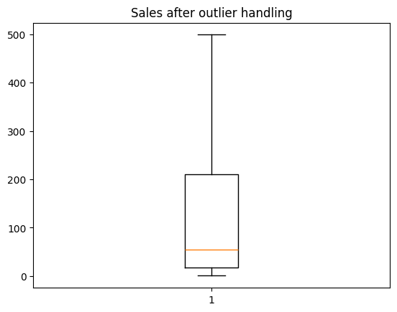
Before vs After Outliers
Sales Outliers(1167)
Observation:
Sales distribution improved after handling
Profit distribution unchanged to preserve insights

Slide 7
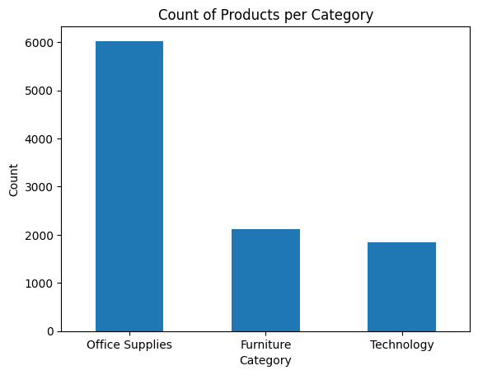
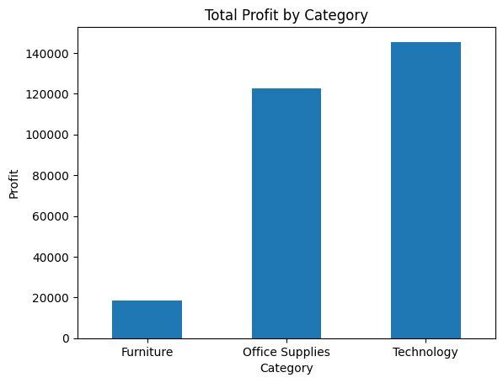

Slide 8
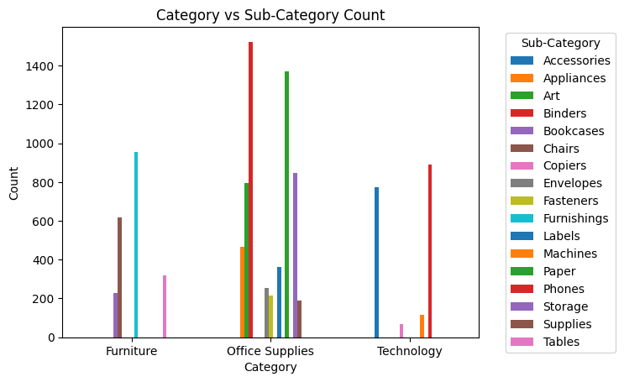

Slide 9
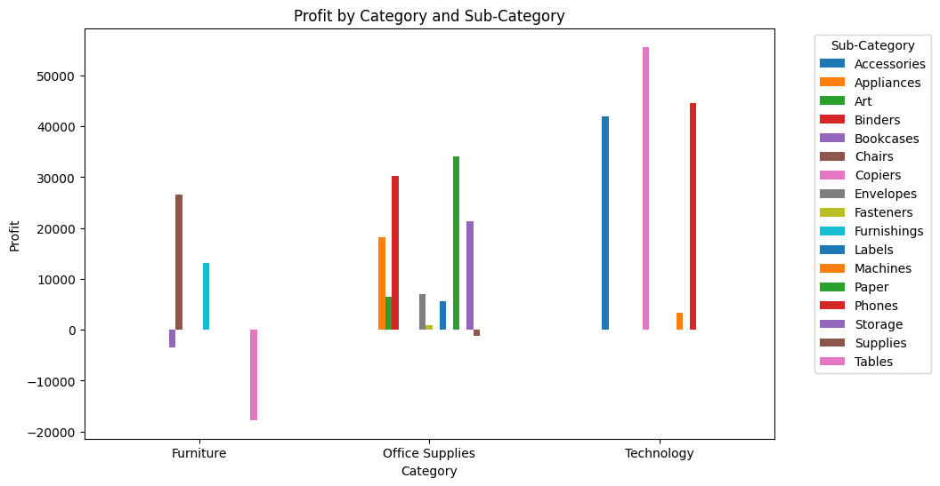

Slide 10
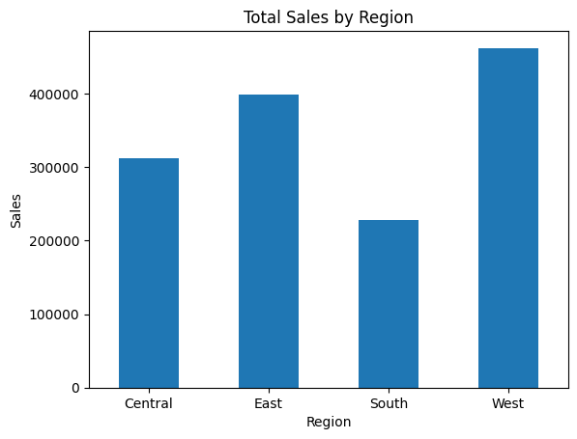
Sales Performance based on Region
Regional Insights:
South region has the lowest sales performance
Compared to:
Central
East
West

Slide 11
Loss Analysis (Overview)
Sub-Category Loss
Total Loss: -156K
Breakdown:
Category-wise
Sub-category-wise
Region-wise
Loss-making products:
Tables → highest loss
Bookcases
Supplies
Tables are the main loss driver.
Category-wise Loss
Region-wise Loss
Furniture → highest loss
Office Supplies → second
Technology → least loss
Furniture is the most problematic category.
Central → highest loss
East → second
South & West → lower
Central region needs improvement

Slide 12
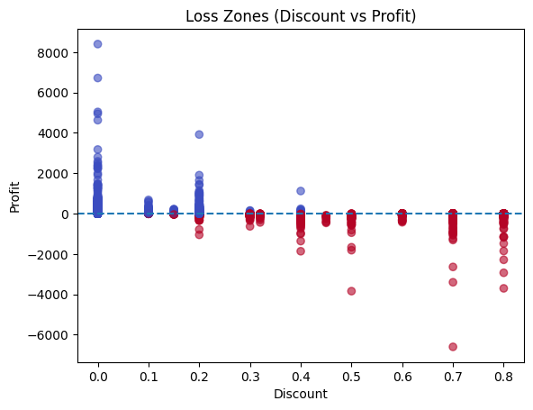
Discount Impact
0.10% -29.2744
0.15% -328.7030
0.20% -17258.0654
0.30% -10777.6879
0.32% -2391.1377
0.40% -25787.8268
0.45% -2493.1111
0.50% -20506.4281
0.60% -5944.6552
0.70% -40075.3569
0.80% -30539.0392
Key Finding:
Higher discount → higher loss
Max loss occurs at 60–80% discount range
Discounts are the main reason for losses

Slide 13
Profit Margin (KPI)
Top Performing Products
Formula:
Profit Margin = Profit / Sales
Results:
Technology → ~24% (best)
Office Supplies → ~15%
Furniture → ~5% (worst)
Furniture is inefficient despite sales
Highest Profit Generators:
Copiers
Phones
Accessories
Paper
These are business strengths
Worst Performing Products
Loss Makers:
Tables
Bookcases
Supplies
These require immediate action

Slide 14
Key Insights
Conclusion
High discounts → major cause of loss
Furniture → lowest profit margin
Tables → biggest loss contributor
Technology → most profitable category
Sales ≠ Profit
Identified key loss drivers
Analyzed root causes (discount impact)
Suggested actionable improvements
Data-driven decisions can significantly improve profitability
Business Recommendations
Future Scope
Actions:
Reduce discounts above 20%
Re-evaluate pricing of Tables
Focus on high-margin products (Technology)
Improve performance in Central region
Avoid low-margin bulk sales
Build interactive dashboard (Streamlit / Power BI)
Apply machine learning for profit prediction
Customer segmentation analysis

Slide 15

Team 2
Thank You
For Your Attention
This project demonstrates how data analysis can identify business problems and provide actionable strategies to improve profitability.

