Slide 1
DeepSpec
Understand the part.
Keep the evidence.
Photo-assisted identification,
useful explanations and reviewable records
Working prototype · September 2026
Illustrative artwork
Notes:
The V1 aim is to let someone photograph an automotive part, receive an AI identification suggestion and useful information, inspect the result, and easily report or correct problems. Human inspection records add traceable evidence for seller and shop workflows. Actual time savings and real-user accuracy remain unmeasured. The cover uses existing original AI-generated brand artwork, not a customer scan.
Sources
docs/V1_V2_MASTER_PLAN.md
docs/PART_INSPECTION_PILOT.md
docs/PILOT_RUNBOOK.md
public/brand/alternator-workbench.webp
docs/UI_POLISH_2026-09-21.md

Slide 2
When a part is unfamiliar
A photo needs an explanation and context.
Identity
A label, part number or useful reference can take time to find.
Condition
A photo, a visible observation and a test result answer different questions.
Documentation
Notes and pictures can become scattered or need to be entered again.
Workflow hypotheses to check with real users.
02
Notes:
These are product hypotheses, not claims from an industry survey. They apply to a person trying to understand a component as well as to seller intake. DeepSpec should observe real users before quantifying prevalence, time lost or return-rate impact.
Sources
docs/V1_V2_MASTER_PLAN.md
docs/PILOT_RUNBOOK.md
docs/PART_INSPECTION_PILOT.md

Slide 3
People DeepSpec can help
01
Parts sellers
Document incoming parts and reopen the evidence behind a listing.
02
Auto shops
Attach scan records to a job and prepare a customer report.
03
DIY owners
Understand a possible part identity and keep notes for a mechanic.
03
Notes:
Audience roles are intended uses, not existing customer counts. Seller intake is one candidate workflow in the broader trusted-user beta. Shop mode currently stores jobs locally for the account/device, rather than providing a live shared workspace. DIY users should treat AI output as a starting point and seek appropriate human checks.
Sources
docs/PILOT_RUNBOOK.md
src/screens/Shop.tsx
src/services/shop.ts

Slide 4
The core DeepSpec workflow
01
Capture
Take or upload a clear photo of the part.
02
Review
Read the AI suggestion and ask follow-up questions.
03
Inspect
Correct the answer or add human inspection evidence.
04
Keep
Save, reopen and export the record when needed.
04
Notes:
The workflow combines scanner capture and results with human inspection metadata and saved history/report tools. Save state distinguishes device persistence from successful cloud receipt. Cloud behavior depends on configuration and connectivity.
Sources
docs/PART_INSPECTION_PILOT.md
src/screens/Scanner.tsx
src/screens/Result.tsx
src/screens/History.tsx
src/services/report.ts

Slide 5
Photo capture and the AR experience
Current camera workflow
V1 polish target
Camera or image upload
Quality guidance and focus area
Identification overlay and result card
A stable highlight on the part
Readable labels and transitions
Clear fallback to a photo scan
Good AR should help the user see the part and understand what to do next.
Mobile tracking quality needs real-device testing. Current cutouts are 2D.
05
Notes:
The scanner accepts camera and upload input, assesses capture quality and can focus/isolate a selected region. Segmentation service availability affects isolation; do not claim guaranteed segmentation or 3D reconstruction. This is a two-dimensional image workflow. A clearer photo can aid review but does not guarantee identification accuracy.
Sources
docs/V1_V2_MASTER_PLAN.md
src/screens/Scanner.tsx
src/lib/imageQuality.ts
src/lib/promptableSegmentation.ts

Slide 6
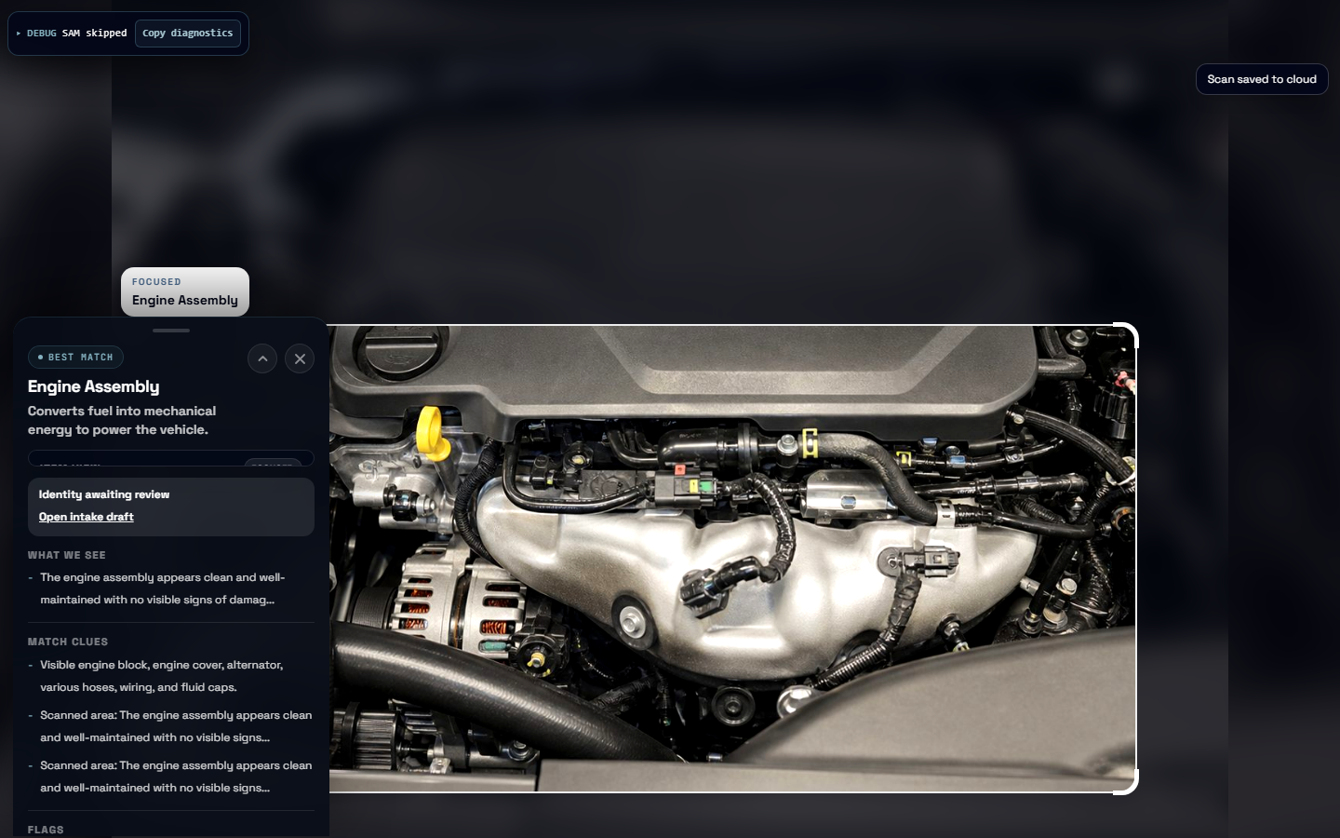
AI result and follow-up chat
A starting point
for the review
Suggested identity
Visible clues
Uncertainty and flags
Follow-up chat keeps
the scan context close.
Actual app QA capture. A photo does not establish function or safety.
06
Notes:
The screenshot records a live engine-image QA response on September 26. It is a feature example, not a measured identification-accuracy study. Results and follow-up chat can contain errors. A separate result chat lets users ask about the scan. Scan upload cloud receipt in the screenshot does not prove the new human-inspection cloud column exists.
Sources
artifacts/qa/2026-09-26T11-35-19-272Z/screenshots/scanner-ai-engine.png
artifacts/qa/2026-09-26T11-35-19-272Z/report.md
src/screens/Result.tsx
src/screens/Chat.tsx

Slide 7
Human checks stay separate
Identity
Visible condition
Function
What part did you confirm?
Which label or reference supports it?
What could you observe?
What damage or uncertainty remains?
What test did you perform?
What happened during the test?
Inspector name and time travel with the saved inspection.
No visible damage is different from a passed functional test.
07
Notes:
DeepSpec stores human inspection fields separately from AI output. The form requires inspector name, identity evidence when identity is provided, notes for visible damage/uncertainty, and a method/result when a functional status has been selected. Inspector identity is self-reported. These records are not safety certification or validated training labels.
Sources
docs/PART_INSPECTION_PILOT.md
src/components/result/PartInspectionForm.tsx
src/lib/partInspection.ts

Slide 8
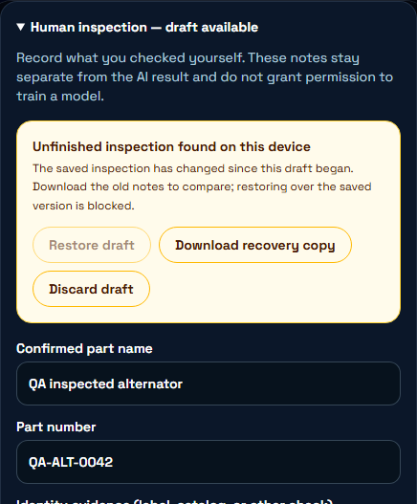
An interruption need not lose the notes
Draft recovery on this device
Edits preserve an unfinished draft.
After reopening, choose restore or discard.
A newer saved inspection blocks
restoring an older draft over it.
A download keeps the notes for comparison.
QA fixture. Browser storage can fail or be cleared. Drafts are not cloud backups.
08
Notes:
The screenshot shows fictional QA input in the actual application. Draft recovery is scoped by signed-in account and scan on the device. Restore and discard are explicit. If the saved inspection changed, restoration is blocked and the user can download old notes. The app warns when storage fails and keeps visible typed text. This guard does not provide atomic cross-device conflict resolution.
Sources
docs/DRAFT_RECOVERY_RELEASE_REPORT_2026-09-26.md
src/services/inspectionDraft.ts
src/components/result/PartInspectionForm.tsx
artifacts/qa/2026-09-26T16-20-49-881Z/screenshots/inspection-stale-recovery-choice.png

Slide 9
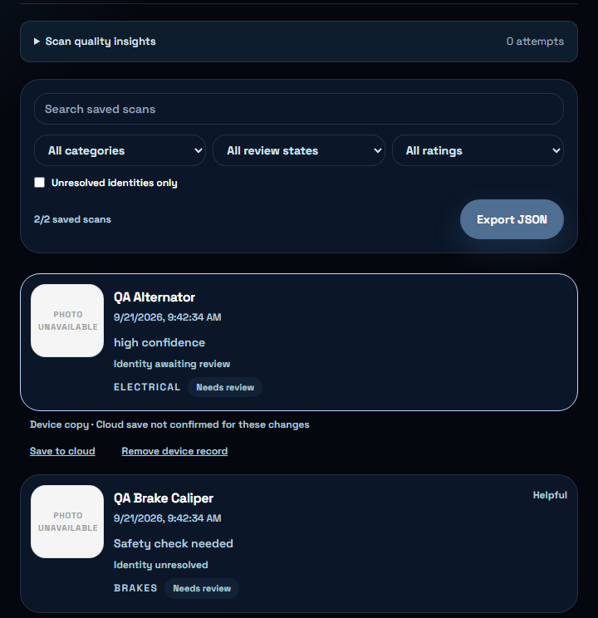
A library that keeps the evidence close
Find the part again
Search saved records.
Filter review states and unresolved identities.
Reopen an inspection or export a report.
Device and cloud status stay visible
so an upload failure is not mistaken
for a successful cloud save.
Actual app screen with fictional QA records.
09
Notes:
Saved history supports search, categories, review states, ratings and an unresolved-identity filter. The screenshot contains synthetic QA records with unavailable photos, not real customer inventory. Library export offers JSON; individual text report export includes human inspection fields and private notes, so review before sharing. Device success and cloud success remain distinct.
Sources
src/screens/History.tsx
src/services/report.ts
artifacts/qa/2026-09-21T13-42-31-354Z/screenshots/saved-history.png

Slide 10
Shop jobs and customer reports
A scan can belong to a job
Job context
Customer explanation
Keep a local job record and attach
relevant scans for the same repair.
Prepare a report of the recorded
findings for a conversation
with the customer.
Current scope: account-scoped jobs on this device. Shared live shop work is future work.
10
Notes:
Shop mode supports local job/customer/vehicle context, linked scans and generated customer reports. It does not currently provide a shared live multi-employee database or automatic catalog/order integration. This is an intended application within the product, not proof that a shop already adopted it.
Sources
src/screens/Shop.tsx
src/services/shop.ts
src/services/report.ts

Slide 11
Accounts, storage and control
Account
Device records and drafts are scoped to the active account.
Device
A saved local record remains distinct from a confirmed cloud upload.
Cloud
Sync and recovery depend on configuration, connectivity and verified persistence.
Photos
Storing a photo does not give permission to train a model on it.
11
Notes:
Account-scope generation guards prevent stale asynchronous activity from applying to another account. Local device data still uses browser storage and is not a guarantee against a compromised device. Existing authentication and cloud pathways require release verification. The live inspection verifier now passes save/read/update and account isolation after the additive migration. No automatic training ingestion is claimed.
Sources
src/lib/accountScope.ts
src/services/storage.ts
src/services/cloudSync.ts
src/services/inspectionDraft.ts
artifacts/qa/v1-foundation-2026-09-26/cloud-inspection.txt
docs/V1_LAUNCH_PLAN.md

Slide 12
What time savings could be worth
Hypothetical workflow, including normal tests
16.5 hours
Modeled monthly time difference
$495 / month
Gross labor capacity at $30/hour
30 parts/day × 22 days/month. Before setup, support and software costs. No observed savings or revenue.
12
Notes:
Illustrative arithmetic only. Assume 30 parts/day × 22 working days/month = 660 parts/month. Assume ordinary intake including required tests takes 6 minutes manually versus 4.5 minutes assisted. (6 - 4.5) × 660 / 60 = 16.5 hours/month. At an assumed $30/hour this is $495 of modeled gross labor capacity before setup, support, software or other costs. It is not cash savings, revenue, profit, a price recommendation, or a seller measurement. Actual values must come from observation. Editable chart contains literal hypothetical data.
Sources
docs/PILOT_RUNBOOK.md

Slide 13
Who might pay, and for what
Possible buyer | Useful outcome | Pricing idea to test
Parts seller | Repeatable intake records | Monthly seller account
Auto shop | Jobs and customer reports | Monthly operator or shop plan
DIY owner | Occasional guidance and records | Free entry or paid scan allowance
Willingness to pay is unvalidated. A useful workflow and repeated use must come first.
13
Notes:
These audiences and pricing structures are hypotheses, not current offers, revenue or customer commitments. Do not infer willingness to pay from the hypothetical time calculator. Observe usage, support burden, model costs and the buyer’s own alternatives, then ask whether they would continue at a concrete proposed scope and price.
Sources
docs/PILOT_RUNBOOK.md

Slide 14
Evidence behind the current build
What was checked | Evidence | What it establishes
Automated app checks | 1,015 tests, lint and build passed | Recorded build and behavior checks
Browser recovery | Mobile and desktop QA passed | Restore, discard, stale edits and exports
Live image analysis | Engine-image response completed | A real configured analysis path
Live inspection cloud | Save, read, update and isolation passed | Private storage and account separation
Engineering evidence as of September 26, 2026. Seller time savings and accuracy remain unmeasured.
14
Notes:
Counts refer to the recorded review-branch implementation, not every future commit. The 1,015 tests plus lint/build evidence is historical. Browser recovery checks used controlled cloud failures. A later live verifier, after the existing additive inspection migration, passed inspection save/read/update, original AI/evidence retention, second-account read/write denial, private image access isolation and generated fixture cleanup. This supersedes the earlier missing-column blocker. Production email authentication, physical-phone testing and real-user usefulness remain separate release checks.
Sources
docs/DRAFT_RECOVERY_RELEASE_REPORT_2026-09-26.md
artifacts/qa/v1-foundation-2026-09-26/cloud-inspection.txt
docs/V1_LAUNCH_PLAN.md
artifacts/qa/2026-09-26T11-35-19-272Z/report.md
https://github.com/om1o/DeepSpec/actions/runs/36255542250
https://github.com/om1o/DeepSpec/pull/114

Slide 15
A focused V1, with room for V2
Status | Capability | Boundary
Current core | Photo analysis, chat and human records | AI suggestions still need review
Current records | Library, recovery, exports and cloud sync | Shop jobs remain local
V1 completion | AR polish, feedback, consent and review | Planned or in review, then verify
Future V2 | Versioned datasets and specialized models | Train only when evidence justifies it
3D reconstruction and ambitious new integrations can wait beyond V1.
15
Notes:
Current means implemented in the reviewed prototype, not publicly launched. Live inspection persistence now passes the cited verifier. Structured feedback categories, review infrastructure and explicit per-example consent/lineage remain planned or in review until their implementation passes verification. Existing ratings and corrections are a starting point. V1 should not wait for custom model training or full 3D reconstruction.
Sources
docs/V1_V2_MASTER_PLAN.md
docs/V1_LAUNCH_PLAN.md
artifacts/qa/v1-foundation-2026-09-26/cloud-inspection.txt
docs/DRAFT_RECOVERY_RELEASE_REPORT_2026-09-26.md
docs/PART_INSPECTION_PILOT.md
src/screens/Shop.tsx
src/services/cloudSync.ts

Slide 16
A one-month route to real users
Week 1
Foundation
Verify accounts, persistence, consent and feedback.
Week 2
Scanning and AR
Test difficult images, overlays and mobile failure states.
Week 3
5–15 trusted users
Observe usefulness, wrong results and recurring confusion.
Week 4
Launch candidate
Fix repeated failures, verify privacy, monitoring and cost controls.
Target plan, not a guaranteed launch date. A seller timing study can be one beta cohort.
16
Notes:
This is the user’s approximately one-month target, governed by readiness rather than a guaranteed deadline. V1 should serve a broader group of 5–15 trusted users. Measure scan success, wrong identifications, corrections, AR failures, latency, crashes and usefulness. One seller can form a focused cohort using the existing separate 10-observation baseline and 20-part comparison protocol. The pilot’s 30% time reduction threshold remains a proposed test target, not a product claim. Keep normal tests in both seller workflows.
Sources
docs/V1_V2_MASTER_PLAN.md
docs/V1_LAUNCH_PLAN.md
docs/PILOT_RUNBOOK.md

Slide 17
Feedback that can support V2
A planned pipeline with permission and review
Report or correct
Keep the prediction, failure category and useful context.
Consent and privacy
Record permission and screen out unsuitable information.
Verify the example
Review the correction against evidence before approval.
Version and evaluate
Track dataset membership, then test changes before training.
Current ratings and corrections provide a starting point. Uploads do not automatically enter training.
17
Notes:
The pipeline is the current product plan, not a claim that a full review dashboard and versioned dataset system already exist. Preserve both good and bad outputs when permitted. A useful wrong-part correction may be valuable, but incorrect corrections, faces, plates and private details require filtering and review. Keep explicit consent, provenance, review status and dataset lineage. Honor opt-out/deletion through the eventual lineage system. Evaluate improved prompts, retrieval, routing and preprocessing before committing to custom training.
Sources
docs/V1_V2_MASTER_PLAN.md
docs/V1_LAUNCH_PLAN.md
docs/PART_INSPECTION_PILOT.md
src/services/trainingReadiness.ts
src/services/shop.ts

Slide 18

A photo that helps you
understand the part
Useful information. Clear evidence.
A simple way to tell us what went wrong.
Next: finish the focused V1, test with real users and let the evidence guide V2.
18
Notes:
The user’s V1 purpose is to help people photograph a car part and better understand what it might be, with useful information and a clear way to inspect/report/correct the answer. Seller and shop documentation are meaningful applications within this broader purpose. The next step is focused reliability and AR/feedback polish, followed by 5–15 real testers. Do not promise verified function, hidden damage detection, fitment, valuation accuracy, revenue or measured time savings.
Sources
docs/V1_V2_MASTER_PLAN.md
docs/V1_LAUNCH_PLAN.md
docs/PILOT_RUNBOOK.md
public/brand/deepspec-logo.png

