Slide 1
DeepSpec
A small trial
for parts intake
AI-assisted identification and
human inspection records
Private beta proposal
September 2026
01
Illustrative artwork
Notes:
A proposal for one seller. No seller study, measured time savings or paid commitment has been established. The illustration is decorative and does not show a scanned customer part.
Sources
docs/PILOT_RUNBOOK.md
docs/UI_POLISH_2026-09-21.md
public/brand/alternator-workbench.webp

Slide 2
What the trial will test
Can a seller document a part
with less staff time?
01
Identify the part
Check a photo suggestion against a label or reference.
02
Keep a usable record
Record human checks, then reopen or export the inspection.
02
Notes:
The time-saving premise is a hypothesis. The trial observes the current intake workflow, including identification, documentation and required functional checks. It does not remove safety or testing work to improve the timing result.
Sources
docs/PILOT_RUNBOOK.md
src/components/result/PartInspectionForm.tsx

Slide 3
AI suggestions and human checks
DeepSpec suggests
The operator records
A possible part identity
from the photo.
The checked identity and evidence.
Visible condition.
The actual test method and result.
Treat uncertain or unsupported
identities as unresolved.
A photo does not establish that
a part works or is safe.
03
Notes:
Human inspection fields remain separate from the AI result. No visible damage does not mean functional success. Recorded tests are not safety certification. DeepSpec does not claim 3D measurement, hidden-defect detection or a custom trained model. Photo storage permission does not imply training permission.
Sources
docs/PILOT_RUNBOOK.md
src/components/result/PartInspectionForm.tsx
docs/PART_INSPECTION_PILOT.md

Slide 4
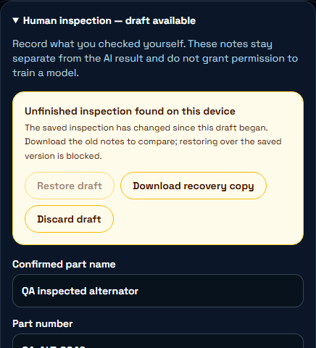
Inspection draft recovery
Interrupted work has
a recovery path
Edits keep a draft in this browser.
After a refresh, choose restore or discard.
A changed saved inspection blocks
restoring the older draft. Download
the notes to compare.
QA fixture. Local browser storage, not a cloud backup.
04
Notes:
Actual application screenshot from browser QA on September 26, 2026. Fictional QA records and controlled cloud failures. This verifies a local recovery behavior, not successful live inspection-cloud persistence. Drafts are scoped to the signed-in account on the device. Browser storage can fail or be cleared. UI preserves typed text and offers a manual download when storage fails. Concurrent checks are not atomic cloud conflict resolution.
Sources
src/components/result/PartInspectionForm.tsx
src/services/inspectionDraft.ts
artifacts/qa/2026-09-26T16-20-49-881Z/report.md

Slide 5
A small supervised trial
One seller. One operator. One part family.
10
20
Manual baseline observations
Parts in the comparison batch
Rehearse first, then record
the ordinary workflow.
10 manual and 10 with DeepSpec.
Use different physical parts.
Keep normal tests. Balance difficulty. Retain failed and abandoned attempts.
05
Notes:
This is a small feasibility study. Ten manual baseline observations are separate from the later twenty-part comparison batch. Balance easy/hard cases and alternate workflows to reduce order effects. Distinct physical parts across arms and batches. Count retakes as captures of the same observation, not independent parts. Keep onboarding and support time separate. Do not infer causal or population-level accuracy from this tiny study.
Sources
docs/PILOT_RUNBOOK.md

Slide 6
Proposed continuation target
30%
The result also needs
No increase in wrong
accepted identities.
No lost records.
Honest counts of failures,
missing timing and support.
Lower median active time
Target only. No measured savings yet.
Required inspection and functional-test time stays in both workflows.
06
Notes:
Proposed continuation threshold from the pilot protocol: at least 30% lower median active time without more wrong accepted identities than manual intake. This is a target and does not establish business value. Also review completed/abandoned outcomes, unresolved identities, missing measurements, elapsed time, retakes, observed provider cost and support. An unsupported identity used externally stops expansion. No validated willingness to pay or prices exist.
Sources
docs/PILOT_RUNBOOK.md

Slide 7
Before a seller begins
The cloud-backed pilot still has release gates
Cloud inspection storage
Apply the reviewed database change.
Verify save, readback and account isolation.
Release checks
Configure the missing CI settings and pass the checks.
Rehearse camera, recovery and exports on the actual phone.
Use one editor during the pilot. Cross-device edits lack atomic conflict protection.
07
Notes:
As of the September 26 checklist, read-only inspection-column preflight returned missing column inspection_json. GitHub Actions lacked VITE_SUPABASE_URL and VITE_SUPABASE_PUBLISHABLE_KEY for auth verification. Apply production changes only through review. A successful ordinary CI cloud test does not replace npm run verify:supabase -- --inspection. Physical-phone and seller evidence remains outstanding. Until applicable gates pass, use only a clearly labeled local rehearsal.
Sources
docs/PRIVATE_BETA_RELEASE_CHECKLIST.md
docs/PILOT_RUNBOOK.md
supabase/migrations/20260920000100_part_inspection.sql

Slide 8
Pilot invitation
Could we observe how you
document incoming parts?
You choose the part family and required checks,
and approve how photos are stored.
We run the small comparison and review
staff time, errors and saved records together.
Supervised, unpaid trial. Discuss paid continuation after the results.
08
Notes:
Suggested invitation, not sent by this task. Choose one seller and one operator, agree on photo storage and the observation protocol before the trial. No model training or public-sharing permission is implied. Stop for lost records, cross-account exposure or unsupported identities accepted externally. Ask yes/no/not-yet about continuation after reporting real results, then record proposed scope, quoted price and reasons.
Sources
docs/PILOT_RUNBOOK.md
docs/PRIVATE_BETA_RELEASE_CHECKLIST.md

