Slide 1
DeepSpec
Understand the part.
Keep the evidence.
Photo-assisted identification,
useful explanations and reviewable records
Private beta candidate · October 2026
Illustrative artwork
Notes:
DeepSpec is now a private-beta candidate: photograph a vehicle part, review an AI suggestion, ask focused follow-ups, mark the answer right, wrong or unresolved, and keep the photo, answer and human feedback together. Public launch still depends on provider evaluation, physical-phone checks, monitoring and real tester evidence.
Sources
docs/V1_LAUNCH_PLAN.md
docs/V1_CREATIVE_RESEARCH_2026-10-01.md
src/screens/Result.tsx
src/screens/EarlyAccess.tsx

Slide 2
When a part is unfamiliar
A photo needs an explanation and context.
Identity
A label, part number or useful reference can take time to find.
Condition
A photo, a visible observation and a test result answer different questions.
Documentation
Notes and pictures can become scattered or need to be entered again.
Workflow hypotheses to check with real users.
02
Notes:
These are product hypotheses, not claims from an industry survey. They apply to a person trying to understand a component as well as to seller intake. DeepSpec should observe real users before quantifying prevalence, time lost or return-rate impact.
Sources
docs/V1_V2_MASTER_PLAN.md
docs/PILOT_RUNBOOK.md
docs/PART_INSPECTION_PILOT.md

Slide 3
People DeepSpec can help
01
Parts sellers & salvage
Document uncertain inventory and keep the evidence behind an intake or listing decision.
02
Mechanics & shop teams
Use a second opinion, teach a trainee and keep evidence with the job.
03
DIY owners & learners
Understand an unfamiliar visible part and learn what evidence to photograph next.
03
Notes:
These are intended-use cohorts, not customer counts or validated demand. DeepSpec should not compete as a generic visual search tool or OEM catalog. Its defensible V1 wedge is a reviewable record: photo, AI suggestion, visible clues, focused follow-up and human feedback kept together.
Sources
docs/V1_CREATIVE_RESEARCH_2026-10-01.md
https://support.google.com/websearch/answer/1325808?hl=en
https://docs.partium.io/partium-find/partium-search-engine/how-partium-image-part-search-works/

Slide 4
The core DeepSpec workflow
01
Capture
Take or upload a clear photo of the part.
02
Review
Read the AI suggestion and ask follow-up questions.
03
Inspect
Correct the answer or add human inspection evidence.
04
Keep
Save, reopen and export the record when needed.
04
Notes:
The workflow combines scanner capture and results with human inspection metadata and saved history/report tools. Save state distinguishes device persistence from successful cloud receipt. Cloud behavior depends on configuration and connectivity.
Sources
docs/PART_INSPECTION_PILOT.md
src/screens/Scanner.tsx
src/screens/Result.tsx
src/screens/History.tsx
src/services/report.ts

Slide 5
Photo capture and the AR experience
Current camera workflow
V1 polish target
Camera or image upload
Quality guidance and focus area
Identification overlay and result card
A stable highlight on the part
Readable labels and transitions
Clear fallback to a photo scan
Good AR should help the user see the part and understand what to do next.
Mobile tracking quality needs real-device testing. Current cutouts are 2D.
05
Notes:
The scanner accepts camera and upload input, assesses capture quality and can focus/isolate a selected region. Segmentation service availability affects isolation; do not claim guaranteed segmentation or 3D reconstruction. This is a two-dimensional image workflow. A clearer photo can aid review but does not guarantee identification accuracy.
Sources
docs/V1_V2_MASTER_PLAN.md
src/screens/Scanner.tsx
src/lib/imageQuality.ts
src/lib/promptableSegmentation.ts

Slide 6
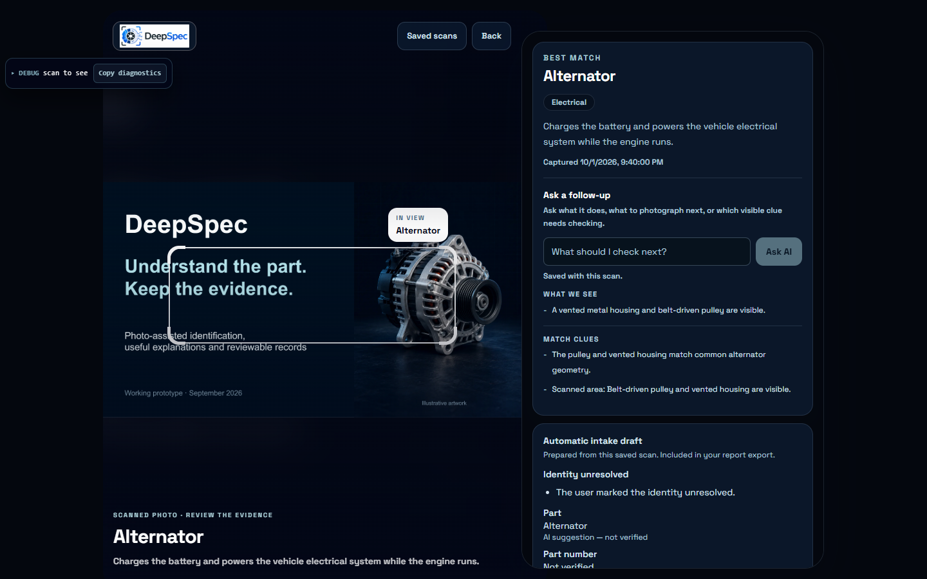
AI result with focused follow-ups
A clear starting point
for the review
Suggested identity
Visible clues
9–25 sentence follow-ups
Follow-up stays with
the saved scan.
Current app capture. Answer depth adapts; a photo does not establish function or safety.
06
Notes:
The screenshot is a current local QA capture of the result page. The result keeps a focused follow-up field beside the evidence and stores the conversation with the scan. Answer depth may vary from 9 to 25 sentences based on complexity. It remains an AI suggestion, not proof of function, safety, fitment or hidden condition.
Sources
output/presentation-work/result-followup-current.png
src/screens/Result.tsx
src/services/resultChat.ts
src/services/storage.ts

Slide 7
Human checks stay separate
Identity
Visible condition
Function
What part did you confirm?
Which label or reference supports it?
What could you observe?
What damage or uncertainty remains?
What test did you perform?
What happened during the test?
Inspector name and time travel with the saved inspection.
No visible damage is different from a passed functional test.
07
Notes:
DeepSpec stores human inspection fields separately from AI output. The form requires inspector name, identity evidence when identity is provided, notes for visible damage/uncertainty, and a method/result when a functional status has been selected. Inspector identity is self-reported. These records are not safety certification or validated training labels.
Sources
docs/PART_INSPECTION_PILOT.md
src/components/result/PartInspectionForm.tsx
src/lib/partInspection.ts

Slide 8
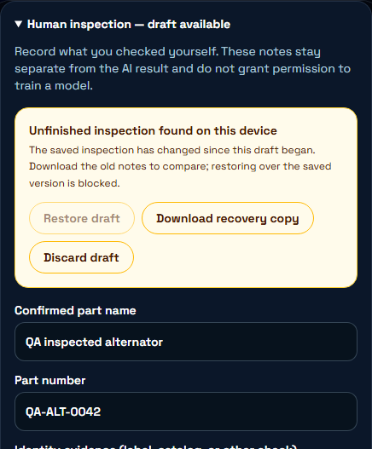
An interruption need not lose the notes
Draft recovery on this device
Edits preserve an unfinished draft.
After reopening, choose restore or discard.
A newer saved inspection blocks
restoring an older draft over it.
A download keeps the notes for comparison.
QA fixture. Browser storage can fail or be cleared. Drafts are not cloud backups.
08
Notes:
The screenshot shows fictional QA input in the actual application. Draft recovery is scoped by signed-in account and scan on the device. Restore and discard are explicit. If the saved inspection changed, restoration is blocked and the user can download old notes. The app warns when storage fails and keeps visible typed text. This guard does not provide atomic cross-device conflict resolution.
Sources
docs/DRAFT_RECOVERY_RELEASE_REPORT_2026-09-26.md
src/services/inspectionDraft.ts
src/components/result/PartInspectionForm.tsx
artifacts/qa/2026-09-26T16-20-49-881Z/screenshots/inspection-stale-recovery-choice.png

Slide 9
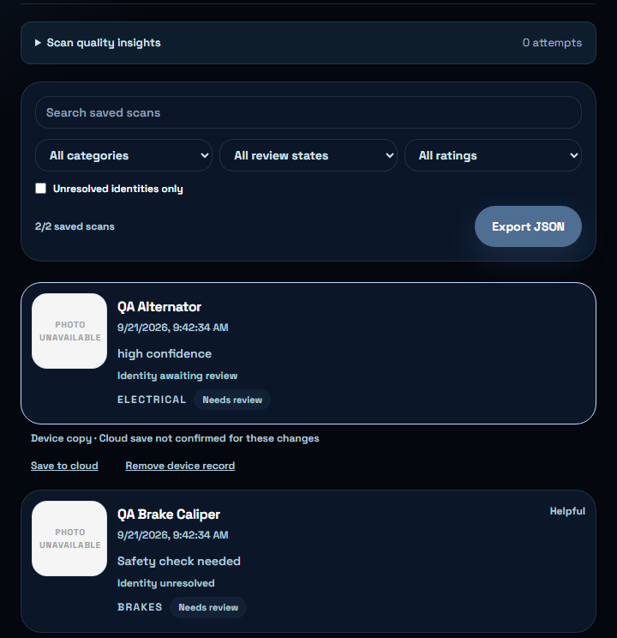
A library that keeps the evidence close
Find the part again
Search saved records.
Filter review states and unresolved identities.
Reopen an inspection or export a report.
Device and cloud status stay visible
so an upload failure is not mistaken
for a successful cloud save.
Actual app screen with fictional QA records.
09
Notes:
Saved history supports search, categories, review states, ratings and an unresolved-identity filter. The screenshot contains synthetic QA records with unavailable photos, not real customer inventory. Library export offers JSON; individual text report export includes human inspection fields and private notes, so review before sharing. Device success and cloud success remain distinct.
Sources
src/screens/History.tsx
src/services/report.ts
artifacts/qa/2026-09-21T13-42-31-354Z/screenshots/saved-history.png

Slide 10
Shop jobs and customer reports
A scan can belong to a job
Job context
Customer explanation
Keep a local job record and attach
relevant scans for the same repair.
Prepare a report of the recorded
findings for a conversation
with the customer.
Current scope: account-scoped jobs on this device. Shared live shop work is future work.
10
Notes:
Shop mode supports local job/customer/vehicle context, linked scans and generated customer reports. It does not currently provide a shared live multi-employee database or automatic catalog/order integration. This is an intended application within the product, not proof that a shop already adopted it.
Sources
src/screens/Shop.tsx
src/services/shop.ts
src/services/report.ts

Slide 11
Accounts, storage and control
Account
Device records and drafts are scoped to the active account.
Device
A saved local record remains distinct from a confirmed cloud upload.
Cloud
Sync and recovery depend on configuration, connectivity and verified persistence.
Photos
Storing a photo does not give permission to train a model on it.
11
Notes:
Account-scope generation guards prevent stale asynchronous activity from applying to another account. Local device data still uses browser storage and is not a guarantee against a compromised device. Existing authentication and cloud pathways require release verification. The live inspection verifier now passes save/read/update and account isolation after the additive migration. No automatic training ingestion is claimed.
Sources
src/lib/accountScope.ts
src/services/storage.ts
src/services/cloudSync.ts
src/services/inspectionDraft.ts
artifacts/qa/v1-foundation-2026-09-26/cloud-inspection.txt
docs/V1_LAUNCH_PLAN.md

Slide 12
What time savings could be worth
Hypothetical workflow, including normal tests
16.5 hours
Modeled monthly time difference
$495 / month
Gross labor capacity at $30/hour
30 parts/day × 22 days/month. Before setup, support and software costs. No observed savings or revenue.
12
Notes:
Illustrative arithmetic only. Assume 30 parts/day × 22 working days/month = 660 parts/month. Assume ordinary intake including required tests takes 6 minutes manually versus 4.5 minutes assisted. (6 - 4.5) × 660 / 60 = 16.5 hours/month. At an assumed $30/hour this is $495 of modeled gross labor capacity before setup, support, software or other costs. It is not cash savings, revenue, profit, a price recommendation, or a seller measurement. Actual values must come from observation. Editable chart contains literal hypothetical data.
Sources
docs/PILOT_RUNBOOK.md

Slide 13
Who might pay, and for what
Possible buyer | Useful outcome | Pricing idea to test
Parts seller | Repeatable intake records | Monthly seller account
Auto shop | Jobs and customer reports | Monthly operator or shop plan
DIY owner | Occasional guidance and records | Free entry or paid scan allowance
Willingness to pay is unvalidated. A useful workflow and repeated use must come first.
13
Notes:
These audiences and pricing structures are hypotheses, not current offers, revenue or customer commitments. Do not infer willingness to pay from the hypothetical time calculator. Observe usage, support burden, model costs and the buyer’s own alternatives, then ask whether they would continue at a concrete proposed scope and price.
Sources
docs/PILOT_RUNBOOK.md

Slide 14
Evidence behind the beta build
What was checked | Evidence | What it establishes
Automated app checks | Focused tests, lint and build pass | Current branch behavior and packaging
Public tester flow | Responsive page and durable forms | Recruitment, checklist and feedback
Result review | Right, wrong and unresolved states | Usable labels for failures and doubt
Live cloud schema | Ratings and inspection persistence | Private account-scoped review records
Engineering evidence as of October 1, 2026. Real-user usefulness and identification accuracy remain unmeasured.
14
Notes:
This slide reports current branch evidence, not public-launch proof. Focused tests, lint and production build pass. The public tester page and the right/wrong/unresolved result review were checked in a real browser at mobile and desktop widths. The live Supabase constraints accept the three review states. Real identification accuracy, real-user usefulness, physical-phone behavior and production monitoring remain release gates.
Sources
docs/V1_CREATIVE_RESEARCH_2026-10-01.md
src/screens/EarlyAccess.test.tsx
src/screens/Result.test.tsx
supabase/migrations/20261002012446_add_unsure_scan_rating.sql
output/playwright/founding-tester-public-desktop.png

Slide 15
V1 is now a private-beta candidate
Status | Capability | Boundary
Current core | Photo analysis, contextual follow-up and human review | AI suggestions still need review
Current records | Library, recovery, exports and cloud sync | Real-device durability still needs proof
Private V1 test | Invite-only reports and three-state feedback | Usefulness still needs real-user proof
Release gates | Provider evaluation, phones, monitoring and access | Must pass before public launch
Custom training, 3D reconstruction and shared-shop expansion stay beyond V1.
15
Notes:
Current means implemented and verified on the review branch, not publicly launched. The tester program, focused follow-up, explicit unresolved feedback and opt-in training consent are built. Public launch still requires a labeled automotive provider evaluation, physical iOS and Android checks, actual tester observations, monitoring, cost controls, access controls and rollback evidence.
Sources
docs/V1_LAUNCH_PLAN.md
docs/PRIVATE_BETA_RELEASE_CHECKLIST.md
docs/PRODUCTION_READINESS_GOAL_PLAN.md
src/screens/EarlyAccess.tsx
src/screens/Result.tsx

Slide 16
A four-stage route to V1 evidence
Now
Beta foundation
Accounts, saved records, consent, follow-ups and the tester page are built.
Next
Device and model proof
Test hard images on iOS and Android, then run the labeled provider evaluation.
Pilot
3–5 trusted family testers
Each scans 10 real parts, judges every result and sends three useful notes.
Decision
Launch decision
Fix repeated failures; verify privacy, monitoring, cost and rollback controls.
Private beta is free. V1 includes no paid reward or future-access promise.
16
Notes:
The product is ready for controlled private-beta preparation, not public launch. Recruit 5–15 founding testers across DIY, trainee, mechanic, seller and shop workflows. Each tester scans 10 real parts, judges every result as right, wrong or unresolved, sends at least three useful notes and reopens records to verify persistence. The reward is free beta access plus six months after paid launch for accepted testers who complete the checklist.
Sources
docs/V1_CREATIVE_RESEARCH_2026-10-01.md
src/screens/EarlyAccess.tsx
https://support.google.com/googleplay/android-developer/answer/14151465?hl=en

Slide 17
Feedback that can support V2
A live capture path with permission and review
Right, wrong or unresolved
Keep the prediction, failure category and useful context.
Consent stays separate
Store review permission explicitly; no upload joins training automatically.
Verify the example
Review the correction against evidence before approval.
Version and evaluate
Track dataset membership, then test changes before training.
Ratings, corrections and opt-in records are live. Dataset approval and training remain review-gated.
17
Notes:
The capture path is live: users can mark a result right, wrong or unresolved, add a correction when known, submit categorized feedback and separately opt a scan into future review. Those records still require review before dataset approval. No upload automatically enters model training.
Sources
src/screens/Result.tsx
src/screens/EarlyAccess.tsx
src/components/result/TrainingConsentPanel.tsx
src/lib/intakeReview.ts
supabase/migrations/20261002012446_add_unsure_scan_rating.sql

Slide 18

A photo that helps you
understand the part
Useful information. Focused follow-ups.
Mark what went wrong or remains unclear.
Next: complete the private family test, measure failures and let the evidence decide V1.
18
Notes:
The immediate objective is evidence, not revenue or scale. Run the founding tester program, measure right/wrong/unresolved outcomes, record failure patterns and verify the app on real phones. Public launch should follow only after repeated failures are fixed and the release gates are satisfied.
Sources
docs/V1_LAUNCH_PLAN.md
docs/PRIVATE_BETA_RELEASE_CHECKLIST.md
docs/V1_CREATIVE_RESEARCH_2026-10-01.md

