Slide 1
Battleship

Slide 2
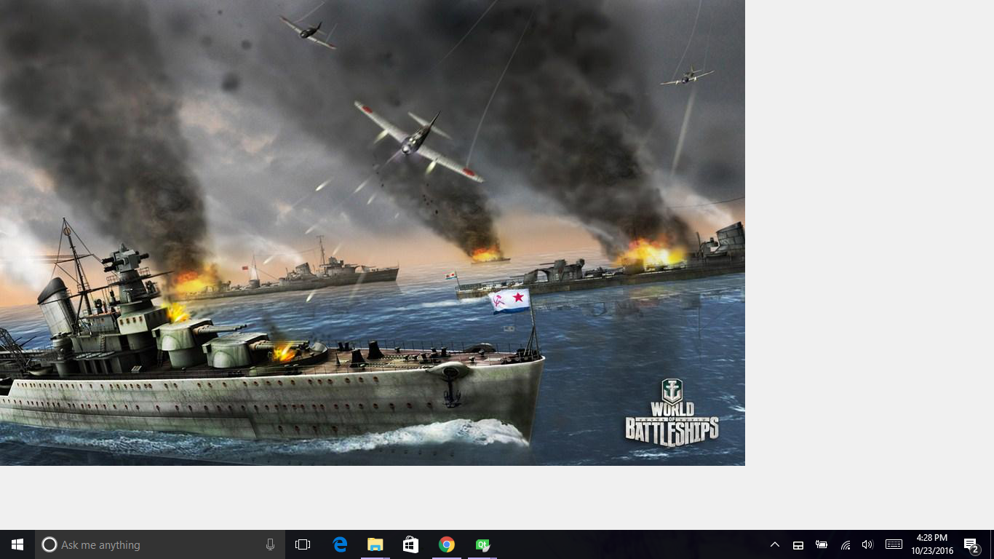
Splach screen

Slide 3
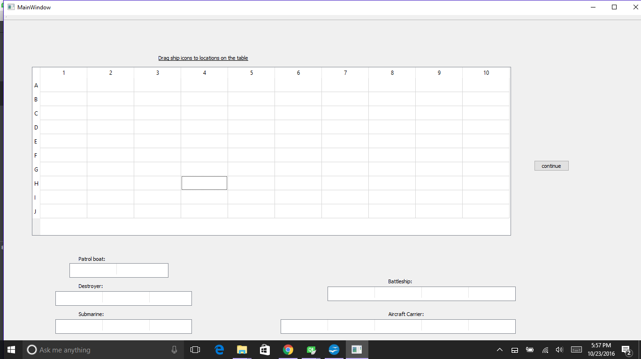
Ship Placement Dialogue Box

