Slide 1
Software Project Management
S. K. Swain

Slide 2
What is a Project?
A project is a multitask job with performance, cost, time, and scope requirements and is done only one
time.
• definite starting and ending time (finite)
• having a budget of costs
• clearly defined scope or magnitude of work to be done (target)
• specific performance requirements
• uses resources

Slide 3
Why to Manage Projects?
•Need to optimize project resources
• Need to maintain times and schedules
• Manage increased complexity of the business
• Need to have a competitive advantage
• Time-based and cost-based competition - get the product or service to market faster than anyone else – at least cost

Slide 4
Software Crisis
We have a software crisis!
What are the symptoms of the software crisis?
  Fail to meet user requirements.
  Expensive.
  Difficult to alter, debug, and enhance.
  Often delivered late.

Slide 5
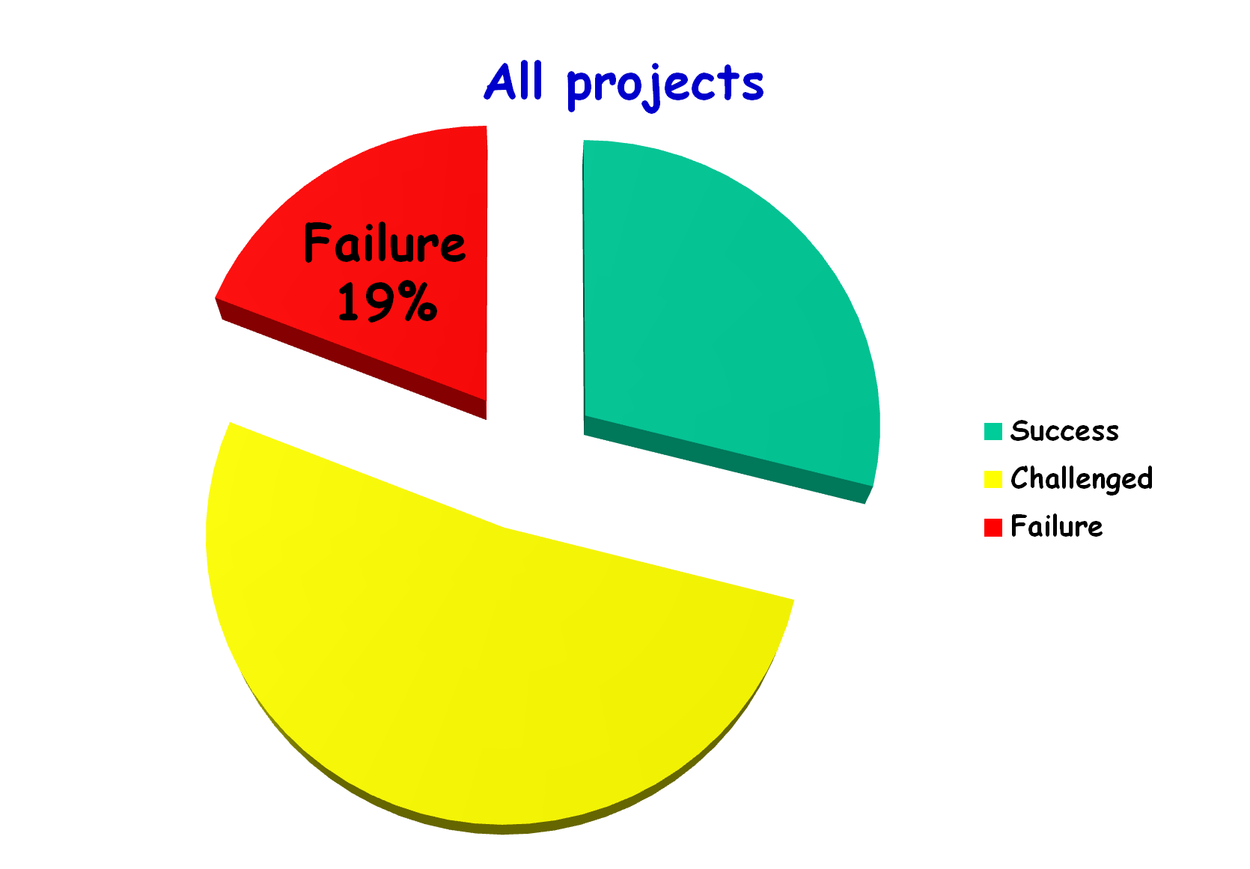
Standish Group CHAOS Report 2015
Success
29%
Challenged
52%

Slide 6
Which Factors are the Key Contributors to the Software Crisis?
Larger problems
Poor project management
Lack of adequate training in software engg and project managmt
Increasing skill shortage and manpower turnover
Low productivity improvements.

Slide 7
Introduction
Many software projects fail:
  due to faulty project management practices: It is important to learn different aspects of software project management.
Goal of software project management:
  enable a group of engineers to work efficiently towards successful completion of a software project.

Slide 8


In What Ways Management of Software Projects Differ from Management of Engineering Systems?
Intangible:
  Software is invisible till it is ready and runs
Large Change Impact:
  A small change request can have terrible impact
  Change is the rule rather than exception
Intellectual work
Complex

Slide 9
Responsibility of project managers
Project proposal writing,
Project cost estimation,
Scheduling,
Project staffing,
Project monitoring and control,
Software configuration management,
Risk management,
Managerial report writing and presentations, etc.

Slide 10
Project Management Activities
A project manager’s activities are varied.
  can be broadly classified into:
    project planning,
    project monitoring and control activities.

Slide 11
Project Planning Activities
Estimation:
  Effort, cost, resource, and project duration
Project scheduling:
Staff organization:
  staffing plans
Risk handling:
  identification, analysis, and abatement procedures
Miscellaneous plans:
  quality assurance plan, configuration management plan, etc.

Slide 12
Project planning
Once a project is found to be feasible, project managers undertake project planning.
Requires utmost care and attention --- commitments to unrealistic time and resource estimates result in:
  irritating delays.
  customer dissatisfaction
  adverse affect on team morale
    poor quality work
  project failure.

Slide 13
Why the problems:
Usually difficult to make accurate plans for large projects
Large projects may take several years to complete
Project parameters, scope of the project, project staff may change drastically
Initial plan of the project may get haywire
Software Project Management

Slide 14
Sliding Window Planning
To overcome:
Involves project planning over several stages:
Revision at frequent intervals
  protects managers from making big commitments too early.
  More information becomes available as project progresses.
    Facilitates accurate planning

Slide 15
In the sliding window planning technique, starting with an initial plan, the project is planned more accurately over a number of stages.
The information base gradually improves as the project progresses through different phases. The complexity of the problem becomes clear, some anticipated risks are resolved, and new risks appear. The project parameters are re-estimated periodically as understanding grows.
Software Project Management

Slide 16
SPMP Document
After planning is complete:
  Document the plans:in a Software Project Management Plan(SPMP) document.

Slide 17
Organization of SPMP Document
  Introduction (Objectives,Major Functions,Performance Issues,Management and Technical Constraints)
  Project Estimates (Historical Data,Estimation Techniques,Effort, Cost, and Project Duration Estimates)
  Project Resources Plan (People,Hardware and Software,Special Resources)
  Schedules (Work Breakdown Structure,Task Network, Gantt Chart Representation,PERT Chart Representation)
  Risk Management Plan (Risk Analysis,Risk Identification,Risk Estimation, Abatement Procedures)
  Project Tracking and Control Plan
  Miscellaneous Plans (Process Tailoring,Quality Assurance)

Slide 18
Software Cost Estimation
Determine size of the product.
From the size estimate,
  determine the effort needed.
From the effort estimate,
  determine project duration, and cost.

Slide 19
Software Estimation
Effort Estimation
Cost Estimation
Size Estimation
Staffing Estimation
Duration Estimation
Scheduling

Slide 20
Project size estimates
LOC/KLOC
Function Point Analysis
Feature Point Analysis
For N number of source lines it becomes NLOC.
When N = 1,000 it becomes KLOC.
PM – One person-month, effort put in a month by an individual
Software Project Management

Slide 21
Lines of code
Simplest and popular among all metrics to estimate project size.
Count the number of source instructions.
Comment lines and header lines are ignored.
At the beginning of the project, counting LOC is very difficult.
Software Project Management

Slide 22
Lines of code
At the beginning of the project, counting LOC is very difficult. Project manager divides the project into modules and sub-modules and further till the sizes of different leaf-level modules can be approximately predicted.
This needs some project developing experiences.
By using the lowest level modules, project manager arrives at the total size estimation.

Slide 23
Shortcomings of LOC
Problem size vary widely with individual coding style. One line source code may be written into several lines by another coder.
It should consider the total effort needed to specify design, code, test etc. but not just coding effort. LOC focuses only on coding activity alone.
LOC measure correlates poorly with the quality and efficiency of the code. A larger code size does not imply better quality or higher efficiency.
LOC metric penalizes use of higher-level programming language, code reuse. Using more library routines, LOC count will be lower as the program is smaller.
Two programs with equal LOC count, one may require more effort than the other having complex logic.
LOC count is accurate if code is fully developed. It is not proper at the time of planning.
Software Project Management

Slide 24
Function Point Metric
Overcomes some of the shortcomings of the LOC metric
  FPs can be expressed as the weighted sum of the 5 problem characteristics.
  The weights associated were proposed empirically and validated by observations over many projects.

Slide 25
Function Point Metric
Input:
  A set of related inputs is counted as one input.
Output:
  A set of related outputs is counted as one output.
Inquiries:
  Each user query type is counted.
Files:
  Files are logically related data and thus can be data structures or physical files.
Interface:
  Data transfer to other systems.

Slide 26
Function Point Metric
  Function Point (FP) = UFP * TCF
  Calculate UFP(unadjusted FP)
  UFP=4 #inputs + 5 #Outputs + 4 #inquiries + 10 #files + 7 #interfaces

Slide 27
Function Point Metric
  Function Point (FP) = UFP * TCF
TCF = Technical Complexity Factor
TCF refines the UFP measure by considering 14 other factors like high transaction rate, throughput, and response time requirements etc. Weights are given from 0 to 5.
TCF= [0.65 + (0.01 * DI]
DI (degree of influence) = Σ (F_{j})
F_{j} (j = 1 to 14) are complexity adjustment

Slide 28
Complexity Adjustment Values:
1. Does the system require reliable backup and recovery?
2. Are data communications required?
3. Are there distributed processing functions?
4. Is performance critical?
5. Will the system run in an existing heavily utilized operational environment?
6. Does the system require on-line data entry?
7. Does the on-line data entry require the input transaction to be built over multiple screens / operations?
8. Are the master files updated on-line?
9. Are the inputs, outputs, files or inquiries complex?
10. Is the internal processing complex?
11. Is the code designed to be reusable?
12. Are conversions and installation included in design?
13. Is the system designed for multiple installations in different organizations?
14. Is the application designed to facilitate change and ease of use by the users?
Software Project Management

Slide 29
Function Point Metric
The F_{j} (j = 1 to 14) are complexity adjustment values based on the questions. Each one is expressed in a scale from 0 to 5 depending on their influence on the development process.
0 – No influence 1 – Incidental 2 – Moderate
3 – Average 4 – Significant 5 – Essential
DI (degree of influence that varies from 0 to 70)

Slide 30
Function Point (FP) = UFP * [0.65 + (0.01 * Σ (F_{j}))]
Computable Measure | Multipliers
 | Simple | Average | Complex
External Inputs (EI) | 3 | 4 | 6
External Outputs (EO) | 4 | 5 | 7
No.of External EnQuiries (EQ) | 3 | 4 | 6
No.of master Internal Logical Files (ILF) | 7 | 10 | 15
No.of External Interface Files (EIF) | 5 | 7 | 10
Software Project Management

Slide 31
Ex-2 Suppose Σ(F_{j}) = 46 (a moderately complex product)
UFP = 50
Σ(F_{i}) = DI = 46) Assumed
TCF = 0.65 + (0.01 X DI) vary from 0.65 to 1.35, (here TCF = 1.11) Assumed
FP = Function Point = UFP * TCF = 55.5 ≈ 56
Information Domain Value | Count | Weighting Factor
 |  | Simple | Average | Complex
External Inputs (EI) | 3 | 3 | 4 | 6 | 9
External Outputs (EO) | 2 | 4 | 5 | 7 | 8
No.of External EnQuiries (EQ) | 2 | 3 | 4 | 6 | 6
No.of master Internal Logical Files (ILF) | 1 | 7 | 10 | 15 | 7
No.of External Interface Files (EIF) | 4 | 5 | 7 | 10 | 20
Count Total | 50
Software Project Management

Slide 32
Example
Compute the Function Point value for a software project with the following details: User inputs = 12, number of files = 6, user outputs = 25, external interfaces = 4, inquiries = 10, and number of algorithms = 8. Assume the multipliers at average and all the complexity adjustment factors at their moderate to average values. Multiplier = 2.5.

Slide 33
Function Point (FP) = UFP * TCF = Count-total * [0.65 + (0.01 * sum(F_{j})) 14 F_{j} – each assumes a value of 2.5 in case the influence is moderate to average.
Hence, Σ(F_{j}) = 14 * 2.5 = 35
Thus, FP = 301 * (0.65 + (0.01 * 35)) = 301
NB: Number of algorithms is not relevant here!
Computable Measure | Countable measure values | Multipliers at average | Count = measure X multiplier
External Inputs (EI) | 12 | 4 | 48
External Outputs (EO) | 25 | 5 | 125
No.of External EnQuiries (EQ) | 10 | 4 | 40
No.of master Internal Logical Files (ILF) | 6 | 10 | 60
No.of External Interface Files (EIF) | 4 | 7 | 28
Count-Total |  |  | 301

Slide 34
Function Point Metric (CONT.)
Suffers from a major drawback:
  the size of a function is considered to be independent of its complexity.
Extend function point metric:
  Feature Point metric:
  considers an extra parameter:
    Algorithm Complexity.

Slide 35
Function Point Metric (CONT.)
Proponents claim:
  FP is language independent.
  Size can be easily derived from problem description
Opponents claim:
  it is subjective --- Different people can come up with different estimates for the same problem.

Slide 36
Ratios of Feature Points to FP
Application | FP | Feature Point
Batch MIS Projects | 1 | 0.8
Online MIS Projects | 1 | 1
Online Database Projects | 1 | 1
Switching systems Projects | 1 | 1.2
Embedded Real-time Projects | 1 | 1.35
Factory Automation Projects | 1 | 1.5
Software Project Management

Slide 37
Feature point metric (Albrecht-1977)
Function Point does not consider the algorithmic complexity. It assumes the effort required to design and develop any two functionalities of the system is same.
Feature Point incorporates an extra parameter into the algorithm complexity. More the complexity of a function , the greater the effort required to develop it and therefore the size is larger in comparison to a simple function.
It looks at the number of objects (screen, reports etc.) likely to be generated in the SW.
Feature point method gives more weightage to algorithms
Software Project Management

Slide 38
Software Cost Estimation
Three main approaches to estimation:
  Empirical
  Heuristic
  Analytical

Slide 39
Software Cost Estimation Techniques
Empirical techniques:
  an educated guess based on past experience.
Make an educated guess on project parameters.
Based on common sense and prior experience.
Heuristic techniques:
  assume that the characteristics to be estimated can be expressed in terms of
  some mathematical expression.
Analytical techniques:
  derive the required results starting from certain simple assumptions.

Slide 40
Empirical Cost Estimation Techniques
Expert Judgement:
  An euphemism for guess made by an expert.
  Suffers from individual bias.
Delphi Estimation:
  overcomes some of the problems of expert judgement.

Slide 41
Expert judgement
Experts divide a software product into component units:
  e.g. GUI, database module, data communication module, billing module, etc.
Add up the guesses for each of the components.

Slide 42
Expert Judgment Technique
Guess by the expert on cost of modules/sub-modules
Experts may overlook some factors inadvertently
Experts should have sufficient knowledge and experience
Software Project Management

Slide 43
Delphi Estimation:
Team of Experts and a coordinator.
Experts carry out estimation independently:
  mention the rationale behind their estimation.
  coordinator notes down any extraordinary rationale:
    circulates among experts.

Slide 44
Delphi Estimation:
Experts re-estimate.
Experts never meet each other
  to discuss their viewpoints.
Estimation by a group of experts,
A refined form
Lack of familiarity on some part of project
No personal bias
No desire to win the contract

Slide 45
Delphi Cost Estimation
A team – group of experts, coordinator
Coordinator provides a SRS document to each expert and a form for recording his cost estimate
Estimators submit to the coordinator
The unusual characteristics are mentioned
A summary is prepared and distributed
Base on summary estimators re-estimate
No discussion in the entire process, no influence
After several iterations, the coordinator compiles the result and makes the final estimate.
Software Project Management

Slide 46
Heuristic Estimation Techniques
Single Variable Model:
  Parameter to be Estimated=C_{1 *}e₁ ^{d1}
  e₁ (Estimated Characteristic)
  C₁ and d₁ are constants
Multivariable Model:
  Assumes that the parameter to be estimated depends on more than one characteristic.
  Parameter to be Estimated=C_{1 *}e₁ ^{d1}+ C_{2 *}e₂ ^{d2}+……
  e₁ , e₂ (Estimated Characteristic)
  C₁, C₂,d₁,d₂ are constants
  Usually more accurate than single variable models.

Slide 47
COCOMO Model
COCOMO (COnstructive COst MOdel) proposed by Boehm.
Divides software product developments into 3 categories:
  Organic
  Semidetached
  Embedded

Slide 48
Heuristic Estimation Technique
COCOMO
COnstructive COst estimation MOdel – Boehm, 1981 Software development project can be classified:
Organic corresponds to application program Semidetached corresponds to utility program Embedded corresponds to system program
Application program – data processing programs Utility programs - compilers, linkers System programs - operating system, real time system
Software Project Management

Slide 49
Elaboration of Product classes
Organic:
  Relatively small groups
    working to develop well-understood applications.
Semidetached:
  Project team consists of a mixture of experienced and inexperienced staff. may be unfamiliar with some aspects of the system being developed
Embedded:
  The software is strongly coupled to complex hardware, or real-time systems.

Slide 50
COCOMO Product classes
Roughly correspond to:
  application, utility and system programs respectively.
    Data processing and scientific programs are considered to be application programs.
    Compilers, linkers, editors, etc., are utility programs.
    Operating systems and real-time system programs, etc. are system programs.

Slide 51
COCOMO Model (CONT.)
Software cost estimation is done through three stages:
  Basic COCOMO,
  Intermediate COCOMO,
  Complete COCOMO.

Slide 52
Basic COCOMO Model (CONT.)
Gives only an approximate estimation:
  Effort = a₁ (KLOC)^{a2}
  Tdev = b₁ (Effort)^{b2}
    KLOC is the estimated kilo lines of source code,
    a₁,a₂,b₁,b₂ are constants for different categories of software products,
    Tdev is the estimated time to develop the software in months,
    Effort estimation is obtained in terms of person months (PMs).

Slide 53
Development Effort Estimation
Organic :
  Effort = 2.4 (KLOC)^{1.05} PM
Semi-detached:
  Effort = 3.0(KLOC)^{1.12} PM
Embedded:
  Effort = 3.6 (KLOC)^{1.20}PM

Slide 54
Development Time Estimation
Organic:
  Tdev = 2.5 (Effort)^{0.38} Months
Semi-detached:
  Tdev = 2.5 (Effort)^{0.35} Months
Embedded:
  Tdev = 2.5 (Effort)^{0.32} Months

Slide 55
Basic COCOMO Model
Effort = E = a₁ X (KLOC)ª2
Time = T = b₁ X (E)^{b}2
Estimation of development effort
Organic : Effort = 2.4(KLOC)^{1.05} PM
Semi-detached : Effort = 3.0(KLOC)^{1.12} PM
Embedded : Effort = 3.6(KLOC)^{1.20} PM
Estimation of development time
Organic : Tdev = 2.5(Effort)^{0.38} months
Semi-detached : Tdev = 2.5(Effort)^{0.35} months
Embedded : Tdev = 2.5(Effort)^{0.32} months
Software Project | a₁ | a₂ | b₁ | b₂
Organic | 2.40 | 1.05 | 2.50 | 0.38
Semi-detached | 3.00 | 1.12 | 2.50 | 0.35
Embedded | 3.60 | 1.20 | 2.50 | 0.32
Software Project Management

Slide 56
The effort and duration estimations obtained using the COCOMO model are called nominal effort estimate and the nominal duration estimate.
If you try to complete the project in a time shorter than the estimated duration, the cost will increase drastically.
If you complete the project over a longer period of time than estimated, then there is almost no decrease in the estimated cost value.
The effort estimation for a project expressed in programmer-month and the development time in month. A novice would determine the staffing level by a simple division. This is highly improper to get staff size.
Software Project Management

Slide 57
Example
The size of an organic software product has been estimated to be 32,000 lines of source code.
Effort = 2.4*(32)^{1.05} = 91 PM
Nominal development time = 2.5*(91)^{0.38} = 14 months

Slide 58
Ex- Assume that the size of an organic type software product has been estimated to be 32,000 lines of source code. Assume that the average salary of software engineers is 15,000 rupees per month. Determine the effort required to develop the software product and the development time.
From basic COCOMO estimation formula for organic software:
Effort = 2.4 X (32)^{1.05} = 91 PM
Nominal development time = 2.5 X (91)^{0.38} = 14 months
Cost required to develop the product = 14 X 15,000
= 210,000 Rs.
Software Project Management

Slide 59
Ex-Two software managers separately estimated a given product to be of 10,000 and 15,000 lines of code respectively. Bring out the effort and schedule time implications of their estimation using COCOMO. For the effort estimation, use a coefficient value of 3.2 and exponent value of 1.05. For the schedule time estimation, the similar values are 2.5 and 0.38 respectively. Assume all adjustment multipliers to be equal to unity.
For 10,000 LOC
Effort = 3.2 X 10^{1.05} = 35.90 PM
Schedule Time = Tdev = 2.5 X 35.90^{0.38} = 9.75 months
For 15,000 LOC
Effort = 3.2 X 15^{1.05} = 54.96 PM
Schedule Time = Tdev = 2.5 X 54.96^{0.38} = 11.46 months
NB: Increase in size drastic increase in effort but moderate change in time.
Software Project Management

Slide 60
Ex-A project size of 200 KLOC is to be developed. Software development team has average experience on similar type of projects. The project schedule is not very tight. Calculate the effort, development time, average staff size and productivity of the project.
Software Project Management

Slide 61
Sol: The semi-detached mode is the most appropriate mode; keeping in view the size, schedules and experience of the development team.
Hence: Effort = E = 3.0(200)^{1.12} = 1133.12 PM
T_{dev} = 2.5(1133.12)^{0.35} = 29.3 M
Average staff size (SS) = E/ T_{dev} = 1133.12 / 29.3 = 38.67 Persons
Productivity = KLOC/E = 200/1133.12 = 0.1765 KLOC/PM
= 176 LOC/PM

Slide 62
Basic COCOMO Model (CONT.)
Effort is somewhat super-linear in problem size.
Semidetached
Effort
Embedded
Organic
Size

Slide 63
Basic COCOMO Model (CONT.)
Development time
  sublinear function of product size.
When product size increases two times,
  development time does not double.
Time taken:
  almost same for all the three product categories.
Dev. Time
Embedded
Semidetached
18 Months
14 Months
Organic
30K
60K
Size

Slide 64
Embedded
Semi-detached
Estimated effort
Organic
Effort vs. product size
(effort is super-linear in the size of the software)
Effort required to develop a product increases very rapidly with project size.
Size
Embedded
Semi-detached
Nominal development time
Organic
Development time vs. product size
(development time is a sub-linear function of the size of the product)
When the size of the software increases by two times,
the development time increases moderately
Software Project anagement
Size

Slide 65
Basic COCOMO Model (CONT.)
Development time does not increase linearly with product size:
  For larger products more parallel activities can be identified:
    can be carried out simultaneously by a number of engineers.

Slide 66
Basic COCOMO Model (CONT.)
Development time is roughly the same for all the three categories of products:
  For example, a 60 KLOC program can be developed in approximately 18 months
    regardless of whether it is of organic, semi-detached, or embedded type.
  There is more scope for parallel activities for system and application programs,
    than utility programs.

Slide 67
Intermediate COCOMO
Basic COCOMO model assumes
  effort and development time depend on product size alone.
However, several parameters affect effort and development time:
    Reliability requirements
    Availability of CASE tools and modern facilities to the developers
    Size of data to be handled

Slide 68
Intermediate COCOMO
For accurate estimation,
  the effect of all relevant parameters must be considered:
  Intermediate COCOMO model recognizes this fact:
    refines the initial estimate obtained by the basic COCOMO by using a set of 15 cost drivers (multipliers).

Slide 69
Intermediate COCOMO (CONT.)
If modern programming practices are used,
  initial estimates are scaled downwards.
If there are stringent reliability requirements on the product :
  initial estimate is scaled upwards.

Slide 70
Intermediate COCOMO (CONT.)
Rate different parameters on a scale of one to three:
  Depending on these ratings,
    multiply cost driver values with the estimate obtained using the basic COCOMO.

Slide 71
Intermediate COCOMO (CONT.)
Cost driver classes:
  Product: Inherent complexity of the product, reliability requirements of the product, etc.
  Computer: Execution time, storage requirements, etc.
  Personnel: Experience of personnel, etc.
  Development Environment: Sophistication of the tools used for software development.

Slide 72
Intermediate COCOMO Model
In order to obtain accurate cost estimation of the effort and time, 15 cost drivers (multipliers), based on various attributes of software development, are taken.
All the attributes are grouped into 4 major categories: Product, Hardware, Personnel, Project.
The attributes are rated on a six-point scale ranging from very low to extra high.
Based on the rating, an effort multiplier is determined.
The product of all effort multiplier results an Effort Adjustment Factor (EAF). The value of EAF ranges from 0.9 to 1.4.
Software Project Management

Slide 73
Effort adjustment factors
Code | Description | R A T I N G
 |  | Very low | Low | Nominal | High | Very high | Extra high
Product
RELY | Required software reliability | 0.75 | 0.88 | 1.00 | 1.15 | 1.40 | -
DATA | Size of application database | - | 0.94 | 1.00 | 1.08 | 1.16 | -
CPLX | Complexity of product | 0.70 | 0.85 | 1.00 | 1.15 | 1.30 | 1.65
Hardware
TIME | Execution time constraint | - | - | 1.00 | 1.11 | 1.30 | 1.66
STOR | Main storage constraint | - | - | 1.00 | 1.06 | 1.21 | 1.56
VIRT | Virtual machine volatility | - | 0.87 | 1.00 | 1.15 | 1.30 | -
TURN | Computer turn-around time | - | 0.87 | 1.00 | 1.07 | 1.15 | -
Personal
ACAP | Analyst capability | 1.46 | 1.19 | 1.00 | 0.86 | 0.71 | -
AEXP | Applications experience | 1.29 | 1.13 | 1.00 | 0.91 | 0.82 | -
PCAP | Programmer capability | 1.42 | 1.17 | 1.00 | 0.86 | 0.70 | -
VEXP | Virtual machine experience | 1.21 | 1.10 | 1.00 | 0.90 | - | -
LEXP | Language experience | 1.14 | 1.07 | 1.00 | 0.95 | - | -
Project
MODP | Modern programmingpractice | 1.24 | 1.10 | 1.00 | 0.91 | 0.82 | -
TOOL | Software tools | 1.24 | 1.10 | 1.00 | 0.91 | 0.83 | -
SCED | Development schedule | 1.23 | 1.08 | 1.00 | 1.04 | 1.10 | -
Software Project Management

Slide 74
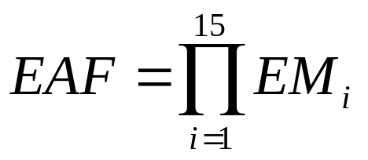
EAF=(RELY*DATA*CPLX*TIME*STOR*VIRT*TURN*AC AP*AEXP*PCAP*VEXP*LEXP*MODP*TOOL*SCED)
Effort = E = a₁ X (KLOC)ª₂ X EAF
Time = T = b₁ X (E)^{b}₂ Value of b₁ and b₂ will not change
Software Project | a₁ | a₂
Organic | 3.2 | 1.05
Semi-detached | 3.0 | 1.12
Embedded | 2.8 | 1.20
Software Project Management

Slide 75
Ex-A new project with estimated 400 KLOC embedded system has to be developed. Project manager has a choice of hiring from two pools of developers: Very highly capable with very little experience in the programming language being used or developers of low quality but a lot of experience with programming language. What is the impact of hiring all developers from one of the pool?
Sol: This is a case of embedded mode and model is intermediate COCOMO. Hence E = 2.8(400)^{1.20} = 3712 PM
CASE-I: Developers are very highly capable with very little experience in the programming being used.
PCAP = very high (0.70), LEXP = very low (1.14)
EAF = 0.70 X 1.14 = 0.798
E = 3712 X 0.798 = 2962 PM T_{dev} = 2.5(2962)^{0.32} = 10.41 M
Software Project Management

Slide 76
CASE-II: Developers are of low quality i.e. low capability but lot of experience with the programming being used.
PCAP = low (1.17), LEXP = high (0.95)
EAF = 1.17 X 0.95 = 1.11
E = 3712 X 1.11 = 4120 PM
T_{dev} = 2.5(4120)^{0.32} = 35.87 M
CASE II requires more effort and time. Hence, low quality developers with lot of programming language experience could not match with the developer with very little experience.
Software Project Management

Slide 77
Shortcoming of basic and intermediate COCOMO models
Both models:
  consider a software product as a single homogeneous entity:
  However, most large systems are made up of several smaller sub-systems.
    Some sub-systems may be considered as organic type, some may be considered embedded, etc.
    for some the reliability requirements may be high, and so on.

Slide 78
Complete COCOMO
Cost of each sub-system is estimated separately.
Costs of the sub-systems are added to obtain total cost.
Reduces the margin of error in the final estimate.

Slide 79
Complete COCOMO Example
A Management Information System (MIS) for an organization having offices at several places across the country:
  Database part (semi-detached)
  Graphical User Interface (GUI) part (organic)
  Communication part (embedded)
Costs of the components are estimated separately:
  summed up to give the overall cost of the system.

Slide 80
Complete COCOMO Model
In previous models, the software product is considered as a single homogeneous entity. Most large systems are made up many sub-systems having widely different characteristics. Some may be treated as organic or semidetached or embedded ones.
Ex- A distributed Management Information System
Sub-systems Type Cost
Database part - Semi-detached C₁
Graphical User Interface - Organic C₂
Communication part - Embedded C₃
Cost of the project = ∑(C_{i})
Software Project Management

Slide 81
Halstead's Software Science(Analytical Approach)
An analytical technique to estimate:
  size,
  development effort,
  development time.

Slide 82
Halstead's Software Science
Halstead used a few primitive program parameters
  number of operators and operands
Derived expressions for:
  over all program length,
  potential minimum volume
  actual volume,
  language level,
  effort, and
  development time.

Slide 83
Halstead's Software Science
M.H. Halstead proposed this metric
  Using primitive measures
  Derived once the design phase is complete and code is generated.
The measures are:
  n₁= number of distinct operators in a program
  n₂= number of distinct operands in a program
  N₁= total numbers of operators
  N₂= total number of operands
By using these measures, Halstead developed an expression for overall program length, program volume, program difficulty, development effort

Slide 84
CONT..
Program length (N) can be calculated by using equation:
  N = n₁log₂ n₁ + n₂log₂ n₂
Program volume (V) can be calculated by using equation:
  V = N log₂(n₁+n₂)
Volume ratio (L) can be calculated by using the following equation:
  L=(Volume of most compact program)/(volume of actual program)
  L = (2/n₁ )* (n₂/N₂ )
Program difficulty level (D) and effort(E) can be calculated by equations:
  D = (n₁/2)*(N₂/n₂)
  E = D * V

Slide 85
General Counting rules for C-Program
Comments are not considered
The identifiers and function declarations are not considered
All the Hash directives are ignored.
All the variables and constants are considered as operands.
Global variables used in different modules are considered as multiple occurrences of same variable
Local variables in different functions are considered as unique operands.

Slide 86
CONT…
Function calls are considered as operators.
All looping statements and all control statements are considered as operators.
In control construct switch, both switch and cases are considered as operators.
The reserve words like return, default etc., are considered as operators
All the braces, commas and terminators are operators
GOTO is counted as operator and label is treated as operand
In the array variables such as array-name[index], array-name and index are treated as operands and [ ] is treated as operator and so on………………..,

Slide 87
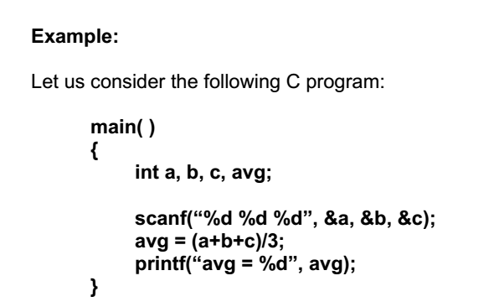
Example

Slide 88
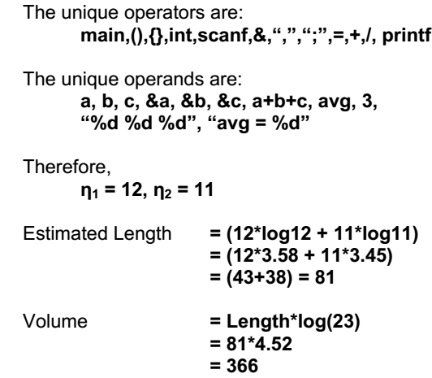

Slide 89
Staffing Level Estimation
Once the effort required to develop a software has been determined, it is necessary to determine the staffing requirement for the project.
Putnam first studied the problem of proper staffing pattern for software projects.
He extended the work of Norden who had earlier investigated the staffing pattern of (R&D) type of projects.
In order to appreciate the staffing pattern of software projects.
Norden’s and Putnam’s results must be understood.

Slide 90
Staffing Level Estimation
Number of personnel required during any development project:
  not constant.
Norden in 1958 analyzed many R&D projects, and observed:
  Rayleigh curve represents the number of full-time personnel required at any time.

Slide 91

Norden’s Work
Norden studied the staffing patterns of several R & D projects.
He found that the staffing pattern can be approximated by the Rayleigh distribution curve
Norden represented the Rayleigh curve by the following
Equation
E is the effort required at time t.
E is an indication of the number of engineers (or the staffing level) at any particular time during the duration of the project.

Slide 92
Rayleigh Curve
Rayleigh curve is specified by two parameters:
  T_{m} the time at which the curve reaches its maximum
  K the total area under the curve.
L=f(K, t_{d})
t_{d is the time for development.}
Rayleigh Curve
Effort
tm
Time

Slide 93
Rayleigh Curve
Very small number of engineers are needed at the beginning of a project
  carry out planning and specification.
As the project progresses:
  more detailed work is required,
  number of engineers slowly increases and reaches a peak.

Slide 94
Putnam’s Work:
In 1976, Putnam studied the problem of staffing of software projects:
observed that the software development has characteristics very similar to other R & D projects studied by Norden and
found that the Rayleigh-Norden curve
    relates the number of delivered lines of code to effort and development time.

Slide 95

Putnam’s Work (CONT.):
Putnam analyzed a large number of army projects, and derived the expression:
  K is the effort expended
  L is the product size in KLOC.
  t_{d} is the time to develop the software.
  C_{k} is the state of technology constant
    reflects factors that affect programmer productivity.

Slide 96
Putnam’s Work (CONT.):
C_{k}=2 for poor development environment
  no methodology, poor documentation, and review, etc.
C_{k}=8 for good software development environment
  software engineering principles used
C_{k}=11 for an excellent environment

Slide 97
Putnam’s Work (CONT.):
Putnam observed that:
  the time at which the Rayleigh curve reaches its maximum value
    corresponds to system testing and product release.
  After system testing,
    the number of project staff falls till product installation and delivery.

Slide 98
Putnam’s Work (CONT.):
From the Rayleigh curve observe that:
  approximately 40% of the area under the Rayleigh curve is to the left of t_{d}
  and 60% to the right.

Slide 99
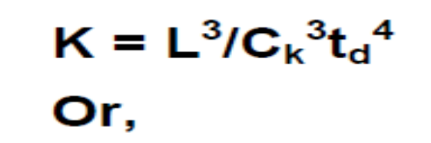

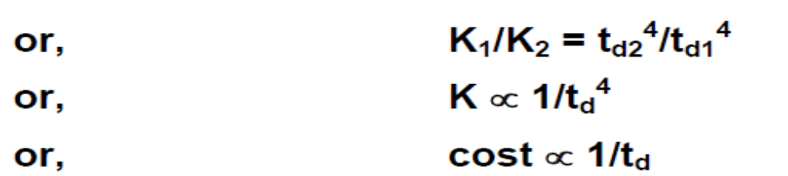
Effect of Schedule Change on Cost
Using the Putnam's expression for L,
      For the same product size, C=L³/C_{k}³ is a constant.
When the schedule of compression is compressed, the required effort increases,in proportion to the fourth power of the degree of compression
Project development effort is equally proportional to development costs.

Slide 100
Effect of Schedule Change on Cost (CONT.)
Observe:
  a relatively small compression in delivery schedule
    can result in substantial penalty on human effort.
Also, observe:
  benefits can be gained by using fewer people over a somewhat longer time span.

Slide 101
Example
If the estimated development time is 1 year, then in order to develop the product in 6 months,
  the total effort and hence the cost increases 16 times.
  In other words,
    the relationship between effort and the chronological delivery time is highly nonlinear.

Slide 102
Effect of Schedule Change on Cost (CONT.)
Putnam model indicates extreme penalty for schedule compression
  and extreme reward for expanding the schedule.
Putnam estimation model works reasonably well for very large systems,
  but seriously overestimates the effort for medium and small systems.

Slide 103
Effect of Schedule Change on Cost (CONT.)
Boehm observed:
  “There is a limit beyond which the schedule of a software project cannot be reduced by buying any more personnel or equipment.”
  This limit occurs roughly at 75% of the nominal time estimate.

Slide 104
Effect of Schedule Change on Cost (CONT.)
If a project manager accepts a customer demand to compress the development time by more than 25%
  very unlikely to succeed.
    every project has only a limited amount of parallel activities
    sequential activities cannot be speeded up by hiring any number of additional engineers.
    many engineers have to sit idle.

Slide 105
Jensen Model
Jensen model is very similar to Putnam model.
  attempts to soften the effect of schedule compression on effort
  makes it applicable to smaller and medium sized projects.

Slide 106
Jensen Model
Jensen proposed the equation:
  L=C_{te}t_{d}K^{1/2}
  Where,
    C_{te} is the effective technology constant,
    t_{d} is the time to develop the software, and
    K is the effort needed to develop the software.

Slide 107
Staffing
Project manager usually takes the responsibility of choosing the team members.
Identify good software engineers for the success of project. There is a large variability between a good and bad software engineer in a scale of 1 to 30.
Who is a good software engineer?
Exposure to systematic technique.
Good technical knowledge of the project areas.
Good programming ability.
Good oral, written communication and interpersonal skills
High motivation.
Sound knowledge of fundamentals of computer science.
Intelligence
Ability to work in a team
Discipline
Software Project Management

Slide 108
Ratio of coding hour for worst:best programmer 25:1
Ratio of debugging hour -do- 28:1
A programmer should have
Good domain knowledge for higher productivity and quality
Familiarity in the application areas
Thorough knowledge in data communication, database application, product quality, reliability & productivity
High motivation, team spirit, and interpersonal skill
Proficiency in design, code, test and documentation
Good writing and documentation skill to make user manual, training manual, installation manual, maintenance manual
Single mind track to outperform the tasks
Software Project Management

Slide 109
Organization Structure
Functional Organization
Project Organization

Slide 110
Functional Organization
Functional Organization:
  Engineers are organized into functional groups, e.g.
    specification, design, coding, testing, maintenance, etc.
  Engineers from functional groups get assigned to different projects

Slide 111
Organisation Structures
Functional Format
Projects borrow developers from various functional groups
Different team of programmers of functional groups perform different phases of a project
Partially completed product passes from one team to other as product evolves
The functional team requires more communication among different teams
Development of good quality documentation since the work of one team is clearly understood by subsequent teams working in the same project
Mandates good quality of documentation to be produced after every activity
Software Project Management

Slide 112
Advantages of Functional Organization
Specialization
Ease of staffing
Good documentation is produced
  different phases are carried out by different teams of engineers.
Helps identify errors earlier.

Slide 113
Advantages:
Ease of staffing
Production of good quality documents
Job specialisation
Efficient handling of problems associated with man power turnover as the replacement taken from pool
Provides efficient solutions to staffing problems
Working on again and again in different projects he develops deep insights to his work
Disadvantages
In need of specialised domain experts, difficulty in bringing in and out of the project for different phases
Not suitable for small organisation for 1 or 2 projects
Not very popular in software industry
Software Project Management

Slide 114
Project Organization
Engineers get assigned to a project for the entire duration of the project
  Same set of engineers carry out all the phases
Advantages:
  Engineers save time on learning details of every project.
  Leads to job rotation

Slide 115
Top management
Top management
Requirements
Project team #1
Design
Coding
Project team #1
Project team #n
Testing
Project team #n
Project Mgmt.
Maintenance
Project organisation
Functional organisation
Software Project Management

Slide 116
MATRIX ORGANISATION
Project
#1 | #2 | #3
2 | 0 | 3
0 | 5 | 3
0 | 4 | 2
1 | 4 | 0
0 | 4 | 6
Project Manager 1 | Project Manager 2 | Project Manager 3
Functional Groups
#1
Functional Manager #1
Functional Manager #1
Functional Manager #1
Functional Manager #1
Functional Manager #1
#2
#3
#4
#5
Software Project Management

Slide 117
Team Structure
Problems of different complexities and sizes require different team structures:
  Democratic team
  Chief-programmer team
  Mixed organization

Slide 118
Team Organization
Democratic Team
Chief Programmer team

Slide 119
Mixed team organization

Slide 120
Democratic Teams
Suitable for:
  small projects requiring less than five or six engineers
  research-oriented projects
A manager provides administrative leadership:
  at different times different members of the group provide technical leadership.

Slide 121
Democratic Teams
Democratic organization provides
  higher morale and job satisfaction to the engineers
  therefore leads to less employee turnover.
Suitable for less understood problems,
  a group of engineers can invent better solutions than a single individual.

Slide 122
Democratic Teams
Disadvantage:
  team members may waste a lot time arguing about trivial points:
    absence of any authority in the team.

Slide 123
Software engineer
Democratic team
Does not enforce hierarchy
Manager, administrative leader
Others are leader in their field
Higher morale, job satisfaction
Team is appropriate for less understood problems
Group can invent better solution than an individual
Suitable for a team of 5-6 engineers, research type project
For larger size project the democratic team will be chaotic
The democratic setup causes egoless programming
Code walk through to review the problem and locate the bugs by someone else
Communication path
Software Project Management

Slide 124
Chief Programmer Team
A senior engineer provides technical leadership:
  partitions the task among the team members.
  verifies and integrates the products developed by the members.

Slide 125
Chief Programmer Team
Works well when
  the task is well understood
    also within the intellectual grasp of a single individual,
  importance of early completion outweighs other factors
    team morale, personal development, etc.

Slide 126
Chief Programmer Team
Chief programmer team is subject to single point failure:
  too much responsibility and authority is assigned to the chief programmer.

Slide 127
Chief programmer structure
Project manager
Chief programmer leads the team.
He is a senior engineer (manager).
He verifies & integrates the products.
He leads to lower team morale.
Constant supervision.
The team is the most efficient to complete simple and small projects.
Task is within the single intellectual grasp of single individual.
Good for MIS kind of projects.
Used, if project needs early completion.
reporting
Software engineer
Software Project Management

Slide 128
Mixed Control Team Organization
Draws upon ideas from both:
  democratic organization and
  chief-programmer team organization.
Communication is limited
  to a small group that is most likely to benefit from it.
Suitable for large organizations.

Slide 129
Project manager
Mixed control team
Combination of both democratic and chief programmer organization
Both hierarchical reporting and democratic setup
Democratic connections are in dashed lines and reporting in solid arrows
Suitable for large team size project
Democratic arrangement at the senior engineer level is used to decompose the problem into small parts
Each democratic setup at the programmer level attempts to find solution to a single part
Team structure is very popular, used by many Software companies.
Senior engineers
Software engineers
Communication
Reporting
Software Project Management

Slide 130
Summary
We discussed the broad responsibilities of the project manager:
  Project planning
  Project Monitoring and Control

Slide 131
Summary
To estimate software cost:
  Determine size of the product.
  Using size estimate,
    determine effort needed.
  From the effort estimate,
    determine project duration, and cost.

Slide 132
Summary (CONT.)
Cost estimation techniques:
  Empirical Techniques
  Heuristic Techniques
  Analytical Techniques
Empirical techniques:
  based on systematic guesses by experts.
    Expert Judgement
    Delphi Estimation

Slide 133
Summary (CONT.)
Heuristic techniques:
  assume that characteristics of a software product can be modeled by a mathematical expression.
  COCOMO
Analytical techniques:
  derive the estimates starting with some basic assumptions:
  Halstead's Software Science

Slide 134
Summary (CONT.)
The staffing level during the life cycle of a software product development:
  follows Rayleigh curve
  maximum number of engineers required during testing.

Slide 135
Summary (CONT.)
Relationship between schedule change and effort:
  highly nonlinear.
Software organizations are usually organized in:
  functional format
  project format

Slide 136
Summary (CONT.)
Project teams can be organized in following ways:
  Chief programmer: suitable for routine work.
  Democratic: Small teams doing R&D type work
  Mixed: Large projects

Slide 137
Software Estimation
Effort Estimation
Cost Estimation
Size Estimation
Staffing Estimation
Duration Estimation
Scheduling

