Slide 1
SOFTWARE
PROJECT MANAGEMENT (II)
Prof. S. K. Swain

Slide 2
Software Estimation
Effort Estimation
Cost Estimation
Size Estimation
Staffing Estimation
Duration Estimation
Scheduling

Slide 3
Scheduling
Scheduling the project tasks is an important project planning activity.
Scheduling involves deciding which tasks would be taken up when.
    In what sequence a set of activities will be performed.
    When they should start and be completed.

Slide 4
Scheduling
To schedule a project, the project manager needs to do:
Identify all tasks needed to complete the project.
Break down large tasks into small activities.
Determine the dependency among different activities.
Establish the most likely estimates for the time durations necessary to complete the activities.
Allocate resources to activities.
Plan the starting and ending dates for various activities.
Determine the critical path. A critical path is the chain of activities that determines the duration of the project.
Software Project Management

Slide 5
Work Breakdown Structure
Decomposing a given task set recursively into small activities. The root is named with problem name. The children nodes are the broken down activities. They are decomposed to leaf-level activities so that it requires two weeks to get completed.
Advantages:
Small activities can be distributed to number of engineers.
Activity ordering permits, the solution to come independently.
Possible to develop the product faster.
Able to complete a project faster.
Breaking the jobs into small ones, parallelism is possible.
Software Project Management

Slide 6
MIS application
Requirement specification
Design
Code
Test
Document
Database
part
Graphical user interface part
Database
part
Graphical user interface part
Work breakdown structure of an MIS problem
Software Project Management

Slide 7
ACTIVITY NETWORK DIAGRAM
• A project management tool used to schedule, organize, and coordinate tasks within a project.
Two approaches to Project management:
• PERT
• CPM

Slide 8
PERT Vs. CPM
PERT was devised to support the development of the Polaris missile in the late 1950’s. PERT is an activity-on-node notation – the ‘nodes’ are the boxes which represent activities
CPM was developed by Du Pont Chemical Company who published the method in 1958. CPM uses an activity-on-arrow notation where the arrows are the activities.

Slide 9
PERT & CPM
PERT and CPM are similar in their basic approach, they do differ in the way activity times are estimated.
PERT (Program Evaluation Review Technique)
• PERT handles probabilistic activity times
• The stress is on the probability of completing a project in a given time.
CPM (Critical Path Method)
• CPM handles deterministic activity times
• The stress is on sensitivity of project completion time on resources

Slide 10
PERT vs CPM
Do B
PERT
Do A
Do D
Do C
CPM
Do B
Do A
Do D
Do C

Slide 11
PERT Charts
PERT = Project Evaluation and Review Technique
PERT chart = graphical representation of the scheduling of events in a project
Sample PERT Chart:
A PERT chart is a graph
  Edges are tasks/activities that need to be done
  Nodes are the events or milestones
Task edge T from event node E1 to event node E2 signifies:
  Until event E1 happens, task T cannot be started
  Until task T finishes, event E2 cannot happen
Events often simply represent completion of tasks associated with arrows entering it
6
3
10
E
B
3
13
0
4
2
6
A
13
1
4
2
F
0
4
C
7
D
10
3
3
4
3
5
7
10

Slide 12
PERT Chart Event Nodes
Event Number:
Sequence number assigned
Only task edges indicate dependencies
Earliest Completion Time (ECT) or ES (Earliest Start):
Earliest time this event can be achieved, given durations and dependencies
9
5
19
Latest Completion Time (LCT) or LF(Latest Finish):
Latest time that this event could be safely achieved
Slack = (Latest Start) - (Earliest Start), or = (Latest Finish) - (Earliest Finish).
A critical path is a path of activities, from the Start node to the Finish node, with 0 slack times.

Slide 13
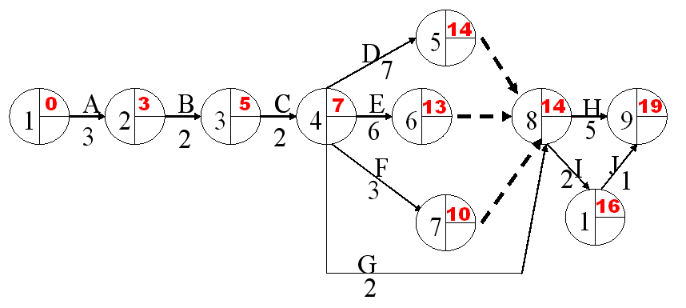
Calculating ECTs or ES
ECT = earliest time event can be completed, To calculate:
  For an event not depending on others: ECT = 0
    Usually this is the first event
  For an event E depending on one or more others:
    Calculate ECTs of event(s) that E depends on
    Add duration(s) of task(s) leading to E
    If E depends on more than one event, take MAX
Proceed left to right ( → ) through the chart

Slide 14
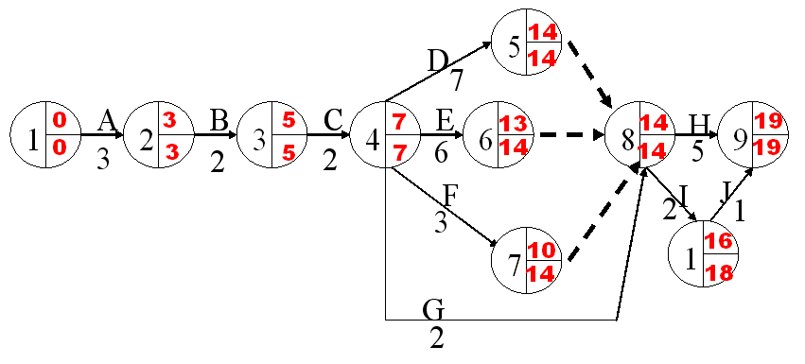
Calculating LCT or LF
LCT = latest time event can be completed, while still finishing last task at indicated time, To calculate:
  For an event which no other events depend on: LCT = ECT
    Generally there will only be one such event
  For an event E which one or more others depend on:
    Calculate LCTs of event(s) that depend on E
    Subtract duration(s) of task(s) leading from E
    If more than one event depends on E, take MINIMUM
Proceed right to left ( ← ) through PERT chart

Slide 15
Critical Path
A critical path for the network is a path consisting of activities with zero slack. And it is always the longest path in the project network.
Red line is the critical path
What does it represent?

Slide 16
Critical Path Method
WBS representation of a project is transformed into an Activity network along with their interdependencies.
An activity network shows the different activities making up a project, their estimated durations, interdependencies.
Ex-Consider a software project of 8 jobs Analysis-module-1 and system requirement study(SRS)-1, Analysis-module-2, System requirement Study(SRS)-2, GUI Design, GUI Coding & Unit Testing-1, Data Base(DB) Design, DB Coding & Unit Testing, and Integration & System Testing. Two groups of professionals are deployed to develop the system. The required time of each activities and precedence of activities are given in the next slide.
Software Project Management

Slide 17
Job | Job Description | Predecessor | Normal Time (days)
A | Analysis-1 & SRS-1 | - | 10
B | Analysis-2 | - | 5
C | SRS-2 | B | 3
D | GUI Design | A, C | 4
E | DB Design | A, C | 5
F | GUI Coding & Unit Testing | D | 6
G | DB Coding & Unit Testing | E | 5
H | Integration & System Testing | F, G | 5
Software Project Management

Slide 18
Job | Job Description | Predecessor | Normal Time (days)
A | Analysis-1 & SRS-1 | - | 10
B | Analysis-2 | - | 5
C | SRS-2 | B | 3
D | GUI Design | A, C | 4
E | DB Design | A, C | 5
F | GUI Coding & Unit Testing | D | 6
G | DB Coding & Unit Testing | E | 5
H | Integration & System Testing | F, G | 5
ES=14
LF=14
4
D
F
ES=20
LF=20
ES=0
LF=0
ES=10
LF=10
4
6
A
5
ES=25
LF=25
1
10
3
6
H
7
5
B
5
3
C
E
5
2
G
5
ES2=5
LF=7
ES=15
LF=15
Software Project Management

Slide 19
ES=14
LF=14
ES=0
LF=0
ES=10
LF=10
D
4
F
ES=20
LF=20
A
4
6
5
ES=25
LF=25
1
10
3
3
5
6
H
7
B
5
C
E
5
G
2
5
ES2=5
LF=7
ES=15
LF=15
Job | Expected Duration | Earliest Start-ES | Latest Finish-LF | Slack Time (Max.delay) | Remarks
A | 10 | 0 | 10 | 0 | Critical
B | 5 | 0 | 7 | 2 | Non-critical
C | 3 | 5 | 10 | 3 | Non-critical
D | 4 | 10 | 14 | 0 | Critical
E | 5 | 10 | 15 | 0 | Critical
F | 6 | 14 | 20 | 0 | Critical
G | 5 | 15 | 20 | 0 | Critical
H | 5 | 20 | 25 | 0 | Critical
If all the jobs are done at their normal times, the project duration (length of the longest path) is 25 days.
Critical path A D F H = 25 days
or A E G H = 25 days
Software Project Management

Slide 20
Example: ABC Associates
Consider the following project:
Immediate
Activity Predecessor time (days)
A -- 6
B -- 4
C A 3
D A 5
E A 1
F B,C 4
G B,C 2
H E,F 6
I E,F 5
J D,H 3
K G,I 5

Slide 21
Example: network
Backward
LF
Forward
ES
6
20
6
19
D
2
5
1
5
J
6
0
A
E
H
3
6
13
23
1
C
3
4
7
0
4
F
5
13
5
B
4
I
23
K
2
3
6
G
9
18
9
18

Slide 22
Example: ABC Associates
Earliest/Latest Times
Activity time ES EF LS LF Slack
A 6 0 6 0 6 0 *critical
B 4 0 4 5 9 5
C 3 6 9 6 9 0 *
D 5 6 11 15 20 9
E 1 6 7 12 13 6
F 4 9 13 9 13 0 *
G 2 9 11 16 18 7
H 6 13 19 14 20 1
I 5 13 18 13 18 0 *
J 3 19 22 20 23 1
K 5 18 23 18 23 0 *
  The estimated project completion time is the Max EF at node 7 = 23.
EF = ES + t
LS = LF – t
Where t is the
Activity time
Slack = LF – EF
= LS - ES

Slide 23
PERT Chart (Program Evaluation Review Technique)
Ex: Consider a project consisting of 9 jobs (A, B, …I) with the following relations and time estimates.
Job | Predecessor | Optimistic Time(t_{o}) | Most probable Time(t_{m}) | Pessimistic Time (t_{p})
A | -- | 2 | 5 | 8
B | A | 6 | 9 | 12
C | A | 6 | 7 | 8
D | B,C | 1 | 4 | 7
E | A | 8 | 8 | 8
F | D,E | 5 | 14 | 17
G | C | 3 | 12 | 21
H | F, G | 3 | 6 | 9
I | H | 5 | 8 | 11
Software Project Management

Slide 24
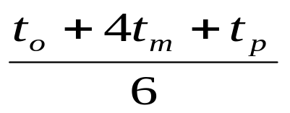
Expected Time = t_{e} =
Variance = V_{e} = {(t_{p} – t_{o}) / 6 }²
Standard deviation = sqrt(Variance)
Where, t_{o} = Optimistic time
t_{m} = Most likely time
t_{p} = Pessimistic time
NB: t_{m} is 4 times more likely to occur than either of the other two. Weightage is applied to the three time estimates. This helps to bias time estimates away from the unrealistically short time-scales normally assumed.
Software Project Management

Slide 25
Job | Average time | Standard deviation | Variance
A | 5
B | 9
C | 7
D | 4
E | 8
F | 13
G | 12
H | 6
I | 8
Software Project Management

Slide 26
Job | Average time | Standard deviation | Variance
A | 5 | 1 | 1
B | 9 | 1 | 1
C | 7 | 1/3 | 1/9
D | 4 | 1 | 1
E | 8 | 0 | 0
F | 13 | 2 | 4
G | 12 | 3 | 9
H | 6 | 1 | 1
I | 8 | 1 | 1
First we compute the average time from the three times given in previous table and the variance for each one of the jobs. They are tabulated in above table. Figure in the next slide gives the project network, where the numbers on the arcs indicate the average job times. Using the average job times, the earliest and latest times of each event are calculated.
Software Project Management

Slide 27
(12, 14)
3
G
C
7
12
A
B
D
F
H
I
1
2
4
5
6
7
8
5
9
4
G
13
6
8
(0, 0)
(5, 5)
(14, 14)
(18, 18)
(31, 31)
(37, 37)
(45, 45)
E
8
Network Events with Earliest and Latest Time
The critical path is found as 1→2→4→5→6→7→8.
Let T denotes the project duration. Then the expected length of the project is
E(T) = sum of the expected times of jobs A,B,D,F,H and I
= 5 + 9 + 4 + 13 + 6 + 8 = 45 days.
Software Project Management

Slide 28
Total project duration = 45 days
Total project variance = 1 + 1 + 1 + 4 + 1 + 1 = 9
The standard deviation of the project = √(9) = 3
With 1 SD there is 68% chance that the project will be completed between 45 + 3 = 42 days to 48 days.
With 2 SD there is 95% chance that the project will be completed between 45 + 2(3) = 39 days to 51 days.
With 3 SD there is 99.7% chance that the project will be completed between 45 + 3 = 36 days to 54 days.
Software Project Management

Slide 29
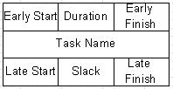
AON (activity on node)
The second type of PERT diagram is called AON (activity on node).
In such diagram the information about the task duration is denoted in the diagram node and each task is represented in the form of rectangle with the definite set of fields.
These are the task name, duration, early and late starts and early and late finishes of the task and also the float for execution of the given task.

Slide 30
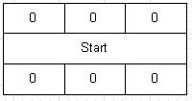
AON (activity on node)
PERT diagram starts from the task which does not have duration and does not use resources and presents just a project start. This is done to denote the common start of the project as starting from the first day of the project several tasks are starting simultaneously. Analogously PERT diagram finishes with the task “finish”.
No task is able to start before the preceding task is finished. Also each task may represent a separate project with its subtasks, which can be displayed on a separate diagram.

Slide 31
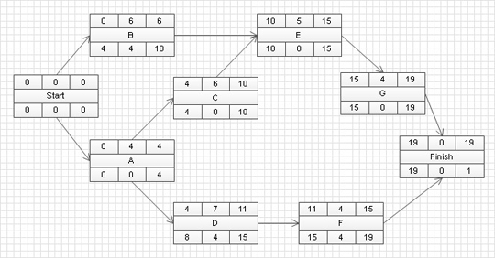
Example

Slide 32
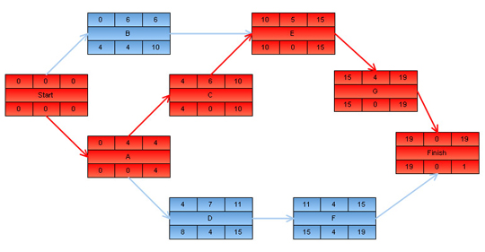
Example
Task appeared on the calculated critical path are marked out with red color. This way any person is able to see at once tasks which require special attention.

Slide 33
Gantt Chart
This technique of using special type of bars representing activities has been developed by Henry Gantt and named as Gantt chart.
The Gantt chart is also known as Time-line chart.
It is a useful used to allocate resources to various activities. The resources are manpower, computer hardware, work space etc. Each bar, an activity, is drawn against a time line.
The shaded part of the bar is the estimated time and the white part of the bar is called the slack time by which the activity has to finish. Therefore the shaded part can be shifted, if necessary, to any part to extent of the white bar limitation.
This allows the project manager to allocate resources suitably by shifting the activity on the timeline without affecting other activities. Many activities can start concurrently. next slide shows the activities to be carried out on a timeline.
Software Project Management

Slide 34
Gantt Charts
Visual scheduling tool
Graphical representation of information
Named after Henry Gantt who invented them in 1917
Show dependencies between tasks, personnel, and other resources allocations
Track progress towards completion
Depicts some of the same information as on a PERT chart
Also depicts new information

Slide 35
Acitivity Code | Description | Duration (Wk) | Preceedence
A | Requirement analysis | 1 | -
B | Design database | 2 | A
C | Interface design | 1.5 | A
D | Write SQL code for DB | 2 | B, C
E | Write code for interface | 1.5 | C
F | Integration and testing | 5 | D, E
G | Documentation | 1.5 | A
Software Project Management

Slide 36
Requirement analysis
ACTIVITIES
Design Database
Interface Design
Write SQL Code for Database
Write Code for Interface
Integration and Testing
Documentation
1
2
3
4
5
6
7
8
9
10
11
weeks
Gantt Chart for Software Development
Software Project Management

Slide 37
Gantt Charts
Establish a time-phased network
Can be used as a tracking tool
Benefits of Gantt charts
Easy to create and comprehend
Identify the schedule baseline network
Allow for updating and control
Identify resource needs

Slide 38
RISK MANAGEMENT
A risk is any anticipated unfavorable event or circumstance that can occur while a project is underway.
It may adversely affect the project to complete in time
The project manager to anticipate and identify
Contingence plans need to be prepared to reduce the impact of risk
Three essential Activities: Risk Identification, Risk Assessment, Risk Containment
Software Project Management

Slide 39
Risk Identification
Early Risk identification is important. The project manager can examine the diff. classes of risks.
Project risks
concerns about budgets, schedule, personnel, resource, customer related problems
Technical risks
potential design, implementation, interfacing, testing, and maintenance, ambiguous specification, changing specification, technical uncertainty, technical obsolescence
Business risk
building an excellent product that no one wants, losing budgetary commitments
Software Project Management

Slide 40
Risk assessment
Rank the risks in terms of their damage causing potential
r = likelihood of a risk becoming real (probability)
s = sequence of problems associated (severity of damage caused due the risk becoming real)
p = priority of risk = r * s
If all the identified risks are priortised, then most likely the damaging risks can be handled and risk abatement procedure can be designed to handle the risks.
Software Project Management

Slide 41
Risk Mitigation
Avoid the risk
Process related risks (work schedule, budget, resource utilization)
Transfer risk
(development by third party, insurance cover)
Risk reduction
(consider the cost handling risk and the corresponding reduction of risk, compute risk coverage)
Risk leverage = (risk exposure before reduction – risk exposure after reduction) / cost of reduction
Software Project Management

Slide 42
Software Configuration Management
It aims at the problems
Inconsistency problems when the objects are replicated
Problems associated with concurrent access
Providing a stable development environment
System accounting and maintaining status information
Handling variants
A baseline is the status of all the objects under configuration control. When any of the objects under configuration control is changed, a new baseline gets formed
Software Project Management

Slide 43
Configuration management activities
(A) Configuration identification
It involves deciding which parts of the system should be kept track of it
Requirement specification document
Design document
Tools used to build the system (compilers, linkers, lexical analysers, parsers)
Source code for each module
Test cases
Problem reports
Configuration management plan is written during the project planning phase. It lists all control objects.
Software Project Management

Slide 44
(B) Configuration control
Configuration control is the process of managing changes to controlled objects. It allows only authorised changes to the controlled objects to occur and prevents authorised changes.
Reserve and restore operation in configuration control
New baseline
Baseline
A
B
A
B
C
D
C
D
Cancel reservation
Reserve
Restore
Private copy of C
Software Project Management

Slide 45
Restoring the changed module to the system configuration requires the permission of a Change control board (CCB). CCB reviews the changes and certifies
1. Changes is well-motivated
2. Developer has considered and documented
3. Changes interact well with other developers
4. Appropriate people (CCB) have validated change
CCB constitutes the project manager and other senior people in the team. The configuration management tool allows one developer to work on one module at any one time, problem of accidental overwriting is eliminated.
Software Project Management

Slide 46
(C) Source code control system (SCCS)
SCCS is a configuration management tool available on Unix system.
It manages and controls different versions of text files and don’t handle binary files (executable, document and diagrams)
SCCS provides an efficient way of storing versions that minimizes the occupied disk space.
The changes to transform each baselined file to the next version are stored as deltas in stead of full files.
Revisions are denoted by numbers in ascending order as 1.1, 1.2, 1.3, etc.
Software Project Management

