Slide 1
2D TRANSFORMATIONS
Dr. Santosh Kumar Swain
Professor
School Of Computer Engineering
KIIT , Bhubaneswar.
sswainfcs@kiit.ac.in

Slide 2
What
Given a 2D object, transformation is to change the object’s
Position (translation , reflection)
Size (scaling)
Orientation (rotation)
Shapes (shear)

Slide 3
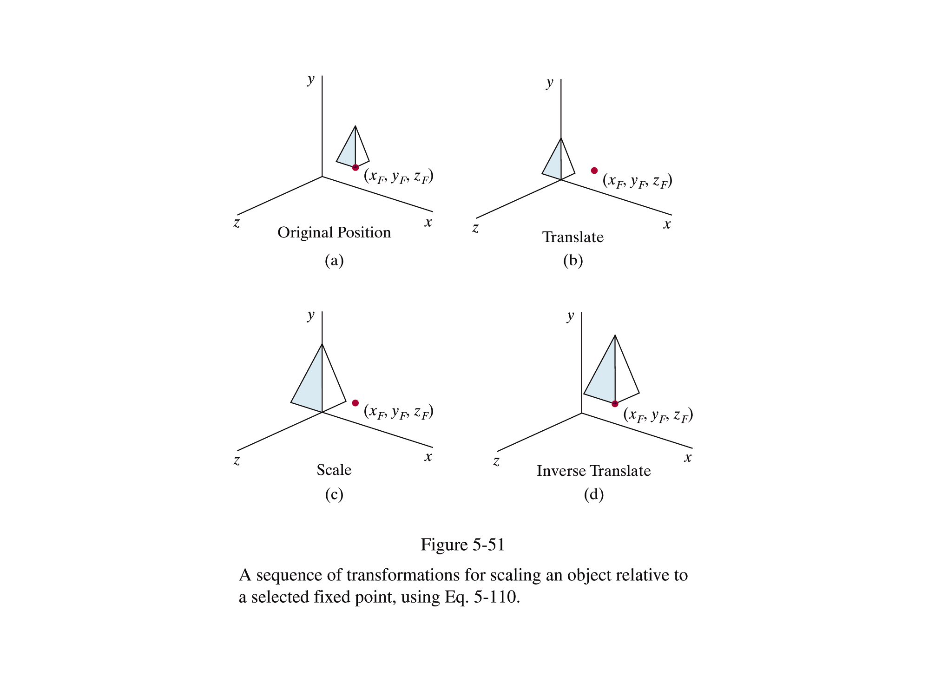
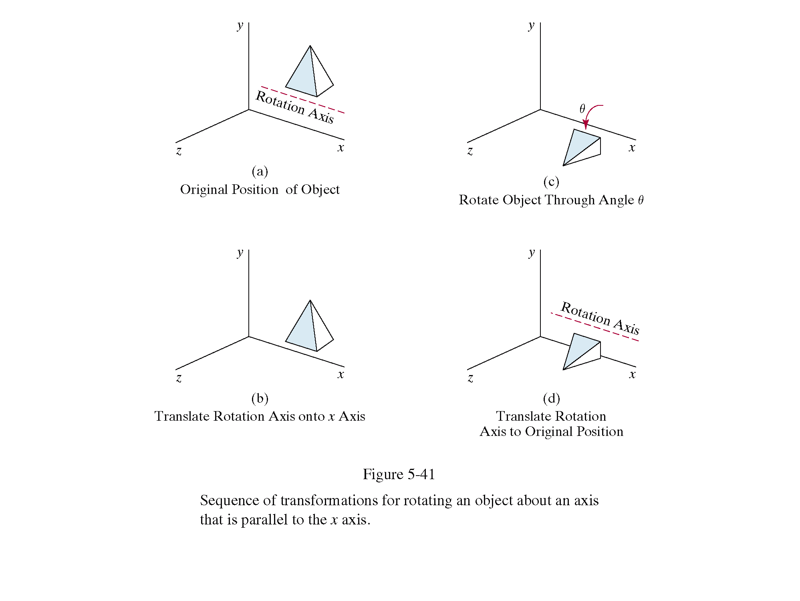
Why Transformations?
In graphics, once we have an object described, transformations are used to move that object, scale it and rotate it

Slide 4
How to implement
2 ways
Geometric Transformation
Alter the coordinates descriptions of an object
Coordinate system unchanged
Coordinate transformation
Produce a different coordinate system

Slide 5
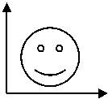
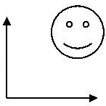
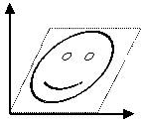
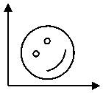
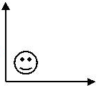
2D Geometrical Transformations
Translate
Shear
Rotate
Scale

Slide 6
Translation
A translation moves all points in an object along the same straight-line path to new positions
The path is represented by a vector, called the translation or shift vector.
. In translation, an object is displaced a given distance and direction from its original position. If the displacement is given b the vector V= t_{x} I+ t_{y} J
We can write the components:
X’ = X+ t_{x}
Y’= Y+ t_{y}
or in matrix form: P' = P + T
P’ = (x’,y’)?
t_{y}
P (x,y)
t_{x}
x’
y’
x
y
t_{x}
t_{y}
= +

Slide 7
Translation
How to translate an object with multiple vertices?
Translate individual
vertices

Slide 8
Translation
The translation transformation can not be expressed as a 2*2 matrix function required for multiplication.
P’= T_{v}(P)
T_{v}=

Slide 9
Rotation
Repositioning the object along the circular path.
x = r cos (φ)
y = r sin (φ)
x’ = r cos (φ + θ)
y’ = r sin (φ + θ)
x’ = x cos(θ) – y sin(θ)
y’ = y cos(θ) + x sin(θ)
P’(x’, y’)
θ
y’
P(x,y)
θ
r
y
φ
x’
x
P' = R • P

Slide 10
Rotation
How to rotate an object with multiple vertices?
Rotate individual
Vertices
θ

Slide 11
Scaling
Changing the size of an object by two scaling factors, S_{x} and S_{y} for the x- and y- coordinates respectively.
X ‘= s_{x *} X Y’= s_{y} * Y
P’
P

Slide 12
Scaling
Scalar multiplies all coordinates
WATCH OUT: Objects grow and move!
x_{new} = Sx × x_{old} y_{new} = Sy × y_{old}
y
6
5
4
3
2
1
0
1
2
3
4
5
6
7
8
9
10
x
Note: House shifts position relative to origin

Slide 13
Combining transformations
We have a general transformation of a point:
P' = M • P + A
When we scale or rotate, M We set
A Additive identity.
When we translate, M Multiplicative identity
A We set
To combine multiple transformations,
we must explicitly compute each transformed point.
But it’d be nicer if we could use the same matrix operation all the time.
So we’d have to combine multiplication and addition into a single operation.

Slide 14
Homogenous Coordinates
y
y
w
x
➔
x
L et's move our problem into 3 D.
Every Cartesian coordinate position (x,y) can be represented by homogeneous coordinate triple (ax, ay, a)
a is any nonzero value
A point in 2D can be represented in many ways in the new space.
(2, 4) ----------→ ( 8, 16, 4) or (6, 12, 3 ) or (2, 4, 1) or etc.

Slide 15
Homogenous Coordinates
We can always map back to the original 2D point by dividing by the last coordinate
(15 , 6, 3 ) → ( 5 , 2).
(60, 40, 10) → ?.
Now we use 1 for the last coordinate
Point in column-vector:
Our point now has three coordinates.
So our transformation matrix needs to be 3 x 3
x
y
1

Slide 16
Homogeneous Coordinates
A point (x, y) can be re-written in homogeneous coordinates as (xh, yh, h)
The homogeneous parameter h is a non- zero value such that:
We can then write any point (x, y) as (hx, hy, h)
We can conveniently choose h = 1 so that (x, y) becomes (x, y, 1)

Slide 17
Why Homogeneous Coordinates?
Mathematicians commonly use homogeneous coordinates as they allow scaling factors to be removed from equations
We will see in a moment that all of the transformations we discussed previously can be represented as 3*3 matrices
Using homogeneous coordinates allows us use matrix multiplication to calculate transformations – extremely efficient!

Slide 18
Matrix Representation
Translation :
Rotation :
Scaling :

Slide 19
Composite Transformation
We can represent any sequence of transformations as a single matrix called as composite transformation matrix .
Composite transformations:
Two successive Translation
Two successive Rotation
Two successive Scaling
Rotate about an arbitrary point
Scale about an arbitrary point
General composite transformation (according to problem)

Slide 20
Two successive Translation is additive
Two successive Rotation is additive

Slide 21
Two successive Scaling is multiplicative

Slide 22
Order of operations
So, it does matter. Let’s look at an example:
Translate
Rotate
Rotate
Translate

Slide 23
Rotation about an arbitrary point
To rotate about an arbitrary pivot point P(px,py) by θ:
Translate the object so that P will coincide with the origin: T(-px, -py)
Rotate the object: R(θ)
Translate the object back so that pivot point is returned to its original position : T(px,py)
(px,py)

Slide 24
Scale about an arbitrary point
To scale about an arbitrary pivot point P (px,py):
Translate the object so that P will coincide with the origin: T(-px, -py)
Rotate the object: S(sx, sy)
Translate the object back so that pivot point is returned to its original position: T(px,py)
(px,py)

Slide 25
Reflection Produce mirror image of the object by rotating the object about an axis of reflection by an angle 180’
Reflection axis on x-y plane
X-Axis
Y- Axis
X=y line
Any line
Reflection axis perpendicular to x-y plane
Axis passing through origin
Axis passing through any pivot point

Slide 26
1. x-axis 2. y-axis
Reflection
Axis on x-y Plane

Slide 27
Reflection
3. About line x=y

Slide 28
Reflection
Axis perpendicular to x-y Plane
1. At origin
2. At any pivot point
(px,py)

Slide 29
Exercises 1
Translate the shape below by (7, 2)
y
6
5
4
(2, 3)
3
(1, 2)
(3, 2)
2
1
(2, 1)
0
x
1
2
3
4
5
6
7
8
9
10

Slide 30
Exercises 2
Scale the shape below by 3 in x and 2 in y
y
6
5
4
(2, 3)
3
(1, 2)
(3, 2)
2
1
(2, 1)
0
x
1
2
3
4
5
6
7
8
9
10

Slide 31
Exercises 3
Rotate the shape below by 30° about the origin
y
6
5
4
(7, 3)
3
(6, 2)
(8, 2)
2
1
(7, 1)
0
x
1
2
3
4
5
6
7
8
9
10

Slide 32
Exercise 4
Write out the homogeneous matrices for the previous three transformations
Translation
Scaling
Rotation

Slide 33
Exercises 5
Using matrix multiplication calculate the rotation of the shape below by 45° about its centre (5, 3)
y
5
(5, 4)
4
(4, 3)
(6, 3)
3
2
(5, 2)
1
0
x
1
2
3
4
5
6
7
8
9
10

Slide 34
Scratch
y
6
5
4
3
2
1
0
x
1
2
3
4
5
6
7
8
9
10

Slide 35
Shear
Distorts the shape such that the transformed shape appears that the object composed of internal layers that cause to slide over each other
x-direction y-direction

Slide 36
Shear
• Shear (a, b): (x’, y’) → (x + S_{hx} y, y + S_{hy} x)

Slide 37
Coordinate Transformation
Translation
Translation applied over the coordinate system
P’(X’,Y’)
Y
Y’
P(X,Y)
We can write the components:
X’ = X- t_{x}
Y’= Y- t_{y}
or in matrix form: P' = P - T
Ty
X’
Tx
X
x’
y’
x
y
t_{x}
t_{y}
= +

Slide 38
Rotation
x = r cos (φ)
y = r sin (φ)
P’(X’,Y’)
Y’
Y
P(X,Y)
r
φ-θ
X’
x’ = r cos (φ − θ)
y’ = r sin (φ − θ)
φ
θ
X
x’ = x cos(θ) + y sin(θ)
y’ = y cos(θ) - x sin(θ)

Slide 39
Window vs. Viewport
Window
World-coordinate area selected for display
What is to be viewed
Viewport
Area on the display device to which a window is mapped
Where it is to be displayed

Slide 40
Viewport Transformation
Window-to-Viewport Mapping
Window
Viewport
wy2
vy2
(wx, wy)
(vx, vy)
wy1
vy1
wx1
wx2
vx1
vx2
Screen Coordinates
Image Coordinates
vx = vx1 + (wx – wx1) * (vx2 – vx1) / (wx2 – wx1);
vy = vy1 + (wy – wy1) * (vy2 – vy1) / (wy2 – wy1);

Slide 41
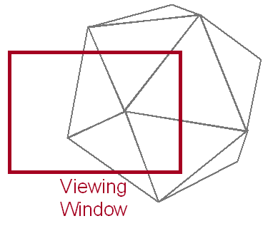
Clipping
Avoid Drawing Parts of Primitives Outside Window
Points
Lines
Polygons
Circles
etc.

Slide 42
Point Clipping
Is Point(x,y) Inside the Clip Window?
wymax
Inside =
(x>=wxmin) &&
(x<=wxmax) &&
(y>=wymin) &&
(y<=wymax);
(x, y)
wymin
wxmin
wxmax

Slide 43
Line Clipping
Find the Part of a Line Inside the Clip Window
P₇
P₁
P₄
P₈
P₃
P₂
P₆
P₁₀
P₅
P₉
Before Clipping

Slide 44
Line Clipping
Find the Part of a Line Inside the Clip Window
P’₇
P₄
P’₈
P₃
P₆
P’₅
After Clipping

Slide 45
Cohen-Sutherland Line Clipping
Use Simple Tests to Classify Easy Cases First
P₇
P₁
P₄
P₈
P₃
P₂
P₆
P₁₀
P₅
P₉

Slide 46
Cohen-Sutherland Line Clipping
Classify Some Lines Quickly by AND of Bit Codes Representing Regions of Two Endpoints (Must Be 0)
1001
P₇
1000
1010
Bit 1
P₁
P₄
P₈
0001
P₃
0000
0010
P₂
P₆
P₁₀
Bit 2
0101
P₅
0100
P₉
0110
Bit 4
Bit 3

Slide 47
Cohen-Sutherland Line Clipping
Classify Some Lines Quickly by AND of Bit Codes Representing Regions of Two Endpoints (Must Be 0)
1001
P₇
1000
1010
Bit 1
P₁
P₄
P₈
0001
P₃
0000
0010
P₂
P₆
P₁₀
Bit 2
0101
P₅
0100
P₉
0110
Bit 4
Bit 3

Slide 48
Cohen-Sutherland Line Clipping
Classify Some Lines Quickly by AND of Bit Codes Representing Regions of Two Endpoints (Must Be 0)
1001
P₇
1000
1010
Bit 1
P₄
P₈
0001
P₃
0000
0010
P₆
P₁₀
Bit 2
0101
P₅
0100
P₉
0110
Bit 4
Bit 3

Slide 49
Cohen-Sutherland Line Clipping
Compute Intersections with Window Boundary for Lines That Can’t be Classified Quickly
1001
P₇
1000
1010
Bit 1
P₄
P₈
0001
P₃
0000
0010
P₆
P₁₀
Bit 2
0101
P₅
0100
P₉
0110
Bit 4
Bit 3

Slide 50
Cohen-Sutherland Line Clipping
Compute Intersections with Window Boundary for Lines That Can’t be Classified Quickly
1001
P₇
1000
1010
Bit 1
P₄
P₈
0001
P₃
0000
0010
P₆
P₁₀
Bit 2
0101
P₅
0100
P₉
0110
Bit 4
Bit 3

Slide 51
Cohen-Sutherland Line Clipping
Compute Intersections with Window Boundary for Lines That Can’t be Classified Quickly
1001
P₇
1000
1010
Bit 1
P₄
P₈
0001
P₃
0000
0010
P₆
P₁₀
Bit 2
P’₅
0101
0100
P₉
0110
Bit 4
Bit 3

Slide 52
Cohen-Sutherland Line Clipping
Compute Intersections with Window Boundary for Lines That Can’t be Classified Quickly
1001
P₇
1000
1010
Bit 1
P₄
P₈
0001
P₃
0000
0010
P₆
P₁₀
Bit 2
P’₅
0101
0100
P₉
0110
Bit 4
Bit 3

Slide 53
Cohen-Sutherland Line Clipping
Compute Intersections with Window Boundary for Lines That Can’t be Classified Quickly
1001
P₇
1000
1010
Bit 1
P₄
P₈
0001
P₃
0000
0010
P₆
P₁₀
Bit 2
P’₅
0101
0100
P₉
0110
Bit 4
Bit 3

Slide 54
Cohen-Sutherland Line Clipping
Compute Intersections with Window Boundary for Lines That Can’t be Classified Quickly
1001
P₇
1000
1010
Bit 1
P₄
P₈
0001
P₃
0000
0010
P₆
P₁₀
Bit 2
P’₅
0101
0100
P₉
0110
Bit 4
Bit 3

Slide 55
Cohen-Sutherland Line Clipping
Compute Intersections with Window Boundary for Lines That Can’t be Classified Quickly
1000
1001
P’₇
1010
Bit 1
P₄
P₈
0001
P₃
0000
0010
P₆
P₁₀
Bit 2
P’₅
0101
0100
P₉
0110
Bit 4
Bit 3

Slide 56
Cohen-Sutherland Line Clipping
Compute Intersections with Window Boundary for Lines That Can’t be Classified Quickly
10001
1001
P’₇
1010
Bit 1
P₄
P₈
0001
P₃
0000
0010
P₆
P₁₀
Bit 2
P’₅
0101
0100
P₉
0110
Bit 4
Bit 3

Slide 57
Cohen-Sutherland Line Clipping
Compute Intersections with Window Boundary for Lines That Can’t be Classified Quickly
1000
1001
P’₇
1010
Bit 1
P₄
P’₈
0001
P₃
0000
0010
P₆
P₁₀
Bit 2
P’₅
0101
0100
P₉
0110
Bit 4
Bit 3

Slide 58
Cohen-Sutherland Line Clipping
Compute Intersections with Window Boundary for Lines That Can’t be Classified Quickly
1001
1000
P’₇
1010
Bit 1
P₄
P’₈
0001
P₃
0000
0010
P₆
P₁₀
Bit 2
P’₅
0101
0100
P₉
0110
Bit 4
Bit 3

Slide 59
Cohen-Sutherland Line Clipping
Compute Intersections with Window Boundary for Lines That Can’t be Classified Quickly
1001
1000
P’₇
1010
Bit 1
P₄
P’₈
0001
P₃
0000
0010
P₆
P₁₀
Bit 2
P’₅
0101
0100
P₉
0110
Bit 4
Bit 3

Slide 60
Cohen-Sutherland Line Clipping
Compute Intersections with Window Boundary for Lines That Can’t be Classified Quickly
1000
1001
P’₇
1010
Bit 1
P₄
P’₈
0001
P₃
0000
0010
P₆
P₁₀
Bit 2
P’₅
0101
0100
P₉
0110
Bit 4
Bit 3

Slide 61
Cohen-Sutherland Line Clipping
Compute Intersections with Window Boundary for Lines That Can’t be Classified Quickly
1000
1001
P’₇
1010
Bit 1
P₄
P’₈
0001
P₃
0000
0010
P₆
P₁₀
Bit 2
P’₅
P’₉
0101
0100
0110
Bit 4
Bit 3

Slide 62
Cohen-Sutherland Line Clipping
Compute Intersections with Window Boundary for Lines That Can’t be Classified Quickly
1000
1001
P’₇
1010
Bit 1
P₄
P’₈
0001
P₃
0000
0010
P₆
P₁₀
Bit 2
P’₅
P’₉
0101
0100
0110
Bit 4
Bit 3

Slide 63
Cohen-Sutherland Line Clipping
Compute Intersections with Window Boundary for Lines That Can’t be Classified Quickly
1000
1001
P’₇
1010
Bit 1
P₄
P’₈
0001
P₃
0000
0010
P₆
Bit 2
P’₅
0101
0100
0110
Bit 4
Bit 3

Slide 64
Cohen-Sutherland Line Clipping Algorithm
1. Read 2 end points of line as p1(x1,y1) and p2(x2,y2)
2. Read 2 corner points of the clipping window (left-top and right-bottom) as (wx1,wy1) and (wx2,wy2)
3. Assign the region codes for 2 endpoints p1 and p2 using following steps:-
initialize code with 0000
Set bit 1 if x<wx1
Set bit 2 if x>wx2
Set bit 3 if y<wy2
Set bit 4 if y>wy1
4. Check for visibility of line
If region codes for both endpoints are zero then line is completely visible. Draw the line go to step 9.
If region codes for endpoints are not zero and logical ANDing of them is also nonzero then line is invisible. Discard the line and move to step 9.
If it does not satisfy 4.a and 4.b then line is partially visible.

Slide 65
Cohen-Sutherland Line Clipping Algorithm Cont..
5. Determine the intersecting edge of clipping window as follows:-
If region codes for both endpoints are nonzero find intersection points p1’ and p2’ with boundary edges.
If region codes for any one end point is non zero then find intersection point p1’ or p2’.
6. Divide the line segments considering intersection points.
7. Reject line segment if any end point of line appears outside of any boundary.
8. Draw the clipped line segment.
9. Stop.

Slide 66
Limitations of Cohen Sutherland line clipping Algorithm
The algorithm is merely applicable to rectangular windows and not to the other convex shaped window.
Disadvantages:
“Random” edge choice
Redundant edge line cross calculations
•Fixed-order decision can do needless work
•Can improve using more regions (Nicholl-Lee-Nicholl Alg)
•Clipping window must be rectangular

Slide 67
Advantages
Simple to implement
•Oriented for most simple window/viewport
systems
•Extends to 3-D cubic volumes

Slide 68
Sutherland-Hodgman Polygon Clipping
Input each edge (vertex pair) successively.
Output is a new list of vertices.
Each edge goes through 4 clippers.
The rule for each edge for each clipper is:
If first input vertex is outside, and second is inside, output the intersection and the second vertex
If first both input vertices are inside, then just output second vertex
If first input vertex is inside, and second is outside, output is the intersection
If both vertices are outside, output is nothing

Slide 69
Sutherland-Hodgman Polygon Clipping: Four possible scenarios at each clipper
outside inside
outside inside
outside inside
outside inside
v2
v2
v2
v2
v1’
v1’
v1
v1
v1
v1
Outside to inside:
Output: v1’ and v2
Inside to inside:
Output: v2
Inside to outside:
Output: v1’
Outside to outside:
Output: nothing

Slide 70
Sutherland-Hodgman Clipping
Edge from s to p takes one of four cases:
inside
outside
inside
outside
inside
outside
inside
outside
p
s
p
s
p
s
p
s
p output
i output
no output
i output p output

Slide 71
Sutherland-Hodgman Clipping
Basic idea:
Consider each edge of the viewport individually
Clip the polygon against the edge equation
After doing all planes, the polygon is fully clipped

Slide 72
Sutherland-Hodgman Clipping
Basic idea:
Consider each edge of the viewport individually
Clip the polygon against the edge equation
After doing all planes, the polygon is fully clipped

Slide 73
Sutherland-Hodgman Clipping
Basic idea:
Consider each edge of the viewport individually
Clip the polygon against the edge equation
After doing all planes, the polygon is fully clipped

Slide 74
Sutherland-Hodgman Clipping
Basic idea:
Consider each edge of the viewport individually
Clip the polygon against the edge equation
After doing all planes, the polygon is fully clipped

Slide 75
Sutherland-Hodgman Clipping
Basic idea:
Consider each edge of the viewport individually
Clip the polygon against the edge equation
After doing all planes, the polygon is fully clipped

Slide 76
Sutherland-Hodgman Clipping
Basic idea:
Consider each edge of the viewport individually
Clip the polygon against the edge equation
After doing all planes, the polygon is fully clipped

Slide 77
Sutherland-Hodgman Clipping
Basic idea:
Consider each edge of the viewport individually
Clip the polygon against the edge equation
After doing all planes, the polygon is fully clipped

Slide 78
Sutherland-Hodgman Clipping
Basic idea:
Consider each edge of the viewport individually
Clip the polygon against the edge equation
After doing all planes, the polygon is fully clipped

Slide 79
Sutherland-Hodgman Clipping
Basic idea:
Consider each edge of the viewport individually
Clip the polygon against the edge equation
After doing all planes, the polygon is fully clipped

Slide 80
Sutherland-Hodgman Clipping
Basic idea:
Consider each edge of the viewport individually
Clip the polygon against the edge equation
After doing all planes, the polygon is fully clipped

