Slide 1
3D Transformation
Translation
Rotation
Scaling

Slide 2
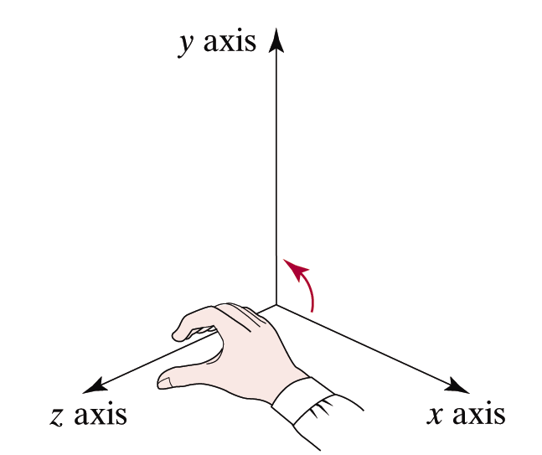
What we mean by a 3-D coordinate space
y axis
y
P
z
x
Right-Hand Reference System
z axis
x axis

Slide 3
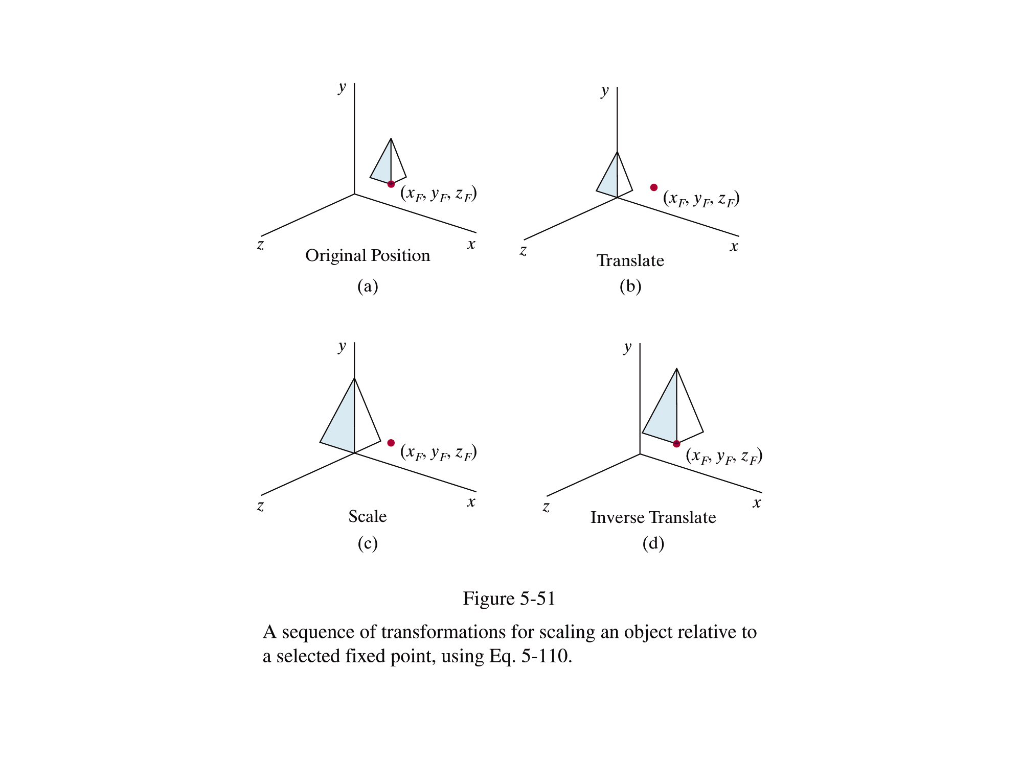

Translation
Translation of a point p(X,Y,Z) means shifting the point along a straight line path to new position p’(X’,Y’,Z’) .
Object translated by factor T(tx,ty,tz)
P
(x, y, z)
(x’, y’, z’)
P’
Hence in equ,
X’=X + t_{x}
Y’=Y + t_{y}
Z’=Z + t_{z}
In matrix form
=

Slide 4
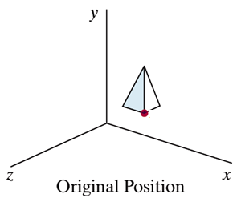
Scaling Changing the size of an object in 3D by scaling factors, S_{x} , S_{y} , S_{z,} for the x , y and z coordinates respectively.
Object scaled by factor S(Sx,Sy,Sz)
P(x,y,z)
P
(x’, y’, z’)
Scaled Position
Hence in equ,
X’=X * S_{x}
Y’=Y * S_{y}
Z’=Z * S_{z}
In matrix form
=

Slide 5
Rotation Repositioning the object along the circular path. Depending on axis of rotation :--
Axis as any principal axis
Axis other than principal axis
Z-Axis
X-Axis
Y-Axis
Parallel to any of the Principal Axis
Not parallel to any of the Principal Axis

Slide 6
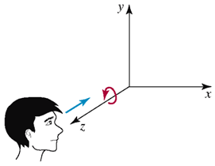
Axis as any principal axis
Axis As Z-axis
Plane of rotation is XY-Plane
In equ form
x’ = x·cosθ - y·sinθ
y’ = x·sinθ + y·cosθ
z’ = z
In matrix form
Rz(θ)

Slide 7
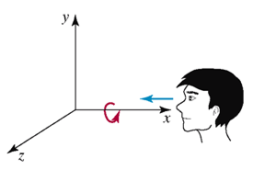
Axis As X-axis
Plane of rotation is YZ-Plane
In equ form
x’ = x
y’ = y·cosθ - z·sinθ
z’ = y·sinθ + z·cosθ
In matrix form
Rx(θ)

Slide 8
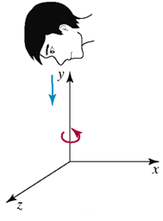
Axis As Y-axis
Plane of rotation is XZ-Plane
In equ form
x’ = z·sinθ + x·cosθ
y’ = y
z’ = z·cosθ - x·sinθ
In matrix form
Ry(θ)

Slide 9
Axis other than principal axis
Parallel to any of the Principal Axis
STEP 1
Translate so that axis coincide with the X Axis
Let axis parallel to X-axis

Slide 10
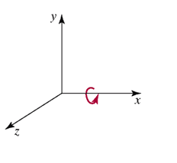
STEP 3
Retranslate to it’s original position
STEP 2
Rotate w.r.t x-axis
So sequence of transformations are
=
*

Slide 11

Not Parallel to any of the Principal Axis
Let the axis vector →
v=ai+bj+ck
The length of the line =
√(a² +b²+c²)

Slide 12
STEP 1
Translate to origin by (-x1,-y1,-z1)
=

Slide 13
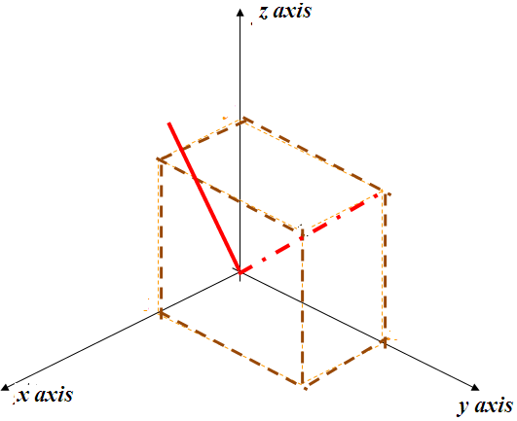
STEP 2
Rotate w.r.t x-axis
Rx(θ1) =
c
(a,b,c)
a
b
Y axis
r
q
In right triangle pqr
cos(Ѳ1)= c/√(b² + c² )
sin(Ѳ1)= b/ √(b² + c² )
(0,b,c)
p

Slide 14
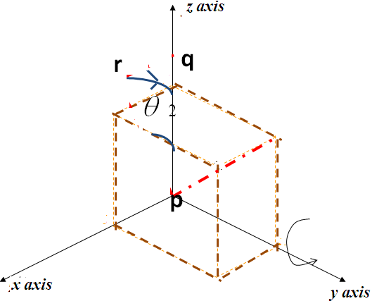
STEP 3
Rotate w.r.t y-axis
Ry(-θ2) =
In right triangle pqr
cos(Ѳ2)= √(b² + c² ) / √(a²⁺b² + c² )
sin(Ѳ2)= a/ √(a²⁺b² + c² )

Slide 15
STEP 4
Rotate w.r.t z-axis
y axis
Rz(θ) =

Slide 16
STEP 5
Re-Rotate w.r.t
y-axis by angle (θ2)
Ry(θ2)
STEP 6
Re-Rotate w.r.t
x-axis by angle (-θ1)
Rx(-θ1)
STEP 6
Re-translate
by factor
Sequence of transformation is
* Rx(θ1)
* Ry(-θ2)
* Rz(θ)
* Ry(θ2)
* Rx(-θ1)

Slide 17
r
q
p

