Slide 1
Projection

Slide 2
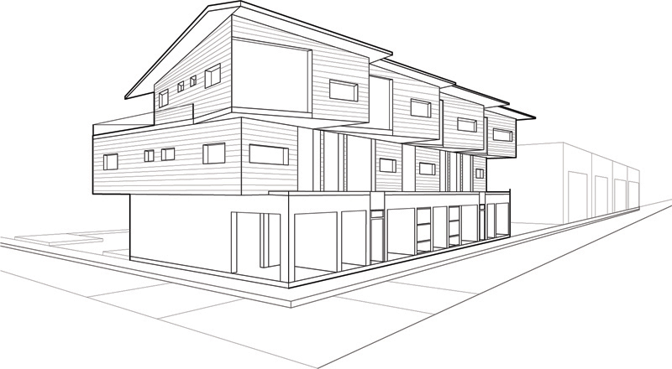
Projection

Slide 3
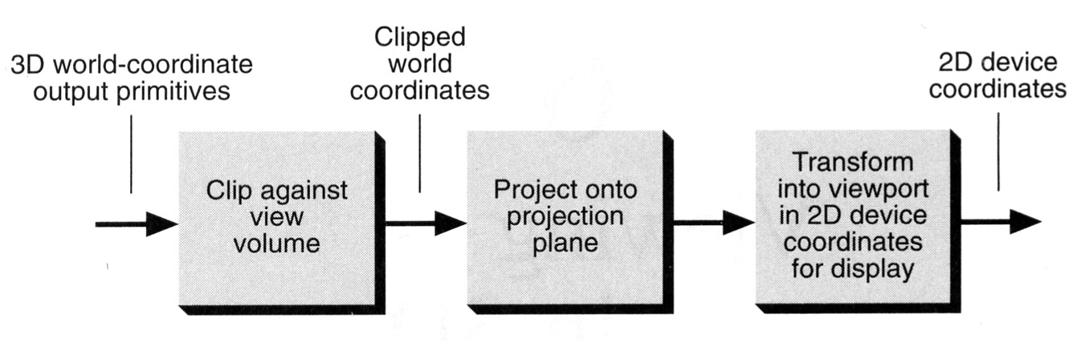
Projection
Conceptual model of 3D viewing process

Slide 4
Projection
In general, projections transform points in a coordinate system of dimension n into points in a coordinate system of dimension less than n.
We shall limit ourselves to the projection from 3D to 2D.
We will deal with planar geometric projections where:
The projection is onto a plane rather than a curved surface
The projectors are straight lines rather than curves

Slide 5
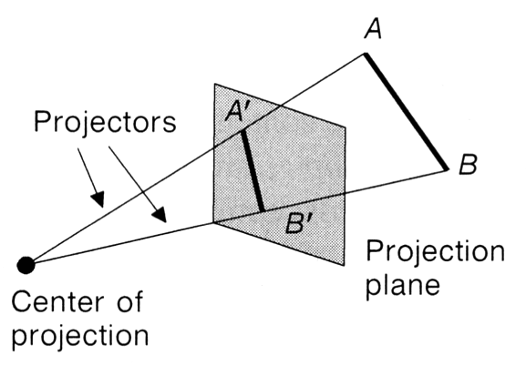
Projection
Projection from 3D to 2D is defined by straight projection rays (projectors) emanating from the 'center of projection', passing through each point of the object, and intersecting the 'projection plane' to form a projection.
projection can be defined as a mapping of point P(x, y, z) on to its image P’ (x’, y’, z’) in the projection plane or view plane and the mapping is determined by intersection of lines called projectors with the projection plane.

Slide 6
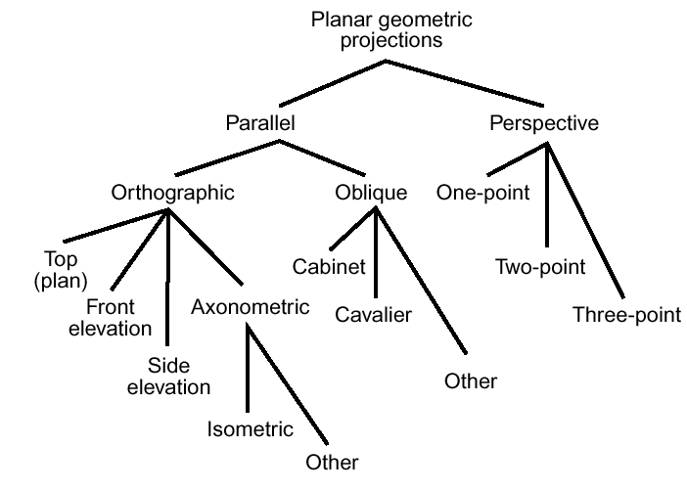
Taxonomy of Projection

Slide 7
Planer Geometric Projection
2 types of projections
perspective and parallel.
Key factor is the center of projection.
if distance to center of projection is finite : perspective
if infinite : parallel
Perspective projection
Parallel projection

Slide 8
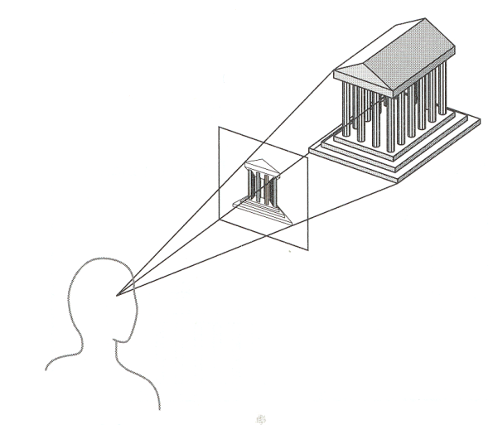
Perspective Projection
Perspective:
visual effect is similar to human visual system...
Perspective projection produces realistic views but does not preserve relative proportions of object dimensions
has 'perspective foreshortening'
size of object varies inversely with distance from the center of projection.
Parallel lines do not in general project to parallel lines
angles only remain intact for faces parallel to projection plane.

Slide 9
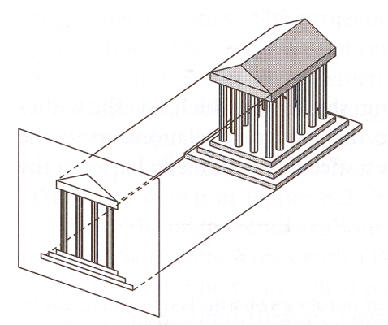
Perspective Projection
Object positions are transformed to view plane along lines that converge to meet at a finite point known as Centre of Projection (COP)

Slide 10
Parallel
Parallel:
less realistic view because of no foreshortening
however, parallel lines remain parallel.
angles only remain intact for faces parallel to projection plane.

Slide 11
Perspective projection- anomalies
Perspective foreshortening The farther an object is from COP the smaller it appears
Perspective foreshortening

Slide 12
Perspective projection- anomalies
Vanishing Points: Any set of parallel lines not parallel to the view plane appear to meet at some point.
There are an infinite number of these, 1 for each of the infinite amount of directions line can be oriented
Vanishing point

Slide 13
Perspective projection- anomalies
View Confusion: Objects behind the center of projection are projected upside down and backward onto the view-plane
Topological distortion: A line segment joining a point which lies in front of the viewer to a point in back of the viewer is projected to a broken line of infinite extent.
P
1
P'
3
Plane containing
Center of Projection (C)
Y
P
3
C
View Plane
P
2
P'
1
P'
2
X
Z

Slide 14
Vanishing Point
Vanishing Point
COP
View Plane

Slide 15
Vanishing Point
If a set of lines are parallel to one of the three axes, the vanishing point is called an axis vanishing point (Principal Vanishing Point).
There are at most 3 such points, corresponding to the number of axes cut by the projection plane
One-point:
One principle axis cut by projection plane
One axis vanishing point
Two-point:
Two principle axes cut by projection plane
Two axis vanishing points
Three-point:
Three principle axes cut by projection plane
Three axis vanishing points

Slide 16
Vanishing Point

Slide 17
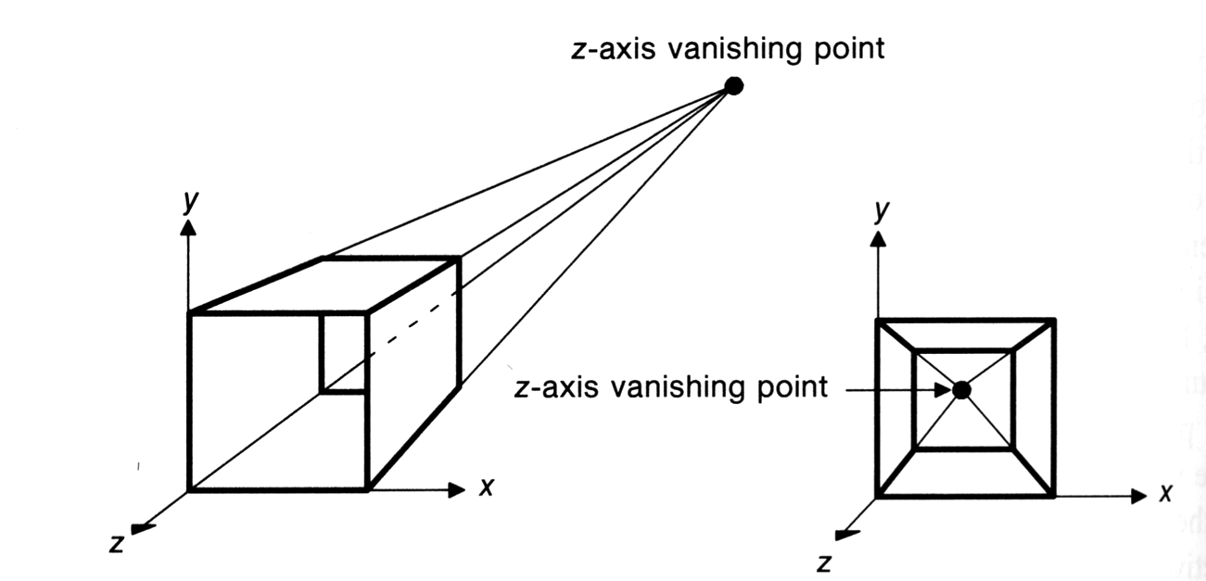
Vanishing Point
One point perspective projection of a cube
X and Y parallel lines do not converge

Slide 18

Vanishing Point

Slide 19
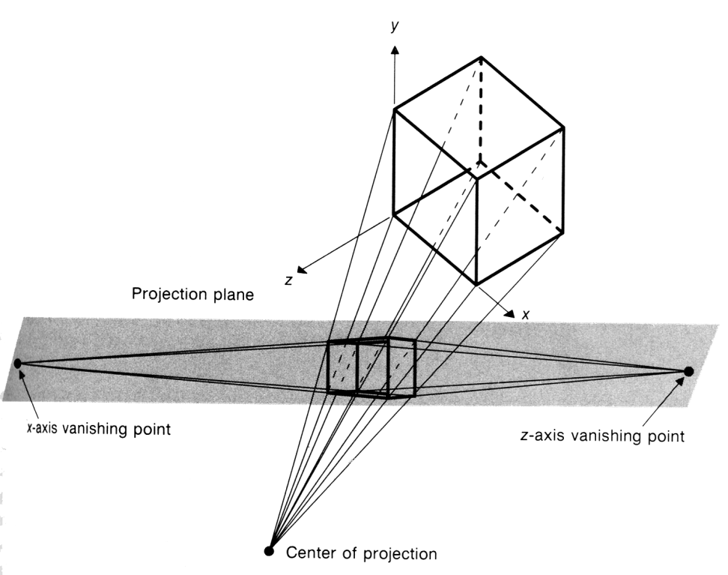
Vanishing Point
Two-point perspective projection:
This is often used in architectural, engineering and industrial design drawings.
Three-point is used less frequently as it adds little extra realism to that offered by two-point perspective projection.

Slide 20
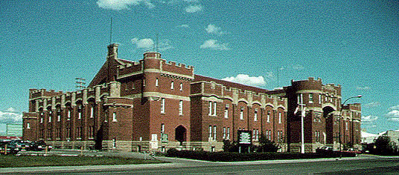
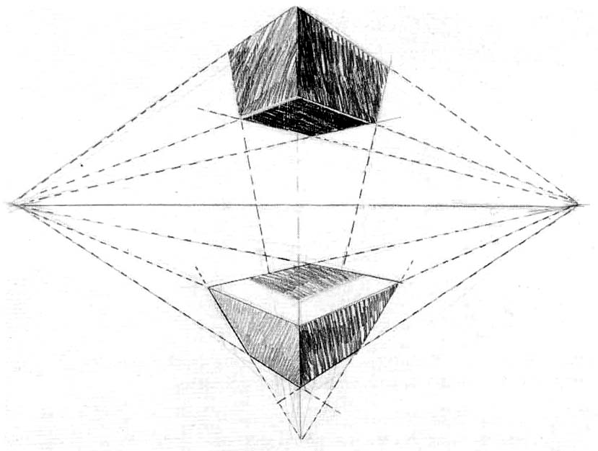
Vanishing Point
H
VPL
VPR
VP₁
VP₂
VP₃

Slide 21
Projective Transformation
Settings for perspective projection

Slide 22
Projective Transformation

Slide 23
Projective Transformation

Slide 24
Parallel projection
2 principle types:
orthographic and oblique.
Orthographic :
direction of projection = normal to the projection plane.
Oblique :
direction of projection != normal to the projection plane.

Slide 25
Orthographic projection
Orthographic (or orthogonal) projections:
front elevation, top-elevation and side-elevation.
all have projection plane perpendicular to a principle axes.
Useful because angle and distance measurements can be made...
However, As only one face of an object is shown, it can be hard to create a mental image of the object, even when several view are available

Slide 26
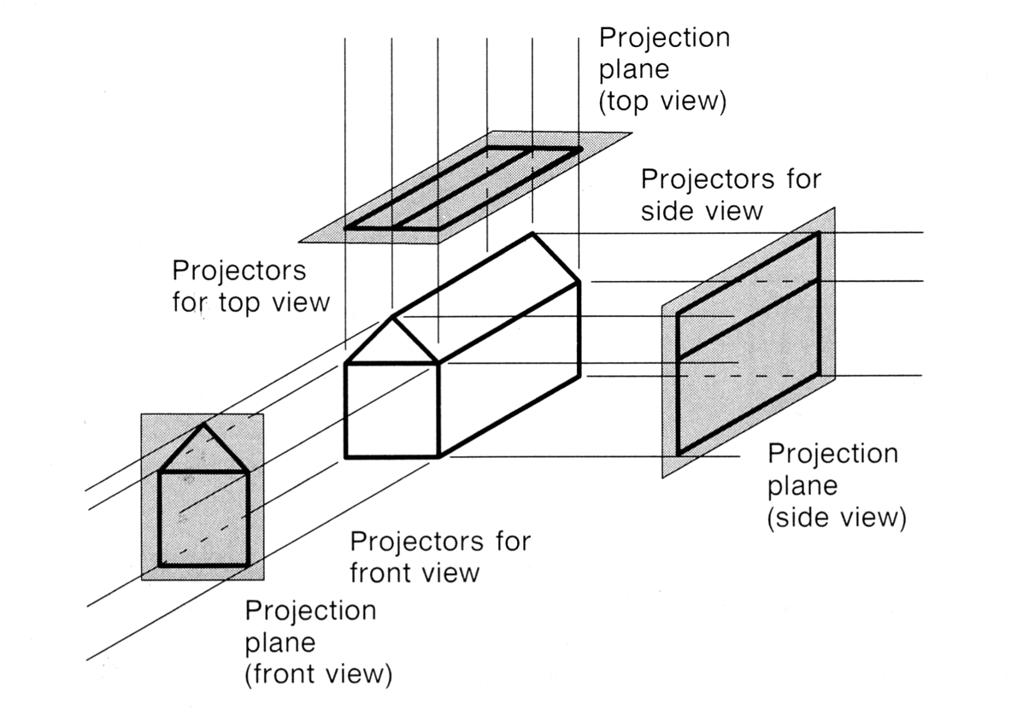
Orthographic projection

Slide 27
Orthogonal Projection Matrix

Slide 28
Axonometric projection
Axonometric Projections use projection planes that are not normal to a principal axis.On the basis of projection plane normal N = (dx, dy, dz) subclasses are:
Isometric : | dx | = | dy | = | dz | i.e. N makes equal angles with all principal axes.
Dimetric : | dx | = | dy |
Trimetric : | dx | != | dy | != | dz |

Slide 29
Axonometric vs Perspective
Axonometric projection shows several faces of an object at once like perspective projection.
But the foreshortening is uniform rather than being related to the distance from the COP.
Isometric proj
Projection Plane

Slide 30
Oblique parallel projection
Oblique parallel projections
Objects can be visualized better then with orthographic projections
Can measure distances, but not angles
* Can only measure angles for faces of objects parallel to the plane
2 common oblique parallel projections:
Cavalier and Cabinet

Slide 31
Oblique parallel projection
Projection Plane
Projector
Projection Plane Normal

Slide 32
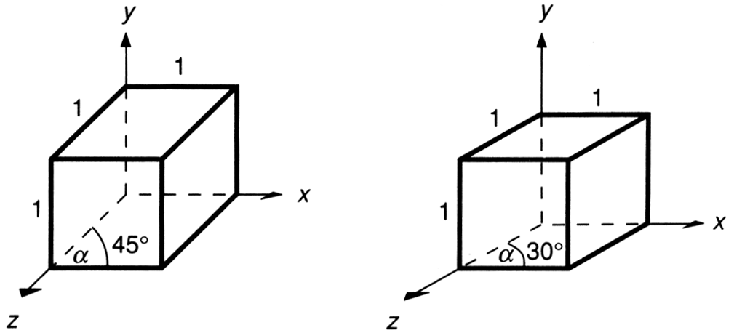
Oblique parallel projection
Cavalier:
The direction of the projection makes a 45 degree angle with the projection plane.
There is no foreshortening

Slide 33
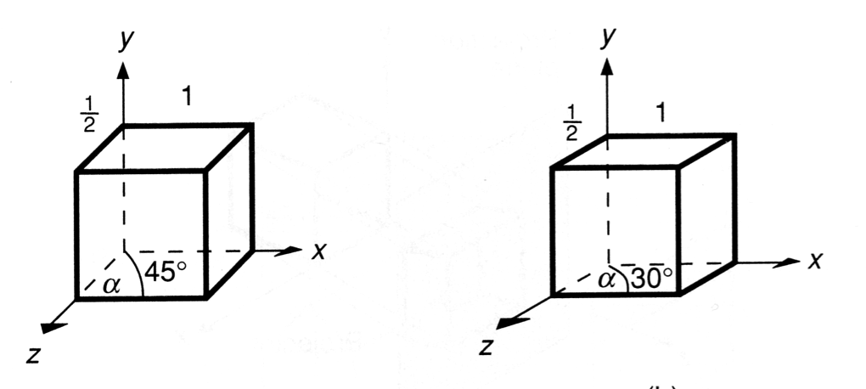
Oblique parallel projection
Cabinet:
The direction of the projection makes a 63.4 degree angle with the projection plane. This results in foreshortening of the z axis, and provides a more “realistic” view

Slide 34
Oblique parallel projection
Cavalier, cabinet and orthogonal projections can all be specified in terms of (α, β) or (α, λ) since
tan(β) = 1/λ
λ sin(α)
P׳(λ cos(α), λ sin(α),0)
β
λ
α
P=(0, 0, 1)
λ cos(α)

Slide 35
Oblique parallel projection
λ=1 | β = 45 | Cavalier projection | α = 0 - 360
λ=0.5 | β = 63.4 | Cabinet projection | α = 0 – 360
λ=0 | β = 90 | Orthogonal projection | α = 0 – 360

Slide 36
Oblique parallel projection
PP‘ = (λ cos(α), λ sin(α),-1) = DOP
Proj(P) = (λ cos(α), λ sin(α),0)
Generally
multiply by z and allow for (non-zero) x and y
x ‘ = x + z λcos α
y‘ = y + z λsin α

Slide 37
Generalized Projection Matrix

Slide 38
Generalized Projection Matrix

Slide 39
Generalized Projection Matrix

Slide 40
Generalized Projection Matrix

Slide 41
Generalized Projection Matrix

Slide 42
Taxonomy of Projection

Slide 43
OpenGL’s Perspective Specification
y field-of-view / fovy
aspect ratio
near and far clipping planes
viewing frustum
gluPerspective(fovy, aspect, near, far)
glFrustum(left, right, bottom, top, near, far)

Slide 44
Perspective without Depth
The depth information is lost as the last two components are same
But dept information of the projected points is essential for hidden surface removal and other purposes like blending, shading etc.

Slide 45
Perspective without Depth
For ß < 0, z’ is a monotonically increasing function of depth.

Slide 46
Canonical View Volume

Slide 47
Canonical View Volume
There is a reversal of the z- coordinates, in the sense that before the transformation, points further from the viewer have smaller z- coordinates

Slide 48
Perspective Matrix
The matrix to perform perspective transformation:

Slide 49
Perspective Matrix

Slide 50
Perspective Matrix

Slide 51
Perspective Matrix

Slide 52
Perspective Matrix

Slide 53
Perspective Matrix
The matrix to perform perspective transformation:

Slide 54
Taxonomy of projection

Slide 55
Generalized Projection
Using the origin as the center of projection, derive the perspective transformation onto the plane passing through the point R₀(x₀, y₀, z₀) and having the normal vector N = n₁I + n₂J + n₃K.
N = n₁I + n₂J + n₃K
R₀=x₀ ,y₀, z₀
y
P(x, y, z)
P'(x', y', z')
O
x
z

Slide 56
Generalized Projection
N = n₁I + n₂J + n₃K
P'O = α PO
x' = αx, y' = αy, z ' = αz
R₀=x₀ ,y₀, z₀
y
P(x, y, z)
N. R₀P' = 0
n₁x ' + n₂y ' + n₃z '
=n₁x₀ + n₂y₀ + n₃z₀ = d₀
P'(x', y', z')
O
x
z

Slide 57
Generalized Projection
Derive the general perspective transformation onto a plane with reference point R₀ and normal vector N and using C(a,b,c) as the center of projection.
N = n₁I + n₂J + n₃K
R₀=x₀ ,y₀, z₀
y
P(x, y, z)
C
P'(x', y', z')
x
z

Slide 58
Generalized Projection
P'C = α PC
x' = α(x-a) + a
N = n₁I + n₂J + n₃K
n₁x' + n₂y' + n₃z‘ = d₀
R₀=x₀ ,y₀, z₀
y
P(x, y, z)
d = (n₁x₀ + n₂y₀ + n₃z₀) – (n₁a + n₂b + n₃c)
= d₀ – d₁
P'(x', y', z')
C
x
z

Slide 59
Generalized Projection
Follow the steps –
Translate so that C lies at the origin
Per
Translate back

Slide 60
Generalized Projection
Find (a) the vanishing points for a given perspective transformation in the direction given by a vector U (b) principal vanishing point.
Family of parallel lines having the direction U(u₁,u₂,u₃) can be written in parametric form as
x = u₁t+p, y = u₂t+q, z = u₃t+r
here (p, q, r) is any point on the line
Let, proj(x,y,z,1) = (x‘, y‘, z‘, h)
x' = (d+an₁)(u₁t+p) + an₂(u₂t+q) + an₃(u₃t+r) – ad₀
y' = bn₁(u₁t+p) + (d+bn₂)(u₂t+q) + bn₃(u₃t+r) – bd₀
z' = cn₁(u₁t+p) + cn₂(u₂t+q) + (d+cn₃)(u₃t+r) – cd₀
h = n₁(u₁t+p) + n₂(u₂t+q) + n₃(u₃t+r) – d₁

Slide 61
Generalized Projection
The vanishing point (x_{v}, y_{v}, z_{v}) is obtained when t=α
x_{u} = (x‘/h) at t= α
= a + (du₁/k)
y_{u} = b + (du₂/k)
z_{u} = c + (du₃/k)
k = N.U = n₁u₁ + n₂u₂ + n₃u₃
If k=0 then ?
Principal vanishing point when
U = I
x_{u} = a + d / n₁, y_{u} = b, z_{u} = c,
U = J
U = k

