Slide 1
Introduction to Software Engineering
Dr. Santosh Kumar Swain
Professor
School Of Computer Engineering
KIIT DU, Bhubaneswar.
sswainfcs@kiit.ac.in

Slide 2
SE:Objective
To acquire knowledge and skills for Analysis, Design , Implementation and management of large and complex Software Systems , fulfilling requirements of quality, budget and schedule.

Slide 3
Course Outcomes
At the end of the course, the students will be able to:
Gather and specify requirements of the software projects.
Analyze software requirements and translate them to Design & development process.
Being acquainted with different testing methodologies.
Understand and apply the basic project management practices and tools in real life projects.
Work in a team as well as independently on software projects.

Slide 4
INTODUCTION to SOFTWARE ENGINEERING
The economies of ALL developed nations are
dependent on software.
More and more systems are software controlled
Software engineering is concerned with theories,
methods and tools for professional software
development.

Slide 5



Famous Software Disaster
Ariane 5 expendable launch system:
  Spacecraft launching system improved from Ariane 4.
First test flight took place on June 4, 1996.

Slide 6
Famous Software Disaster (cont)
US $5 hundred millions worth of payload destroyed.
Reason:
  Main Navigation Computer crashes after 37 seconds.
  Caused by a conversion overflow: converting floating point number to integer number.
  Reuse of specification of Ariane 4 without taking into consideration the new capability.

Slide 7
Software Crisis
It is often the case that software products:
  Fail to meet user requirements.
  Expensive.
  Difficult to alter, debug, and enhance.
  Often delivered late.
  Use resources non-optimally.
  Frequently Crash

Slide 8
Software Crisis (cont.)‏
Laptop or Desktop = Rs.45,000/-
Rational suite node locked = Rs.3,14,600/-
Rational suite floating license= Rs.6,03,200/-
Hw cost
Sw cost
1960
Year
2018
Relative Cost of Hardware and Software

Slide 9
Then why not have entirely hardware systems?...
A virtue of software:
  Relatively easy and faster to develop and to change…
  Consumes no space, weight, or power…
  Otherwise all might as well be hardware.
The more is the complexity of software, the harder it is to change--why?
  Further, the more the changes made to a program, the greater becomes its complexity.

Slide 10
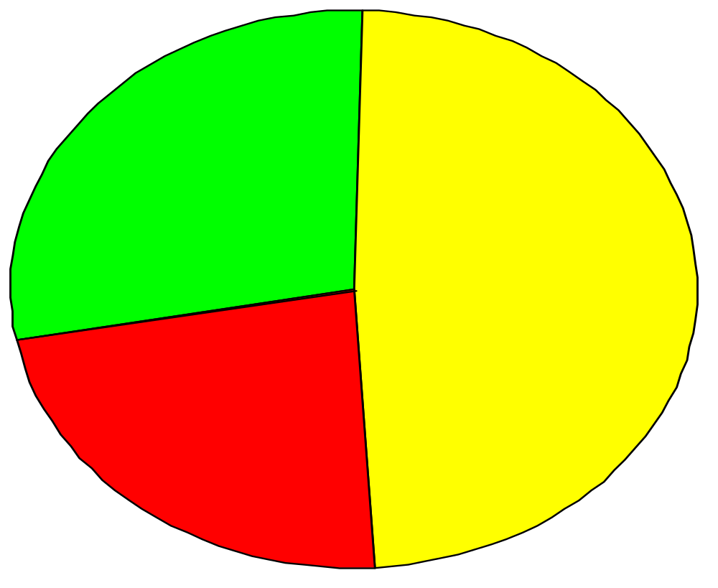
28% Successful
49% Delayed or cost overrun
23% Cancelled
Standish Group Report

Slide 11
Which Factors are Contributing to the Software Crisis?
Larger problems,
Poor project management
Lack of adequate training in software engineering,
Increasing skill shortage,
Low productivity improvements.

Slide 12
FAQS ABOUT SOFTWARE ENGINEERING
What is software?
What is software engineering?
What is the difference between software
engineering and computer science?
What is the difference between software
engineering and system engineering?
What is a software process?
What is a software process model?

Slide 13
What is Software?
More than computer programs.
The collection of programs, documentation and configuration data that ensures correct execution.
Three major types:
  Generic Product: Stand alone, Sold on open market.
  Customized Product: For specific customer.
  Embedded Product: Built into hardware.
A term used occasionally in 1950s, 1960s

Slide 14
What is Software?
1) instructions (programs) that when executed provide desired function and performance
2) data structures that enable the programs to adequately manipulate information
3) documents that describe the operation and use of the programs

Slide 15
The Nature of Software
Intangible:
  Opposite of physical artifacts, e.g., Computer vs Windows XP
  Hard to understand the development process.
Complex
Easy to Reproduce:
  Costly design and construction, cheap manufacturing.
Malleable:
  Easy to change, even without full understanding.
  Untrained people can “hack” something together.

Slide 16
What is Software?
software is engineered
software doesn’t wear out
software is custom built
software is complex

Slide 17
Failure (“Bathtub”) Curve for Hardware
Infant
mortality
Wear
out
Failure Rate
Time

Slide 18

Wear vs. Deterioration

Slide 19
Classification of software
■ System Software
■ Real-time Software
■ Business Software
■ Engineering and
Scientific Software
■ Artificial Intelligence
(AI) Software
■ Web-based Software
■ Personal Computer (PC) Software
■ Commercial Off-the-Shelf Software (COTS)
■ Customized or Bespoke Software
■ Customized COTS
■ Stand-alone software
■ Embedded software
■ Real-time software
■ Network software

Slide 20
Software Applications
■ system software
■ application software
■ engineering/scientific software
■ embedded software
■ product-line software
■ Web-Apps (Web applications)
■ AI software

Slide 21
Quality of Good Software
Accuracy
Usability
  Easy to learn and use.
Efficiency
  Does not waste resources such as CPU time and memory.
Dependability
  Reliable, secure and safe.
Maintainability
  Easily evolved (modified) to meet changing requirement.
Reusability
  Parts can be reused, with minor or no modification.
Interoperability

Slide 22

Quality of Good Software
Can be quite different based on your viewpoint:
Customer:
- Solves problems at acceptable cost (time and resource).
User:
- Easy to learn
- Efficient to use
- Get work done
Developer Manager:
- Sells more and pleases customers
- Costing less to develop and maintain
Developer:
- Easy to design and maintain

Slide 23
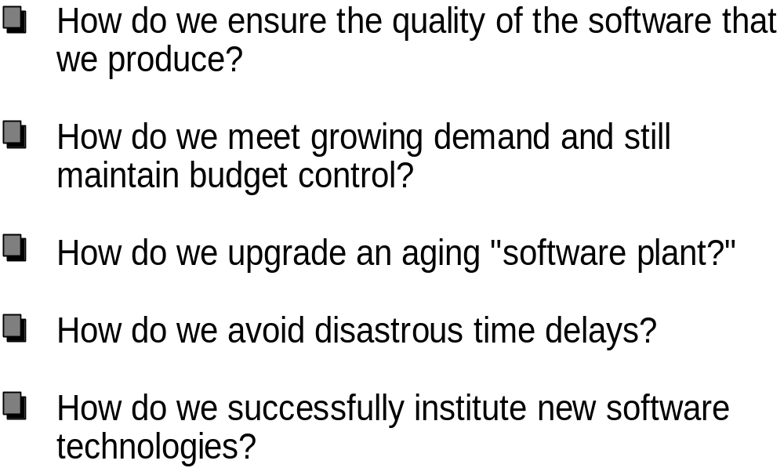
Software Poses Challenges

Slide 24
Software Development Problems
“Software is not constrained by materials, or governed by physical laws, or by manufacturing process” ---- (Sommerville, Software Engineering)
Allows almost unbounded complexity:
  Exponential growth of complexity w.r.t. to the size of a program: twice the size, four times the complexity;
  Example: Windows XP has 40millions lines of source code (estimation).

Slide 25
Software Development Problems
Difficulty in understanding and managing the complexity causes:
  Late completion:
    “vaporware” that are announced but never produced
  Overrunning Cost:
    Denver Airport Automated Baggage System, 2 billions US dollar over budget
  Unreliable
  Difficult to maintain
  Etc…

Slide 26
What is Engineering?
Systematically identify, understand, and integrate the constraints on a design to produce a successful result.
Constraints may include:
  available resources,
  physical or technical limitations,
  flexibility for future modifications and additions,
  cost, manufacturability, and serviceability.
Deduce specifications from the limits.
Ethical Practices.

Slide 27
WHAT IS SOFTWARE ENGINEERING?
􀁺 Software engineering is an engineering discipline that is concerned with all aspects of software production.
􀁺 Software engineers should adopt a systematic and organized approach to their work and use appropriate tools and techniques depending on the problem to be solved, the development constraints and the resources available.

Slide 28
IEEE Definition
“Software engineering is the application of a systematic, disciplined, quantifiable approach to the development, operation, and maintenance of software; that is, the application of engineering to software.”

Slide 29
Software Engineering
Software engineering discusses systematic and cost-effective techniques to software development. These techniques have resulted from innovations as well as lessons learnt from past mistake.
Alternatively, We can view SE as the engg. approach to develop software.
Software engineering is a
  Modelling activity
  Problem solving activity
  Knowledge acquisition activity
  Rationale-driven activity

Slide 30
Why to Study Software Engineering? (1)
■ To acquire skills to develop large programs.
■ Exponential growth in complexity and
difficulty level with size.
■ The ad hoc approach breaks down when
size of software increases:

Slide 31
Why to Study Software Engineering? (2)
■ Ability to solve complex programming
problems:
■ How to break large projects into smaller
and manageable parts?
■ Learn techniques of:
■ specification, design, interface
development, testing, project
management, etc.

Slide 32
Why to Study Software Engineering? (3)
To acquire skills to be a
better programmer:
Higher Productivity
Better Quality Programs

Slide 33


So, What is Software Engineering?
Engineering approach to develop software.
  Building Construction Analogy.
Systematic collection of past experience:
  Techniques,
  Methodologies,
  Guidelines.

Slide 34
Technology Development Pattern
Programming: an Art or Engineering?
Esoteric Past
Experience
Technology
Engineering
Craft
Systematic Use of Past
Experience and Scientific Basis
Unorganized Use of
Past Experience
Art
Time

Slide 35
Programming an Art or Engineering?
Heavy use of past experience:
  Past experience is systematically arranged.
Theoretical basis and quantitative techniques provided.
Many are just thumb rules.
Tradeoff between alternatives.
Pragmatic approach to cost-effectiveness.

Slide 36
Software Engineering Neither a form of Science Nor an Art
Make heavy use of past Experience
Several conflicting goals might have to
be optimized.
A pragmatic approach to cost effectiveness
is adopted and economics concerns are addressed
Based on well understood and quantitative principles

Slide 37
What is software Product?
Software Products are nothing but software systems delivered to the customer with the documentation that describes how to install and use the system. Software products are produced with the help of the software process. The software process is a way in which we produce software
􀁺
Computer programs and associated documentation such as requirements, design models and user manuals.
􀁺 􀁺 Software products may be
• Generic - developed to be sold to a range of different customers (general market)
e.g. PC software such as Excel or Word.
• Custom - developed for a single/particular customer according
to their specification.
􀁺 New software can be created by developing new programs, configuring generic software systems or reusing existing software.

Slide 38
Programs versus Software Products
Usually small in size
Author himself is sole user
Single developer
■
Lacks proper user
interface
Lacks proper
documentation
■
Adhoc development.
■ Large in size
Large number of users
■
Team of developers
Well-designed
interface
■
Well documented &
user-manual prepared
■
Systematic development

Slide 39
WHAT IS THE DIFFERENCE BETWEEN
SOFTWARE ENGINEERING AND COMPUTER SCIENCE?
􀁺 Computer science is concerned with theory and fundamentals; software engineering is concerned with the practicalities of developing and delivering useful software.
􀁺 Computer science theories are still insufficient to act as a complete underpinning for software engineering (unlike e.g. physics and electrical
engineering).

Slide 40
WHAT IS THE DIFFERENCE BETWEEN SOFTWARE
ENGINEERING AND SYSTEM ENGINEERING?
􀁺 System engineering is concerned with all aspects of computer-based systems development including hardware, software and process engineering. Software engineering is part of this process concerned with developing the software infrastructure, control, applications and databases in the system.
􀁺 System engineers are involved in system specification, architectural design, integration and deployment.

Slide 41
SE:A Layered Technology
Software Engineering
Software Engineering
- provide support for methods
and processes
tools
methods
- technical how tos
-glue that holds layers
together
process model
a “quality” focus
- bedrock

Slide 42
A Common Process Framework
Common process framework
  Framework activities
  Task Sets
  Umbrella Activities
    tasks
    milestones,deliverables
    SQA checkpoints

Slide 43
Umbrella Activities
Software project management (tracking and control)
Formal technical reviews
Software quality assurance
Software configuration management
Document preparation and production
Reusability management
Measurement
Risk management

Slide 44
WHAT IS A SOFTWARE PROCESS?
A set of activities whose goal is the development or evolution of software.
Generic activities in all software processes are:
• Specification - what the system should do and its development constraints
• Development - production of the software system
• Validation - checking that the software is what the
customer wants
• Evolution - changing the software in response to changing demands.

Slide 45
WHAT IS A SOFTWARE PROCESS MODEL?
A simplified representation of a software process, presented from a specific perspective.
Examples of process perspectives are
• Workflow perspective - sequence of activities;
• Data-flow perspective - information flow;
• Role/action perspective - who does what.
􀁺 Generic process models
• Waterfall;
• Iterative development;
• Component-based software engineering.

Slide 46
Types of Software Projects
Software product development projects
Software services projects

Slide 47
Why Projects Fail?
• an unrealistic deadline is established
• changing customer requirements
• an honest underestimate of effort
• predictable and/or unpredictable risks
• technical difficulties
• miscommunication among project staff
• failure in project management

Slide 48
WHAT ARE THE KEY CHALLENGES FACING
SOFTWARE ENGINEERING?
Heterogeneity, delivery and trust.
􀁺 Heterogeneity
• Developing techniques for building software that can cope with
heterogeneous platforms and execution environments;
􀁺 Delivery
• Developing techniques that lead to faster delivery of software;
􀁺 Trust
• Developing techniques that demonstrate that software can be trusted by its users.

Slide 49
What is the Implication in Program Development?
A small program having just a few variables:
  Is within easy grasp of an individual.
As the number of independent variables in the program increases:
  It quickly exceeds the grasping power of an individual…
  Requires an unduly large effort to master the problem.

Slide 50
Implication in Program Development
Instead of a human, if a machine could be writing (generating) a program,
  The slope of the curve would be linear.
But, how does use of software engineering principles helps hold down the effort-size curve to be almost linear?
  Software engineering principles extensively use techniques specifically targeted to overcome the human cognitive limitations.

Slide 51
Two Fundamental Techniques to Handle Complexity

Slide 52
Which Principles are Deployed by Software Engineering Techniques to Overcome Human Cognitive Limitations?
Two important principles are profusely used:
  Abstraction
  Decomposition

Slide 53
What is Abstraction?
Simplify a problem by omitting unnecessary details.
  Focus attention on only one aspect of the problem and ignore other aspects and irrelevant details.
  Also called model building.

Slide 54
Abstraction Example
Suppose you are asked to develop an overall understanding of some country.
  Would you:
    Meet all the citizens of the country, visit every house, and examine every tree of the country?
  You would possibly refer to various types of maps for that country only.

Slide 55
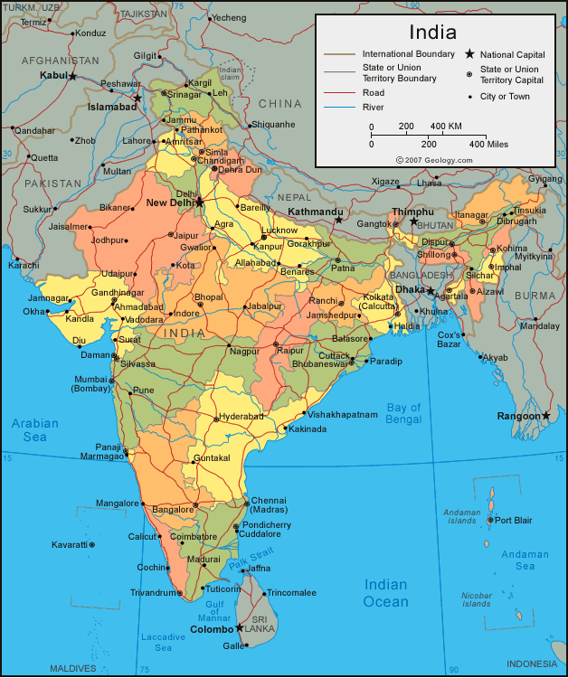
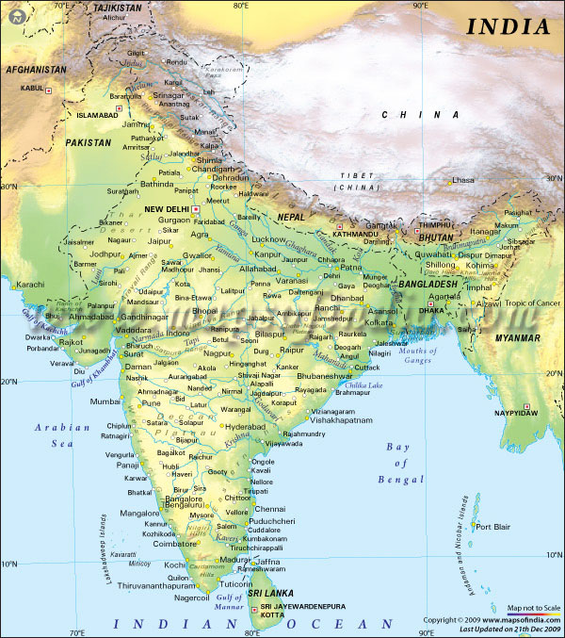
You would study an Abstraction…
A map is:
  An abstract representation of a country.
  Various types of maps (abstractions) possible.

Slide 56
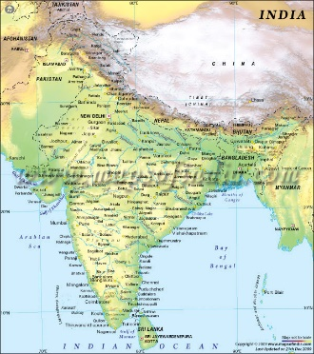
Does every Problem have a single Abstraction?
Several abstractions of the same problem can be created:
  Focus on some specific aspect and ignore the rest.
  Different types of models help understand different aspects of the problem.

Slide 57
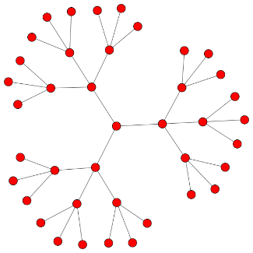
Abstractions of Complex Problems
For complex problems:
  A single level of abstraction is inadequate.
  A hierarchy of abstractions may have to be constructed.
Hierarchy of models:
  A model in one layer is an abstraction of the lower layer model.
  An implementation of the model at the higher layer.

Slide 58
Abstraction of Complex Problems -- An Example
Suppose you are asked to understand all life forms that inhabit the earth.
Would you start examining each living organism?
  You will almost never complete it.
  Also, get thoroughly confused.
Solution: Try to build an abstraction hierarchy.

Slide 59
Living Organisms
Kingdom
Animalia
Plantae
Fungae
Mollusca
Chordata
Ascomycota
Zygomycota
Phyllum
Homo Sapien
Solanum Tuberosum
Coprinus Comatus
Species

Slide 60
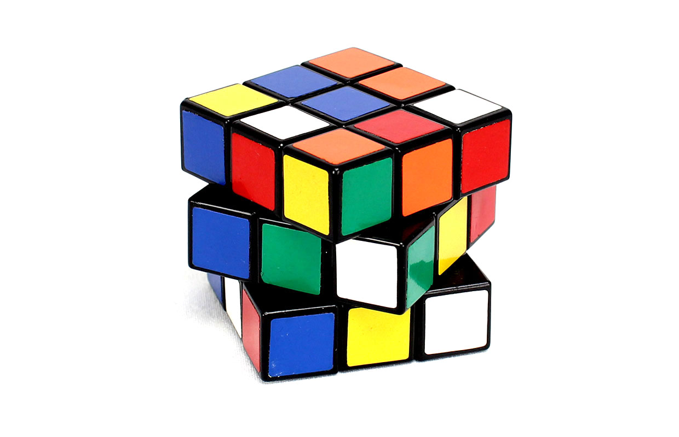
Decomposition
Decompose a problem into many small independent parts.
  The small parts are then taken up one by one and solved separately.
  The idea is that each small part would be easy to grasp and therefore can be easily solved.
  The full problem is solved when all the parts are solved.

Slide 61


Decomposition
A popular example of decomposition principle:
  Try to break a bunch of sticks tied together versus breaking them individually.
Any arbitrary decomposition of a problem may not help.
  The decomposed parts must be more or less independent of each other.

Slide 62
Decomposition: Another Example
Example use of decomposition principle:
  You understand a book better when the contents are organized into independent chapters.
  Compared to when everything is mixed up.

Slide 63
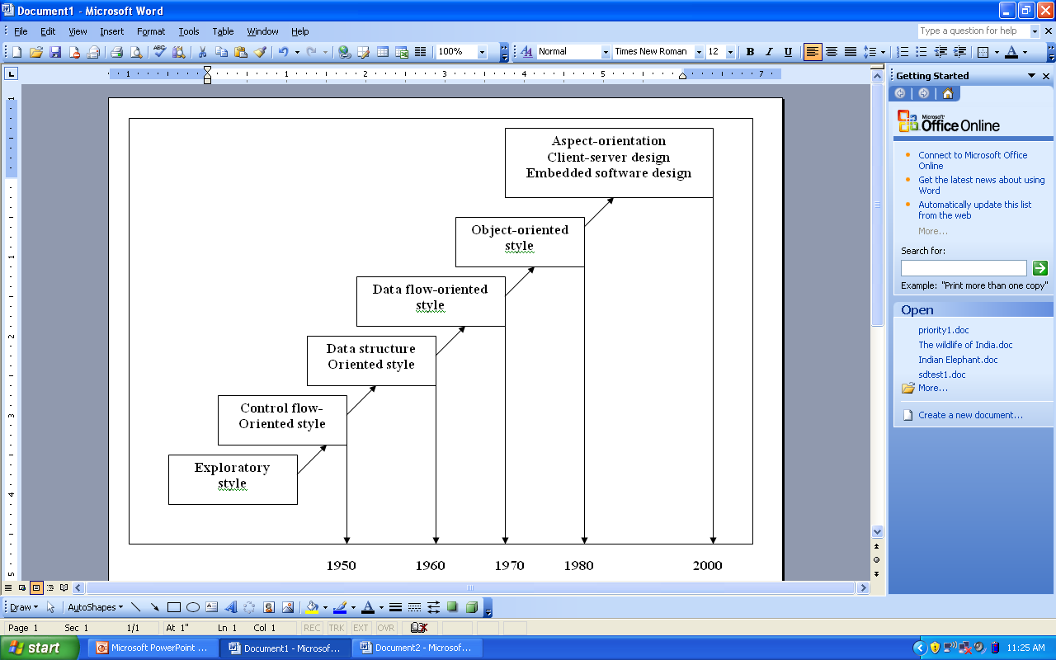
Emergence of Software Engineering
1950
1960
1970
1980
2000
2007

Slide 64
What is Exploratory Software Development?
Early programmers used exploratory (also called build and fix) style.
  A `dirty' program is quickly developed.
  The bugs are fixed as and when they are noticed.
  Similar to how a junior student develops programs…

Slide 65
Exploratory Style
Fix
Initial
Coding
Test
Do Until Done
Does not work for nontrivial projects… Why?...

Slide 66
What is Wrong with the Exploratory Style?
Can successfully be used for developing only very small (toy) programs.
Software
Engineering
Exploratory
Effort, time, cost
Machine
Program Size

Slide 67
What is Wrong with the Exploratory Style? Cont…
Besides the exponential growth of effort, cost, and time with problem size:
  Exploratory style usually results in unmaintainable code.
  It becomes very difficult to use the exploratory style in team development environments…

Slide 68
What is Wrong with the Exploratory Style? Cont…
Why does the effort required to develop a software grow exponentially with size?
Why does the approach completely breaks down when the size of software becomes large?
Software
Engineering
Effort, time, cost
Exploratory
Machine
Program Size

Slide 69
Evaluation Scheme
Exam |  | Marks
End Semester |  | 50
Internal | Mid Semester | 20
 | Activity, Assignment/Quiz | 30
Total |  | 100
Class Days: Pre Midsem: 5th July to 9th Sept 2021
Midsem Exam: 13th Sept to 17th Sept 21
Post Mid Sem: 20th Sept to 25 Nov 2021
End Sem Exam: 29th Nov to 11th Dec 2021
SE
Text Books
1. Fundamentals of Software Engineering, Rajib Mall , PHI
2. Software Engineering, A Practitioner’s Approach, Roger S. Pressman ,TMG Hill.
Reference Book
1. Software Engineering, I. Sommerville, Pearson Education, Asia.

