Slide 1
Introduction
Continued….

Slide 2
Types of Software Projects
Software product development projects
Software services projects

Slide 3

Software Services
Software service is an umbrella term, includes:
Software customization
Software maintenance
Software testing
Also contract programmers (CP) carrying out coding or any other assigned activities.
CP

Slide 4
Factors responsible for accelerated growth of services…
Now lots of code is available in a company:
New software can be developed by modifying the closest.
Speed of Conducting Business has increased tremendously:
Requires shortening of project duration

Slide 5
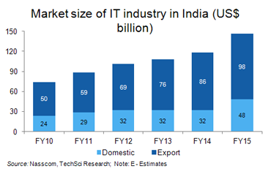
Contribution of the IT sector to India’s GDP rose to approximately 9.5% in 2015 from 1.2% in 98

Slide 6
Scenario of Indian Software Companies
Indian companies have largely focused on the services segment --- Why?

Slide 7
Few Changes in Software Project Characteristics over Last 40 Years
40 years back, very few software existed
Every project started from scratch
Projects were multi year long
The programming languages that were used earlier hardly provided any scope for reuse:
FORTRAN, PASCAL, COBOL, BASIC
No application was GUI-based:
Mostly command selection from displayed text menu items.

Slide 8
Traditional versus Modern Projects
Projects are increasingly becoming services:
Either tailor some existing software or reuse pre-built libraries.
Facilitate and accommodate client feedbacks
Facilitate customer participation in project development work
Incremental software delivery with evolving functionalities.
No software is being developed from scratch --- Significant reuse is being made…
Notes:
Rather than making a long term project completion plan, the project manager now plans all incremental deliveries with evolving functionalities. This type of project management is often called Extreme project management.

Slide 9
Computer Systems Engineering
Many products require development of software as well as specific hardware to run it:
a coffee vending machine,
a robotic toy,
A new health band product, etc.
Computer systems engineering:
encompasses software engineering.

Slide 10
Computer Systems Engineering
The high-level problem:
Deciding which tasks are to be solved by software.
Which ones by hardware.

Slide 11
Computer Systems Engineering (CONT.)
Typically, hardware and software are developed together:
Hardware simulator is used during software development.
Integration of hardware and software.
Final system testing

Slide 12
Computer Systems Engineering (CONT.)
Feasibility
Study
Requirements Analysis and Specification
Hardware Development
Hardware Software Partitioning
Software Development
Integration and Testing
Project Management

Slide 13
Emergence of Software Engineering Techniques

Slide 14
Emergence of Software Engineering Techniques
Early Computer Programming (1950s):
Programs were being written in assembly language…
Sizes limited to about a few hundreds of lines of assembly code…

Slide 15
Early Computer Programming (50s)‏
Every programmer developed his/her own style of writing programs:
According to his intuition (called exploratory or build-and-fix programming) .

Slide 16
High-Level Language Programming (Early 60s)‏
High-level languages such as FORTRAN, ALGOL, and COBOL were introduced:
This reduced software development efforts greatly.
Why reduces?

Slide 17
High-Level Language Programming (Early 60s)‏
Software development style was still exploratory.
Typical program sizes were limited to a few thousands of lines of source code.

Slide 18
Control Flow-Based Design (late 60s)‏
Size and complexity of programs increased further:
Exploratory programming style proved to be insufficient.
Programmers found:
Very difficult to write cost-effective and correct programs.

Slide 19
Control Flow-Based Design (late 60s)‏
Programmers found it very difficult:
To understand and maintain programs written by others.
To cope up with this problem, experienced programmers advised---”Pay particular attention to the design of the program's control structure.'’

Slide 20
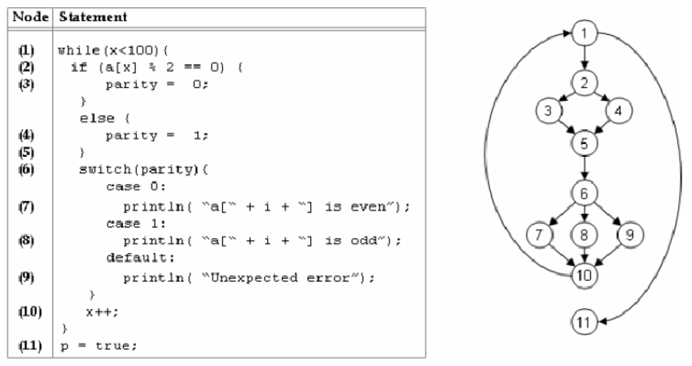
Control Flow-Based Design (late 60s)
What is a program's control structure?
Sequence in which a program's instructions are executed.
To help design programs having good control structure:
Flow charting technique was developed.

Slide 21
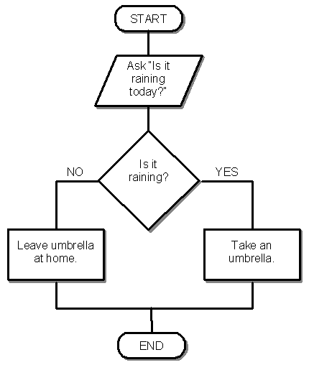
Control Flow-Based Design (late 60s)
Using flow charting technique:
One can represent and design a program's control structure.
When asked to understand a program:
One would mentally trace the program's execution sequence.

Slide 22
Control Flow-Based Design
A program having a messy flow chart representation:
Difficult to understand and debug.

Slide 23
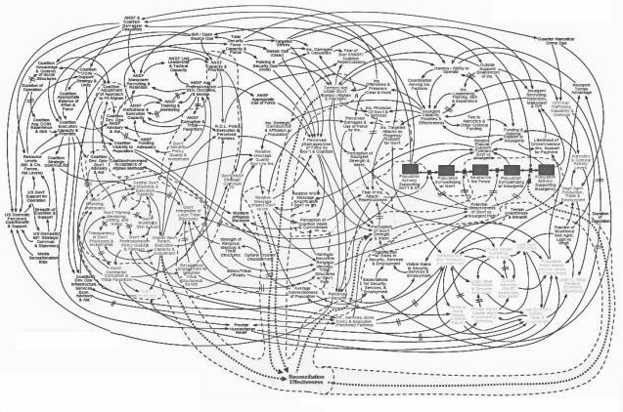
Spaghetti Code Structure

Slide 24

Control Flow-Based Design (Late 60s)‏
What causes program complexity?
GO TO statements makes control structure of a program messy.
GO TO statements alter the flow of control arbitrarily.
The need to restrict use of GO TO statements was recognized.

Slide 25
Control Flow-Based Design (Late 60s)
addi $a0, $0, 1
j next
next:
j skip1
add $a0, $a0, $a0
skip1:
j skip2
add $a0, $a0, $a0
add $a0, $a0, $a0
skip2:
j skip3
loop:
add $a0, $a0, $a0
add $a0, $a0, $a0
add $a0, $a0, $a0
skip3:
j loop
Many programmers had extensively used assembly languages.
JUMP instructions are frequently used for program branching in assembly languages.
Programmers considered use of GO TO statements inevitable.

Slide 26
Control-flow Based Design (Late 60s)‏
At that time, Dijkstra published his article:
“Goto Statement Considered Harmful” Comm. of ACM, 1969.
Many programmers were unhappy to read his article.

Slide 27
Control Flow-Based Design (Late 60s)
Some programmers published several counter articles:
Highlighted the advantages and inevitability of GO TO statements.

Slide 28
Control Flow-Based Design (Late 60s)
It soon was conclusively proved:
Only three programming constructs are sufficient to express any programming logic:
sequence (a=0;b=5;)‏
selection (if(c==true) k=5 else m=5;)‏
iteration (while(k>0) k=j-k;)‏

Slide 29
Control-flow Based Design (Late 60s)‏
Everyone accepted:
It is possible to solve any programming problem without using GO TO statements.
This formed the basis of Structured Programming methodology.

Slide 30
Structured Programming
A program is called structured:
When it uses only the following types of constructs:
sequence,
selection,
iteration
Consists of modules.

Slide 31
Structured Programs
Sometimes, violations to structured programming are permitted:
Due to practical considerations such as:
Premature loop exit (break) or for exception handling.

Slide 32
Advantages of Structured programming
Structured programs are:
Easier to read and understand,
Easier to maintain,
Require less effort and time for development.
Less buggy

Slide 33
Structured Programming
Research experience shows:
Programmers commit less number of errors:
While using structured if-then-else and do-while statements.
Compared to test-and-branch (GOTO) constructs.

Slide 34
Data Structure-Oriented Design (Early 70s)‏
As program sizes increased further, soon it was discovered:
It is important to pay more attention to the design of data structures of a program
Than to the design of its control structure.

Slide 35
Data Structure-Oriented Design (Early 70s)‏
Techniques which emphasize designing the data structure:
Derive program structure from it:
Are called data structure-oriented design techniques.

Slide 36
Data Structure Oriented Design (Early 70s)‏
An example of data structure-oriented design technique:
Jackson's Structured Programming(JSP) methodology
Developed by Michael Jackson in 1970s.

Slide 37
Data Structure Oriented Design (Early 70s)‏
JSP technique:
Program code structure should correspond to the data structure.

Slide 38
A Data Structure Oriented Design (Early 70s)‏
JSP methodology:
A program's data structures are first designed using notations for
sequence, selection, and iteration.
The data structure design is then used :
To derive the program structure.

Slide 39
Data Structure Oriented Design (Early 70s)‏
Several other data structure-oriented Methodologies also exist:
e.g., Warnier-Orr Methodology.

Slide 40
Data Flow-Oriented Design (Late 70s)
Data flow-oriented techniques advocate:
The data items input to a system must first be identified,
Processing required on the data items to produce the required outputs should be determined.

Slide 41
Data Flow-Oriented Design (Late 70s)‏
Data flow technique identifies:
Different processing stations (functions) in a system.
The items (data) that flow between processing stations.

Slide 42
Data Flow-Oriented Design (Late 70s)‏
Data flow technique is a generic technique:
Can be used to model the working of any system.
not just software systems.
A major advantage of the data flow technique is its simplicity.

Slide 43
Data Flow Model of a Car Assembly Unit
Engine Store
Door Store
Chassis with Engine
Partly Assembled Car
Fit
Engine
Fit
Wheels
Paint and
Test
Car
Fit
Doors
Assembled Car
Chassis Store
Wheel Store

Slide 44
Object-Oriented Design (80s)
Object-oriented technique:
An intuitively appealing design approach:
Natural objects (such as employees, pay-roll-register, etc.) occurring in a problem are first identified.

Slide 45
Object-Oriented Design (80s)
Relationships among objects:
Such as composition, reference, and inheritance are determined.
Each object essentially acts as
A data hiding (or data abstraction) entity.

Slide 46
Object-Oriented Design (80s)
Object-Oriented Techniques have gained wide acceptance:
Simplicity
Reuse possibilities
Lower development time and cost
More robust code
Easy maintenance

Slide 47
Thank You!!

