Slide 1
Software Development Life Cycle (SDLC)/ Software Process Models
Dr. S. K. Swain

Slide 2
Software Life Cycle
Breaks software project activities into tasks and chunks of tasks into phases, orders them….
Conceptualize
Specify
Retire
Design
Maintain
Deliver
Code
Test

Slide 3
SDLC
Normally, a lifecycle model covers the entire
lifetime of a product.
From birth of a commercial idea
to final de-installation of last release

Slide 4
Software Life Cycle Model
A software life cycle model (also called process model and at times SDLC):
  A descriptive and diagrammatic model of software life cycle…:
  Identifies all the activities undertaken during product development,
  Establishes a precedence ordering among the different activities,
  Divides life cycle into phases.

Slide 5
SDLC/Software Process Model
A (software/system) lifecycle model is a
description of the
    sequence of activities carried out in an SE
    project
    relative order of these activities.
A framework that describes/specifies the various phases/workflows of the software process, such as the requirements, analysis (specification), design, implementation, and post delivery maintenance, and the order in which they are to be carried out.

Slide 6
Life-Cycle Model
It specifies the various phases/workflows of the software process, such as the requirements, analysis (specification), design, implementation, and post delivery maintenance, and the order in which they are to be carried out.

Slide 7
Phase Entry and Exit Criteria
A life cycle model:
  defines entry and exit criteria for every phase.
A phase can start:
  Only if its phase-entry criteria have been satisfied.
A phase is considered to be complete:
    only when all its exit criteria are satisfied.

Slide 8

Milestones
Setting milestones makes it easier to manage software projects:
  Helps to track the progress of the project accurately.
  Phase entry and exit are important milestones.

Slide 9
Why Model Life Cycle?
A documented model:
  Helps common understanding of activities among the software developers.
  Helps to identify inconsistencies, redundancies, and omissions in the development process.
  Helps in tailoring a process model for specific projects.

Slide 10
Life Cycle Model (CONT.)
When a program is developed by a single programmer ---
  The problem is within the grasp of an individual.
  He has the freedom to decide his exact steps and still succeed --- called Exploratory model--- One can use it in many ways
  Code➔Test ➔Design
  Code➔Design ➔Test ➔ Change Code ➔
  Specify ➔code ➔Design ➔Test ➔ etc.
Fix
Initial
Coding
Test
Do Until Done

Slide 11
Life Cycle Model (CONT.)‏
A software project will never succeed if:
  one engineer starts writing code,
  another concentrates on writing the test document first,
  yet another engineer first defines the file structure
  another defines the I/O for his portion first.

Slide 12
Life Cycle Model (CONT.)‏
When software is being developed by a team:
  There must be a precise understanding among team members as to when to do what,
  Otherwise, it would lead to chaos and project failure.

Slide 13
Life Cycle Model (CONT.)‏
The project manager must identify a suitable life cycle model:
  Make the project team to adhere to it.
  Primary advantage of adhering to a life cycle model:
    Helps development of software in a systematic and disciplined manner.

Slide 14
Life Cycle and Project Management
When a life cycle model is followed:
  The project manager can at any time fairly accurately tell,
    At which stage (e.g., design, code, test, etc.) the project is.

Slide 15
Project Management Without Life Cycle Model
It becomes very difficult to track the progress of the project.
  The project manager would have to depend on the guesses of the team members.
This usually leads to a problem:
  known as the 99% complete syndrome.

Slide 16
Project Deliverables: Myth and Reality
Myth:
The only deliverable for a successful project is the working program.
Reality:
Documentation of all aspects of software development are needed to help in operation and maintenance.

Slide 17
Life Cycle Model (CONT.)‏
Many life cycle models have been proposed.
We confine our attention to a few important and commonly used models.
  Waterfall
  V model,
  Evolutionary,
  Prototyping
  Spiral model, and
  Agile models
Traditional Process models

Slide 18
Software Life Cycle
Software life cycle (or software process):
  Series of identifiable stages that a software product undergoes during its life time:
    Feasibility study
    Requirements analysis and specification,
    Design,
    Coding,
    Testing
    Maintenance.

Slide 19
Classical Waterfall Model
Classical waterfall model divides life cycle into following phases:
  Feasibility study,
  Requirements analysis and specification,
  Design,
  Coding and unit testing,
  Integration and system testing,
  Maintenance.
Conceptualize
Retire
Specify
Design
Maintain
Deliver
Code
Test

Slide 20
Classical Waterfall Model
Feasibility Study
Simplest and most intuitive
Req. Analysis
Design
Coding
Testing
Maintenance

Slide 21
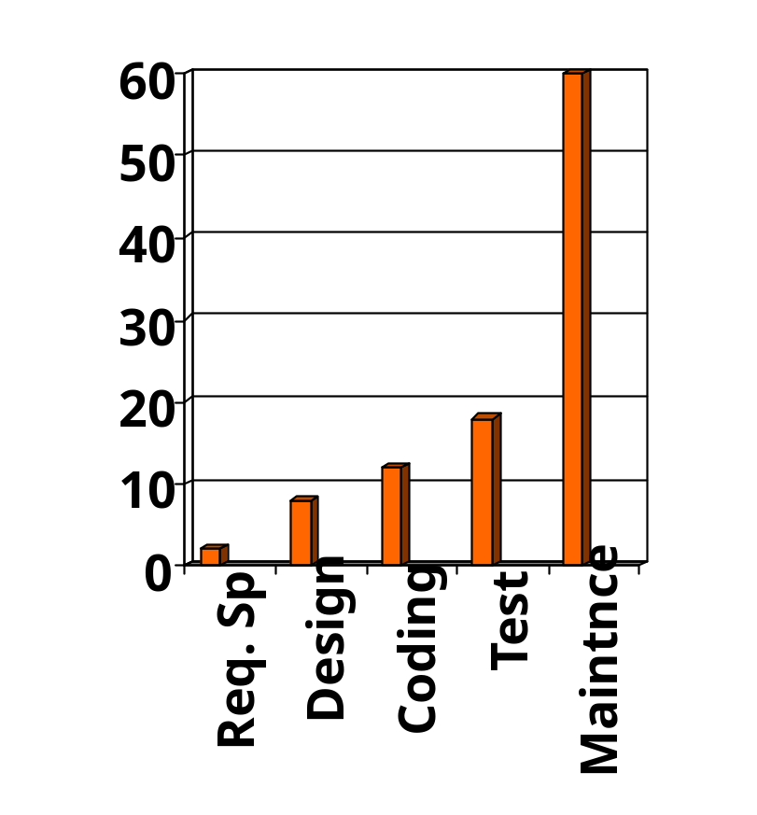
Relative Effort for Phases
Phases between feasibility study and testing
  known as development phases.
Among all life cycle phases
  maintenance phase consumes maximum effort.
Among development phases,
  testing phase consumes the maximum effort.
Relative Effort

Slide 22
Classical Waterfall Model (CONT.)
Most organizations usually define:
  standards on the outputs (deliverables) produced at the end of every phase
  entry and exit criteria for every phase.
They also prescribe specific methodologies for:
  specification,
  design,
  testing,
  project management, etc.

Slide 23
Feasibility Study
Main aim of feasibility study:determine whether developing the product
  financially worthwhile
  technically feasible.
  Behavioural feasibility
First roughly understand what the customer wants:
  different data which would be input to the system,
  processing needed on these data,
  output data to be produced by the system,
  various constraints on the behavior of the system.

Slide 24
Feasibility Study
Economic feasibility (also called cost/benefit feasibility)
Feasibility
Dimensions
Technical feasibility
Schedule feasibility

Slide 25
Activities During Feasibility Study
Work out an overall understanding of the problem.
Formulate different solution strategies.
Examine alternate solution strategies in terms of:
    resources required,
    cost of development, and
    development time.

Slide 26
Activities during Feasibility Study
Perform a cost/benefit analysis:
  to determine which solution is the best.
  you may determine that none of the solutions is feasible due to:
    high cost,
    resource constraints,
    technical reasons.

Slide 27
Cost benefit analysis (CBA)
Need to identify all costs --- these could be:
  Development costs
  Set-up
  Operational costs
Identify the value of benefits
Check benefits are greater than costs

Slide 28
The business case
Benefits of delivered project must outweigh costs
Costs include:
  Development
  Operation
Benefits:
  Quantifiable
  Non-quantifiable
Benefits
Rs
Costs
Rs

Slide 29
The business case
Feasibility studies should help write a ‘business case’
Should provide a justification for starting the project
Should show that the benefits of the project will exceed:
  Various costs
Needs to take account of business risks

Slide 30
Writing an Effective Business Case
Executive summary
Project background:
  The focus must be on what, exactly, the project is undertaking, and should not be confused with what might be a bigger picture.
Business opportunity
  What difference will it make?
  What if we don’t do it?
Costs
  Should include the cost of development, implementation, training, change management, and operations.
Benefits
  Benefits usually presented in terms of revenue generation and cost reductions.
Risks
  Identify risks.
  Explain how these will be managed.

Slide 31
Classical Waterfall Model
Feasibility Study
Req. Analysis
Design
Coding
Testing
Maintenance

Slide 32
Requirements Analysis and Specification
Aim of this phase:
  understand the exact requirements of the customer,
  document them properly.
Consists of three distinct activities:
  requirements gathering
  requirements analysis
  requirements specification.

Slide 33
Goals of Requirements Analysis
Collect all related data from the customer:
  analyze the collected data to clearly understand what the customer wants,
  find out any inconsistencies and incompleteness in the requirements,
  resolve all inconsistencies and incompleteness.

Slide 34
Requirements Gathering
Gathering relevant data:
  usually collected from the end-users through interviews and discussions.
  For example, for a business accounting software:
    interview all the accountants of the organization to find out their requirements.

Slide 35
Requirements Analysis (CONT.)
The data you initially collect from the users:
  would usually contain several contradictions and ambiguities:
  each user typically has only a partial and incomplete view of the system.

Slide 36
Requirements Analysis (CONT.)
Ambiguities and contradictions:
  must be identified
  resolved by discussions with the customers.
Next, requirements are organized:
  into a Software Requirements Specification (SRS) document.

Slide 37
Classical Waterfall Model
Feasibility Study
Req. Analysis
Design
Design
Coding
Testing
Maintenance

Slide 38
Design
During design phase, requirements specification is transformed into :
  A form suitable for implementation in some programming language.
Two commonly used design approaches:
  Traditional approach,
  Object oriented approach

Slide 39
Traditional Design Approach
Consists of two activities:
  Structured analysis (typically carried out by using DFD)
  Structured design

Slide 40
Structured Analysis Activity
Identify all the functions to be performed.
Identify data flow among the functions.
Decompose each function recursively into sub-functions.
  Identify data flow among the subfunctions as well.

Slide 41
Structured Analysis (CONT.)
Carried out using Data flow diagrams (DFDs).
After structured analysis, carry out structured design:
  architectural design (or high-level design)
  detailed design (or low-level design).

Slide 42
Structured Design
High-level design:
  decompose the system into modules,
  represent invocation relationships among modules.
Detailed design:
  different modules designed in greater detail:
    data structures and algorithms for each module are designed.
root
order
query
indent
Handle-order
Handle-indent
Handle-query
Accept-order
Process-order
Get-order

Slide 43
Object Oriented Design
First identify various objects (real world entities) occurring in the problem:
  identify the relationships among the objects.
  For example, the objects in a pay-roll software may be:
    employees,
    managers,
    pay-roll register,
    Departments, etc.

Slide 44
Object Oriented Design (CONT.)
Object structure
  further refined to obtain the detailed design.
OOD has several advantages:
  lower development effort,
  lower development time,
  better maintainability.

Slide 45
Classical Waterfall Model
Feasibility Study
Req. Analysis
Design
Coding
Coding
Testing
Maintenance

Slide 46
Coding and Unit Testing
During this phase:
  Each module of the design is coded,
  Each module is unit tested
    That is, tested independently as a stand alone unit, and debugged.
  Each module is documented.

Slide 47
Unit Testing
The purpose of unit testing:
  test if individual modules work correctly.
The end product of implementation phase:
  a set of program modules that have been tested individually.

Slide 48
Classical Waterfall Model
Feasibility Study
Req. Analysis
Design
Coding
Testing
Testing
Maintenance

Slide 49
Integration and System Testing
Different modules are integrated in a planned manner:
  Modules are usually integrated through a number of steps.
During each integration step,
  the partially integrated system is tested.
M1
M2
M5
M7
M3
M4
M6
M8

Slide 50
System Testing
After all the modules have been successfully integrated and tested:
  System testing is carried out.
Goal of system testing:
  Ensure that the developed system functions according to its requirements as specified in the SRS document.

Slide 51
Classical Waterfall Model
Feasibility Study
Req. Analysis
Design
Coding
Testing
Maintenance
Maintenance

Slide 52
Maintenance
Maintenance of any software product:
  requires much more effort than the effort to develop the product itself.
  development effort to maintenance effort is typically 40:60.

Slide 53
Maintenance (CONT.)
Corrective maintenance:
  Correct errors which were not discovered during the product development phases.
Perfective maintenance:
  Improve implementation of the system
  enhance functionalities of the system.
Adaptive maintenance:
  Port software to a new environment,
    e.g. to a new computer or to a new operating system.

Slide 54
Waterfall Strengths
Easy to understand, easy to use, especially by inexperienced staff
Milestones are well understood by the team
Provides requirements stability during development
Facilitates strong management control (plan, staff, track)

Slide 55
Waterfall Deficiencies
All requirements must be known upfront – in most projects requirement change occurs after project start
Can give a false impression of progress
Integration is one big bang at the end
Little opportunity for customer to pre-view the system.

Slide 56
When to use the Waterfall Model?
Requirements are well known and stable
Technology is understood
Development team have experience with similar projects

Slide 57
Iterative Waterfall Model
Classical waterfall model is idealistic:
  Assumes that no defect is introduced during any development activity.
  In practice:
    Defects do get introduced in almost every phase of the life cycle.

Slide 58
Iterative Waterfall Model (CONT.)‏
Defects usually get detected much later in the life cycle:
  For example, a design defect might go unnoticed till the coding or testing phase.
  The later the phase in which the defect gets detected, the more expensive is its removal --- why?

Slide 59
Iterative Waterfall Model (CONT.)‏
Once a defect is detected:
  The phase in which it occurred needs to be reworked.
  Redo some of the work done during that and all subsequent phases.
Therefore need feedback paths in the classical waterfall model.

Slide 60
Iterative Waterfall Model (CONT.)‏
Feasibility Study
Req. Analysis
Design
Coding
Testing
Maintenance

Slide 61
Phase Containment of Errors (Cont...)‏
Errors should be detected:
  In the same phase in which they are introduced.
For example:
  If a design problem is detected in the design phase itself,
    The problem can be taken care of much more easily
    Than say if it is identified at the end of the integration and system testing phase.

Slide 62
Phase Containment of Errors
Reason: rework must be carried out not only to the design but also to code and test phases.
The principle of detecting errors as close to its point of introduction as possible:
  is known as phase containment of errors.
Iterative waterfall model is by far the most widely used model.
  Almost every other model is derived from the waterfall model.

Slide 63
Phase containment of errors
Reason: rework must be carried out not only to the design but also to code and test phases.
The principle of detecting errors as close to its point of introduction as possible:
  is known as phase containment of errors.
Iterative waterfall model is by far the most widely used model.
  Almost every other model is derived from the waterfall model.

Slide 64
Classical Waterfall Model (CONT.)
Irrespective of the life cycle model actually followed:
  the documents should reflect a classical waterfall model of development,
  comprehension of the documents is facilitated.

Slide 65
Classical Waterfall Model (CONT.)
Metaphor of mathematical theorem proving:
  A mathematician presents a proof as a single chain of deductions,
    even though the proof might have come from a convoluted set of partial attempts, blind alleys and backtracks.

Slide 66
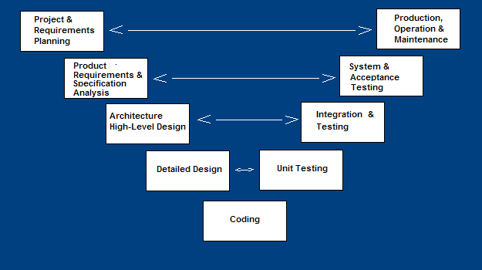
V-Shaped SDLC Model
A variant of the Waterfall that emphasizes the verification and validation of the product.
Testing of the product is planned in parallel with a corresponding phase of development

Slide 67
V Model Steps
Planning
Requirements Analysis and Specification
High-level Design
Detailed Design
System test design
Integration Test design
Unit test design

Slide 68
V-Shaped Steps
Project and Requirements Planning – allocate resources
Product Requirements and Specification Analysis – complete specification of the software system
Architecture or High-Level Design – defines how software functions fulfill the design
Detailed Design – develop algorithms for each architectural component
Production, operation and maintenance – provide for enhancement and corrections
System and acceptance testing – check the entire software system in its environment
Integration and Testing – check that modules interconnect correctly
Unit testing – check that each module acts as expected
Coding – transform algorithms into software

Slide 69
V Model: Strengths
Starting from early stages of software development:
  Emphasizes planning for verification and validation of the software
Each deliverable is made testable
Easy to use

Slide 70
V Model Weaknesses
Does not support overlapping of phases
Does not handle iterations or phases
Does not easily accommodate later changes to requirements
Does not provide support for effective risk handling
Project Planning
Production,
Operation &
Maintenance
Requirements
Specification
System Testing
High Level Design
Integration Testing
Detailed Design
Unit testing
Coding

Slide 71
When to use V Model
Natural choice for systems requiring high reliability:
  Embedded control applications, safety-critical software
All requirements are known up-front
Solution and technology are known

Slide 72
Major difficulties of Waterfall-Based Models
Difficulty in accommodating change requests during development.
  40% of the requirements change during development
High cost incurred in developing custom applications.
“Heavy weight processes.”

Slide 73
Major difficulties of Waterfall-Based Life Cycle Models
Requirements for the system are determined at the start:
  Are assumed to be fixed from that point on.
  Long term planning is made based on this.

Slide 74
Prototyping Model
A derivative of waterfall model.
Before starting actual development,
  A working prototype of the system should first be built.
A prototype is a toy implementation of a system:
  Limited functional capabilities,
  Low reliability,
  Inefficient performance.
Prototype Construction
Design
Coding
Testing
Maintenance

Slide 75
Prototyping Model ‏
Start with approximate requirements.
Carry out a quick design.
Prototype is built using several short-cuts:
  Short-cuts might involve:
    Using inefficient, inaccurate, or dummy functions.
    A table look-up rather than performing the actual computations.
Prototype Construction
Design
Coding
Testing
Maintenance

Slide 76
Prototyping Model (CONT.)‏
Build Prototype
Requirements
Gathering
Customer Evaluation of Prototype
Customer
satisfied
Quick Design
Design
Refine Requirements
Implement
Test
Maintain

Slide 77
Prototyping Model (CONT.)‏
The developed prototype is submitted to the customer for his evaluation:
  Based on the user feedback, the prototype is refined.
  This cycle continues until the user approves the prototype.
The actual system is developed using the waterfall model.
Build Prototype
Requirements
Gathering
Customer Evaluation of Prototype
Customer
satisfied
Quick Design
Design
Refine Requirements
Implement
Test
Maintain

Slide 78
Prototyping Model (CONT.)‏
Requirements analysis and specification phase becomes redundant:
  Final working prototype (incorporating all user feedbacks) serves as an animated requirements specification.
Design and code for the prototype is usually thrown away:
  However, experience gathered from developing the prototype helps a great deal while developing the actual software.
Prototype Construction
Design
Coding
Testing
Maintenance

Slide 79
Prototyping Model (CONT.)‏
Even though construction of a working prototype model involves additional cost --- overall development cost usually lower for:
  Systems with unclear user requirements,
  Systems with unresolved technical issues.
Many user requirements get properly defined and technical issues get resolved:
  These would have appeared later as change requests and resulted in incurring massive redesign costs.

Slide 80
Reasons for prototyping
Learning by doing: useful where requirements are only partially known
Improved communication
Improved user involvement
Reduced need for documentation
Reduced maintenance costs
Prototype Construction
Design
Coding
Testing
Maintenance

Slide 81
Reasons for Developing a Prototype
Illustrate to the customer:
  input data formats, messages, reports, or interactive dialogs.
Examine technical issues associated with product development:
  Often major design decisions depend on issues like:
    Response time of a hardware controller,
    Efficiency of a sorting algorithm, etc.

Slide 82
Prototyping Model (CONT.)‏
Another reason for developing a prototype:
  It is impossible to “get it right” the first time,
  We must plan to throw away the first version:
    If we want to develop a good software.

Slide 83
Prototyping: advantages
The resulting software is usually more usable
User needs are better accommodated
The design is of higher quality
The resulting software is easier to maintain
Overall, the development incurs less cost

Slide 84
Prototyping: disadvantages
For some projects, it is expensive
Susceptible to over-engineering:
  Designers start to incorporate sophistications that they could not incorporate in the prototype.

Slide 85
When to use
Requirements are unstable or have to be clarified
As the requirements clarification stage of a waterfall model
Develop user interfaces
Short-lived demonstrations
New, original development
With the analysis and design portions of object-oriented development.

Slide 86
Incremental and Iterative Development (IID)
Key characteristics
  Builds system incrementally
  Consists of a planned number of iterations
  Each iteration produces a working program
Benefits
  Facilitates and manages changes
Foundation of agile techniques and the basis for
  Rational Unified Process (RUP)
  Extreme Programming (XP)

Slide 87
Customer’s Perspective‏
C
A
A
A
B
B
B

Slide 88
Incremental Model
Waterfall: single release
Iterative: many releases (increments)
  First increment: core functionality
  Successive increments: add/fix functionality
  Final increment: the complete product
Each iteration: a short mini-project with a separate lifecycle
  e.g., waterfall

Slide 89
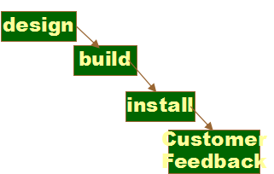
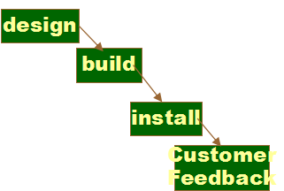
Incremental delivery
increment
1
increment
2
increment
3

Slide 90
Incremental process
Planned
incremental
delivery
Identify System Objectives
Plan increments
Incremental delivery plan
Design increment
Build the increment
Feedback
Repeat for each increment
Implement the increment
Evaluate the results

Slide 91
Evolutionary Model
Evolutionary model (aka successive versions or incremental model):
  The system is broken down into several modules which can be incrementally implemented and delivered.
First develop the core modules of the system.
The initial product skeleton is refined into increasing levels of capability:
  by adding new functionalities in successive versions.

Slide 92
Evolutionary Model (CONT.)
C
A
A
A
B
B

Slide 93
Evolutionary Model
Evolves an initial implementation with user feedback:
  Multiple versions until the final version.
Initial
version
Specification
Initial Rough
Requirements
Intermediate
versions
Development
Final
version
Validation

Slide 94
Advantages of Evolutionary Model
Users get a chance to experiment with a partially developed system:
  Much before the full working version is released,
Helps finding exact user requirements:
  Software more likely to meet exact user requirements.
Core modules get tested thoroughly:
  Reduces chances of errors in final delivered software.

Slide 95
Advantages of evolutionary model
Better management of complexity by developing one increment at a time.
Better management of changing requirements.
Can get customer feedback and incorporate them much more efficiently:
  As compared when customer feedbacks come only after the development work is complete.

Slide 96
Disadvantages of Evolutionary Model
Often, difficult to subdivide problems into functional units:
  which can be incrementally implemented and delivered.
  evolutionary model is useful for very large problems,
    where it is easier to find modules for incremental implementation.

Slide 97
Evolutionary Model with Iterations

Slide 98
Evolutionary Model with Iteration
Many organizations use a combination of iterative and incremental development:
  a new release may include new functionality
  existing functionality from the current release may also have been modified.

Slide 99
An Evolutionary and Iterative Development Process...
Recognizes the reality of changing requirements
  Capers Jones’s research on 8000 projects: 40% of final requirements arrived after development had already begun
Promotes early risk mitigation:
  Breaks down the system into mini-projects and focuses on the riskier issues first.
  “plan a little, design a little, and code a little”
Encourages all development participants to be involved earlier on,:
  End users, Testers, integrators, and technical writers

Slide 100
Activities in an Iteration
Software developed over several “mini waterfalls”.
The result of a single iteration:
  Ends with delivery of some tangible code
  An incremental improvement to the software --- leads to evolutionary development

Slide 101
Evolutionary Model with Iteration
Outcome of each iteration: tested, integrated, executable system
Iteration length is short and fixed
  Usually between 2 and 6 weeks
  Development takes many iterations (for example: 10-15)
Does not “freeze” requirements and then conservatively design :
  Opportunity exists to modify requirements as well as the design…

Slide 102
Evolutionary Model with iteration
Several advantages:
  Training can start on an earlier release
    customer feedback taken into account
  Markets can be created:
    for functionality that has never been offered.
  Frequent releases allow developers to fix unanticipated problems quickly.

Slide 103
Evolutionary Model: Problems
The process is intangible:
  No regular, well-defined deliverables.
The process is unpredictable:
  Hard to manage, e.g., scheduling, workforce allocation, etc.
Systems are rather poorly structured:
  Continual, unpredictable changes tend to degrade the software structure.
Systems may not even converge to a final version.

Slide 104
RAD Model

Slide 105
Rapid Application Development (RAD) Model
Sometimes referred to as the rapid prototyping model.
Major aims:
  Decrease the time taken and the cost incurred to develop software systems.
  Facilitate accommodating change requests as early as possible:
    Before large investments have been made in development and testing.

Slide 106
Important Underlying Principle
A way to reduce development time and cost, and yet have flexibility to incorporate changes:
  Make only short term plans and make heavy reuse of existing code.

Slide 107
Rapid Application Model (RAD)
Requirements planning phase (a workshop utilizing structured discussion of business problems)
User description phase – automated tools capture information from users
Construction phase – productivity tools, such as code generators, screen generators, etc. inside a time-box. (“Do until done”)
Cutover phase -- installation of the system, user acceptance testing and user training

Slide 108
Methodology
Plans are made for one increment at a time.
  The time planned for each iteration is called a time box.
Each iteration (increment):
  Enhances the implemented functionality of the application a little.

Slide 109
Methodology
During each iteration,
  A quick-and-dirty prototype-style software for some selected functionality is developed.
  The customer evaluates the prototype and gives his feedback.
  The prototype is refined based on the customer feedback.

Slide 110
How Does RAD Facilitate Faster Development?
RAD achieves fast creation of working prototypes.
  Through use of specialized tools.
These specialized tools usually support the following features:
  Visual style of development.
  Use of reusable components.
  Use of standard APIs (Application Program Interfaces).

Slide 111
RAD Strengths
Reduced cycle time and improved productivity with fewer people means lower costs
Time-box approach mitigates cost and schedule risk
Customer involved throughout the complete cycle minimizes risk of not achieving customer satisfaction and business needs
Focus moves from documentation to code (WYSIWYG).
Uses modeling concepts to capture information about business, data, and processes.

Slide 112
For which Applications is RAD Suitable?
Customized product developed for one or two customers only
Performance and reliability are not critical.
The system can be split into several independent modules.

Slide 113
Prototyping versus RAD
In prototyping model:
    The developed prototype is primarily used to gain insights into the solution
    Choose between alternatives
    Elicit customer feedback.
  The developed prototype:
    Usually thrown away.

Slide 114
Prototyping versus RAD
In contrast:
  In RAD the developed prototype evolves into deliverable software.
RAD leads to faster development compared to traditional models:
  However, the quality and reliability would possibly be poorer.

Slide 115
RAD versus Iterative Waterfall Model
In the iterative waterfall model,
  All product functionalities are developed together.
In the RAD model on the other hand,
  Product functionalities are developed incrementally through heavy code and design reuse.
  Customer feedback is obtained on the developed prototype after each iteration:
    Based on this the prototype is refined.

Slide 116
RAD versus Iterative Waterfall Model
The iterative waterfall model:
  Does not facilitate accommodating requirement change requests.
Iterative waterfall model does have some important advantages:
  Use of the iterative waterfall model leads to production of good documentation.
  Also, the developed software usually has better quality and reliability than that developed using RAD.

Slide 117
RAD versus Evolutionary Model
Incremental development:
  Occurs in both evolutionary and RAD models.
However, in RAD:
  Each increment is a quick and dirty prototype,
  Whereas in the evolutionary model each increment is systematically developed using the iterative waterfall model.
Also, RAD develops software in shorter increments:
  The incremental functionalities are fairly large in the evolutionary model.

Slide 118
Spiral Model
Proposed by Boehm in 1988.
Appears like a spiral with many loops.
Each loop of the spiral represents a phase of the software process:
  the innermost loop might be concerned with system feasibility,
  the next loop with system requirements definition,
  the next one with system design, and so on.
The exact number of loops (phases) in the spiral is not fixed.

Slide 119
Spiral Model (CONT.)
The team must decide:
  how to structure the project into phases.
Start work using some generic model:
  add extra phases
    for specific projects or when problems are identified during a project.
Each loop in the spiral is split into four sectors (quadrants).

Slide 120
Spiral Model (CONT.)
Determine Objectives, alternatives and constraints
Evaluate altrn. Identify & Resolve Risks
Review and Plan for the next Phase
Develop, verify Next Level of Product

Slide 121
Spiral Model
  The main focus of this model is identification and resolution of Risks (product, project and process Risks)
  Risk:
    any adverse circumstance that might hamper successful completion of a software project.

Slide 122
Spiral Model as a meta model
Subsumes all discussed models:
  a single loop spiral represents waterfall model.
  uses an evolutionary approach --
    iterations through the spiral are evolutionary levels.
  enables understanding and reacting to risks during each iteration along the spiral.
  uses:
    prototyping as a risk reduction mechanism
    retains the step-wise approach of the waterfall model.

Slide 123
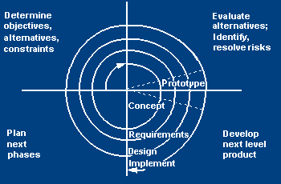
Spiral SDLC Model
Adds risk analysis, and RAD, prototyping to the waterfall model
Each cycle involves the same sequence of steps as the waterfall process model

Slide 124
Determine objectives, alternatives and constraints
Objectives: functionality, performance, hardware/software interface, critical success factors, etc.
Alternatives: build, reuse, buy, sub-contract, etc.
Constraints: cost, schedule, interface, etc.

Slide 125
Evaluate alternatives, identify and resolve risks
Study alternatives relative to objectives and constraints
Identify risks (lack of experience, new technology, tight schedules, poor process, etc.
Resolve risks (evaluate if money could be lost by continuing system development

Slide 126
Develop next-level product
Typical activites:
  Create a design
  Review design
  Develop code
  Inspect code
  Test product

Slide 127
Review and
Plan next phase
Typical activities
  Develop project plan
  Develop configuration management plan
  Develop a test plan
  Develop an installation plan

Slide 128
Spiral Model Strengths
Provides early indication of insurmountable risks, without much cost
Users see the system early because of rapid prototyping tools
Critical high-risk functions are developed first
The design does not have to be perfect
Users can be closely tied to all lifecycle steps
Early and frequent feedback from users
Cumulative costs assessed frequently

Slide 129
Spiral Model Weaknesses
Time spent for evaluating risks too large for small or low-risk projects
Time spent planning, resetting objectives, doing risk analysis and prototyping may be excessive
The model is complex
Risk assessment expertise is required
Spiral may continue indefinitely
Developers must be reassigned during non-development phase activities
May be hard to define objective, verifiable milestones that indicate readiness to proceed through the next iteration

Slide 130
When to use Spiral Model
When creation of a prototype is appropriate
When costs and risk evaluation is important
For medium to high-risk projects
Long-term project commitment unwise because of potential changes to economic priorities
Users are unsure of their needs
Requirements are complex
New product line
Significant changes are expected (research and exploration)

Slide 131
Comparison of Different Life Cycle Models
Iterative waterfall model
  most widely used model.
  But, suitable only for well-understood problems.
Prototype model is suitable for projects not well understood:
  user requirements
  technical aspects

Slide 132
Comparison of Different Life Cycle Models (CONT.)
Evolutionary model is suitable for large problems:
  can be decomposed into a set of modules that can be incrementally implemented,
  incremental delivery of the system is acceptable to the customer.
The spiral model:
  suitable for development of technically challenging software products that are subject to several kinds of risks.

