Slide 1
Software Development Life Cycle (SDLC)/ Software Process Models
(New)
Dr. S. K. Swain

Slide 2
Software Life Cycle
Breaks software project activities into tasks and chunks of tasks into phases, orders them….
Conceptualize
Specify
Retire
Design
Maintain
Deliver
Code
Test

Slide 3
SDLC
Normally, a lifecycle model covers the entire
lifetime of a product.
From birth of a commercial idea
to final de-installation of last release

Slide 4
Software Life Cycle Model
A software life cycle model (also called process model and at times SDLC):
  A descriptive and diagrammatic model of software life cycle…:
  Identifies all the activities undertaken during product development,
  Establishes a precedence ordering among the different activities,
  Divides life cycle into phases.

Slide 5
Agile S/W Development
The Agile software development lifecycle is dominated by the iterative process.
Each iteration results in the next piece of the software development - working software and supporting elements, such as documentation, available for used by customers - until the final product is complete.

Slide 6
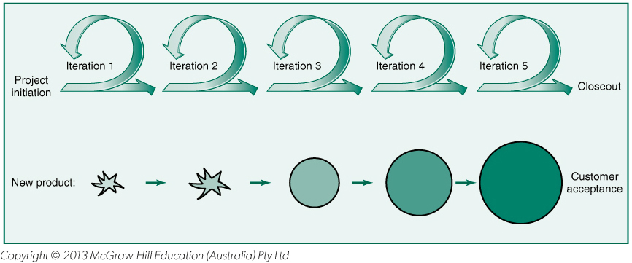
Agile: Iterative, Incremental Product Development

Slide 7
Agile Model
To overcome the shortcomings such as
:schedule slips, Business misunderstanding, high defect rate, project failures, requirement changes and so on
  Proposed in Feb 2001 by 17 Software developers
The agile model was primarily designed:
  To help a project to adapt to change requests
In the agile model:
  The requirements are decomposed into many small incremental parts that can be developed over one to four weeks each.

Slide 8
SIZE
Process
SUCCESSFUL
CHALLENGED
FAILED
All
Projects
Agile
39%
52%
9%
Waterfall
11%
60%
29%
Large Sized
Projects
Agile
18%
59%
23%
Waterfall
3%
55%
42%
Agile
27%
62%
11%
Medium Sized
Projects
Waterfall
7%
68%
25%
Small Sized
Projects
Agile
58%
38%
4%
Waterfall
44%
45%
11%

Slide 9
Agile software Development
Based on light weight methodologies (less documentation and less planning) having dynamic nature, which is its major strength.
Provides an environment to accommodate frequent changes as per market standards and customer needs.
an iterative and incremental development method
it is customer centred.

Slide 10
Agile software Development
Incremental delivery after each time-box
accommodate frequent changes as per market standards and customer needs.
Face to face communication
Customer Interaction
Minimal Documentation
Pair Programming
an iterative and incremental development method
Used for time-critical applications

Slide 11
Agile Model
The Agile model puts emphasis on the fact that whole Agile team should be a tightly integrated unit and is composed of
Developers
Quality assurance members
Testers
Project owner
Customer

Slide 12
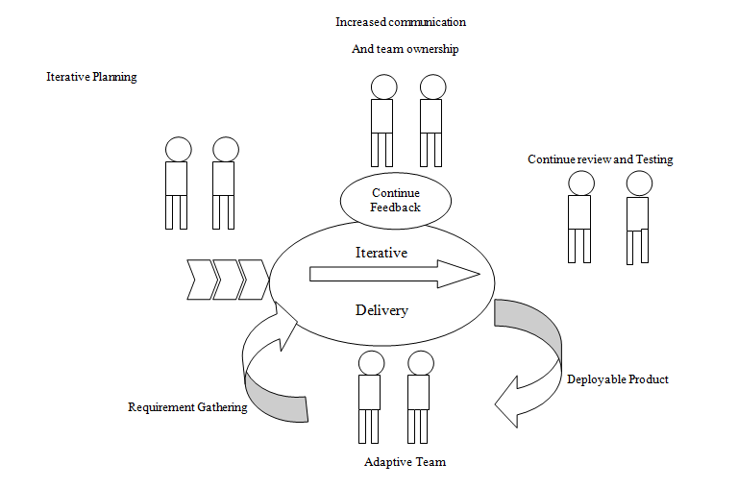
Agile Model

Slide 13
Agile Process Flow
Concept - Projects are envisioned and prioritized
Inception - Team members are identified, funding is put in place, and initial environments and requirements are discussed
Iteration/Construction - The development team works to deliver working software based on iteration requirements and feedback
Release - QA (Quality Assurance) testing, internal and external training, documentation development, and final release of the iteration into production
Production - Ongoing support of the software
Retirement - End-of-life activities, including customer notification and migration

Slide 14
Manifesto for Agile Software Devpmt
We are uncovering better ways of developing
software by doing it and helping others do it.
Through this work we have come to value:
Individuals and interactions over processes and tools
Working software over comprehensive documentation
Customer collaboration over contract negotiation
Responding to change over following a plan
That is, while there is value in the items on
the right, we value the items on the left more.

Slide 15
Some Agile Methods
Adaptive Software Development (ASD)
Feature Driven Development (FDD)
Crystal Clear
Dynamic Software Development Method (DSDM)
Rapid Application Development (RAD)
Scrum
Extreme Programming (XP)
Rational Unified Process (RUP)

Slide 16
Extreme Programming (XP)Model
proposed by Kent Beck in 1999.
Focuses mostly on customer satisfaction by communicating with the customers on a regular basis
The methodology got its name from the fact that:
  Recommends taking the best practices to extreme levels.
  If something is good, why not do it all the time.

Slide 17
4 Values
Communication:
  Enhance communication among team members and with the customers.
Simplicity:
  Build something simple that will work today rather than something that takes time and yet never used
  May not pay attention for tomorrow
Feedback:
  System staying out of users is trouble waiting to happen
Courage:
  Don’t hesitate to discard code

Slide 18
Extreme Programming (XP)Model
Extreme Programming (XP) is system of practices that is being evolved by a community of software developers to address the problems of quickly delivering quality software.
Evolved to meet the changing business needs

Slide 19
Extreme Programming - XP
For small-to-medium-sized teams developing software with rapidly changing requirements
Coding is the key activity throughout a software project
Communication among teammates is done with code
Life cycle and behavior of complex objects defined in test cases – again in code

Slide 20
XP Practices (1-6)
Planning – determine scope of the next release by combining business priorities and technical estimates
Small releases – put a simple system into production, then release new versions in very short cycle
Metaphor – all development is guided by a simple shared story of how the whole system works
Simple design – system is designed as simply as possible (extra complexity removed as soon as found)
Testing – programmers continuously write unit tests; customers write tests for features
Refactoring – programmers continuously restructure the system without changing its behavior to remove duplication and simplify

Slide 21
XP Practices (7 – 12)
Pair-programming -- all production code is written with two programmers at one machine
Collective ownership – anyone can change any code anywhere in the system at any time.
Continuous integration – integrate and build the system many times a day – every time a task is completed.
40-hour week – work no more than 40 hours a week as a rule
On-site customer – a user is on the team and available full-time to answer questions
Coding standards – programmers write all code in accordance with rules emphasizing communication through the code

Slide 22
Taking Good Practices to Extreme
If code review is good:
  Always review --- pair programming
If testing is good:
  Continually write and execute test cases --- test-driven development
If incremental development is good:
  Come up with new increments every few days
If simplicity is good:
  Create the simplest design that will support only the currently required functionality.

Slide 23
Taking to Extreme
If design is good,
  everybody will design daily (refactoring)
If architecture is important,
  everybody will work at defining and refining the architecture (metaphor)
If integration testing is important,
  build and integrate test several times a day (continuous integration)

Slide 24
Scrum
Scrum is an Agile framework which concentrates on how team members should function to produce system flexibly in a constantly changing environment.

Slide 25
Scrum
Self-organizing and cross-functional teams - decides tasks for the people
Self-organizing means that there is no overall team leader who decides the tasks for the people
Cross-functional so that everyone necessary to take a feature from idea to implementation is involved.

Slide 26
Scrum: Characteristics
Product progresses in a series of month-long “sprints”
  Iterative process with the idea of time boxing is known as SPRINT
Requirements are captured as items in a list of “product backlog”
Product backlog describes what will be built
Popular agile framework

Slide 27
Scrum
Scrum is concerned with the
  product owner-represents voice of customer
  Srum Master (project lead)-enforcer of scrum process and facilitates to reach the sprint goal.
  Scrum team – all the expertise necessary to deliver a quality product
working together in an intensive and interdependent manner.

Slide 28
Scrum (contd..)
Scrum process includes three phases: Pre-game, Development, and Post-game.
There are two roles (six identifiable roles) in Scrum :
Pigs: Product owner, Scrum master, Scrum team,
Chickens: Customer, User, and Management

Slide 29
Scrum Life Cycle
7
Product Backlog
Sprint Backlog
CODE
DSM
SPRINT(2-4 Weeks)
REVIEW(R1)
RETROSPECIVE (R2)
RELEASE(R3))
TEST

Slide 30
Scrum life cycle
Scrum includes product backlog which is a document that lists all the characteristics of software in a prioritized order--- created by product owner and customer.
When a certain feature is implemented, it is removed from the list.
The Product backlog items are prioritized and then transferred to the sprint backlog which works as a task list in one sprint– created by product owner, scrum master and team.

Slide 31
Scrum life cycle (contd..)
It contains items from the Product backlog which are planned to be implemented in one sprint .
One product characteristic is divided into smaller tasks.
New tasks cannot be added into the sprint backlog when the sprint has started.
Scrum practices include
  product backlog list(PBL),
  effort estimation, sprint, sprint planning meeting, sprint backlog list (SBL),
  daily scrum meeting (DSM),
  test, code sprint review meeting (R1), retrospective (R2), and release (R3).

Slide 32
RUP Iterations in Phases
The duration of and iteration may vary from two weeks or less.
Iterations
Iterations
Iterations
Iterations
Inception
Elaboration
Construction
Transition

Slide 33
Agile Model versus Iterative Waterfall Model
The waterfall model steps through in a planned sequence:
  Requirements-capture, analysis, design, coding, and testing stages:
Progress is measured in terms of delivered artifacts:
  Requirement specifications, design documents, test plans, code reviews, etc.
In contrast agile model sequences:
  Delivery of working versions of a product in several increments.

Slide 34
Agile Model Shortcomings
Derive agility through developing tacit knowledge in the team, rather than any formal document:
  Can be misinterpreted…
  External review difficult to get…
  When project is complete, and team disperses, maintenance becomes difficult…

