Slide 1
Object-Orientation Concepts, UML, and OOAD
Prof. S. K. Swain
School of CE, KIIT, Bhubaneswar

Slide 2
Organization of This Lecture
Object-oriented concepts
Object modelling using Unified Modelling Language (UML)‏
Object-oriented software development and patterns
CASE tools
Summary

Slide 3
Object-Oriention Concepts
Object-oriented (OO) design techniques are extremely popular:
  Inception in early 1980’s and nearing maturity.
  Widespread acceptance in industry and academics.
  Unified Modelling Language (UML) already an ISO standard (ISO/IEC 19501).

Slide 4
A system is designed as a set of interacting objects:
Often, real-world entities:
Examples: an employee, a book etc.
Consists of data (attributes) and functions (methods) that operate on data.
Hides organization of internal information (Data abstraction).
Objects

Slide 5
Model of an Object
m8
m7
mi are methods
of the object
m1
Data
m6
m2
m5
Object
m3
m4

Slide 6
Instances are objects
Template for object creation
Considered as abstract data type (ADT)‏
Examples: Employees, Books, etc.
Sometimes not intended to produce instances:
Abstract classes
Class

Slide 7
Example Class Diagram
LibraryMember
LibraryMember
LibraryMember
Member Name
Membership Number
Address
Phone Number
E-Mail Address
Membership Admission Date
Membership Expiry Date
Books Issued
issueBook( );
findPendingBooks( );
findOverdueBooks( );
returnBook( );
findMembershipDetails( );
issueBook( );
findPendingBooks( );
findOverdueBooks( );
returnBook( );
findMembershipDetails( );
Different representations of the LibraryMember class

Slide 8
Operations supported by an object:
Means for manipulating the data of other objects.
Invoked by sending a message (method call).
Examples: calculate_salary, issue-book, member_details, etc.
Methods and Messages

Slide 9
What are the Different Types of Relationships Among Classes?
Four types of relationships:
  Inheritance
  Association
  Aggregation/Composition
  Dependency

Slide 10
Allows to define a new class (derived class) by extending or modifying existing class (base class).
Represents generalization-specialization relationship.
Allows redefinition of the existing methods (method overriding).
Inheritance

Slide 11
Lets a subclass inherit attributes and methods from more than one base class.
Inheritance
LibraryMember
Base Class
Faculty
Students
Staff
Derived
Classes
UnderGrad
PostGrad
Research

Slide 12
Inheritance Example
Library
Book
issuable
reference
Issuable
Single Volume
Book
Issuable
BookSet
Reference
Single Volume
Book
Reference
BookSet
Representation of the inheritance relationship

Slide 13
Multiple Inheritance cont…
LibraryMember
Base Class
LibraryMember
Base Class
Faculty
Students
Staff
Derived
Classes
Faculty
Students
Staff
Multiple
Inheritance
UnderGrad
PostGrad
Research
UnderGrad
PostGrad
Research

Slide 14
Association Relationship
Enables objects to communicate with each other:
  Thus one object must “know” the address of the corresponding object in the association.
Usually binary:
  But in general can be n-ary.

Slide 15
Association Relationship
A class can be associated with itself (recursive association).
  Give an example?
An arrowhead used along with name, indicates direction of association.
Multiplicity indicates # of instances taking part in the association.

Slide 16
Association Relationship
Library Member
Book
*
1
borrowed by

Slide 17
3-ary Association
Person
*
*
Skill
Competency
level

Slide 18
Association and Link
A link:
  An instance of an association
  Exists between two or more objects
  Dynamically created and destroyed as the run of a system proceeds
For example:
  An employee joins an organization,
  Leaves that organization and joins a new organization etc.

Slide 19
Aggregation Relationship
Represents whole-part relationship
Represented by a diamond symbol at the composite end
Cannot be reflexive(i.e. recursive)‏
Not symmetric
It can be transitive

Slide 20
Aggregation Relationship
1
*
*
1
Document
Paragraph
Line

Slide 21
Composition Relationship
Life of item is same as the order
Order
1
*
Item

Slide 22
A aggregate object contains other objects.
Aggregation limited to tree hierarchy:
No circular inclusion relation.
Aggregation
cont…

Slide 23
Inheritance:
Different object types with similar features.
Necessary semantics for similarity of behavior is in place.
Aggregation:
Containment allows construction of complex objects.
Aggregation vs. Inheritance
Cont…

Slide 24
Aggregation vs. Composition
Composition:
  Composite and components have the same life.
Aggregation:
  Lifelines are different.
Consider an order object:
  Aggregation: If order items can be changed or deleted after placing the order.
  Composition: Otherwise.

Slide 25
Composition versus Aggregation
1
*
Order
Item
Composition
1
*
Order
Item
Aggregation

Slide 26
Class Dependency
Dependent Class
Independent Class
Representation of dependence between classes

Slide 27
Consider aspects relevant for certain purpose
Suppress non-relevant aspects
Types of abstraction:
Data abstraction
Behaviour abstraction
Abstraction

Slide 28
Advantages of abstraction:
Reduces complexity of design
Enhances understandability
Increases productivity
It has been observed that:
Productivity is inversely proportional to complexity.
Abstraction
cont…

Slide 29
Objects communicate with outside world through messages:
Data of objects encapsulated within its methods.
Data accessible only through methods.
Encapsulation

Slide 30
Encapsulation cont…
Methods
m4
m3
Data
m5
m2
m6
m1
Concept of encapsulation

Slide 31
Denotes poly (many) morphism (forms).
Under different situations:
Same message to the same object can result in different actions:
Static binding
Dynamic binding
Polymorphism

Slide 32
A class named Circle has three definitions for create operation
Without any parameter, default
Centre and radius as parameter
Centre, radius and fillType as parameter
Depending upon parameters, method will be invoked
Method create is said to be overloaded
An Example of Static Binding
cont…

Slide 33
Dynamic Binding
A method call to an object of an ancestor class:
  Would result in the invocation of the method of an appropriate object of the derived class.
Following principles are involved:
  Inheritance hierarchy
  Method overriding
  Assignment to compatible types

Slide 34
Principle of substitutability (Liskov’s substitutability principle):
An object can be assigned to an object of its ancestor class, but not vice versa.
Dynamic Binding
A
A a; B b;
a=b; (OK)‏
b=a; (not OK)‏
B

Slide 35
Exact method to be bound on a method call:
Not possible to determine at compile time.
Dynamically decided at runtime.
Dynamic Binding
Cont …

Slide 36
Consider a class hierarchy of different geometric objects:
Display method is declared in the shape class and overridden in each derived class.
A single call to the display method for each object would take care of displaying the appropriate element.
An Example of Dynamic Binding

Slide 37
An Example of Dynamic Binding cont…
Shape
Circle
Rectangle
Line
Ellipse
Square
Cube
Class hierarchy of geometric objects

Slide 38
An Example cont…
Traditional code
Shape s[1000];
For(i=0;i<1000;i++){
If (s[i] == Circle) then
draw_circle();
else if (s[i]== Rectangle) then
draw_rectangle();
-
}
Object-oriented code
Shape s[1000];
For(i=0;i<1000;i++)
Shape.draw();
-
-
-
-
Traditional code and OO code using dynamic binding

Slide 39
Ability to parameterize class definitions.
Example: class stack of different types of elements:
Integer stack
Character stack
Floating point stack
Define generic class stack:
Later instantiate as required
Genericity

Slide 40
Genericity
T
Set
insert(T)‏
remove(T)‏
Refinement
EmployeeSet

Slide 41
Code and design reuse
Increased productivity
Ease of testing (?) and maintenance
Better understandability
Elegant design:
Loosely coupled, highly cohesive objects:
Essential for solving large problems.
Advantages of Object-Oriented Development

Slide 42
Initially incurs higher costs
After completion of some projects reduction in cost become possible
Using well-established OO methodology and environment:
Projects can be managed with 20% -- 50% of traditional cost of development.
Advantages of Object-Oriented
Development cont…

Slide 43
UML is a modelling language
Not a system design or development methodology
Used to document object-oriented analysis and design results.
Independent of any specific design methodology.
Object Modelling Using UML

Slide 44
OOD in late 1980s and early 1990s:
Different software development houses were using different notations.
Methodologies were tied to notations.
UML developed in early 1990s to:
Standardize the large number of object-oriented modelling notations
UML Origin

Slide 45


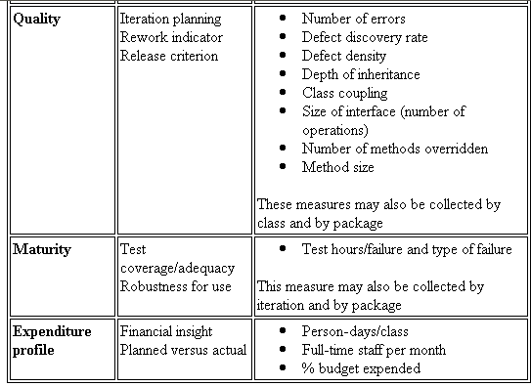
UML Diagram – What is UML?
The Unified Modeling Language (UML) is a standard language for
specifying
Visualizing
Constructing
Documenting
the artifacts of software intensive system.
the artifacts of software intensive system.system.

Slide 46
Goals of UML
Provide users with a ready-to-use, expressive visual modeling language so they can develop and exchange meaningful models.
Provide extensibility and specialization mechanisms to extend the core concepts.
Be independent of particular programming languages and development processes.
Provide a formal basis for understanding the modeling language.
Encourage the growth of the OO tools market.
Support higher-level development concepts such as collaborations, frameworks, patterns and components.
Integrate best practices.

Slide 47
Based Principally on:
OMT [Rumbaugh 1991]
Booch’s methodology[Booch 1991]
OOSE [Jacobson 1992]
Odell’s methodology[Odell 1992]
Shlaer and Mellor [Shlaer 1992]
UML Lineology

Slide 48
Different Object Modeling Techniques in UML
OMT
UML
Booch’s
Methodology
OOSE

Slide 49
Adopted by Object Management Group (OMG) in 1997
OMG is an association of industries
Promotes consensus notations and techniques
Used outside software development
Example car manufacturing
UML as A Standard

Slide 50
Developments to UML
UML continues to develop:
  Refinements
  Making it applicable to new contexts
UML 1.0
UML 1.X
Application to embedded systems
UML 2.0

Slide 51
A model is an abstraction mechanism:
Capture only important aspects and ignores the rest.
Different models result when different aspects are ignored.
An effective mechanism to handle complexity.
UML is a graphical modelling tool
Easy to understand and construct
Why are UML Models Required?

Slide 52
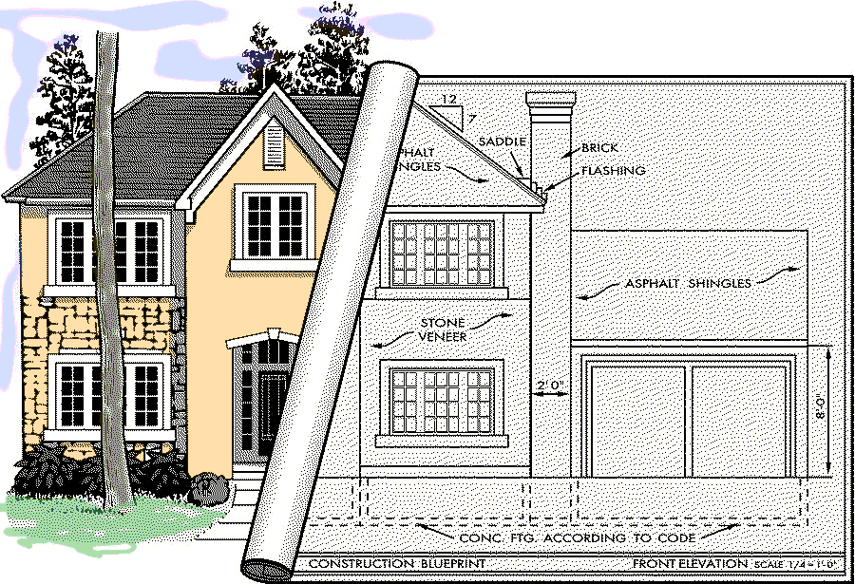
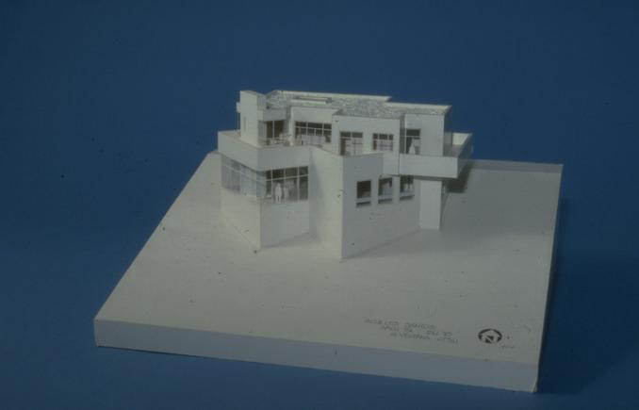
Modeling a House

Slide 53
Nine diagrams are used to capture different views of a system.
Views:
Provide different perspectives of a software system.
Diagrams can be refined to get the actual implementation of a system.
UML Diagrams

Slide 54
Views of a system:
User’s view
Structural view
Behavioral view
Implementation view
Environmental view
UML Model Views

Slide 55
UML Diagrams
Behavioural View
Sequence Diagram
Collaboration Diagram
- State-chart Diagram
- Activity Diagram
Structural View
Class Diagram
Object Diagram
User’s View
Use Case
Diagram
Implementation View
Component Diagram
Environmental View
Deployment Diagram
Diagrams and views in UML

Slide 56
NO
Use case diagram, class diagram and one of the interaction diagram for a simple system
State chart diagram required to be developed when a class state changes
However, when states are only one or two, state chart model becomes trivial
Deployment diagram in case of large number of hardware components used to develop the system
Are All Views Required for Developing A Typical System?

Slide 57
Use Case Model
Consists of set of “use cases”
An important analysis and design artifact
The central model:
  Other models must confirm to this model
  Not really an object-oriented model
  Represents a functional or process model

Slide 58
Use Cases
Different ways in which a system can be used by the users
Corresponds to the high-level requirements
Represents transaction between the user and the system
Defines external behavior without revealing internal structure of system
Set of related scenarios tied together by a common goal.

Slide 59
Use Cases
Cont…
Normally, use cases are independent of each other
Implicit dependencies may exist
Example: In Library Automation System, renew-book & reserve-book are independent use cases.
  But in actual implementation of renew-book: a check is made to see if any book has been reserved using reserve-book.

Slide 60
Example Use Cases
  For library information system
    issue-book
    query-book
    return-book
    create-member
    add-book, etc.

Slide 61
Representation of
Use Cases
  Represented by use case diagram
  A use case is represented by an ellipse
  System boundary is represented by a rectangle
  Users are represented by stick person icons (actor)‏
  Communication relationship between actor and use case by a line
  External system by a stereotype

Slide 62
An Example Use Case Diagram
Tic-tac-toe game
Play Move
Player
Use case model

Slide 63
Why Develop A
Use Case Diagram?
Serves as requirements specification
How are actor identification useful in software development:
  User identification helps in implementing appropriate interfaces for different categories of users
  Another use in preparing appropriate documents (e.g. user’s manual).

Slide 64
Factoring Use Cases
Two main reasons for factoring:
  Complex use cases need to be factored into simpler use cases
  To represent common behavior across different use cases
Three ways of factoring:
  Generalization
  Includes
  Extends

Slide 65
Factoring Use Cases Using
Generalization
Pay membership fee
Pay through credit card
Pay through library pay card

Slide 66
Factoring Use Cases Using
Includes
Base use case
<<include>>
Common
use case
Base use case
Base use case
<<include>>
<<include>>
<<include>>
<<include>>
Base use case
Base use case
Base use case

Slide 67
Factoring Use Cases Using
Extends
Base
use case
<<extends>>
Common
use case

Slide 68
Hierarchical Organization of Use Cases
use case 1
use case 3
External users
use case 2
use case 3.1
use case 3.3
Subsystems
use case 3. 2
use case 1
use case 3
Method
use case 2

Slide 69
Use Case Packaging
Accounts
Query balance
Print
Balance sheet
Receive
grant
Make
payments

Slide 70
Class Diagram
Describes static structure of a system
Main constituents are classes and their relationships:
  Generalization
  Aggregation
  Association
  Various kinds of dependencies

Slide 71
Class Diagram
Entities with common features, i.e. attributes and operations
Classes are represented as solid outline rectangle with compartments
Compartments for name, attributes, and operations.
Attribute and operation compartments are optional depending on the purpose of a diagram.

Slide 72
Object Diagram
LibraryMember
Mritunjay
B10028
C-108, Laksmikant Hall
1119
Mrituj@cse
25-02-04
25-03-06
NIL
IssueBook( );
findPendingBooks( );
findOverdueBooks( );
returnBook( );
findMembershipDetails( );
LibraryMember
Mritunjay
B10028
C-108, Laksmikant Hall
1119
Mrituj@cse
25-02-04
25-03-06
NIL
LibraryMember
Different representations of the LibraryMember object

Slide 73
Interaction Diagram
Models how groups of objects collaborate to realize some behaviour
Typically each interaction diagram realizes behaviour of a single use case

Slide 74
Interaction Diagram
Two kinds: Sequence and Collaboration diagrams.
Two diagrams are equivalent
  Portray different perspectives
These diagrams play a very important role in the design process.

Slide 75
Sequence Diagram
Shows interaction among objects as a two-dimensional chart
Objects are shown as boxes at top
If object created during execution then shown at appropriate place
Objects existence are shown as dashed lines (lifeline)‏
Objects activeness, shown as a rectangle on lifeline

Slide 76
Sequence Diagram Cont…
Messages are shown as arrows
Each message labelled with corresponding message name
Each message can be labelled with some control information
Two types of control information
  condition ([])‏
  iteration (*)‏

Slide 77
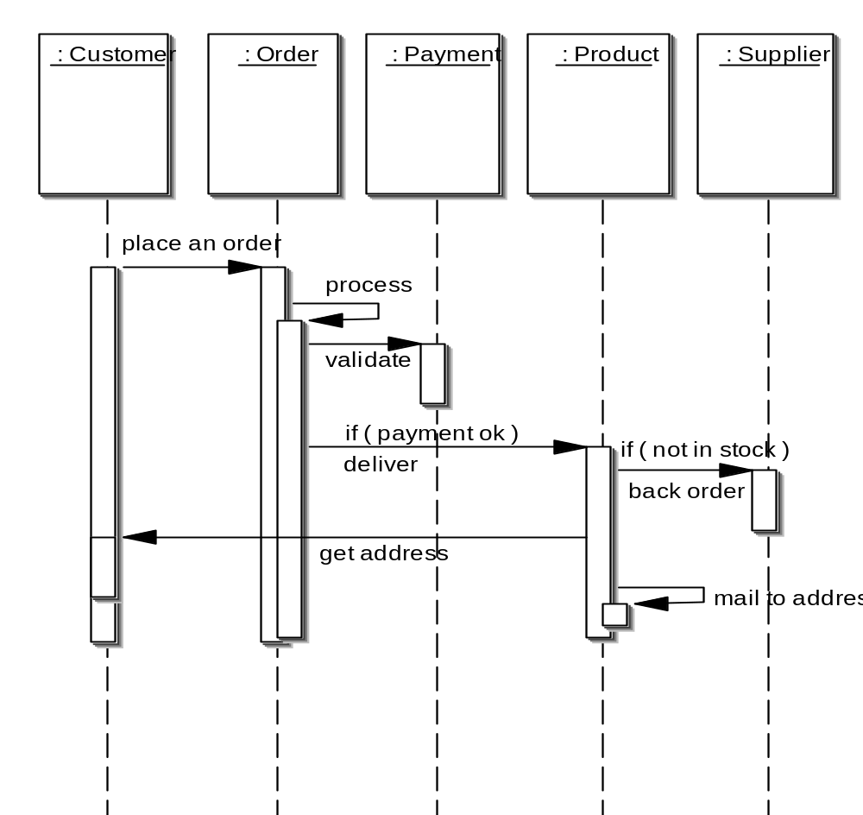
Elements of a Sequence Diagram
object
control
lifetime
message

Slide 78
Example
Cont…
Sequence of message sending

Slide 79
An Example of
A Sequence Diagram
:Library
Boundary
:Library
Book
Renewal
Controller
:Library
Book
Register
:Book
:Library
Member
renewBook
find MemberBorrowing
displayBorrowing
selectBooks
bookSelected
* find
[reserved]
[reserved]
apology
update
apology
confirm
confirm
updateMemberBorrowing
Sequence Diagram for the renew book use case

Slide 80
Collaboration Diagram
Shows both structural and behavioural aspects
Objects are collaborator, shown as boxes
Messages between objects shown as a solid line
A message is shown as a labelled arrow placed near the link
Messages are prefixed with sequence numbers to show relative sequencing

Slide 81
An Example of
A Collaboration Diagram
:Library
Book
Register
6: * find
:Book
[reserved]
9: update
8: apology
5: book
Selected
10: confirm
:Library
Boundary
1: renewBook
:Library
Book
Renewal
Controller
[reserved]
7: apology
3: display
Borrowing
4: selectBooks
2: findMemberBorrowing
12: confirm
:Library
Member
updateMemberBorrowing
Collaboration Diagram for the renew book use case

Slide 82
Activity Diagram
Not present in earlier modelling techniques:
  Possibly based on event diagram of Odell [1992]
Represents processing activity, may not correspond to methods
Activity is a state with an internal action and one/many outgoing transitions
Somewhat related to flowcharts

Slide 83
Activity Diagram vs Flow Chart
Can represent parallel activity and synchronization aspects
Swim lanes can be used to group activities based on who is performing them
Example: academic department vs. hostel

Slide 84
Activity Diagram
Normally employed in business process modelling.
Carried out during requirements analysis and specification stage.
Can be used to develop interaction diagrams.

Slide 85
An Example of
An Activity Diagram
Academic Section
Accounts Section
Hostel Office
Hospital
Department
check
student
records
receive
fees
allot
hostel
create
hospital
record
receive
fees
register
in
course
conduct
medical
examination
allot
room
issue
identity card
Activity diagram for student admission procedure at IIT

Slide 86
Activity Diagram: Example 2
Finance
Order
Processing
Stock
Manager
Receive
Order
Receive
Supply
*[for each line
item on order]
Choose
Outstanding
Order Items
Authorize
Payment
Check
Line Item
[failed]
[in stock]
* [for each chosen
order item]
Cancel
Order
Assign to
Order
Assign
Goods to
Order
[succeeded]
[need to reorder]
Reorder
Item
[stock assigned to all
line items and payment
authorized]
[all outstanding
order items filled]
Dispatch
Order

Slide 87
State Chart Diagram
Based on the work of David Harel [1990]
Model how the state of an object changes in its lifetime
Based on finite state machine (FSM) formalism

Slide 88
State Chart Diagram
Cont…
State chart avoids the problem of state explosion of FSM.
Hierarchical model of a system:
  Represents composite nested states

Slide 89
State Chart Diagram
Cont…
  Elements of state chart diagram
  Initial State: A filled circle
  Final State: A filled circle inside a larger circle
  State: Rectangle with rounded corners
  Transitions: Arrow between states, also boolean logic condition (guard)‏

Slide 90
An Example of A State Chart Diagram
order received
Unprocessed
Order
[reject] checked
[accept] checked
Rejected
Order
Accepted
Order
[some items available]
processed / deliver
[some items not
available] processed
Pending
Order
[all items
available]
newsupply
Fulfilled
Order
Example: State chart diagram for an order object

Slide 91
Package Diagrams
A package is a grouping of several classes:
  Java packages are a good example
Package diagrams show module dependencies.
Useful for large projects with multiple binary files
Order Capture
UI
AWT
Mailing List
UI
Order Capture
Application
Mailing List
Application
Dependency
Common
{global}
Oracle
Interface
Quantity
Money
DateRange
Domain
Orders
Customers
Sybase
Interface
Database
Interface
{abstract}

Slide 92
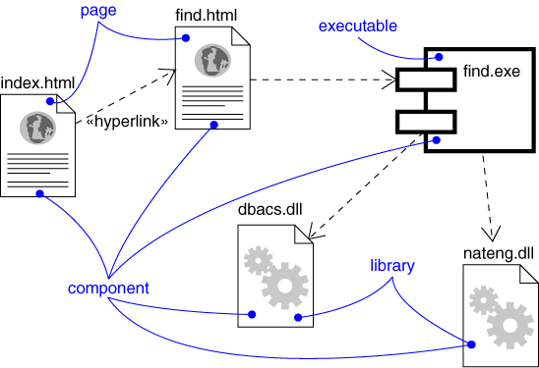
Component Diagram
Captures the physical structure of the implementation (code components)‏
dependency
Components:
Executables
Library
Table
File
Document

Slide 93
Component Diagram
Captures the physical structure of the implementation
Built as part of architectural specification
Purpose
  Organize source code
  Construct an executable release
  Specify a physical database
Developed by architects and programmers

Slide 94
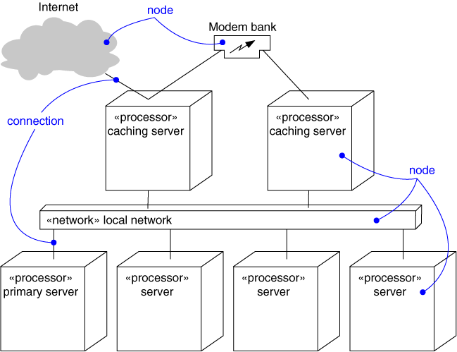
Deployment Diagram
Captures the topology of a system’s hardware
A piece of hardware

Slide 95
A Design Process
  Developed from various methodologies.
    However, UML has been designed to be usable with any design methodology.
  From requirements specification, initial model is developed (OOA)‏
    Analysis model is iteratively refined into a design model
  Design model is implemented using OO concepts

Slide 96
OOAD
Iterative and Incremental
OOA OOD/OOP
Definition of
the problem
Domain Model
Use case model
Construction of
the solution
Specification
Program

Slide 97
Unified Development Process Cont…
OOA
OOD
User interface
Issues or GUI
prototype
Use case
diagram
Interaction
diagram
Start
SRS document
Domain model
Class diagram
Code
Glossary

Slide 98
Example 1: Tic-Tac-Toe Computer Game
A human player and the computer make alternate moves on a 3 3 square.
A move consists of marking a previously unmarked square.
The user inputs a number between 1 and 9 to mark a square
Whoever is first to place three consecutive marks along a straight line (i.e., along a row, column, or diagonal) on the square wins.

Slide 99
Example 1: Tic-Tac-Toe Computer Game
As soon as either of the human player or the computer wins,
  A message announcing the winner should be displayed.
If neither player manages to get three consecutive marks along a straight line,
  And all the squares on the board are filled up,
  Then the game is drawn.
The computer always tries to win a game.

Slide 100
Example 1: Use Case Model
Tic-tac-toe game
Play Move
Player

Slide 101
Example 1: Initial and Refined Domain Model
Board
Initial domain model
PlayMoveBoundary
PlayMoveController
Board
Refined domain model

Slide 102
Example 1: Sequence Diagram
:playMove
Boundary
:playMove
Controller
:board
acceptMove
checkMoveValidity
move
[invalidMove]
[invalidMove]
announceInvalidMove
announceInvalidMove
checkWinner
[game over]
[game over]
announceResult
announceResult
playMove
checkWinner
[game over]
[game over]
announceResult
announceResult
displayBoardPositions
getBoardPositions
[game not over]
promptNextMove
Sequence Diagram for the play move use case

Slide 103
Example 1: Class Diagram
Board
PlayMoveBoundary
int position[9]
checkMove Validity
checkResult
playMove
announceInvalidMove
announceResult
displayBoard
Controller
announceInvalidMove
announceResult

Slide 104
Example 2: Supermarket Prize Scheme
Supermarket needs to develop software to encourage regular customers.
Customer needs to supply his:
  Residence address, telephone number, and the driving licence number.
Each customer who registers is:
  Assigned a unique customer number (CN) by the computer.

Slide 105
Example 2: Supermarket Prize Scheme
A customer can present his CN to the staff when he makes any purchase.
The value of his purchase is credited against his CN.
At the end of each year:
  The supermarket awards surprise gifts to ten customers who make highest purchase.

Slide 106
Example 2: Supermarket Prize Scheme
Also, it awards a 22 carat gold coin to every customer:
  Whose purchases exceed Rs. 10,000.
The entries against the CN are reset:
  On the last day of every year after the prize winner’s lists are generated.

Slide 107
Example 2: Use Case Model
Supermarket
Prize scheme
register
customer
Customer
Clerk
register
sales
Sales Clerk
select
winners
Manager

Slide 108
Example 2: Initial Domain Model
SalesHistory
CustomerRegister
1
1
*
*
SalesRecords
CustomerRecord
Initial domain model

Slide 109
Example 2: Refined Domain Model
SalesHistory
CustomerRegister
1
1
*
*
SalesRecords
CustomerRecord
RegisterCustomerBoundary
RegisterCustomerController
RegisterSalesBoundary
RegisterSalesController
SelectWinnersBoundary
SelectWinnersControllers
Refined domain model

Slide 110
Example 2: Sequence Diagram for the Select Winners Use Case
:SelectWinner
Boundary
:SelectWinner
Controller
:Sales
History
:Sales
Record
:Customer
Register
:Customer
Record
Select
Winners
SelectWinners
SelectWinners
*computeSales
*browse
[for each winner]
announces
find WinnerDetails
[for each winner]
browse
Sequence Diagram for the select winners use case

Slide 111
Example 2: Sequence Diagram for the Register Customer Use Case
:RegisterCustomer
Boundary
:RegisterCustomer
Controller
:Customer
Register
:Customer
Record
register
register
checkDuplicate
*match
[duplicate]
showError
generateCIN
create
:Customer
Record
register
displayCIN
Sequence Diagram for the register customer use case

Slide 112
Example 2: Sequence Diagram for the Register Sales Use Case
:Register
Sales
Boundary
:Register
Sales
Controller
:Sales
History
RegisterSales
registerSales
registerSales
:Sales
Record
create
confirm
confirm
Sequence Diagram for the register sales use case

Slide 113
Example 2: Sequence Diagram for the Register Sales Use Case
:Register
Sales
Boundary
:Sales
History
registerSales
RegisterSales
:Sales
Record
create
confirm
Refined Sequence Diagram for the register sales use case

Slide 114
Example 2: Class Diagram
SalesHistory
CustomerRegister
selectWinners
registerSales
findWinnerDetails
register
1
1
*
*
SalesRecords
CustomerRecord
salesDetails
name
address
computerSales
browse
create
browse
checkDuplicate
create

Slide 115
Summary
We discussed object-oriented concepts
  Basic mechanisms: Such as objects, class, methods, inheritance etc.
  Key concepts: Such as abstraction, encapsulation, polymorphism, composite objects etc.

Slide 116
Summary
We discussed an important OO language UML:
  Its origin, as a standard, as a model
  Use case representation, its factorisation such as generalization, includes and extends
  Different diagrams for UML representation
  In class diagram we discussed some relationships association, aggregation, composition and inheritance

Slide 117
Summary cont…
Other UML diagrams:
  Interaction diagrams (sequence and collaboration),
  Activity diagrams,
  State chart diagrams.
We discussed OO software development process.

