Slide 1
User Interface Design

Slide 2
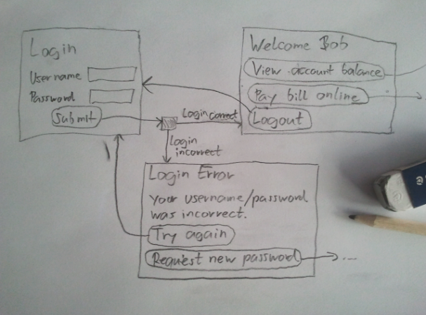
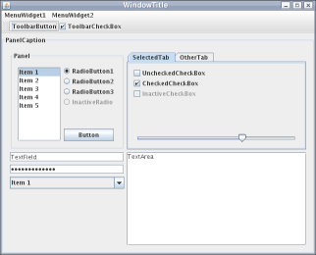
User Interface Design
Topics:
  Introduction
  Graphical User Interfaces
  UI development
  User Interface Design
  User Interface Evaluation

Slide 3
1.Introduction
User Interfaces (UIs)
User interfaces are the interfaces between humans and computers
  Input: “How does the user talk to the system?“
  Output: “How does the system talk to the user?“
  Interaction: input and output between human and computer over time (HCI=Human-Computer Interaction)
Out
In

Slide 4
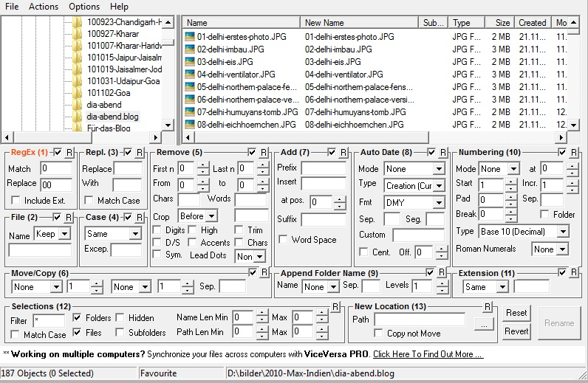
1.Introduction
User Interfaces (UIs)
System users often judge a system by its interface rather than its functionality
  A poorly designed interface can cause a user to make catastrophic errors
  Poor user interface design is the reason why so many software systems are never used
The UI is a crucial part of a system
  Functionality is useless if
  users don‘t know how to use it
  Users won‘t use it if usage is

Slide 5
2.Graphical user interfaces
Most users of business systems interact with these systems through graphical interfaces although, in some cases, legacy text-based interfaces are still used
Graphical user interfaces (GUIs) have helped to eliminate many of the most horrific interface problems
  However, some are still difficult to learn, hard to use, confusing, counterintuitive, unforgiving, and frustrating
User interface analysis and design has to do with the study of people and how they relate to technology

Slide 6
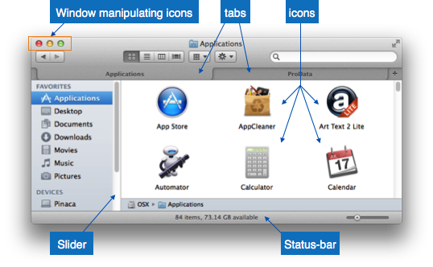
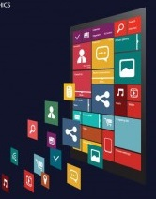
2.Graphical User Interfaces
GUI characteristics
Characteristic | Description
Windows | Multiple windows allow different information to be displayed simultaneously on the user’s screen.
Icons | Icons different types of information. On some systems, icons represent files; on others, icons represent processes.
Menus | Commands are selected from a menu rather than typed in a command language.
Pointing | A pointing device such as a mouse is used for selecting choices from a menu or indicating items of interest in a window.
Graphics | Graphical elements can be mixed with text on the same display.

Slide 7

2.Graphical User Interfaces
GUI advantages
They are easy to learn and use.
  Users without experience can learn to use the system quickly.
The user may switch quickly from one task to another and can interact with several different applications.
  Information remains visible in its own window when attention is switched.
Fast, full-screen interaction is possible with immediate access to anywhere on the screen

Slide 8
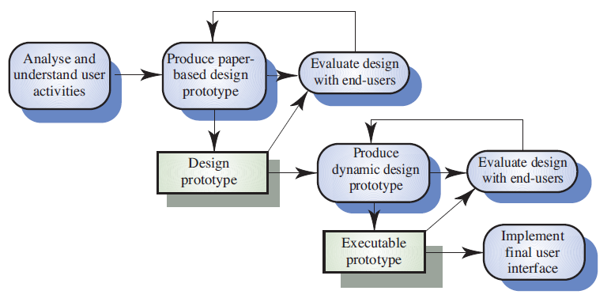
3.UI Development
User Interface Design Process

Slide 9
4.User interface design principles
Principle Description
User familiarity The interface should use terms and concepts which are drawn from the experience of the people who will make most use of the system.
For example,an office system should use concepts such as letters, documents,folders etc. rather than directories, file identifiers, etc.
Consistency The interface should be consistent in that, wherever possible, comparable operations should be activated in the same way.
Commands and menus should have the same format
Minimal surprise Users should never be surprised by the behaviour of a system. The user should be able to predict the operation of comparable commands.

Slide 10
4.User interface design principles
Principle Description
Recoverability The interface should include mechanisms to allow users to recover from errors.
This might include an undo facility, confirmation of destructive actions,'soft' deletes, etc
User guidance The interface should provide meaningful feedback when errors occur and provide context-sensitive user help facilities.
such as help systems, on-line manuals, etc. should be supplied
User diversity The interface should provide appropriate interaction
facilities for different types of system user.
For example, some users have seeing difficulties and so larger text should be available.

Slide 11
5.User Interface Design
User-system Interaction
Two problems must be addressed in interactive systems design
  How should information from the user be provided to the computer system?
  How should information from the computer system be presented to the user?

Slide 12
5.User Interface Design
Guidelines for Error Messages
The message should
  describe the problem in plain language that a typical user can understand
  provide constructive advice for recovering from the error
  indicate any negative consequences of the error (e.g., potentially corrupted data files) so that the user can check to ensure that they have not occurred (or correct them if they have)
  be accompanied by an audible or visual cue such as a beep, momentary flashing, or a special error color
  be non-judgmental (never place blame on the user)
An effective error message philosophy can do much to improve the quality of an interactive system and will significantly reduce user frustration when problems do occur

Slide 13
User Interaction styles
Direct manipulation (iconic interface)
Menu selection -.
scrolling menu, walking menu, and hierarchical menu.
Form fill-in
Command language
Natural language

Slide 14
User Interaction styles
Command language – as the name itself suggests, is based on designing a command language which the user can use to issue the commands. Commands are entered as lines of text (that is, sequences of typed characters) from a keyboard, and output is also received as text.
Menu selection - A menu is set of options displayed on the screen where the selection and execution of one or more of the options results in a change in the state of the interface.
scrolling menu, walking menu, and hierarchical menu.
Direct manipulation present the interface to the user in the form of visual models (i.e. icons or objects). For this reason, direct manipulation interfaces are sometimes called as iconic interface.

Slide 15
User Interaction styles
Form fill-in -When several different categories are fed into a system, using a keyboard, It is often helpful to design the screen as though it is a form (form fill) , particularly if the same type of data has to entered repeatedly as occurs in retailing.
Natural language- Commands given in “natural” sentences and phrases rather than set commands Range fromsimple voice recognition menu-driven systems to more complex ‘natural language’ dialogues.
Examples include search engines, advice-giving systems, help systems.

Slide 16
Interaction styles
Interaction style | Main advantages | Main disadvantages | Application examples
Direct manipulation (Iconic Interface) | Fast and intuitive interaction Easy to learn | May be hard to implement Only suitable where there is a visual metaphor for tasks and objects | Video games CAD systems
Menu selection | Avoids user error Little typing required Users need not remember command names Keystrokes are reduced | Slow for experienced users Can become complex if many menu options. Actions which involve logical conjunction (and) or disjunction (or) are awkward to represent | Most general-purpose systems
Form fill-in | Simple data entry Easy to learn | Takes up a lot of screen space | Stock control Personal loan processing
Command language | Powerful and flexible Low resource usage Flexibility and speed for expert users | Hard to learn and remember a command language Users make errors in command , Not suitable for casual or inexperienced users | Operating systems Library information retrieval systems
Natural language | Accessible to casual users Easily extended | Requires more typing Natural language understanding systems are unreliable | Timetable System, WWW Information retrieval systems
Checkable
Causes problems where
user options do not
match the form fields

Slide 17
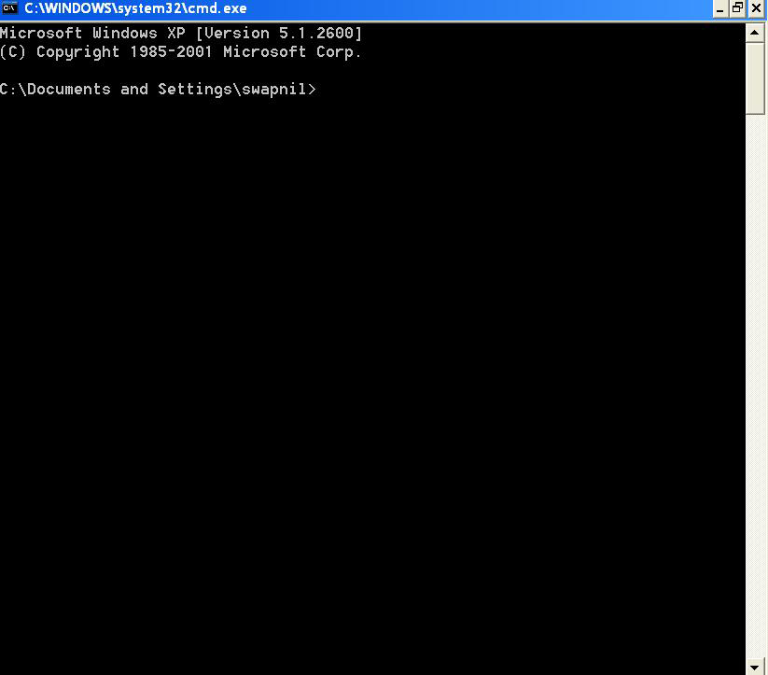
Command Language Interface

Slide 18
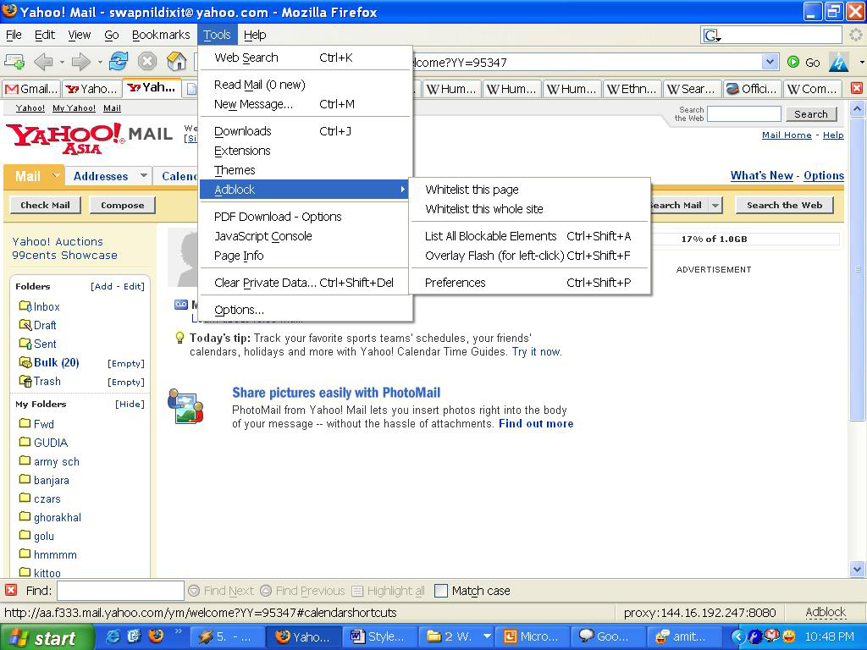
Menu Based Interface

Slide 19
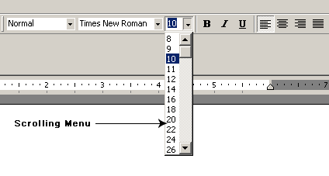
Scrolling Menu

Slide 20
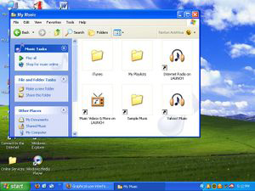
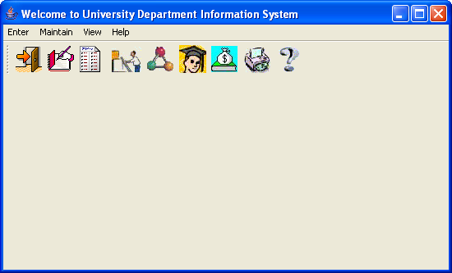
ICON Interface
Desktop metaphor

Slide 21
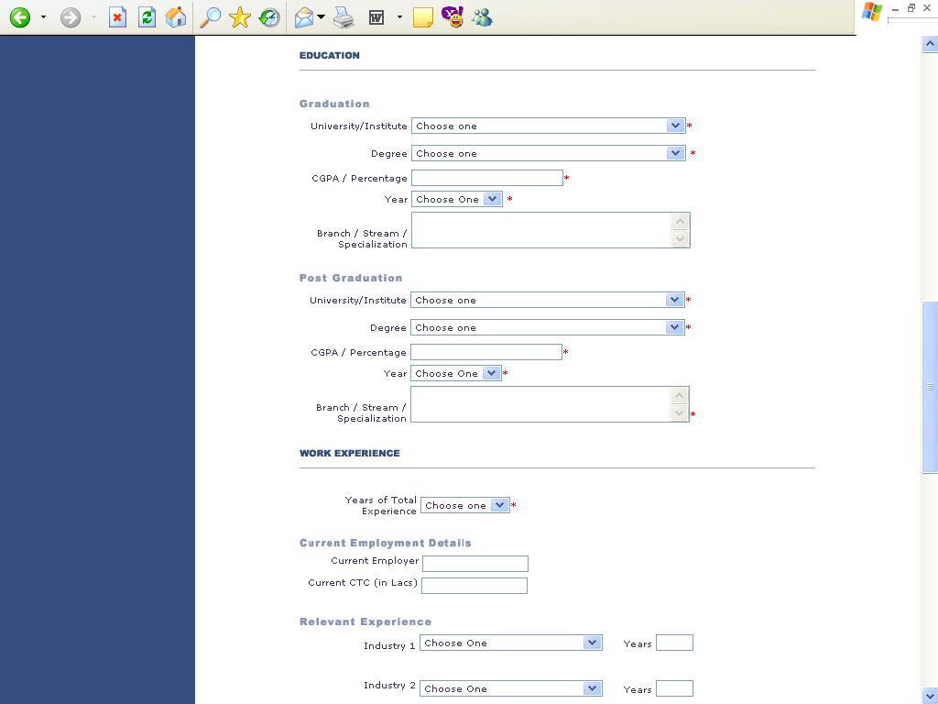
Form –Fill Interface

Slide 22
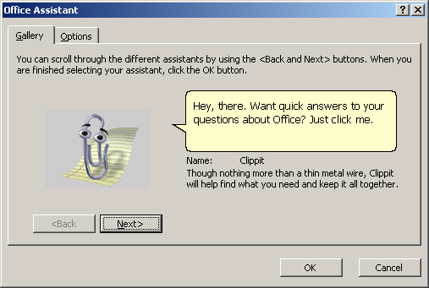
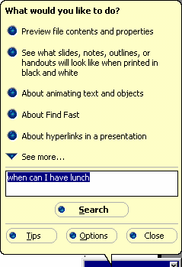
Natural Language Interface

Slide 23
Review
Interface design should be user-centred. An interface should be logical and consistent and help users recover from errors
Graphical displays should be used to present trends and approximate values. Digital displays when precision is required
Colour should be used sparingly and consistently
Systems should provide on-line help. This should include “help, I’m in trouble” and “help, I want information”
Error messages should be positive rather than negative.
Ideally, a user interface should be evaluated against a usability specification

