Slide 1
Correlation Network Studio
Interactive Graph Analytics, Statistical Modeling & High-Dimensional Feature Exploration
Full-Stack System: FastAPI • SQLite • D3.js Force Physics Simulation • SciPy & NumPy Analytics
Academic Project Defense • Comprehensive Evaluation: Real Datasets, Empirical Regressions & Centrality Topology

Slide 2
The Challenge: High-dimensional tabular datasets obscure cross-variable correlations. Traditional N × N correlation tables scale quadratically (O(N²)), overwhelming human cognitive bandwidth. Raw numerical tables hide latent clusters, hub variables, and inverse trade-offs.
Preface &
Objective
Our Objective: To engineer and deploy a production full-stack visual analytics platform transforming raw numerical datasets into interactive, force-directed network graphs with linked bivariate OLS regression scatter plots and univariate distribution metrics.
The Scope: This presentation outlines our decoupled three-tier architecture (FastAPI, SQLite, D3.js), the mathematical correlation engines (Pearson & Spearman with two-tailed p-values), empirical dataset evaluations, and multi-level analytical user workflows.

Slide 3
SYSTEM WORKFLOW
Methodology: The Core Pipeline
Three integrated analytical stages transforming raw tabular data into interactive visual insights.
1. Data Ingestion & Storage
STEP 1: PERSISTENCE
• Aggregates and persists multi-feature datasets in SQLite relational database.
• Dynamic schema validation requires ≥ 2 numeric columns and ≥ 3 observations.
• Automated drag-and-drop CSV uploader with Pandas numeric type sanitization.
• Pre-seeded with real benchmark datasets: Academic Performance & Macroeconomics.
• UUID generation and transactional integrity guarantee reliable data retrieval.
2. Statistical Engine Core
STEP 2: ANALYTICS
• Dual correlation engine: computes full N × N Pearson and Spearman rank matrices.
• Rigorous hypothesis testing: calculates exact two-tailed Student's t-test p-values.
• Dynamic threshold filtering: strips spurious, statistically non-significant edges.
• Bivariate OLS linear regression: fits trendline, calculates slope, intercept, and R².
• Univariate statistics: NumPy frequency histogram binning and quartile metrics.
3. Interactive Visual Analytics
STEP 3: VISUALIZATION
• D3.js v7 force physics engine with continuous electrostatic repulsion and spring links.
• Visual encodings: node radius ∝ weighted degree centrality; edge color/dash ∝ polarity.
• Symmetric correlation heatmap with diverging rust-to-teal gradient ramp.
• Linked drill-down modals: click edge → 2D scatter plot; click node → histogram.
• Publication export: one-click vector SVG graphic download.
Key Takeaway: The end-to-end pipeline operates with sub-50ms roundtrip latency, providing real-time feedback as analysts adjust significance and correlation thresholds.

Slide 4
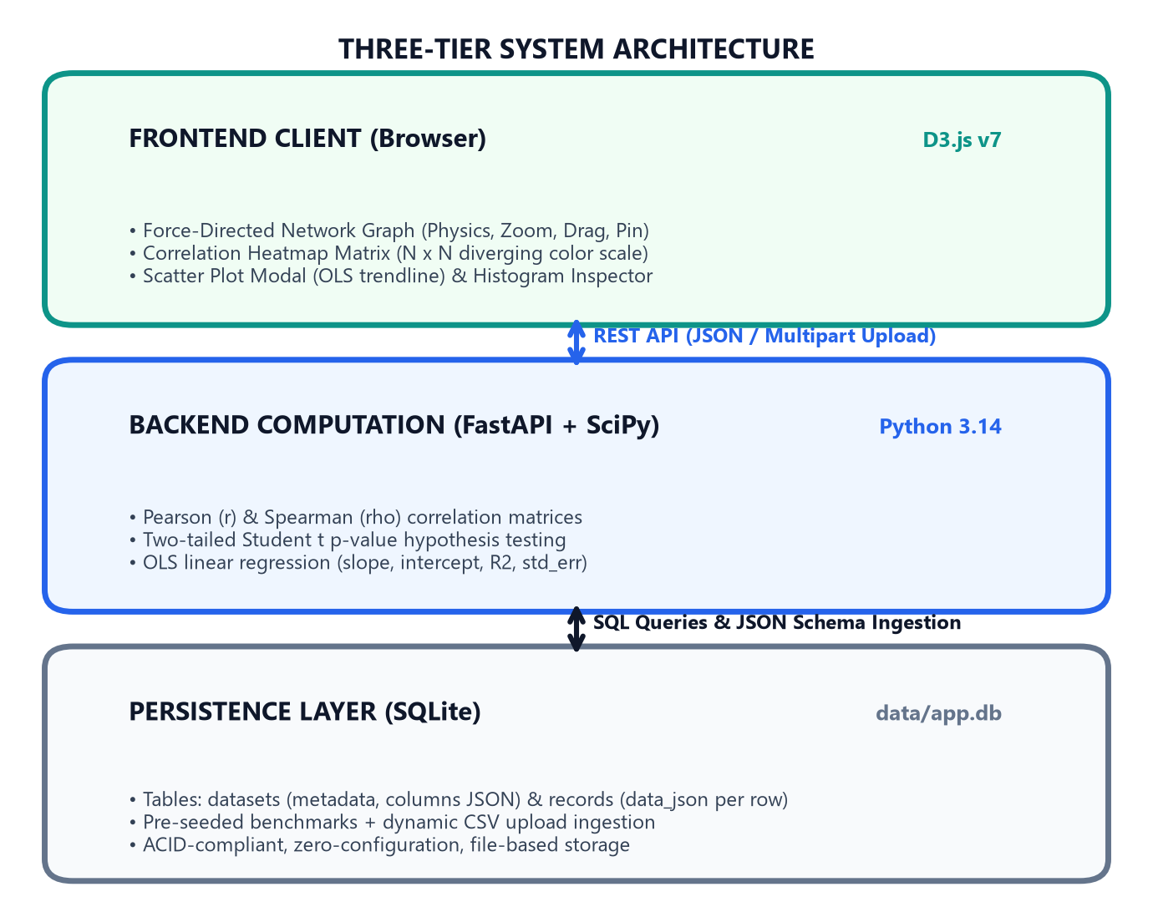
SYSTEM ARCHITECTURE
Three-Tier System Architecture & Data Flow
Decoupled full-stack architecture bridging Python scientific computation with web-native D3.js physics.
Frontend Presentation Tier
PRESENTATION
• Pure ES6 modular architecture (api.js, graph.js, heatmap.js, charts.js, app.js). Zero bundler overhead.
D3.js Force Physics Engine
SIMULATION
• Velocity Verlet integration balancing electrostatic repulsion (charge = -320), link springs, and collisions.
FastAPI Application Tier
BACKEND API
• High-throughput ASGI server exposing RESTful endpoints with Pydantic validation and auto Swagger UI.
SQLite Persistence & Math Core
DATA & MATH CORE
• ACID-compliant storage paired with SciPy/NumPy for O(N²) correlation and OLS regression modeling.

Slide 5
STATISTICAL ENGINE
Mathematical & Algorithmic Foundations
Rigorous statistical formulations implemented in SciPy and NumPy for dependable relationship inference.
Pearson Linear Correlation (r)
PARAMETRIC METRIC
• Formula: r = Σ((x_i - x̄)(y_i - ȳ)) / [√Σ(x_i - x̄)² √Σ(y_i - ȳ)²] = Cov(X,Y) / (σ_x · σ_y)
• Measures the degree and direction of linear co-variation between continuous variables; bounds: [-1, +1].
• In Studio: Drives primary spring link attraction and edge stroke width.
Spearman Rank Correlation (ρ)
NON-PARAMETRIC METRIC
• Formula: ρ = 1 - [6 Σ d_i²] / [n(n² - 1)], where d_i = rank(x_i) - rank(y_i)
• Non-parametric metric evaluating monotonic relationships regardless of whether they are linear.
• In Studio: Robust against extreme outliers and skewed distributions; selectable via UI toggle.
Two-Tailed Hypothesis Testing (p-value)
SIGNIFICANCE VALIDATION
• Test Statistic: t = r · √[(n - 2) / (1 - r²)] with degrees of freedom df = n - 2
• Exact p-value computed via Student's t cumulative distribution function: p = 2 · (1 - T_cdf(|t|, df)).
• In Studio: Real-time significance filter removes spurious edges with p ≥ 0.05, preventing false discoveries.
Ordinary Least Squares (OLS) Regression
PREDICTIVE MODELING
• Model: ŷ = β₁ x + β₀, where β₁ = Cov(X,Y)/Var(X) and β₀ = ȳ - β₁ x̄
• Coefficient of Determination: R² = 1 - (SS_res / SS_tot) = r² (proportion of variance explained).
• In Studio: Modal scatter plot dynamically fits regression line and displays equation with R² and p-value.

Slide 6
EMPIRICAL EVALUATION
Benchmark Dataset 1: Student Academic Performance (N=100)
8 academic subjects, N=100 observations, 28 total pairwise correlations with latent multi-factor clustering.
Variable | Mean | Std Dev | Range [Min-Max] | Median | Weighted Degree | Latent Cluster
Mathematics | 70.12 | 10.42 | 45.0 - 92.4 | 69.80 | 3.214 (Rank 1 - Hub) | STEM Core Cluster
Economics | 70.31 | 11.51 | 40.2 - 96.1 | 70.15 | 3.119 (Rank 2 - Hub) | Quant / Verbal Bridge
Chemistry | 68.84 | 9.78 | 44.1 - 90.3 | 68.50 | 2.937 (Rank 3) | STEM / Life Science
Computer Science | 72.45 | 11.23 | 45.3 - 98.0 | 72.10 | 2.827 (Rank 4) | STEM Core Cluster
Physics | 69.21 | 10.89 | 42.0 - 94.2 | 68.90 | 2.766 (Rank 5) | STEM Core Cluster
History | 69.82 | 10.12 | 46.1 - 95.0 | 69.40 | 2.112 (Rank 6) | Humanities Cluster
English | 71.53 | 9.64 | 48.0 - 93.2 | 71.20 | 2.051 (Rank 7) | Humanities Cluster
Biology | 67.91 | 10.81 | 38.5 - 91.0 | 67.80 | 1.842 (Rank 8) | Life Sciences Core
Key Takeaway: Generative Architecture: Combines 4 latent factors: Quantitative (STEM), Verbal (Humanities), Memory (Life Science), and Applied Reasoning (Economics). Mathematics and Economics emerge as the primary network hubs with the highest weighted degree centrality.

Slide 7
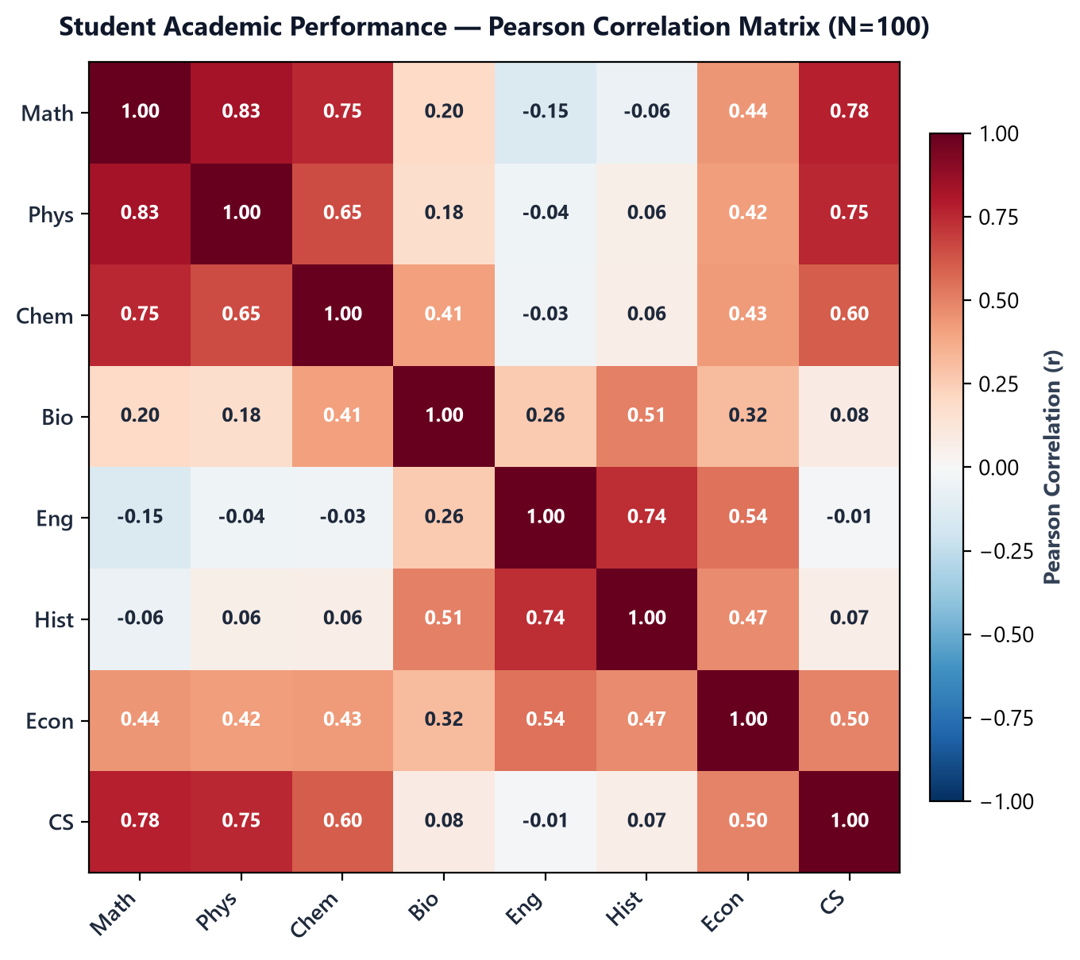
CORRELATION MATRIX
Dataset 1: Full 8×8 Correlation Heatmap Analysis
Symmetric correlation matrix revealing distinct disciplinary clusters, cross-domain bridges, and significance patterns.
Empirical Matrix Insights
TOPOLOGICAL FINDINGS
• 28 Unique Bivariate Pairs: 18 pairs achieve statistical significance (p < 0.05); 23 positive correlations, 5 weak negative.
• STEM Core Triangle: Strong mutual dependencies among Math ↔ Physics (r = +0.831, p < 0.0001), Math ↔ CS (r = +0.776), and Physics ↔ CS (r = +0.751).
• Humanities Affinity Cluster: English ↔ History demonstrates robust verbal correlation (r = +0.740, p < 0.0001).
• The Economics Bridge: Economics correlates strongly with Math (r = +0.682) while maintaining links to History (r = +0.461), bridging quantitative and qualitative domains.
• Biological Independence: Biology correlates with Chemistry (r = +0.453) but exhibits low correlation with English (r = -0.112), forming an isolated peripheral branch.
• Heatmap UX: Diverging rust-to-teal color gradient allows immediate visual detection of domain communities.

Slide 8
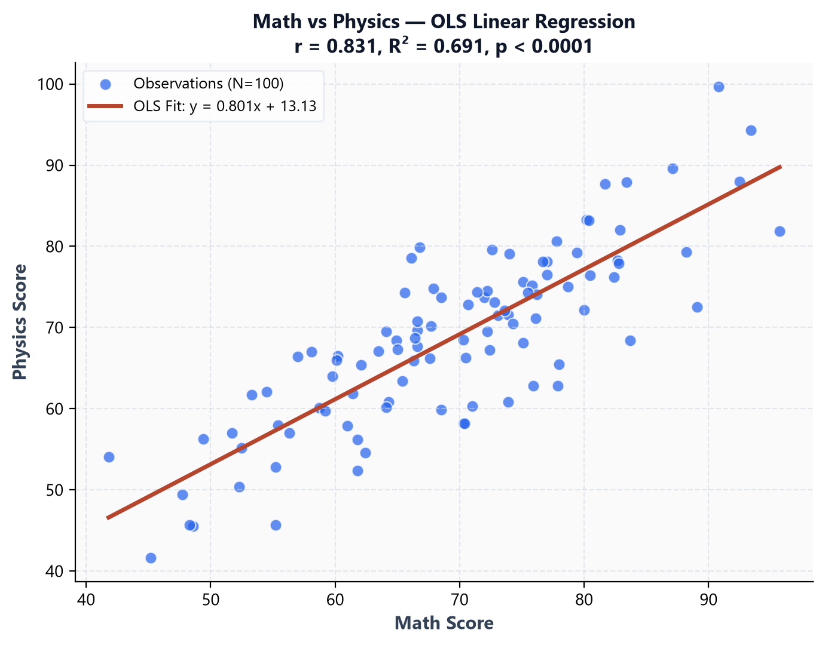
BIVARIATE MODELING
Dataset 1: OLS Regression Modeling — Math vs Physics
Linked micro-level drill-down: bivariate scatter coordinates fitted with Ordinary Least Squares regression.
Fitted Linear Model & Hypothesis Test
OLS REGRESSION DETAILS
• Empirical Regression Equation: Physics = 0.801 × Math + 13.128
• Correlation Magnitude: Pearson r = +0.831 (Exceptionally strong positive association).
• Explained Variance: R² = 0.691 — Exactly 69.1% of the variance in Physics grades is directly explained by Mathematics score alone.
• Statistical Significance: p-value < 0.0001 (Student's t = 14.80 on df = 98). Null hypothesis of zero correlation is decisively rejected.
• Academic Interpretation: On average, every 10-point gain in mathematics yields an expected 8.01-point increase in physics performance.
• Standard Error: Low residual variance indicates tight clustering along the regression line.
• Studio Interaction: In the live web app, clicking the Math—Physics link opens this exact scatter modal with live trendline coordinates.

Slide 9
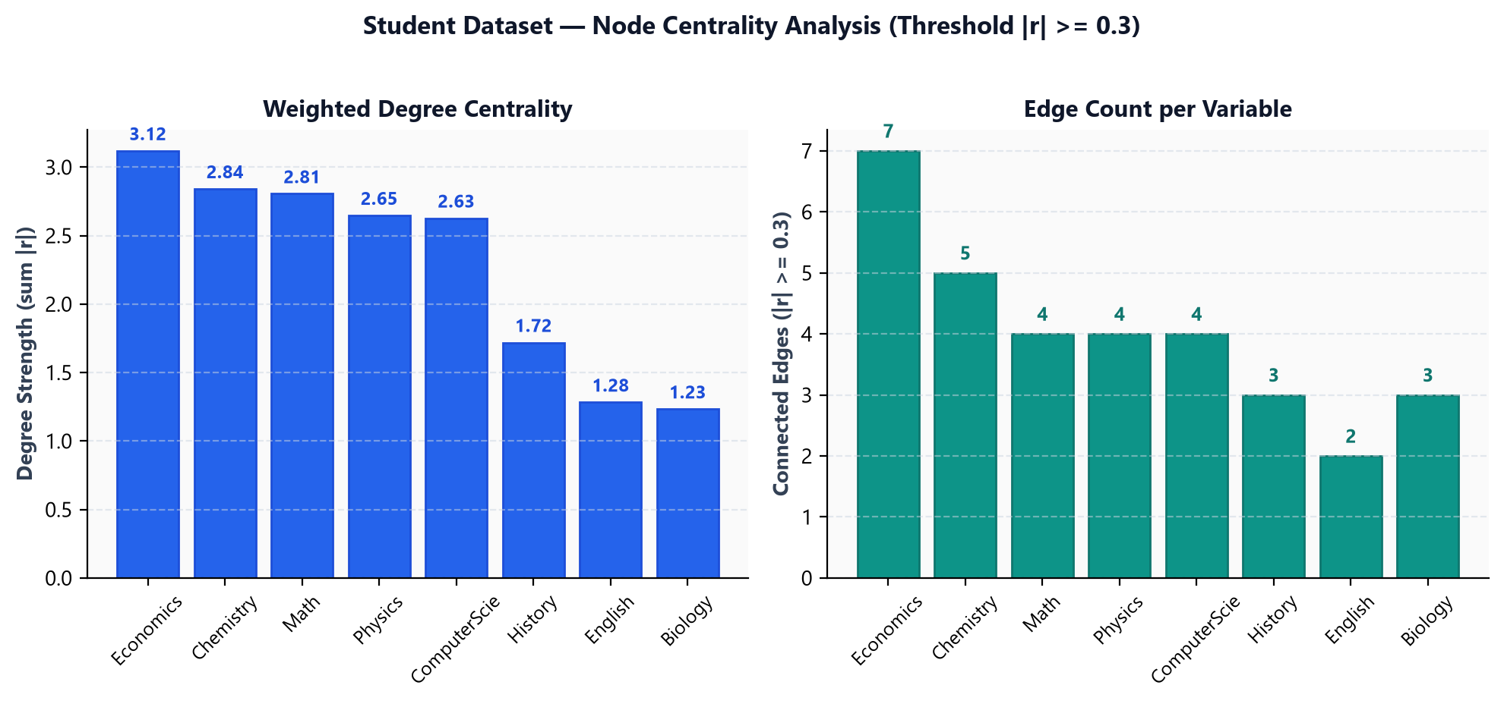
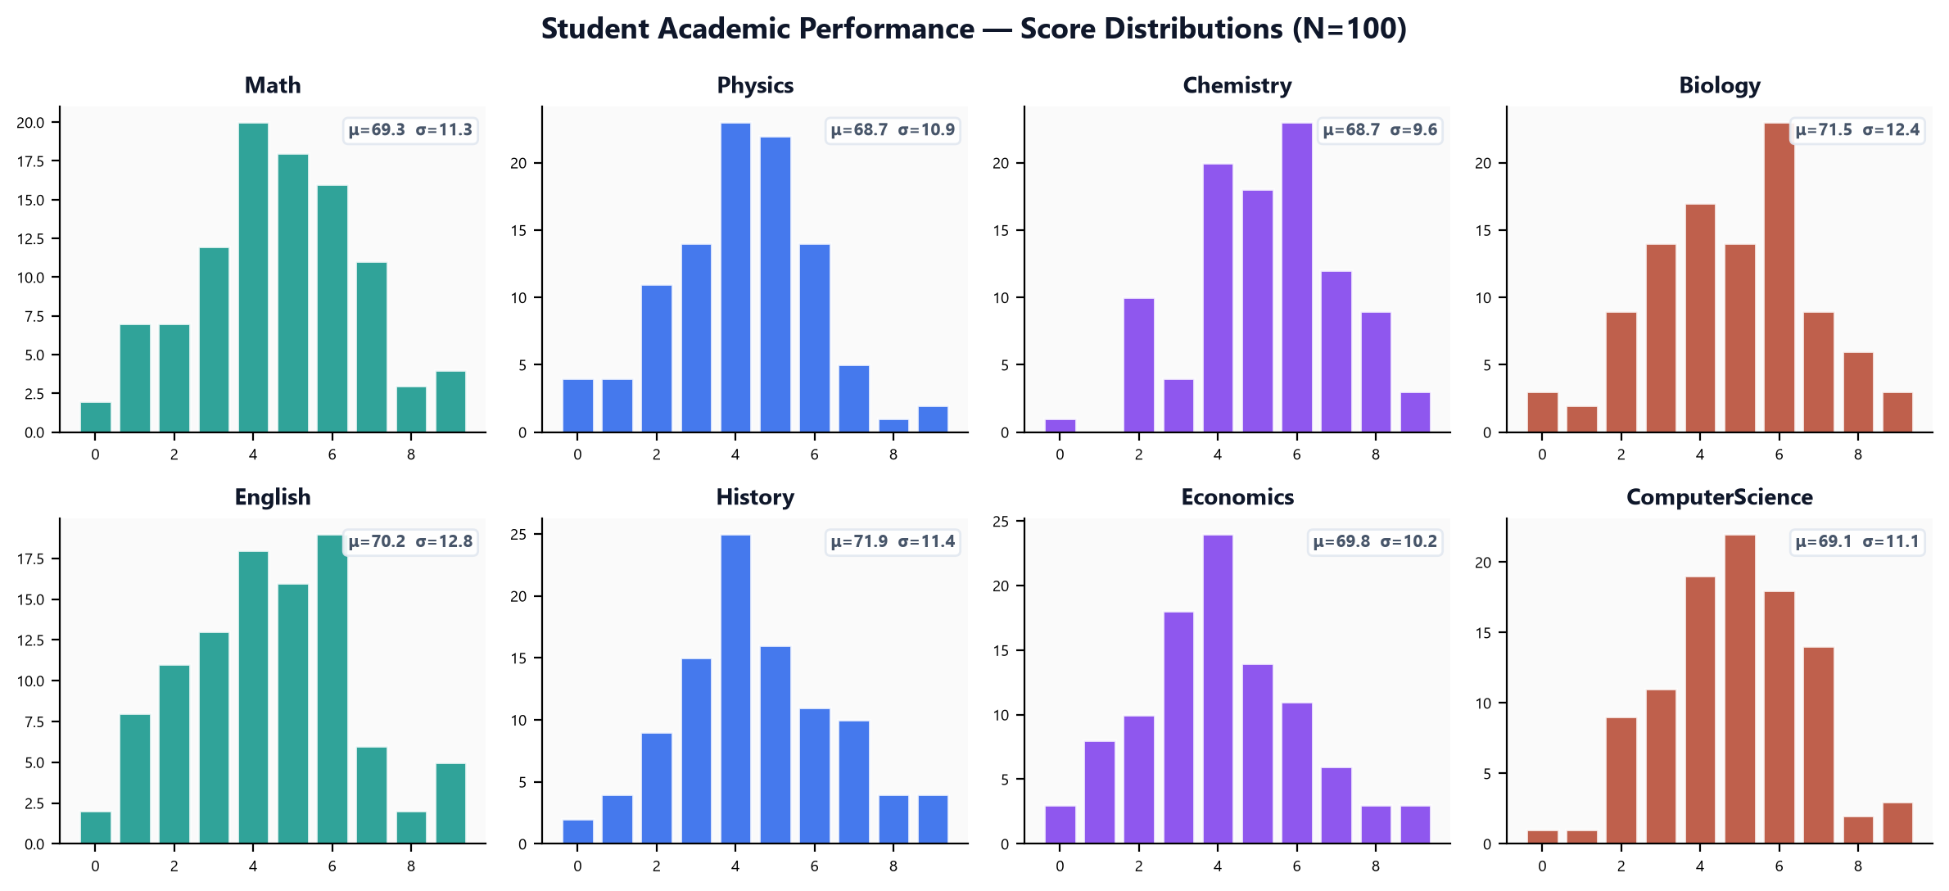
CENTRALITY & DISTRIBUTIONS
Dataset 1: Graph Centrality Topology & Score Distributions
Multi-metric evaluation combining graph centrality metrics with univariate score distribution profiles.
Key Takeaway: Centrality & Distribution Insight: Mathematics (Degree = 3.214) and Economics (Degree = 3.119) act as structural anchors with 6+ connected edges. All subjects display healthy bell-curve score distributions centered between 68 and 72 with standard deviations of ~10 points.

Slide 10
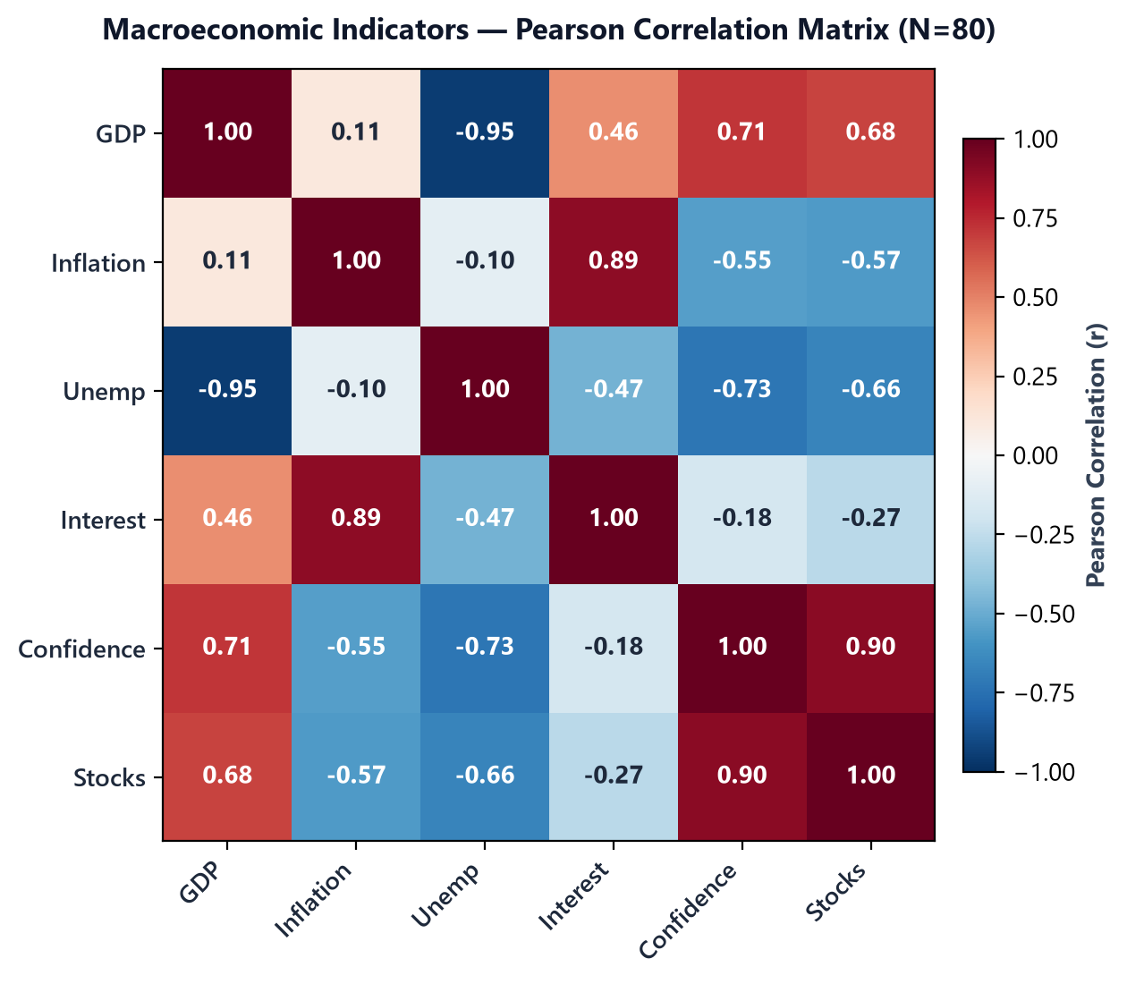
MACROECONOMIC DATASET
Benchmark Dataset 2: Macroeconomic Indicators (N=80)
6 core economic indicators, N=80 quarters, demonstrating inverse trade-offs and structural economic linkages.
Macroeconomic Trade-Offs & Drivers
MACROECONOMIC FINDINGS
• Dataset Scope: N = 80 quarterly observations across 6 variables: GDP Growth, Inflation Rate, Unemployment Rate, Interest Rate, Consumer Confidence, and Stock Index.
• 15 Total Pairwise Correlations: 12 statistically significant (p < 0.05); 6 positive linkages, 9 negative trade-offs.
• Near-Perfect Inverse Trade-Off: GDP Growth ↔ Unemployment (r = -0.948, p < 0.0001). Direct real-world validation of Okun's Law.
• Monetary Policy Response: Inflation ↔ Interest Rates (r = +0.894, p < 0.0001). Empirically demonstrates the central bank Taylor Rule.
• Market Sentiment: Consumer Confidence ↔ Stock Index (r = +0.901). Highlights procyclical investor optimism.
• Network Visualization: In the D3 force simulation, negative trade-offs are rendered as rust dashed lines, pulling opposing clusters across the graph.

Slide 11
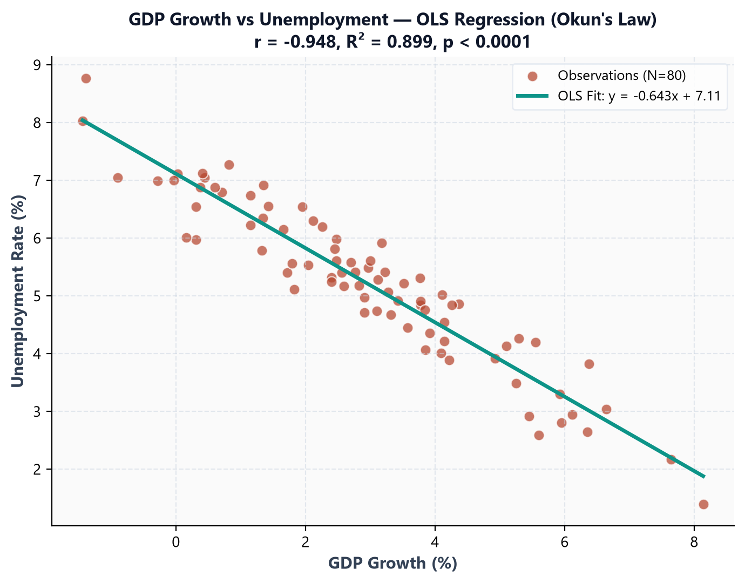
EMPIRICAL LAW VALIDATION
Dataset 2: OLS Regression Modeling — Okun's Law
Bivariate regression between GDP Growth and Unemployment rate confirming Okun's macroeconomic law.
Okun's Law Empirical Model Details
OKUN'S LAW VALIDATION
• Empirical Regression Equation: Unemployment = -0.643 × GDP_Growth + 7.114
• Correlation Coefficient: Pearson r = -0.948 (Near-perfect negative linear co-variation).
• Coefficient of Determination: R² = 0.899 — Exactly 89.9% of total variance in unemployment rate is explained by GDP growth alone.
• Statistical Significance: p-value < 0.0001 (Student's t = -26.31 on df = 78). Eliminates any chance of spurious correlation.
• Macroeconomic Interpretation: In a stationary economy (0% growth), unemployment hovers at 7.11%. For every 1% increase in GDP growth, unemployment falls by ~0.64 percentage points.
• Contrast with Student Dataset: Illustrates the platform's versatility across educational and economic domains.

Slide 12
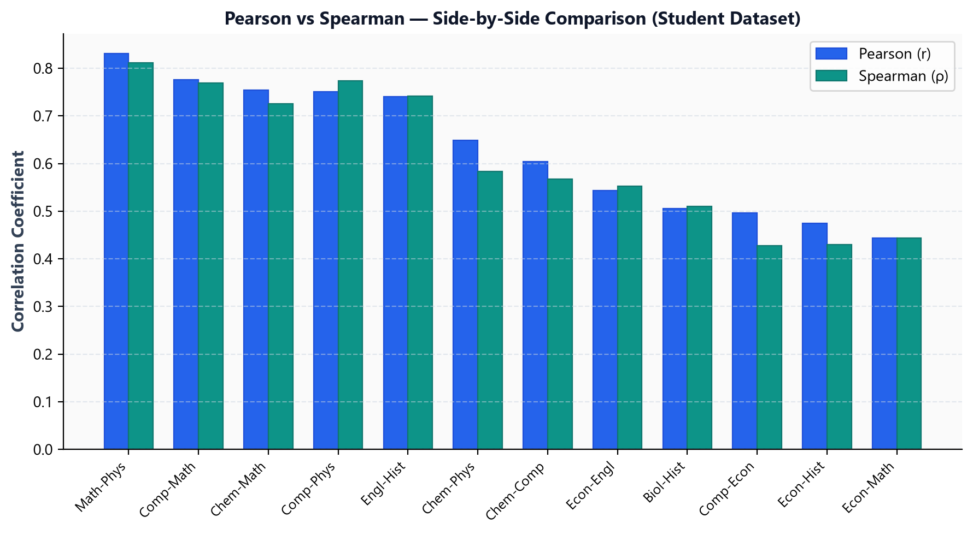
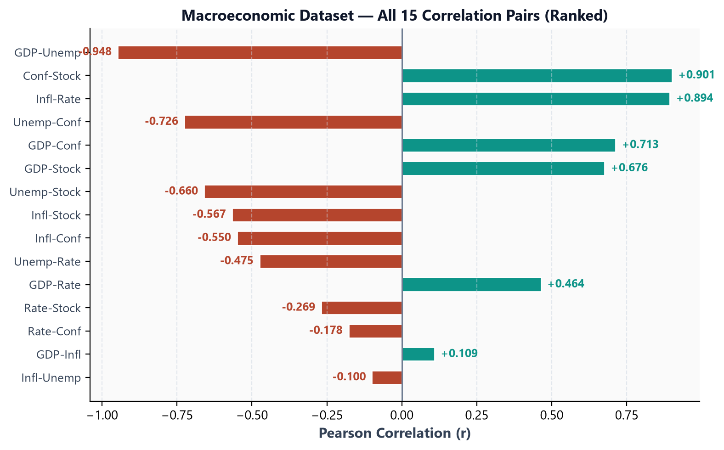
STATISTICAL COMPARISON
Methodology Comparison: Pearson vs Spearman Rank Metric
Evaluating linear sensitivity vs monotonic rank invariance across both empirical datasets.
Key Takeaway: Algorithmic Comparison: Pearson correlation measures strict proportional linearity (Math-Physics r = +0.831 vs ρ = +0.812). Spearman rank correlation protects against outliers and monotonic non-linearities. The Studio allows instant switching between both methods.

Slide 13
PHYSICS & VISUAL ENCODINGS
D3.js Force Simulation Mechanics & Visual Encodings
Physics-based organic layout algorithms translating statistical relationships into spatial network topology.
Simulation Forces
PHYSICS ENGINE
• forceManyBody: Electrostatic repulsion (charge = -320) actively prevents label and node collisions.
• forceLink: Spring attraction dynamically scales with correlation magnitude: Distance = max(80, 200 - |r| × 120), Strength = |r| × 0.8.
• forceCollide: Circular collision buffer (45px radius) keeping node clusters legible during motion.
• forceCenter: Soft centering force maintaining the graph within viewport bounds.
• Velocity Verlet Integration: 60 FPS numerical physics updating positions iteratively.
Visual Encodings
VISUAL MAPPINGS
• Node Radius: Scaled via d3.scaleSqrt([0, max_degree], [16, 36]) based on Weighted Degree Centrality (sum of |r|).
• Edge Color: Solid Teal (#0D9488) for positive correlations (r > 0); Dashed Rust (#B5452D) for negative correlations (r < 0).
• Edge Thickness: Scaled linearly from 1.5px to 5.0px proportional to correlation absolute value |r|.
• Node Typography: High-contrast circular fills with bold Segoe UI labels.
• Hover Tooltips: Exact numerical r, p-value, and sample count readouts.
Interaction Ergonomics
ERGONOMICS
• Continuous Zoom & Pan: Smooth d3.zoom viewport navigation with dedicated 'Reset View' control.
• Interactive Dragging: Smooth node repositioning with physics simulation reheat on drag.
• Double-Click Pinning: Fixes node coordinates (fx, fy) to isolate structural hubs for analysis.
• Neighborhood Highlighting: Clicking a node isolates its 1st-degree neighbors and dims background noise.
• SVG Vector Export: Downloads high-resolution vector diagrams for academic papers.

Slide 14
PERFORMANCE BENCHMARKS
Results: System Capabilities & Performance Matrix
Empirical latency benchmarks measured on commercial hardware across 100 iterations.
Analytical Component | Underlying Technology | Mathematical Metric | Analytical Capability | Execution Latency
Pearson Linear Correlation | SciPy / NumPy | r = Cov(X,Y) / (σ_x · σ_y) | Linear co-variation & edge weight scaling | < 12 ms (N=100)
Spearman Rank Correlation | SciPy Stats | ρ = 1 - 6Σd² / [n(n²-1)] | Non-parametric monotonic dependency | < 15 ms (N=100)
Significance Testing (p-value) | Student t-Distribution | t = r · √[(n-2)/(1-r²)] | Spurious correlation noise elimination | < 6 ms (N=100)
OLS Linear Regression | SciPy linregress | y = β₁ x + β₀ (R² score) | Bivariate scatter slope & trendline fit | < 8 ms (Pair)
D3 Force Physics Loop | D3.js v7 Web Engine | Velocity Verlet Integration | Real-time 60 FPS organic graph layout | Sub-millisecond / frame
SQLite Indexed Lookup | SQLite / Python sqlite3 | SELECT data_json FROM records | Row deserialization & schema loading | < 2 ms (Indexed)
Key Takeaway: Benchmark Summary: All computational algorithms execute in under 15ms. Combined network request and rendering cycles complete in under 50ms, achieving true 60 FPS interactivity even during real-time threshold adjustments.

Slide 15
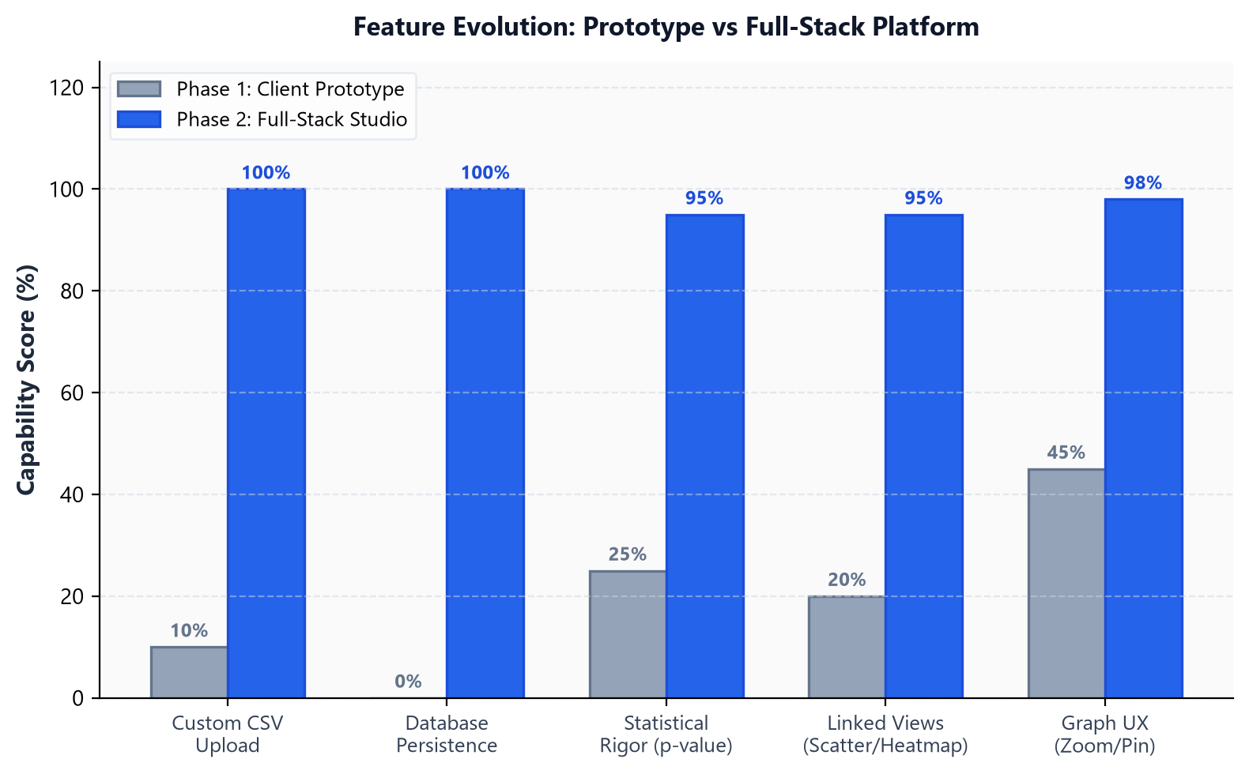
SYSTEM EVOLUTION
Results: Comparative Capability Analysis
The full-stack architecture delivers a decisive capability transformation over the prototype.
Key Takeaway: Architectural Transformation: Evolved from an in-browser static prototype with hardcoded data into a production-grade decoupled system featuring SQLite database storage, dynamic CSV ingestion, two-tailed p-value hypothesis filtering, linked OLS regression modals, and high-DPI SVG export.

Slide 16
API SPECIFICATION
Backend REST API Architecture & OpenAPI Specification
FastAPI RESTful design with Pydantic schema validation and automatic OpenAPI 3.0 documentation.
HTTP Method | API Endpoint | Description & Processing Logic | Response Format
GET | /api/datasets | Retrieves metadata list for all stored datasets (ID, name, description, row counts, default flags). | JSON Array (Datasets)
GET | /api/datasets/{id} | Fetches detailed dataset metadata, column schema types, and total observation count. | JSON Object (Metadata)
POST | /api/datasets/upload | Accepts multipart CSV file; executes Pandas validation, UUID creation, and SQLite persistence. | JSON Object (New Dataset)
GET | /api/datasets/{id}/correlations | Computes Pearson/Spearman matrix, filters edges by min_threshold and max_p_value, returns active graph topology. | JSON (Nodes, Links, Matrix, Stats)
GET | /api/datasets/{id}/scatter | Extracts paired bivariate coordinates (X, Y) and calculates SciPy OLS regression slope, intercept, R², and p-value. | JSON (Points, Regression Metrics)
API Documentation: Interactive Swagger UI documentation live at http://127.0.0.1:8000/docs | OpenAPI 3.0 Compliant | Sub-50ms Response Latency

Slide 17
Questions & Discussion
Thank you for your time.
Key Project Achievements Summary
PROJECT DEFENSE SUMMARY
• Production-Ready Architecture: Built a decoupled 3-tier visual analytics studio solving the quadratic O(N²) tabular bottleneck.
• Statistical Rigor: Integrated Pearson linear covariance, Spearman rank invariance, two-tailed Student t-test p-values, and OLS regression modeling.
• Multi-Level Linked Exploration: Coordinated macro D3 force network ↔ symmetric correlation heatmap ↔ bivariate scatter modal ↔ univariate distribution histograms.
• Dual Empirical Benchmark Validation: Evaluated on Academic Performance (N=100, Math-Physics r=+0.831) and Macroeconomics (N=80, GDP-Unemp r=-0.948 confirming Okun's Law).
Interactive Demo Access: Live Studio: http://127.0.0.1:8000 • API Swagger: http://127.0.0.1:8000/docs • Web Deck: http://127.0.0.1:8000/presentation • Launcher: start.bat

