Slide 1

Zeal Institute — Project Management System
Digital solution to manage the end-to-end academic project lifecycle for ZIBACAR (affiliated to SPPU, AICTE approved, DTE recognized).
Presented by: Omkar Dhumal
Nikhil Devkar

Slide 2

Why a Digital System?
Current Challenges
Opportunity
Manual tracking, scattered documents, missed deadlines, and high admin workload.
Centralize monitoring, automate notifications, and enforce stage-wise progress tracking.

Slide 3
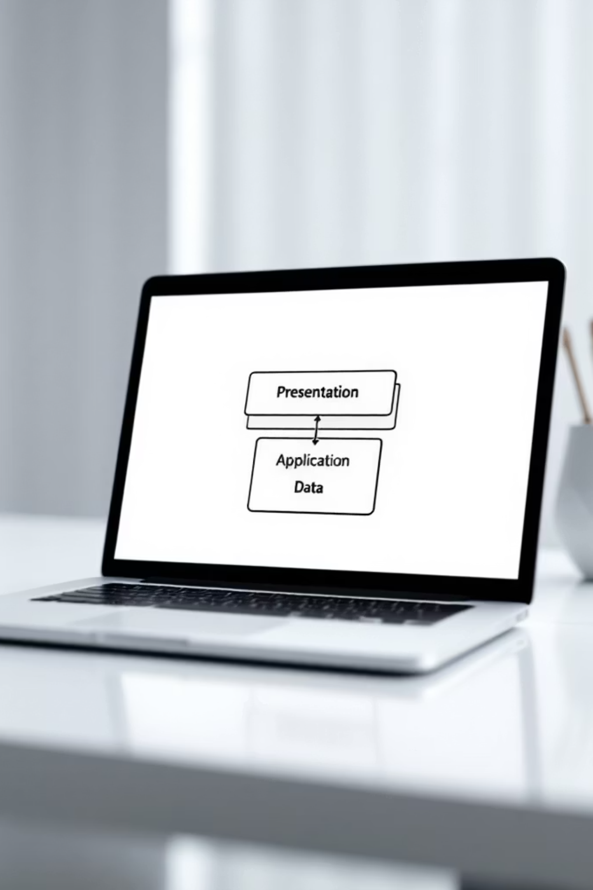
System Architecture
Three-tier architecture: Presentation (UI/dashboards), Application (Flask backend, business logic), Data (MongoDB collections for users, batches, stages, submissions, notifications).

Slide 4


Primary Roles & Permissions
Admin (Coordinator)
Create/manage batches, assign mentors, bulk upload students, configure stages/deadlines, monitor progress.
Faculty (Mentor)
View assigned students, review & approve submissions, add remarks, track stage-wise progress.
Student (Mentee)
Upload documents, view mentor, track deadlines and statuses, receive notifications.

Slide 5


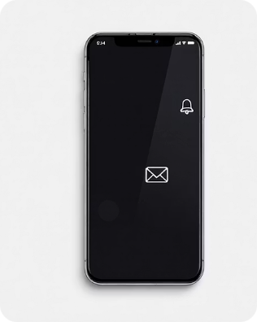
Scope — Core Functionalities
Batch & Stage Management
Submission Workflow
Notifications
Automated email and in-app alerts for deadlines, approvals, and late submissions.
Create/reorder stages, set deadlines, and monitor batch progress.
Upload, review, approve/reject with remarks; support PDF/DOC/PPT and replacements before approval.

Slide 6

Technical Stack
Frontend: HTML5, CSS3, JavaScript (ES6)
Backend: Python (Flask)
Database: MongoDB (NoSQL)
Tools: VS Code, MongoDB Compass, modern browsers
Open-source stack ensures economic feasibility and easy deployment.

Slide 7

Feasibility Overview
Operational
Technical
Economic
Time
User-friendly, minimal training; browser-based access for students and faculty.
Proven open-source technologies; modular design for scalability.
No licensing costs; deployable on free or low-cost hosting.
Modular scope allows completion within an academic project timeline.

Slide 8
Functional & Non-Functional Requirements
Key Functional Needs
Non-Functional Standards
Secure login & role-based access
Bulk student upload (Excel)
Stage-wise submission & approval
Deadline monitoring & late detection
Performance: fast load, efficient uploads
Usability: responsive, intuitive UI
Security: authenticated access, secure file storage
Compatibility: desktop/tablet/mobile, modern browsers

Slide 9

Operating Environment & Hardware
Minimum hardware: PC/laptop, 4 GB RAM, 20 GB free storage, stable internet.
Software environment: Windows OS, Chrome/Firefox/Edge, Flask backend, MongoDB database, VS Code for development.

Slide 10

Expected Benefits & Next Steps
Benefits
Centralized monitoring, reduced admin effort, transparent stage tracking, timely notifications.
Next Steps
Finalize requirements, develop modular sprints, deploy to cloud, pilot with one batch, iterate on feedback.

