Slide 1
ResistanceMap
Where and when is antibiotic resistance spreading?
1,991,552 sequenced isolates, six bacteria, PySpark and Streamlit
BDSMA mini project · SpatioTemporal Data Analytics
Genotypic resistance among sequenced isolates. Not national prevalence. Not for clinical use.
Notes:
Open with the question. One sentence on what the tool is, one on who it is for.

Slide 2
The problem
• Resistance genes appear in one country, become established, then spread
• Carbapenems and colistin are last-resort drugs: genes against them matter most
• NCBI holds 1,991,552 records for six bacteria, but the files are messy
  – Six date formats, free-text places, placeholders such as 'missing'
  – Outbreaks flood single years; recent years are incomplete
Genotypic resistance among sequenced isolates. Not national prevalence. Not for clinical use.
Notes:
Explain why raw counts mislead: outbreaks and upload delay.

Slide 3
Users and guardrails
• Public health students and researchers first; doctors may read it
• Every percentage has its count, Wilson interval and confidence label
• Says 'among sequenced isolates' and 'genotypic resistance' everywhere
• Never recommends a drug, never ranks countries
• Not for clinical use
Genotypic resistance among sequenced isolates. Not national prevalence. Not for clinical use.
Notes:
Doctors may read it, so the app shows evidence about genes, never advice about drugs.

Slide 4
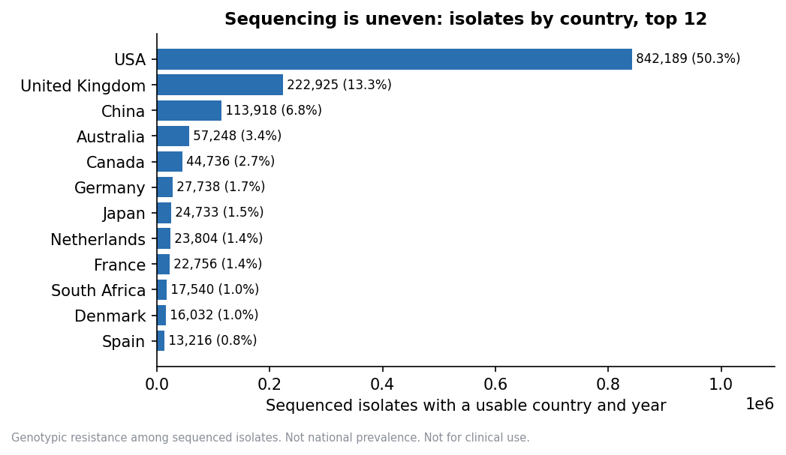
Data
• 1,991,552 rows, 1.92 GB TSV, six organisms
• 11,274,636 isolate and gene rows after splitting gene lists
• Gene catalog and cluster lists from NCBI
• WHO GLASS and AWaRe: comparison and labels only, never merged
• USA 44.53% of isolates, India 0.6%
• Only 2,848 of 9,470 country-year groups reach 30 isolates
Genotypic resistance among sequenced isolates. Not national prevalence. Not for clinical use.
Notes:
The skew is the first limit to state. It shapes every page.

Slide 5
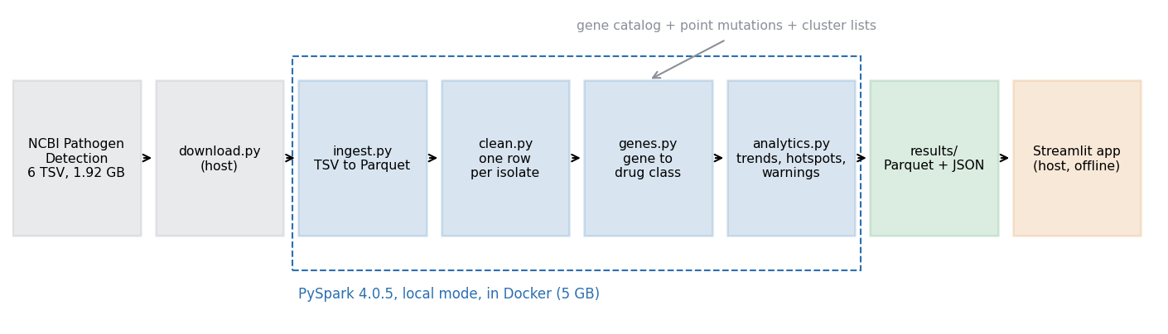
Architecture
Genotypic resistance among sequenced isolates. Not national prevalence. Not for clinical use.
Notes:
Spark in Docker because the host Java 22 is unsupported. Parquet throughout. The app reads only results/, so it runs with Docker stopped.

Slide 6
Methods
• Prevalence: isolates with a gene in the class / all isolates, zero-gene isolates kept
• Wilson 95% interval; hidden under 30 isolates
• Outbreak-adjusted: one count per SNP cluster per country and year
• Rising: slope > 0 and Cochran-Armitage z ≥ 1.96 over 2013–2022
• Established: 3+ isolates from 2+ clusters, not the first raw record
• Early warning: newly established in last 3 years, 'new sequencing' flagged
• Provisional from 2023 because uploads lag collection
Genotypic resistance among sequenced isolates. Not national prevalence. Not for clinical use.
Notes:
Each rule exists to stop one specific over-reading.

Slide 7
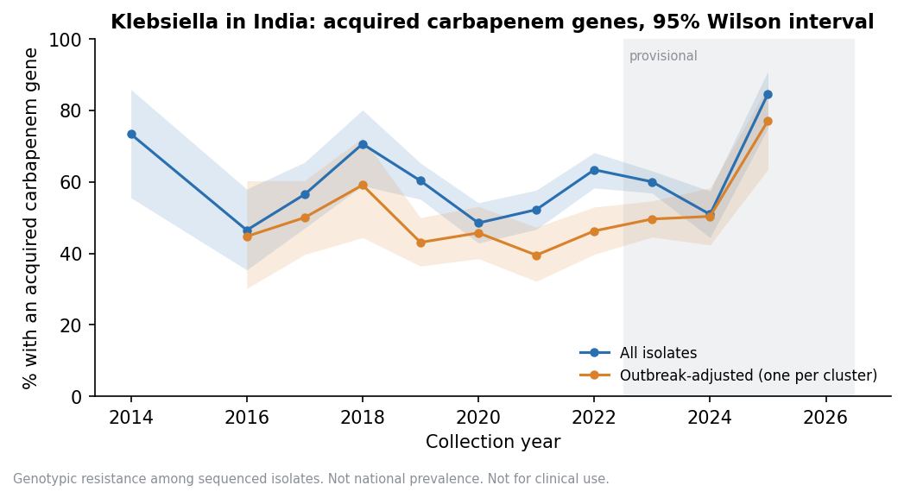
Klebsiella in India: no clear rise
• 2013–2022: 918 of 1,610, slope 0.06 points/yr, z 0.08
• Adjusted: slope -0.87, z -0.92
• Clinical only: slope 1.44, z 1.91
  – Just under 1.96, so not a firm 'no rise'
• High level partly reflects what labs choose to sequence
Genotypic resistance among sequenced isolates. Not national prevalence. Not for clinical use.
Notes:
State the unfavourable result plainly.

Slide 8
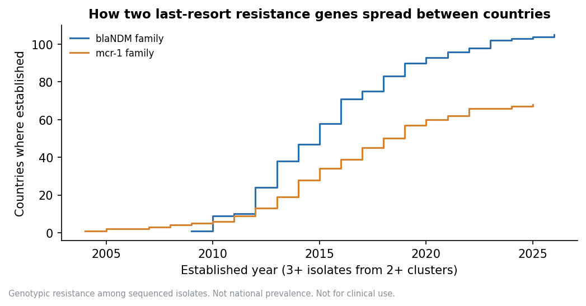
Spread of blaNDM and mcr-1
• blaNDM: established in 105 countries; earliest 2009, India
  – Fits its 2008 discovery linked to New Delhi
• mcr-1: established in 68 countries; earliest 2004, China
  – Before its 2015 report, fits look-back studies
• Raw first records include errors such as a 1943 blaNDM
Genotypic resistance among sequenced isolates. Not national prevalence. Not for clinical use.
Notes:
This is the validation against published history.

Slide 9
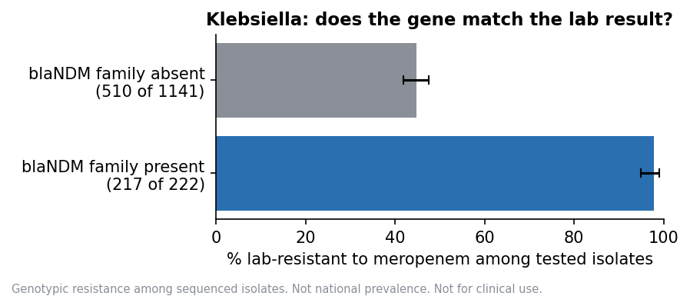
Genes against lab results
• Klebsiella and meropenem, blaNDM family present: 217 of 222 resistant
• Absent: 510 of 1,141 resistant
• A strong marker, but absence does not mean susceptible
• Lab results exist for only 24,803 isolates
Genotypic resistance among sequenced isolates. Not national prevalence. Not for clinical use.
Notes:
Evidence about the gene, not advice about the drug.

Slide 10
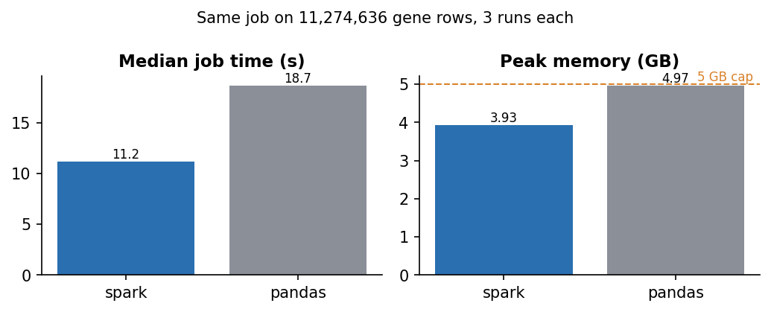
Why Spark
• Same job on 11,274,636 rows, 3 runs each, 5 GB container
• Spark 11.2 s, pandas 18.7 s (median job)
• Peak memory 3.93 GB against 4.97 GB
  – pandas ran right at the 5 GB cap
• Identical answers on all 85,404 rows
• Honest: 1.92 GB is modest; Spark buys headroom and scaling
Genotypic resistance among sequenced isolates. Not national prevalence. Not for clinical use.
Notes:
Do not oversell. The data fits on a laptop.

Slide 11
Validation
• Row counts match source files for every organism
• Reconciliation: 1,991,177 isolates in both tables; all checks pass
• Known sample SAMN02147118 gives its six genes
• First-established years fit published gene history
• pytest on small hand-checked tables; pandas reproduces Spark exactly
• Staph aureus method mix shifted 34.1 points: trend caveat
Genotypic resistance among sequenced isolates. Not national prevalence. Not for clinical use.
Notes:
Validation is what lets a reader trust the numbers.

Slide 12
Limits
• Sampling bias: labs choose what to sequence; not prevalence
• Upload delay: 2023 on is provisional
• A gene is not a lab result; no gene does not mean a drug works
• Country and year only; most groups are under 30 isolates
• Many comparisons: some hotspots flag by chance
• Not for clinical use
Genotypic resistance among sequenced isolates. Not national prevalence. Not for clinical use.
Notes:
Say these before the examiner asks.

Slide 13
Demo
• Map and trends: Klebsiella, carbapenem, acquired, India
• Switch to outbreak-adjusted, then clinical only
• Gene profile: blaNDM spread timeline
• Early warnings: new-sequencing rows hidden by default
• Evidence panel: blaNDM against meropenem
• About the data: coverage and limits
Genotypic resistance among sequenced isolates. Not national prevalence. Not for clinical use.
Notes:
Follow report/viva_notes.md for the full script.

