Slide 1

Econ 452 Forecasting Project
Max Folkins 10133860, Carson O’Sullivan 10153789, Om Sharan 10129754, Aidan Worswick 10148752.

Slide 2
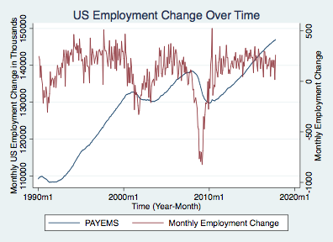
Labour Trends Jan 1990 - Oct 2017
PAYEMS shows us the total U.S. employment (in thousands of people), Seasonally adjusted. It excludes proprietors, household workers, unpaid volunteers, farm workers, and unincorporated self-employed thus isolating changes in PAYEMS to be caused by market forces.
The data set for PAYEMS consists of four Excel files of the real-time monthly observations that would have been available to someone at the point of time (the vintage date).
There is often errors in reported Bureau of Labour Statistics data due to human or technological reporting or calculating errors.
If there are errors in the BLS reported data, they will not be automatically incorporated, rather they will be released at the vintage date following confirmation.

Slide 3
Our Regression Model
We estimated the following equation for monthly changes in employment:
We started with a larger set of variables that we thought would have economic significance (including CPI, interest rates, consumption expenditures, disposable income, and value of exports) and ran the regression with them all included as independent variables.
We then ran an F test with all the variables that were not statistically significant at the 10% level and found that we could not reject the null that the coefficients for all of the variables were zero. We were left with the variables currently included in our model.

Slide 4
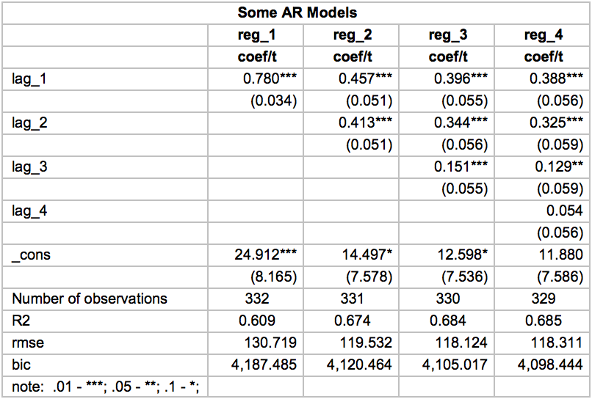
Regression Model For The Monthly Change In Employment
We used AR models with lags ranging from 1 to 4 and compared their regression output to determine how many lags of employment change we would need to include in our model.
The 4th lag of the change was not significant at the 10% level so we excluded it from our model.
The first 3 lags were all statistically significant at the 5% level so we included them in our model.

Slide 5
Our Variables
Lagged growth rate of unemployment - We incorporated the lagged growth rate of unemployment since it is highly negatively correlated with employment.
Growth of world oil price - Increases in oil price lead to decreases in output since a vast majority of projects will see their costs increase since oil is a widely used input. We found this to be more statistically significant when we lagged the variable, this is likely since projects will decide how many workers can fit their budget after they calculate costs of the project, and oil/fuel will often be a major cost.
Lagged Growth of the Participation Rate - The Participation Rate is the amount of people currently employed and the amount of people looking for work. Lagging this variable will be useful since many people looking for work will have found work and those employed will likely continue to be employed.
Notes:
. Higher corporate profits typically higher retail sales and higher economic output. This can lead us to assume that an increase or decrease in NASDAQ can help us predict that amount of labour employed.
“an oil price increase leads to reduction in output since the price increases signaling the reduced availability of basic input to production. As a result, growth rate and productivity decline. Slowing productivity growth decreases real wage growth and increases the unemployment rate (Brown and Yücel, 1999, 2002).”
Lagged gr un
Lagged gr
Growth of world oil price
Growth rate of nasdaq comp index

Slide 6
Our Variables (Continued)
Lagged Growth rate of NASDAQ composite index
The NASDAQ can be a proxy measure of the economy’s overall health. We assume that increases in the NASDAQ index generally reflect increases in business revenue which, in turn, will promote economic expansion and increases in labour to fill new positions. We lagged this variable since many corporate actions must occur before businesses can hire new workers.
Growth rate of initial unemployment benefit claims
A claim may be filed when a worker loses his/her job through no fault of his/her own, usually due to a layoff. We do not lag the growth rate of this claim since we assume workers will file for benefits shortly after losing their job. We think this will be a good indicator since it will correlate negatively with employment and it is easily and accurately reported. This data is published weekly so we already have it up until November 25th. This allows our OLS model to predict the change in employment for November.

Slide 7
Regression Results
Variable | Coefficients | Standard Error
L.emp | 0.328*** | (0.050)
L2.emp | 0.297*** | (0.051)
L3.emp | 0.193*** | (0.049)
g_claims | -2.537*** | (0.358)
L.g_u | -1.952*** | (0.652)
L.g_participation | 12.869* | (7.617)
L.g_oil | 0.379** | (0.170)
L.g_nasdaq | 0.697** | (0.281)
_cons | 17.365** | (7.114)
The Beta (coefficient) value for lagged participation rate is quite a bit larger than the others since it directly defines the amount of people employed and those looking for work in a previous period.
The R2 value defines how closely our regression data fits the true data. This value is 0.753 which tells us that 75.3% of the variation in employment is defined in our model.
The RMSE is an absolute measure of fit. This value is the standard deviation of the unexplained variation in employment.
Number of observations: 330
R2: 0.753
Rmse: 105.153
Significance level: .01 - ***; .05 - **; .1 - *;

Slide 8
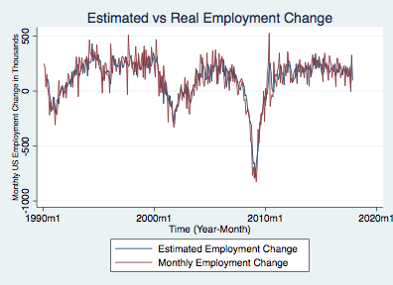
Our Regression Model Accuracy
Within the time period, our model seems to predict the real employment change fairly accurately.
Our estimation also accurately predicts the drop in employment during the 2008 recession showing that it accurately captures large fluctuations.
The estimated regression model has an R² of 0.753 indicating that our model is a good fit with the actual monthly employment change (using a 95% confidence level)

Slide 9
OLS Model vs ARMAX Model vs AR(3) Model
Our OLS model gives very similar estimates to the ARMAX model with the same independent variables and 3 lags of monthly employment change. We also compared with an AR(3) model using only the dependent variable’s value over 3 lagged periods.
We computed the error for each model by subtracting the estimated monthly change in employment from the real monthly change in employment.
We found that the OLS model’s error has a mean of -0.000000321 and a variance 10788.39, the ARMAX model’s error has a mean of -0.2898687 and a variance of 12404.63, and the AR(3) model’s error has a mean of -0.6233737 and a variance of 13845.47.
We used the OLS model for our regression since its error has the lowest absolute mean value and lower variance.

Slide 10
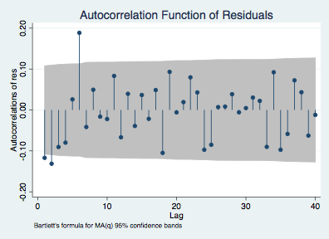
OLS Model Residuals
We calculated the residuals from our regression model and graphed their auto correlation function.
As can be seen on the graph, there is very little persistence in the residuals and the residuals are I(0), meaning there is not much serial correlation in the errors.

Slide 11
Forecasts for November
OLS model predicted a change of employment of 104,651
ARMAX model predicted a change of employment of 103,079
AR(3) model predicted a change of employment of 154,288
Mean monthly employment change from out sample is 113,590
The OLS and ARMAX predictions are very similar and both slightly below the sample mean monthly change in employment

Slide 12
Comparing With Other Forecasts
Most of the forecasts we found online were for the civilian employment level (CE16OV on FRED) rather than the total nonfarm payrolls that we are looking at.
The civilian employment level is quite a bit higher than the nonfarm payrolls level (about 7 million more people in October 2017) so the estimates we found were much higher than the estimates from our models and did not seem very relevant.
The other forecasts we found were all for quarterly employment data so the estimates were also not very relevant or helpful to our prediction.

Slide 13
Choosing a Model to Forecast Employment in November 2017
We want to use a model that has performed well at predicting the monthly change in employment for recent months as it should be more accurate.
This graph shows the errors the three models we calculated over this year.
We found that the ARMAX model had the lowest aboslute mean error for the year and also the lowest variance of its error in 2017.
This led us to use the ARMAX model for our prediction of the change in employment in November 2017.

Slide 14
Our Prediction
From using our ARMAX model, we predict that the change in employment in November 2017 to be an increase of 103,079.
Taking the total employment level in November 2017 to 147,113,079 people.

