Slide 1
CYBERFORGE 2026
01
Real-time analytics
without OLTP slowdown
THE CORE IDEA
Keep PostgreSQL focused on writes.
Move analytical reads to isolated, columnar replicas.
A multi-tenant aggregation layer that turns millions of transactional records into fast, fresh, and isolated business insights.
POSTGRESQL → DUCKDB → FASTAPI
P50
FRESHNESS
SPEEDUP
< 20 ms
< 5 s
30.1×
System design & solution walkthrough

Slide 2
WHY THIS MATTERS
02
The problem: one database, two very different workloads
Transactional systems are optimized for fast, safe writes. Dashboards ask for repeated scans, joins, and aggregations.
!
OLTP pressure
↗
Slow answers
◷
Stale alternatives
Dashboard GROUP BY / SUM queries compete with order placement, updates, and customer operations.
As rows grow into millions, raw analytical queries become hundreds of milliseconds to seconds.
Nightly exports are cheaper—but merchants make decisions using yesterday’s numbers.
The design question
How do we make analytics fast and fresh without putting the transactional database at risk?

Slide 3
THE ARCHITECTURE
03
The solution: separate the read path from the write path
CyberForge continuously replicates only changed data into tenant-isolated DuckDB files, then serves every dashboard query from those replicas.
PostgreSQL
Sync worker
DuckDB replicas
FastAPI
Dashboard
OLTP source
orders & updates
watermark poll
changed rows only
one file per tenant
columnar OLAP
isolation + limits
REST / JSON
fresh metrics
for every owner
WRITE / SYNC PATH
READ / QUERY PATH
PostgreSQL stays safe
DuckDB makes analytics fast

Slide 4
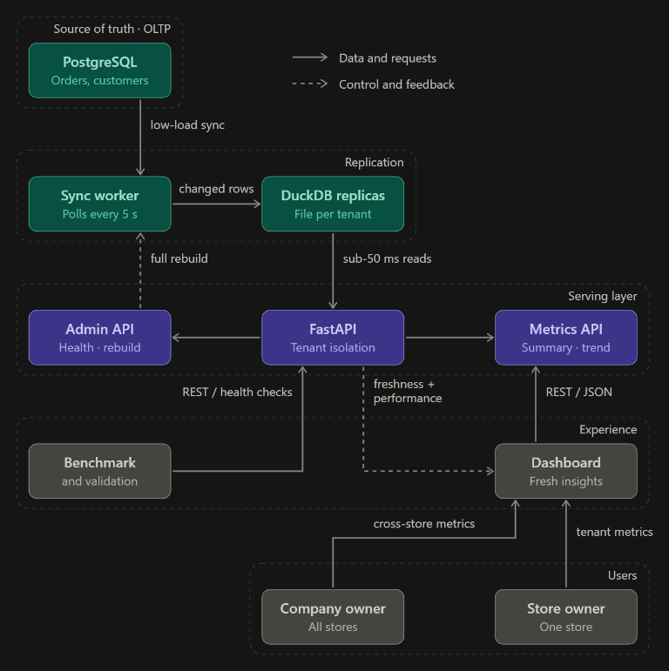
END-TO-END FLOW
04
One picture: how a request becomes an insight
Three flows to remember
1 Data flow
PostgreSQL → worker → tenant DuckDB
2 Query flow
Owner → dashboard → FastAPI → DuckDB
3 Control flow
Admin rebuild / health / telemetry
The visual rule: solid arrows carry data; dashed arrows carry control and feedback.

Slide 5
TRUST BY DESIGN
05
Multi-tenancy without cross-tenant leakage
Isolation is not only an API convention. Each store has its own physical DuckDB replica and its own sync watermark.
Company owner
Four protection layers
permitted stores only
API path
/tenants/{id}/...
Tenant 1
Tenant 2
Database path
dedicated tenant DuckDB file
isolated file
isolated file
Query guard
tenant filter enforced in reads
Tenant 3
isolated file
Operations
per-tenant watermark + lock
Result: Tenant #1 cannot read Tenant #2’s replica or metrics.

Slide 6
PRODUCT SURFACE
06
What the dashboard can answer
One consistent REST API serves both a single store and a company owner managing multiple stores.
01
02
03
04
SUMMARY
TREND
TOP PRODUCTS
STATUS
How many orders?
Total revenue
Average order value
Daily or hourly
sales trajectory
for any date range
Top-N products
by revenue or
units sold
Placed · shipped
Delivered · cancelled
with percentages
Same metrics engine • different scope • consistent JSON • freshness included in every response

Slide 7
PROOF, NOT PROMISES
07
Measured performance: analytics where it belongs
Benchmark: 1,000,000 orders + 1,730,270 line items across 10 tenants
30.1×
maximum speedup
12–16 ms
DuckDB p50 range
100%
dashboard reads offloaded
Every measured endpoint beat the competition target of < 200 ms.

Slide 8
PRODUCTION-MINDED FEATURES
08
Fast is useful only when it is safe and observable
◷
Freshness
↻
Rebuild
◇
Rate limits
Every response exposes data_freshness_seconds.
POST /admin/rebuild restores replicas from PostgreSQL.
Sliding-window limits protect each tenant.
⌁
Telemetry
≡
Dynamic metrics
✓
OpenAPI
Health plus p50 / p95 / p99 latency metrics.
config/metrics.yaml adds metrics without rewiring APIs.
Swagger docs at /docs make the system easy to verify.
The result is not just a fast query engine—it is a recoverable, inspectable service.

Slide 9
VALIDATION PATH
09
The judge demo: three minutes, one clear story
01
Show the baseline
Explain why raw PostgreSQL is the wrong place for repeated dashboard scans.
02
Open the dashboard
Pick a tenant, change the date range, show summary / trend / products / status.
03
Show the proof
Compare latency, freshness, and isolation using the verification suite.
04
Trigger recovery
Call /admin/rebuild and show the replica re-syncing without changing the API.
A judge should leave with one sentence: “The dashboard is fast because it never scans the transactional database.”

Slide 10
CYBERFORGE
Analytics that stay fast,
fresh, and safe.
Judge takeaway
Reads leave the OLTP database.
Freshness stays near real time.
Tenants stay isolated.
Performance is measurable.
Separate the workload. Isolate the tenant. Measure the result.
1M+
30.1×
<5s
orders benchmarked
maximum speedup
freshness target
Thank you
CyberForge 2026

