Slide 1
The Art Of Communication
By Davies Rwabu
Coordinator & Asst. Lecturer, Communication Skills
UB -15, Institute of Languages.

Slide 2
Learning Objectives
What is Communication?
The Communication Cycle
Impact of a message
Types of Communication
Styles of Communication
Effective Listening
Organizational Communication Flow
Barriers to Communication
Communicating Effectively

Slide 3
What is Communication?
The dictionary defines communication as:
A process by which information is
exchanged between
individuals through a common
system of symbols, signs or behavior
Communication is a two-way process which involves:
Listening to others (Receiving) message
Asserting/Expressing (Sending)

Slide 4
Communication Goals
To change behavior
To get and give
Information
To get action
To persuade
To ensure understanding

Slide 5
Communication Cycle
Communication normally goes through a cycle involving:
The Sender
The Recipient
The Message
The Channel

Slide 6
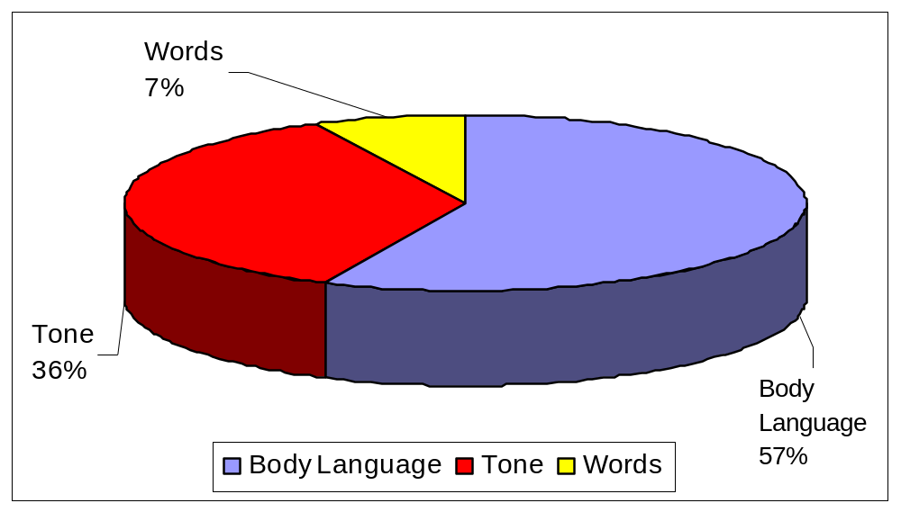
Impact of a Message
Face-To-Face Communication

Slide 7
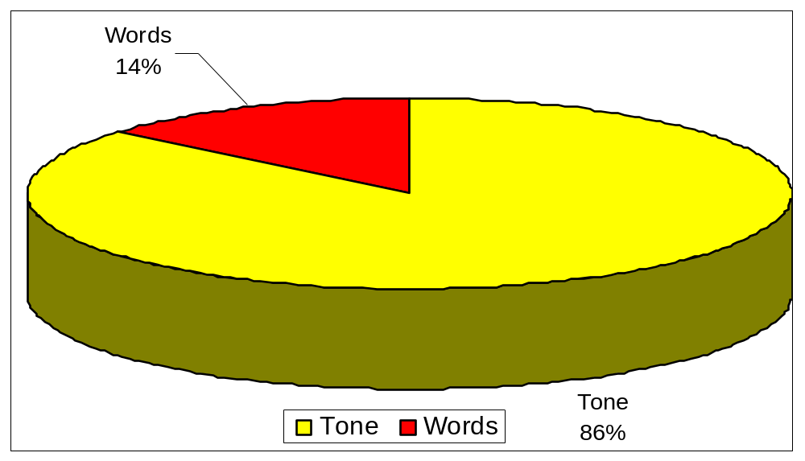
Impact of A Message
Voice Communication

Slide 8
2 Types of Communication
Verbal Communication
Words
Voice modulation
Non-Verbal Communication
Communicates emotions and attitudes
Regulates verbal messages

Slide 9
Verbal Communication
Words
  Use simple language (avoid jargon and slang)
  Make sure that you are grammatically correct
  Be clear and precise (avoid redundancy)
Voice Modulation
  Diction
  Tone
  Pitch
  Volume
  Rate

Slide 10
Non-Verbal Communication
Gestures
  Are you aware of how you look to others?
  Find out your habits and nervous gestures
Posture and movement
  Stand tall
Facial Expressions
  Smile
  Eye Communication
90% of our personal communication calls for involvement. To show involvement, look at your audience for 5 to 10 seconds before looking away.

Slide 11
Communication
Rights and Responsibilities
Rights
Responsibilities
You have the right to be treated with respect.
You have the right to have and express your own opinions.
You have the right to ask for what you need in order to be effective.
You have the right to set reasonable limits.
You have the responsibility to treat others with respect.
You have the responsibility to listen to the opinion of others.
You have the responsibility to acknowledge and address the needs of others.
You have the responsibility to respect the limits and boundaries of others.

Slide 12
Styles Of Communication
Passive
Assertive
Aggressive
Accepts responsibilities.
Extends but does not feel entitled to “rights” .
Both exercises and extends “rights” and responsibilities.
Demands but does not extend “rights”.
Does not accept responsibilities.

Slide 13
Effective Listening Involves. . .
Setting the stage
Remove Distractions
Be open and accessible
Listen with Empathy
Ensuring Mutual Understanding
Reflect feelings
Paraphrase main ideas
Seek clarification
Confirm next steps
Understanding body Language
Observe position and posturing
Make eye contact
Consider expressions/gestures
Suspending judgment
Concentrate
Keep an open mind
Hear the person out
.

Slide 14
3 Types of Listening
Passive Listening
Active Listening
Hearing

Slide 15
Listening and Speaking
Listening takes:
Concentration and energy
Curiosity and open-mindedness
Analysis and understanding
Speaking requires:
Sharp focus
Logical thinking
Clear phrasing
Crisp delivery

Slide 16
Organizational Communication Flow
Upward
Information
Downward
Instructions
Directives
Horizontal
Coordination

Slide 17
Vertical Communication
Upward Communication
  Consists of messages sent up the line from subordinates to bosses.
  Includes employee suggestions, reactions to organizational policies, inquiries or concerns.
Downward Communication
  Flows from individuals in higher levels of the organization to those in lower levels.
  Includes meetings, official memos, policy statements, manuals, and organizational publications.

Slide 18
Horizontal Communication
The horizontal information flow that occurs both within and between departments.
Generally, the purpose of lateral communication is coordination and collaboration.

Slide 19
Barriers To Effective Communication
Assumptions
Fears
  Reluctance to confront
  Ridicule, rejection, fear of being wrong
Values and attitudes
Generation Gap
Information overload
  When the information we can process is exceeded
Trust and Honesty
  A lack of trust can cause the receiver to look for hidden meanings in the sender’s message.
Cross-Cultural Diversity
  The greater the difference between the sender’s and receiver’s cultures, the greater the chance for miscommunication.

Slide 20
Key To Communicating Effectively
Know your subject.
Focus on the purpose.
Know your audience.
Use a confident tone and a level pitch.
  Be calm and collected at all times.
  Try to eliminate excessive “ums” and “uhs” as fillers.
Speak slowly and make use of pauses to stress important ideas.
  Use accurate diction and correct pronunciation
Know what you are talking about and accept the limitations of your knowledge.
Be vibrant and enthusiastic.
  Avoid a dull, monotonous tone.
  Be loud enough to be easily heard.

Slide 21
.
Barriers to communication
can lead to misunderstanding and confusion

Slide 22
Remember. . .
Effective communication encompasses a multitude of skills.
Skills can be learned and practiced.

