Slide 1
NetCoop AI
Seven cooperating agents diagnose campus network faults and say how sure they are, and why.
Live demo: netcoop-ai-six.vercel.app
Agentic AI Hackathon, grand finale · IIT Bhubaneswar campus scenario · synthetic telemetry
Notes:
One line: specialised agents look at the network from different angles, test competing explanations, and produce one report with evidence, a documented confidence score and honest limitations.

Slide 2
The problem: “the hostel internet is slow”
Same symptom, many causes
Messy, inconsistent data
Congestion, a faulty cable, an overloaded switch, weak Wi-Fi, DNS or DHCP all look like “slow”.
Different field names, units (s vs ms, 0.2 vs 20%), old formats and broken records.
Confident wrong answers
Risky fixes
A tool that always names a cause is dangerous when the data does not support one.
A reboot of a core switch during class hours takes a whole hostel offline.

Slide 3
What NetCoop does, in four steps
1
2
3
4
Take any telemetry
Clean it
Agents investigate
One honest report
JSON or CSV, any field names, units or protocol version. Shown raw before diagnosis.
Rename, convert units, fix IDs and times. Unfixable records are quarantined, never dropped.
Each agent reports findings; the reasoning agent predicts, asks for evidence, scores causes.
Likely cause, evidence, alternatives, confidence, limitations, policy-checked actions.
Same answer every time. Root cause, confidence and actions are computed by code. An optional LLM may only suggest a candidate and write the narrative.

Slide 4
Architecture: one message bus, one event log
Telemetry in
JSON / CSV, any dialect
Performance
latency, loss, load
Device health
CPU, errors, flaps
Connectivity
topology, DNS, DHCP
Triage (LLM)
optional, hint only
Wi-Fi agent
Node.js, external, v0.9
Data cleaner
normalizer, 10 steps
Message bus + append-only event log (replayable)
A2A gateway
Coordinator
runs rounds, bounds loops
Reasoning
predicts, scores causes
Report writer
playbook + policy check
One report
CLI · web UI · MCP · API
Agents never call each other: every message goes through the bus and is logged with a sequence number before delivery.

Slide 5
Seven agents, all deterministic code
Performance
Latency, jitter, packet loss, throughput, link load
Device health
CPU, memory, interface and CRC errors, flaps, queue drops
Connectivity
Who is affected, nearest common upstream device, DNS and DHCP
Wi-Fi (external)
Signal, noise margin, retransmissions per access point. Node.js, joins over A2A
Reasoning
Builds hypotheses, logs predictions, requests evidence, detects conflicts, scores
Report writer
Report in the required format, playbook actions, policy check, limitations
Triage (optional LLM)
Only optional piece: turns a free-text complaint into a hint. Off by default
Not LLM wrappers. Every agent is plain code driven by config thresholds and weights: the same input always gives the same report. No LLM decides the cause, confidence or actions.

Slide 6
Key ideas

Slide 7
1 · Predict before you look
#12
#13
#14
result
Prediction logged
Evidence requested
Evidence returned
Scored
If congestion: interface errors on HOSTEL_CORE_SW_01 stay below 50
Reasoning agent asks Device-health for exactly that measurement
Observed: 2 errors (a normal value, only shared when asked)
Hit: counts as support. A miss counts against the cause
From the congestion demo run: 3 predictions, all shown in the report
✓ congestion: interface errors @ HOSTEL_CORE_SW_01 < 50 observed 2 hit
✗ interface fault: interface errors @ HOSTEL_ACC_SW_01 ≥ 50 observed 1 miss
✓ interface fault: link load @ L_HOSTEL_ACC_01 < 85% observed 49.2% hit

Slide 8
2 · “Not enough data” is a real answer
diagnosed
Strong match, clear lead over the runner-up
Example: Wi-Fi complaint, no Wi-Fi agent
probable
Two causes too close to call: both reported
insufficient evidence
insufficient evidence
Too little coverage, or an anomaly no known fault explains
“Anomaly present, but no known fault signature matches.” The report lists the measurements that would decide it: signal strength, noise margin and retransmissions at the access point.
no fault detected
Measurements within expected ranges
failed
Reasoning step broke: raw findings still reported
Confidence 0.33, category low
In evaluation, a real fault is reported as “healthy” only 1.3% of the time, and healthy networks are never flagged as faulty.

Slide 9
3 · A different-language agent joins mid-run
What the Node.js agent sends over A2A (v0.9)
What the agents read (NMP v1.x)
{"ver": "0.9",
"from": "wifi-probe",
"obs": [{"ap": "ap-h3",
"signal": -78,
"noise_margin": 9,
"retx": 0.22,
"ts": 1730370000}]}
signal
→ rssi_dbm = -78
noise_margin
→ snr_db = 9
upcaster
+ registry
retx (fraction)
→ retransmission_pct = 22
ts (epoch s)
→ RFC 3339 UTC time
ap-h3
→ AP_H3 (topology ID)
Without it: insufficient evidence → agent joins, passes the conformance kit live → With it: weak Wi-Fi, diagnosed

Slide 10
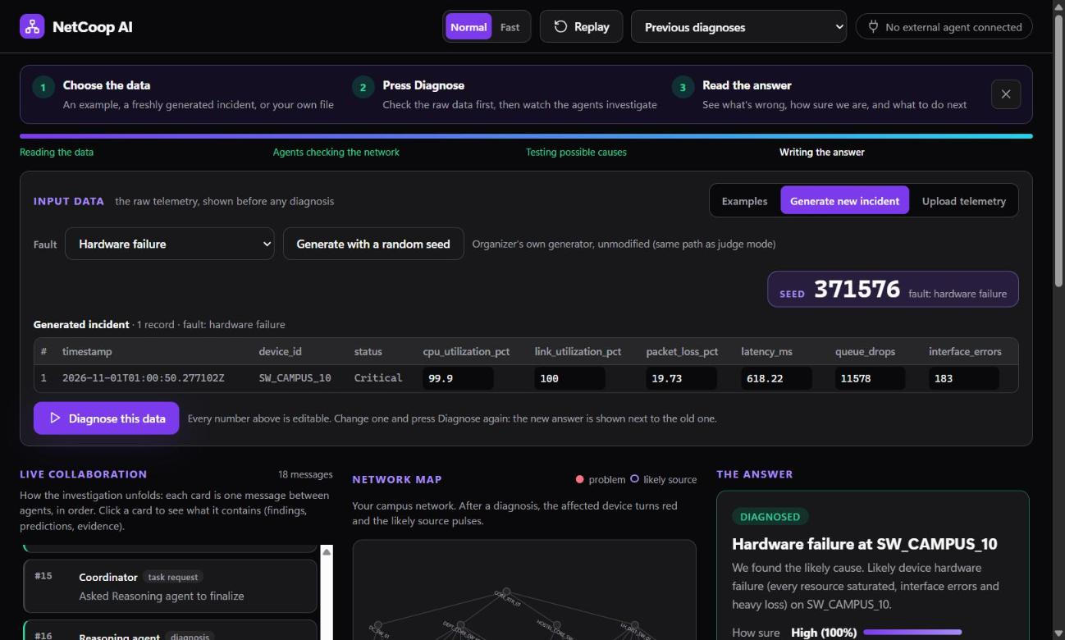
4 · Not hard-coded: change the data, the answer changes
Fresh incidents
The organizer’s own generator, unmodified, with a random seed shown on screen.
Every number editable
Set interface errors to 200 on HOSTEL_CORE_SW_01 and re-run: congestion flips to “faulty cable or port” (probable, 0.56).
Your own data
Upload JSON or CSV; it is shown raw before any diagnosis.

Slide 11
5 · Recommends, never acts
Recommended
Blocked
Inspect upstream and egress link utilization on L_HOSTEL_UPLINK
Review queue configuration on HOSTEL_CORE_SW_01
Apply temporary rate limiting to top talkers
Reboot HOSTEL_CORE_SW_01
Blocked by R1: no core-switch reboots during class hours (09:00–17:00).
5 rules: class hours, exam period, core-router change approval, service restart windows, lecture-hall SLA
Human in the loop: an operator approves or rejects each action in the CLI or dashboard, without blocking the run. Approval produces a simulated dry-run plan only; nothing touches the network.

Slide 12
6 · Measured, not claimed
0.904
overall accuracy
280 held-out incidents (seed range B)
98.2%
right when it commits
precision of “diagnosed”
0%
false alarms
on healthy networks
100%
organizer generator
on its own fault labels
Constants tuned on seed range A; results reported on range B. Never tuned on the demo scenarios.

Slide 13
Robust to bad data: 0 crashes at 60% corruption
Corruption we inject
renamed fields, swapped units, old protocol versions, missing fields, mangled IDs
What the cleaner does
recover what it can, quarantine the rest, report every change as a limitation
Never silently drop
input records = used + quarantined, checked by tests

Slide 14
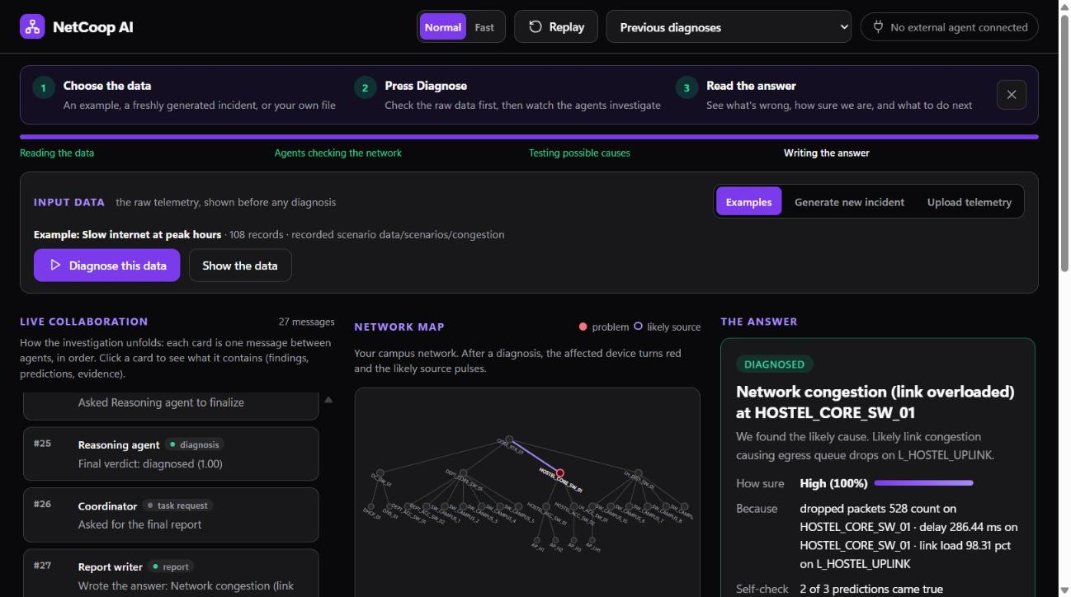
Watch the agents work, then read a plain answer
Live collaboration
every agent message, in order, click to inspect
Network map
affected device turns red, likely source pulses
The answer
cause, how sure, because, self-check, next steps
Same core, four doors
CLI, web UI, REST + live stream, MCP server
Try it live
netcoop-ai-six.vercel.app

Slide 15
Run any file, a recorded case, or from an AI assistant
Any telemetry file
Pre-run cases
Upload any JSON or CSV. Field names, units, old versions and broken IDs are cleaned; what can't be read is quarantined and listed, never silently dropped.
Seven recorded scenarios for realistic simulation: normal, congestion, weak Wi-Fi, faulty port, DNS, DHCP, interoperability. Plus fresh incidents from the organizer's generator.
Human in the loop
MCP server
Each recommended action can be approved or rejected (netcoop feedback, or the dashboard). Non-blocking; approvals give a simulated plan, never a real change.
netcoop mcp exposes NetCoop to any MCP client (for example Claude Desktop): list_scenarios, list_agents, diagnose, get_report, explain. Read-only on reports.

Slide 16
Where it stands, honestly
Limitations today
Next steps
All results are on synthetic telemetry
No live collection yet (SNMP, NetFlow, controller APIs)
No user authentication; runs locally only
Thresholds tuned on generated data, not a real campus
Maturity: working prototype validated in a lab setting
Read-only pilot on real campus telemetry
Collectors for SNMP / NetFlow feeding the same normalizer
Recalibrate thresholds and confidence on real incidents
Authentication and role-based approvals
More external agents via the same conformance kit
Every number in this deck is reproducible: the eval, fuzz and organizer reports are generated by commands in the repo, and 277 offline tests run in CI.

Slide 17
Measured, not claimed.
Right when it commits. Honest when it can’t. Never touches the network.
Live demo netcoop-ai-six.vercel.app
Code github.com/omadityajha01/NetCoop-AI

