Slide 1
Wine
DAT0424 - Achieving a Machine Learning Proof of Concept
Quality
Prediction
Student ML project using the Wine Quality Dataset.
Goal: predict quality_group from wine measurements and wine_type
DAT0424 Wine Quality POC | 1

Slide 2
WHAT THIS POC TRIES TO DO
Project Context and Objective
Business objective
Help a producer, distributor, or laboratory quickly estimate the probable quality group of a wine using physicochemical characteristics.
POC scope
Clean data
Feature engineering
Useful as a first screening before more detailed sensory analysis.
Three models
Mock-up dashboard
The output is a quality group, not an exact expert score.
This is a first ML proof of concept, not a production system.
DAT0424 Wine Quality POC | 2

Slide 3
FILES AND BASIC CHECKS
Dataset Overview
1,599
4,898
6,497
0
red wine rows
white wine rows
total rows after merging
missing values detected
Source files: winequality-red.csv and winequality-white.csv.
The data is structured and tabular, with one row per wine sample.
No time variables were found, so no date-time feature engineering was needed.
winequality.names documents the variables and dataset context.
DAT0424 Wine Quality POC | 3

Slide 4
WHAT THE MODEL SEES
Inputs and Target
Input features
Target
fixed acidity
total sulfur dioxide
volatile acidity
density
quality_group
citric acid
pH
Classes: low quality, medium quality, high quality.
residual sugar
sulphates
chlorides
alcohol
free sulfur dioxide
wine_type
quality is not used as an input feature to avoid leakage.
DAT0424 Wine Quality POC | 4

Slide 5
FROM QUALITY SCORE TO CLASSIFICATION GROUPS
Target Engineering
Original target: quality
Engineered target: quality_group
Why classification?
low quality
quality <= 5
The original score is useful, but grouping it into three classes makes the first POC easier to explain and defend in a student presentation.
medium quality
quality == 6
high quality
quality >= 7
DAT0424 Wine Quality POC | 5

Slide 6
HOW THE GRAPHS SUPPORT THE STORY
Role of the Visualizations
Original quality distribution
Quality group distribution
Model performance comparison
Shows how the raw quality scores are spread before target engineering.
Shows the final classes used for classification and their imbalance.
Shows which of the three models performs best using macro F1-score.
Together, these visuals explain the data, the engineered target, and the model choice without adding unnecessary graphs.
DAT0424 Wine Quality POC | 6

Slide 7
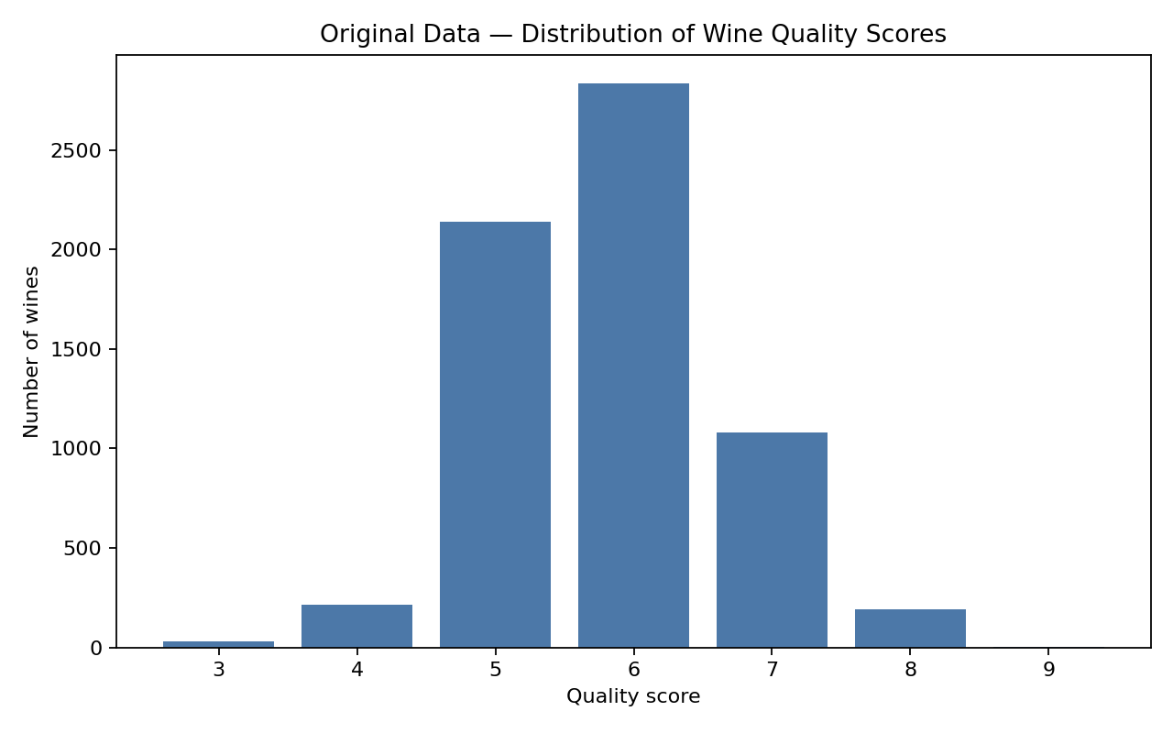
RAW DATA BEFORE TARGET ENGINEERING
Graph 1 - Original Quality Distribution
What it shows
Most wines are around middle quality scores. Very low and very high scores are rare.
Why it matters
It helps justify simplifying the task into three quality groups.
DAT0424 Wine Quality POC | 7

Slide 8
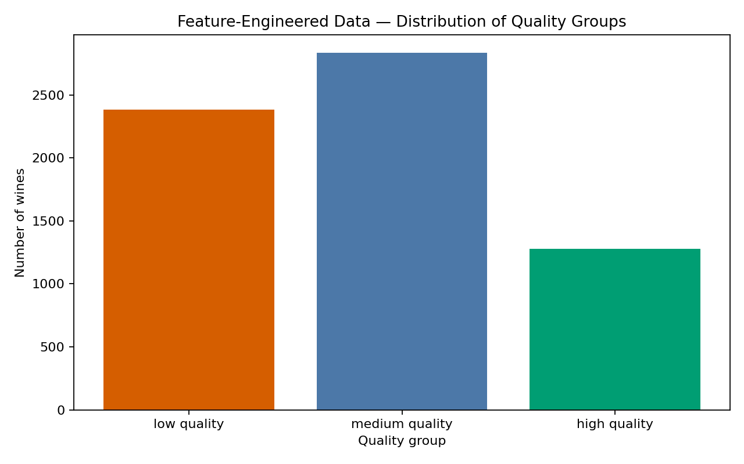
CLASS DISTRIBUTION AFTER FEATURE ENGINEERING
Graph 2 - Final Classification Target
What it shows
The final classes low, medium, and high are not perfectly balanced.
Why it matters
This supports using macro F1-score instead of relying only on accuracy.
DAT0424 Wine Quality POC | 8

Slide 9
SIMPLE PREPROCESSING WITH LEAKAGE PREVENTION
Feature Engineering Pipeline
01
02
03
04
Add wine_type
Merge red and white
Create quality_group
Split train/test
05
06
07
08
Median imputation
Standardization
One-hot wine_type
Remove target columns
The train/test split is done before preprocessing, and preprocessing is fitted only on the training data.
DAT0424 Wine Quality POC | 9

Slide 10
KEEPING THE MODEL COMPARISON FAIR
Evaluation Protocol
Same setup for all models
Leakage prevention
Same engineered dataset.
quality is removed from input features.
Same train/test split.
quality_group is the target only.
Same target: quality_group.
Preprocessing is fitted only on X_train.
Same final test set and same metrics.
DAT0424 Wine Quality POC | 10

Slide 11
THREE SIMPLE MODEL FAMILIES
Models Compared
Logistic Regression
Random Forest
SVM Classifier
Simple baseline
Flexible non-linear model
Margin-based model
Fast, understandable, and useful as a reference model.
Can capture interactions between physicochemical variables.
Uses standardized features and gives a different comparison logic.
No heavy tuning was used because the goal is a first student proof of concept.
DAT0424 Wine Quality POC | 11

Slide 12
WHY MACRO F1-SCORE IS THE MAIN METRIC
Metrics Used
Main metric
Secondary metrics
macro F1-score
accuracy
Macro F1 gives each class more balanced importance, which is useful because the classes are not perfectly balanced.
precision_macro
recall_macro
Accuracy is still useful, but it can hide weak results on minority classes.
DAT0424 Wine Quality POC | 12

Slide 13
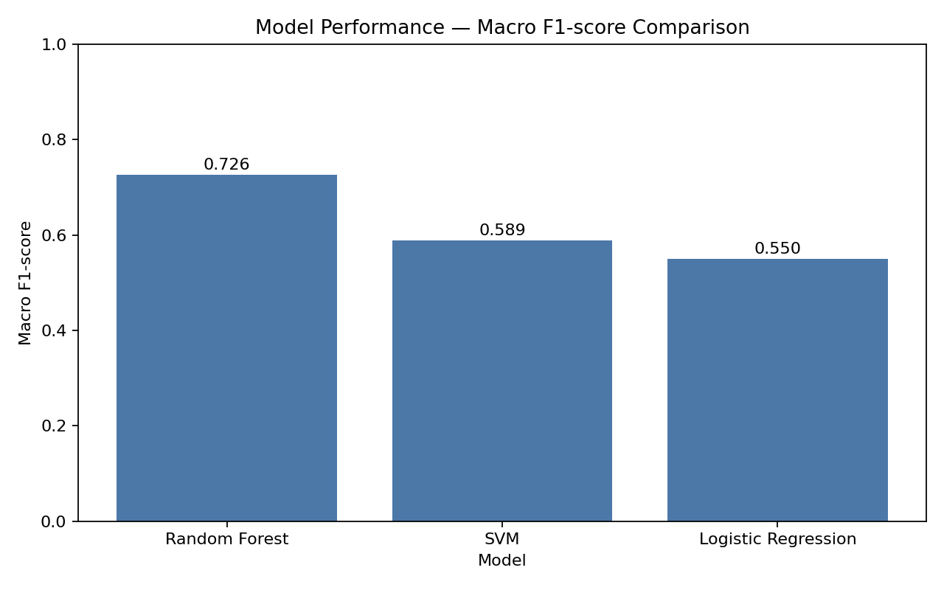
FIRST POC COMPARISON
Model Results and Performance Graph
Model
Acc.
Prec.
Rec.
F1
Logistic Regression
0.582
0.585
0.539
0.550
Random Forest
0.732
0.748
0.712
0.726
SVM
0.627
0.637
0.576
0.589
Random Forest performed best in this first comparison with macro F1 = 0.726.
This is not a final production model.
DAT0424 Wine Quality POC | 13

Slide 14
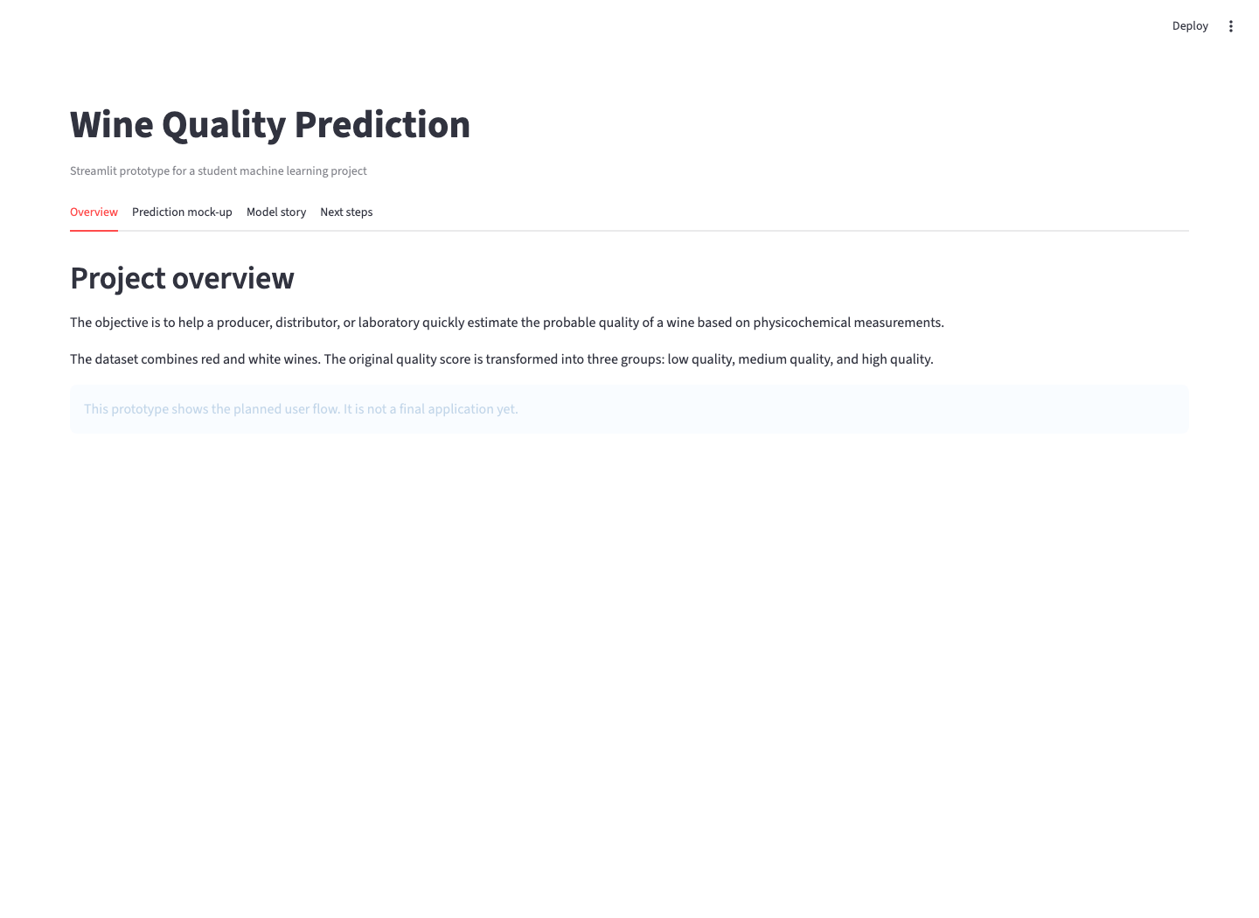
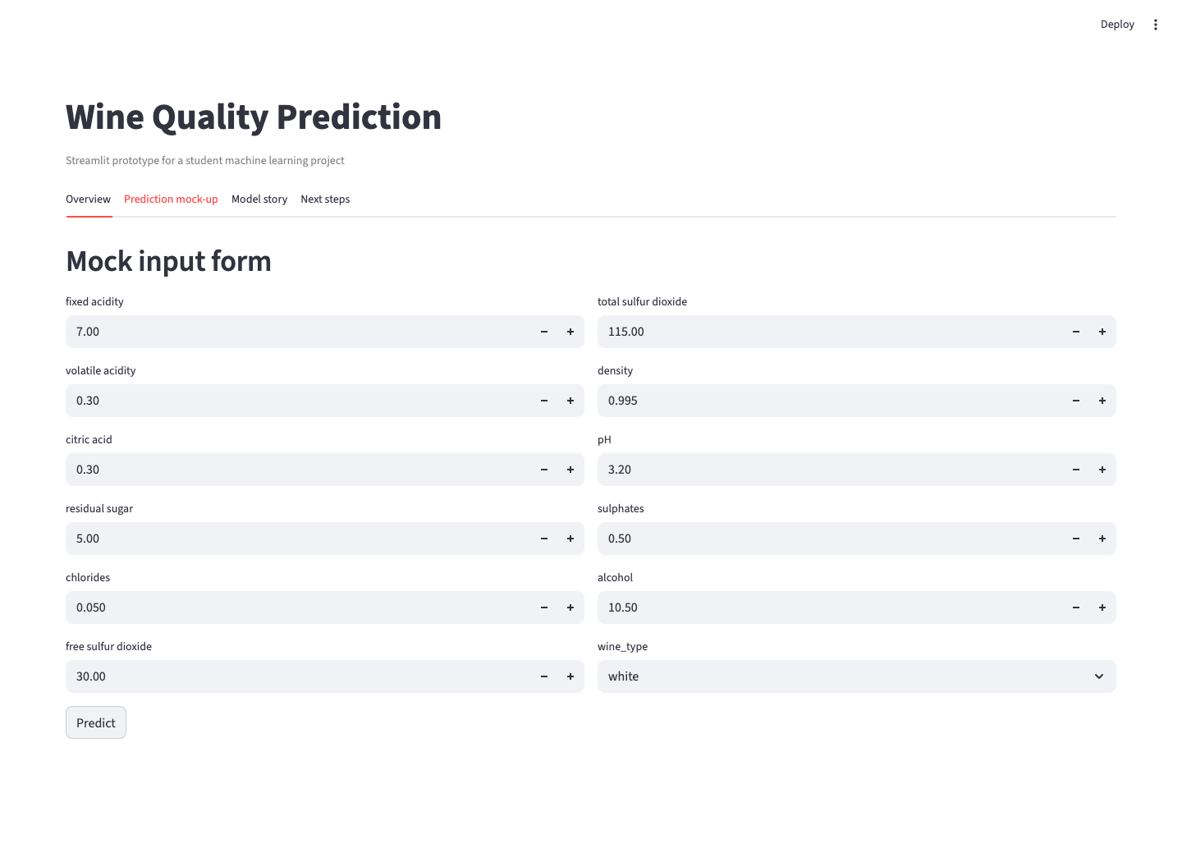
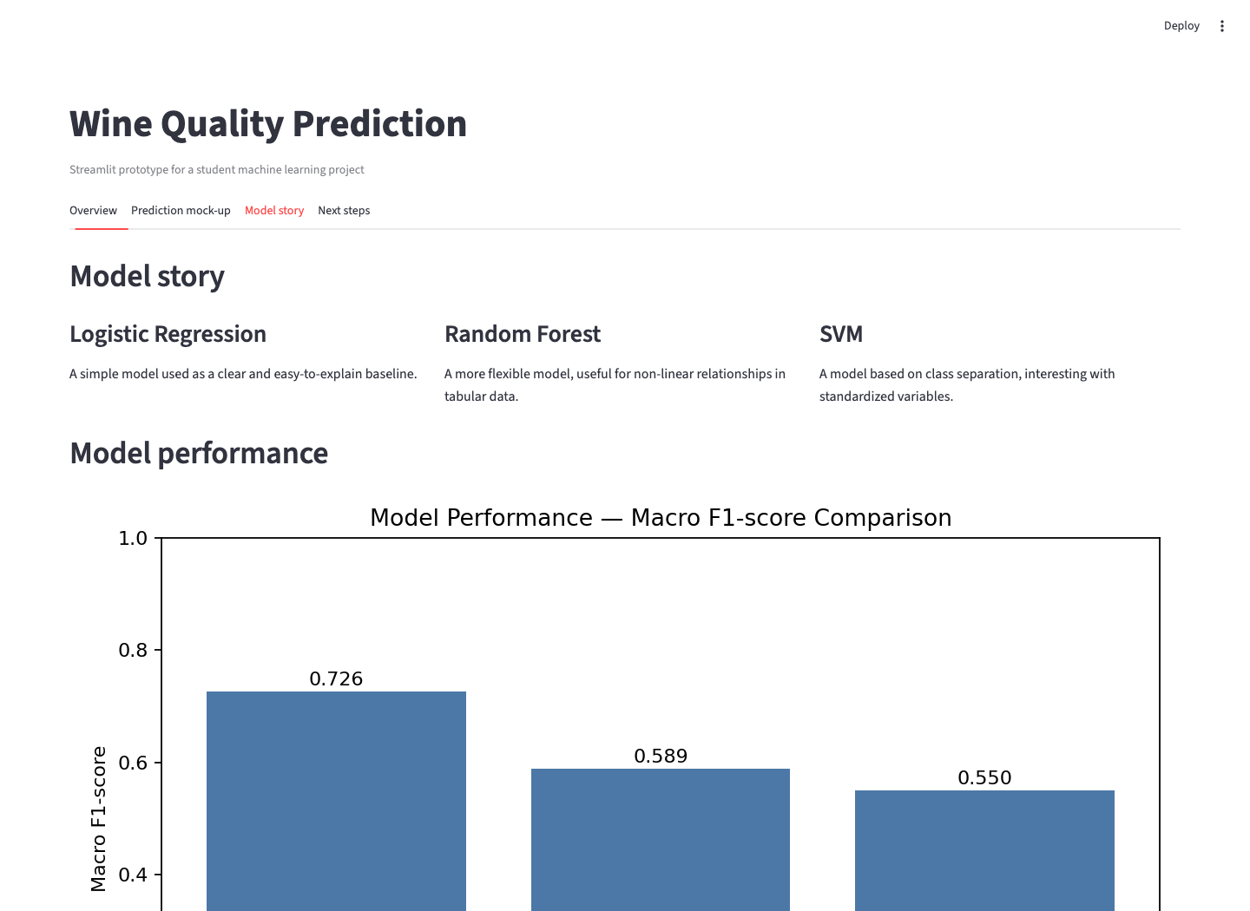
FUTURE INTERFACE IDEA
Streamlit Mock-up and Dashboard Journey
User journey
1. Open the app -> 2. Read the objective -> 3. Enter wine characteristics -> 4. See a mocked prediction -> 5. View model story and performance -> 6. Future version connects the trained model.
DAT0424 Wine Quality POC | 14

Slide 15
WHAT REMAINS AFTER THIS POC
Limitations, Next Steps, and Conclusion
Limitations
Next steps
Conclusion
Model is not final.
Connect final preprocessing.
This project built a complete student ML POC: data preparation, visual analysis, three-model comparison, and a Streamlit mock-up.
Tuning is limited.
Load the selected trained model.
Wine quality is partly subjective.
Replace mocked prediction with real prediction.
No region, price, grape variety, vintage, or brand.
Test the app with new examples.
GitHub repository link: [to be added by the student]
Streamlit is not connected to a real backend yet.
Improve validation and possibly tune the best model.
DAT0424 Wine Quality POC | 15

