Slide 1
AWS QuickSight & Lambda function
Quicksight AWS
SPICE
Lambda function

Slide 2
QuickSight (Business Intelligence Service)
Amazon QuickSight is a scalable, serverless, embeddable, business intelligence (BI) service built for the cloud
QuickSight dashboards can be accessed from any device, and seamlessly embedded into your applications, portals, and websites
QuickSight is serverless and can automatically scale to tens of thousands of users without any infrastructure to manage or capacity to plan for
It is also the first BI service to offer pay-per-session pricing, where you only pay when your users access their dashboards or reports, making it cost-effective for large scale deployments
QuickSight App is also available for mobile phones

Slide 3
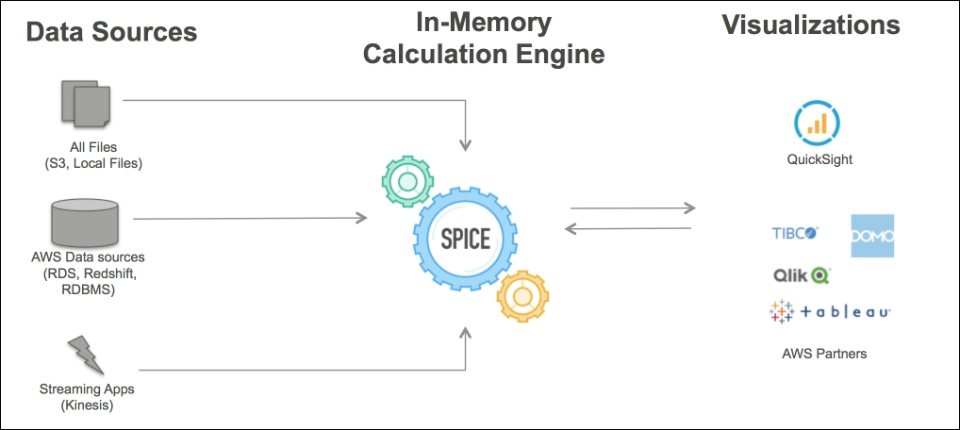
SPICE
SPICE is an abbreviation for Super-fast, Parallel, In-memory, Calculation, Engine and is the brain of QuickSight
SPICE has a great toolset of functions that can do lightweight transformation of data in memory

Slide 4
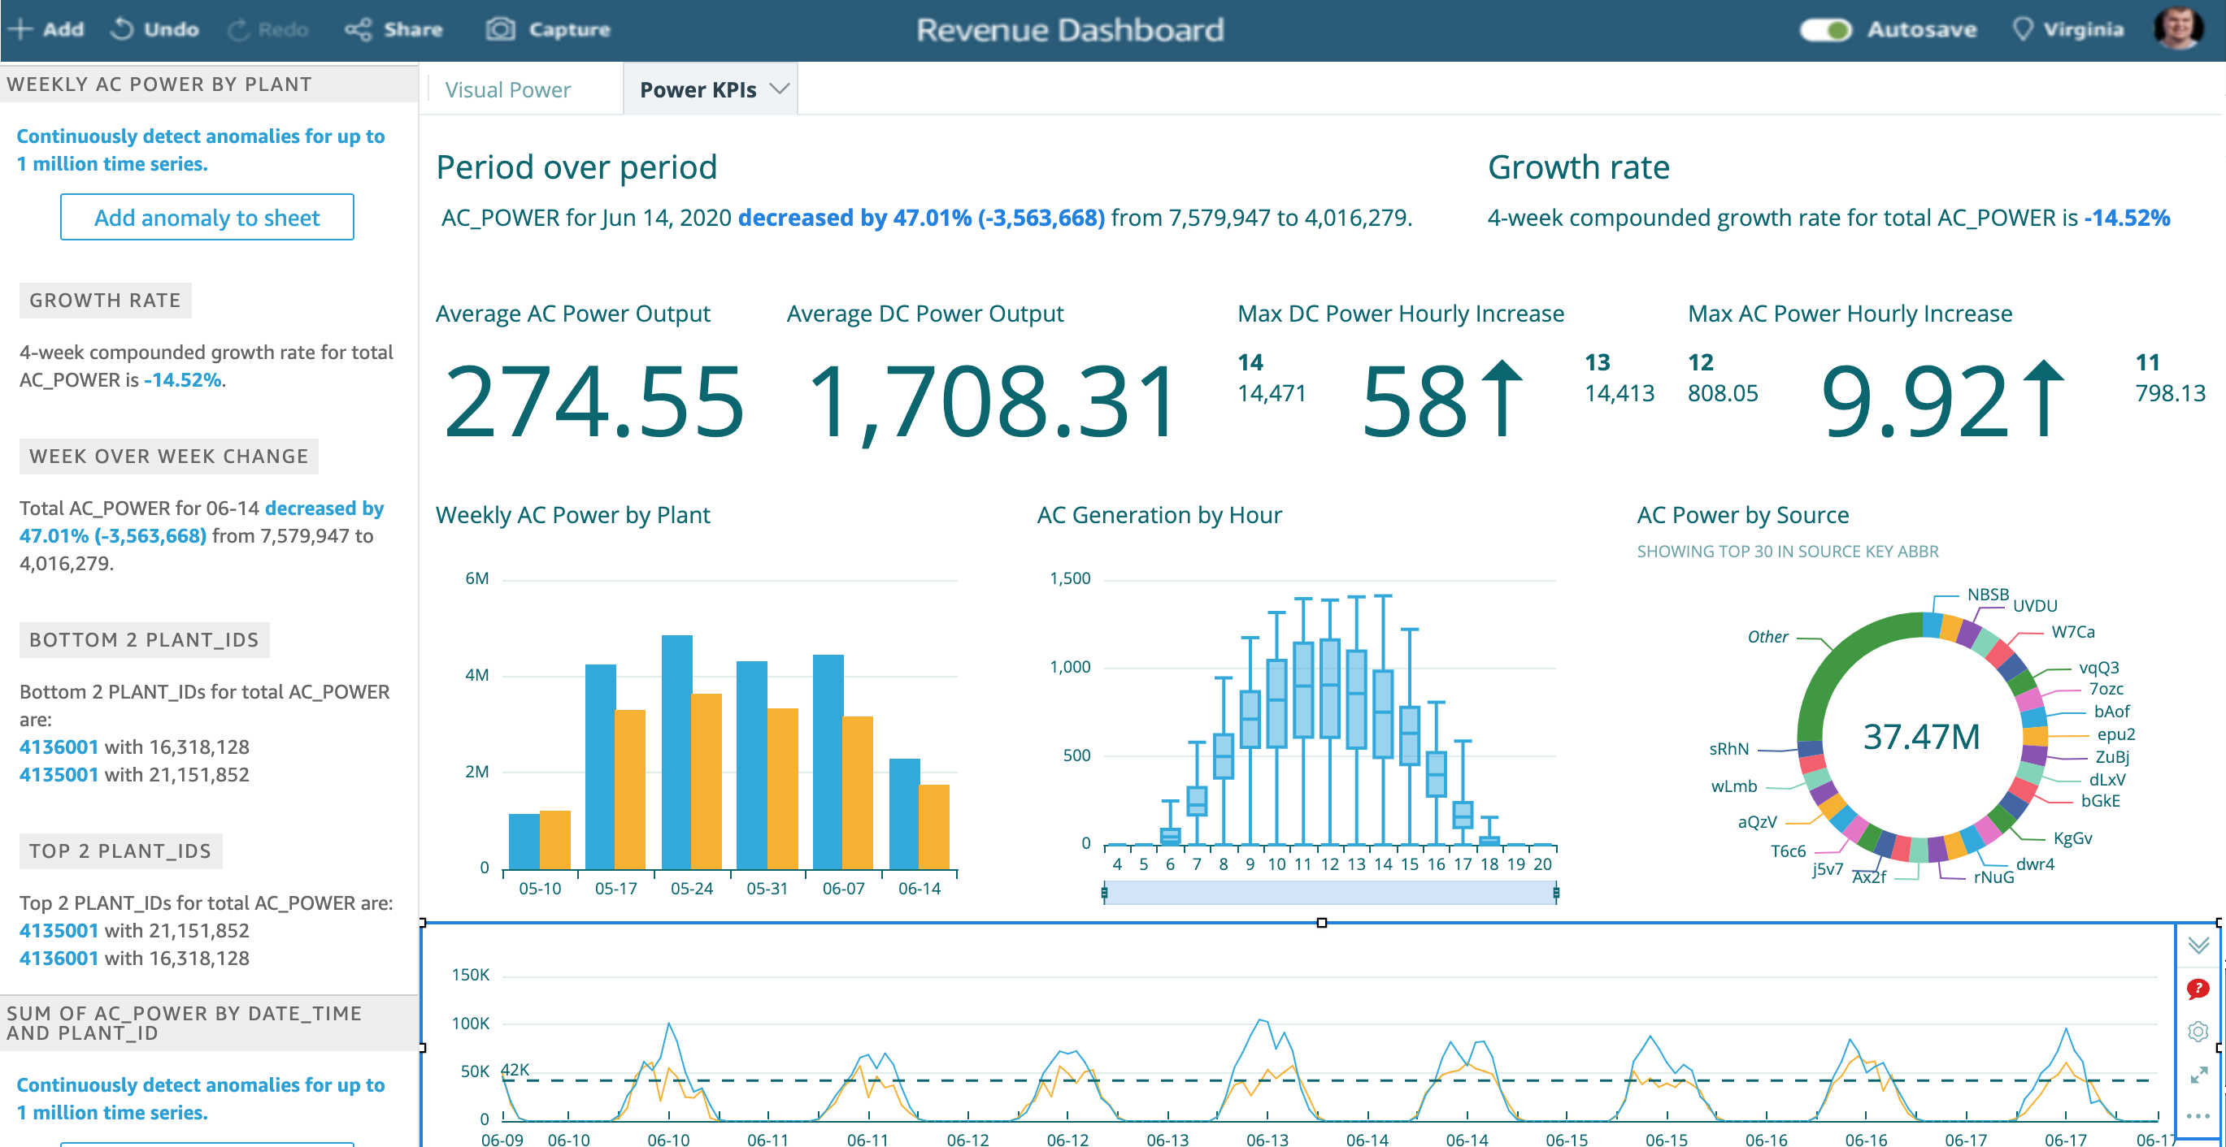
Sample Dashboard

Slide 5
Links
Dataset: https://us-west-2.quicksight.aws.amazon.com/sn/start/data-sets
Analysis: https://us-west-2.quicksight.aws.amazon.com/sn/start/analyses

Slide 6
Lambda
AWS Lambda is a serverless compute service that lets you run code without provisioning or managing servers, creating workload-aware cluster scaling logic, maintaining event integrations, or managing runtimes
Benefits: - No servers to manage - Continuous scaling - Cost optimized with millisecond metering - Consistent performance at any scale

Slide 7
API Gateway
An API gateway is an API management tool that sits between a client and a collection of backend services. An API gateway acts as a reverse proxy to accept all application programming interface (API) calls, aggregate the various services required to fulfill them, and return the appropriate result.
Enable client-server communication
Implement standard HTTP methods such as GET, POST, PUT, PATCH, and DELETE.

Slide 8


