Slide 1
WEEK 2 ASSIGNMENT
Invoice Processing Automation
Using UiPath RPA — Comprehensive Project Plan
TOOL
PROCESS
AUTOMATION
ROI TARGET
UiPath
Invoice Processing
Attended + Unattended
70% Time Reduction
Live Website: https://omais-eng.github.io/rpa/assignment2/index.html | GitHub: https://github.com/omais-eng/rpa
Notes:
Good [morning/afternoon], everyone.
My name is [your name], and today I'll be walking you through my Week 2 RPA project plan — a comprehensive proposal to automate invoice processing using UiPath.
This assignment builds on the use case analysis I completed in Week 1. What I've developed is a full project plan covering why I chose UiPath, a visual process flowchart, a formal Process Design Document, and a step-by-step implementation strategy.
The entire plan is also published as an interactive website, which you can find at the GitHub link shown here. I'll take you through each component now.

Slide 2
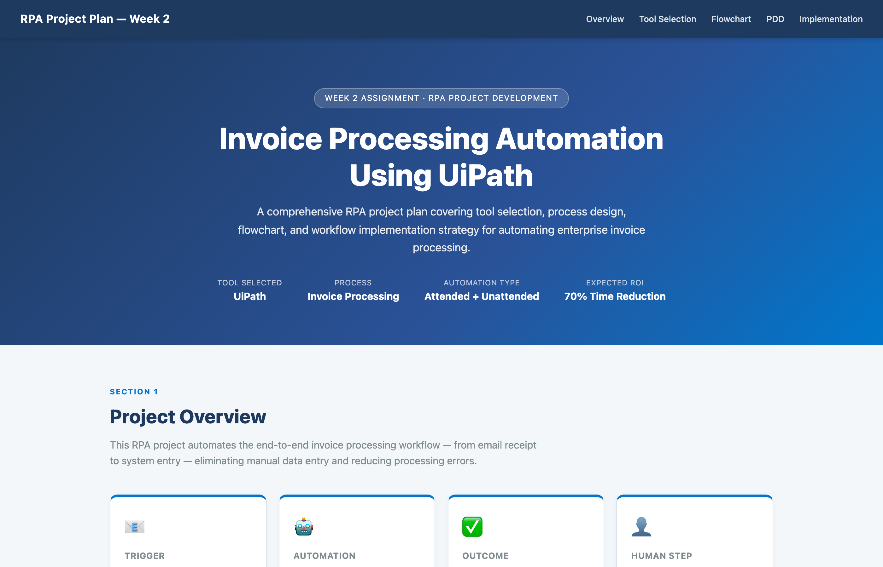
PROJECT WEBSITE — BUILT WITH CLAUDE CODE (VIBE CODING)
Live Site: https://omais-eng.github.io/rpa/assignment2/index.html | GitHub: https://github.com/omais-eng/rpa
Notes:
This is the website I built using Claude Code — what the course calls "vibe coding."
Rather than writing raw HTML from scratch, I described what I wanted to Claude — a professional single-page RPA project plan with a Mermaid.js flowchart, comparison table, and PDD sections — and Claude generated the full website for me.
I iterated on it by refining the sections, adjusting the colors and layout, and making sure every required component from the assignment was covered.
The website is hosted on GitHub and can be opened in any browser. It serves as the primary deliverable for this assignment.

Slide 3
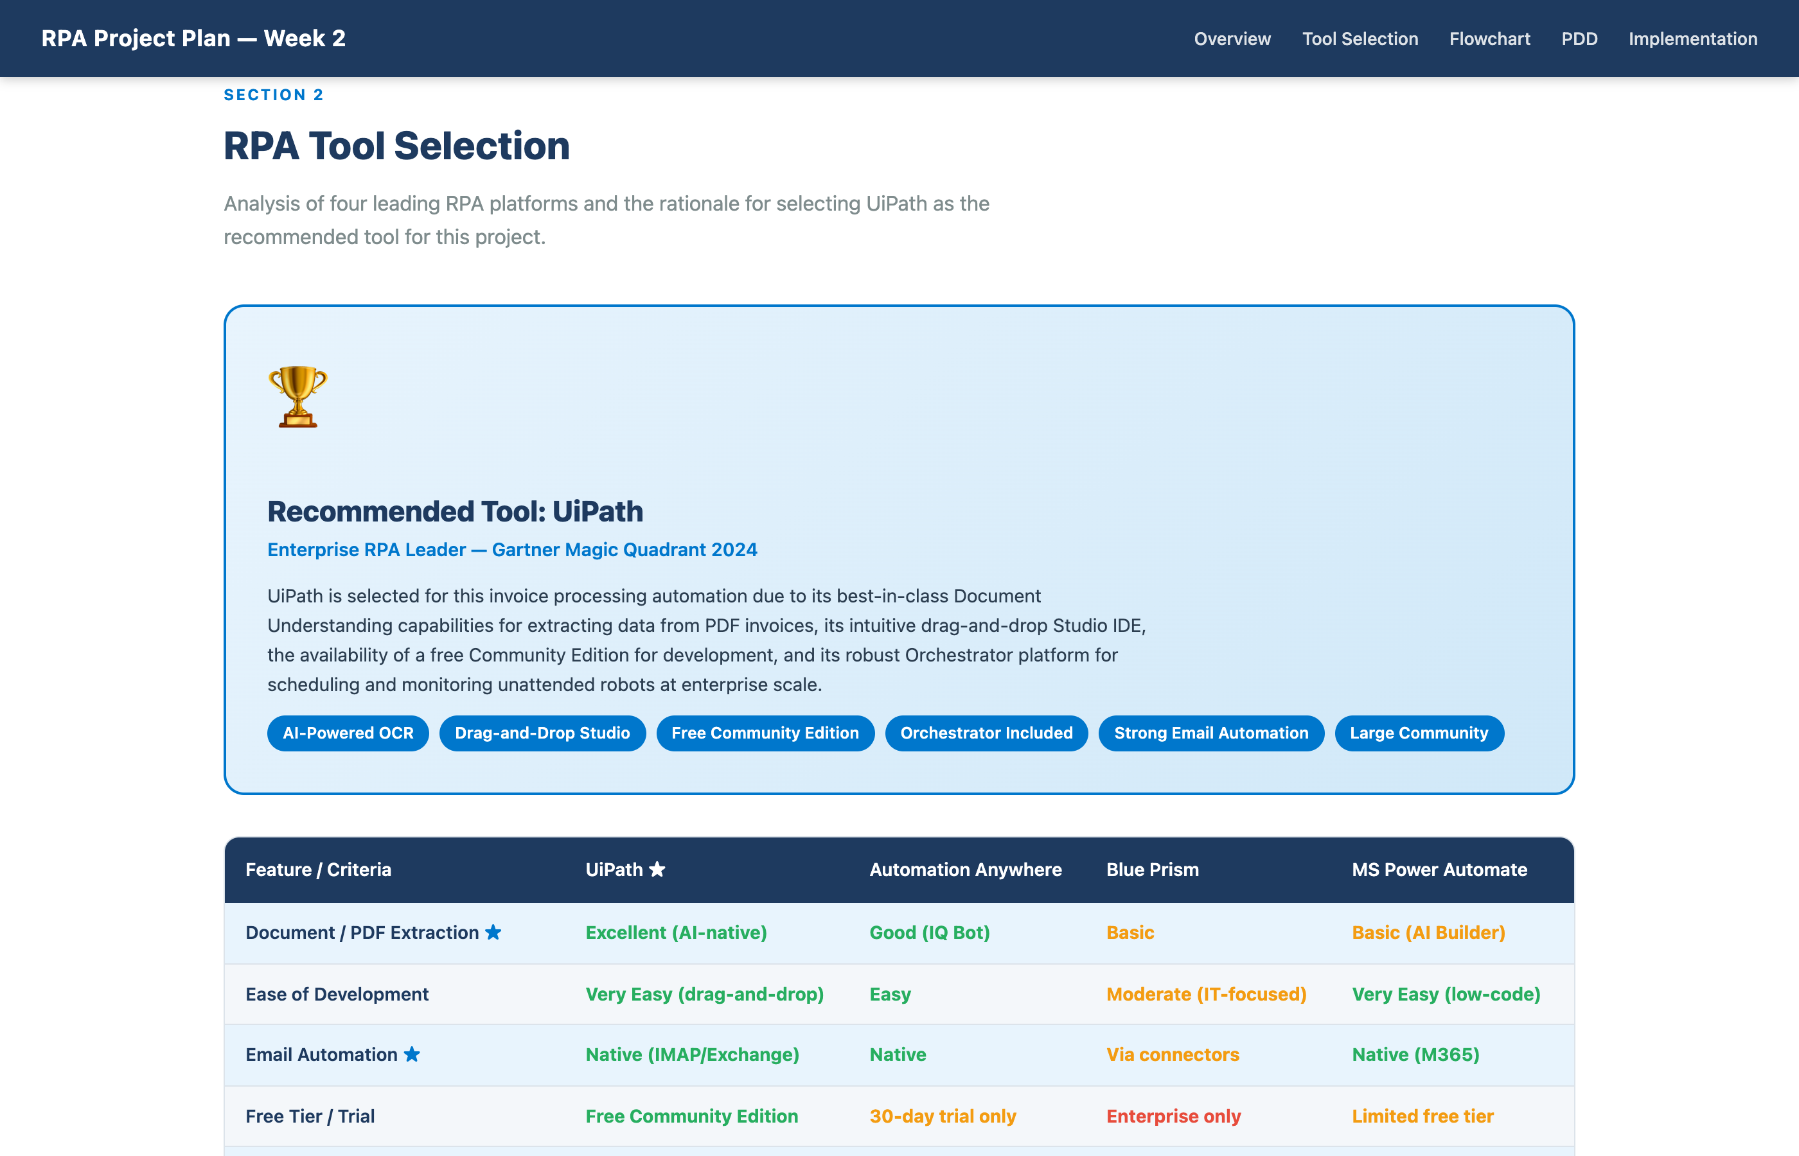
SECTION 1 — RPA TOOL SELECTION
Why I Chose UiPath
Notes:
For this project, I evaluated four major RPA platforms: UiPath, Automation Anywhere, Blue Prism, and Microsoft Power Automate.
I chose UiPath for three main reasons.
First, it has the best document understanding capabilities. Invoice processing means reading PDFs, and UiPath's built-in AI-powered OCR — called Document Understanding — is purpose-built for exactly this.
Second, it has a free Community Edition, which makes it accessible for development and prototyping without upfront licensing costs.
Third, UiPath Orchestrator gives us enterprise-grade scheduling and monitoring out of the box, so once we deploy, we can track every bot run, handle exceptions, and scale up easily.
I acknowledged the limitations too — it's more expensive than Power Automate at enterprise scale, and it has a steeper learning curve for non-technical users. But for a finance automation with complex PDF handling, it's the right tool.

Slide 4
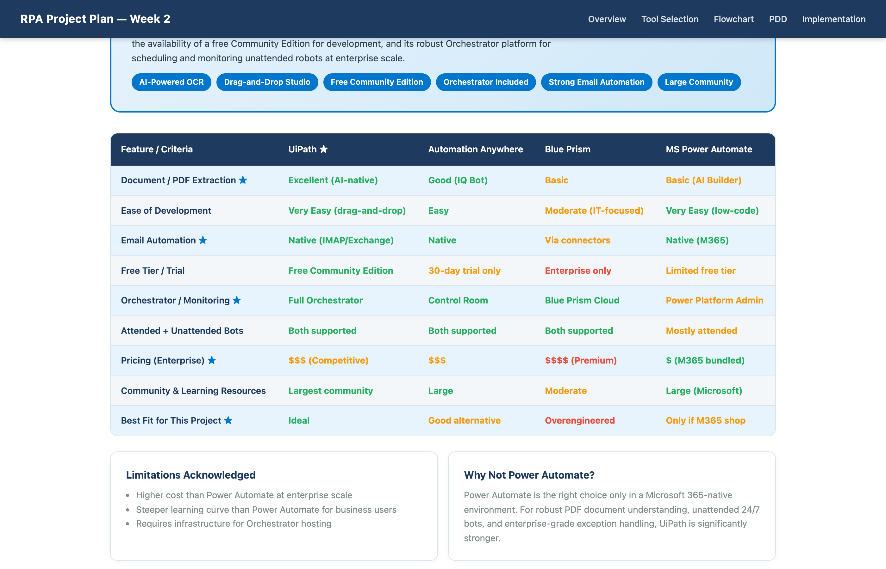
SECTION 1 — TOOL COMPARISON MATRIX
Feature-by-Feature Analysis Across 4 RPA Platforms
Notes:
This comparison table breaks down 9 key criteria across all four tools.
The columns highlighted in blue are UiPath's results — you can see it scores highest or equal-highest across document extraction, email automation, free tier availability, and orchestration.
Blue Prism is a strong enterprise tool but it's overkill and very expensive for this use case — it's designed for IT-heavy environments and doesn't have a free development tier.
Power Automate would be a reasonable choice if the company is already fully inside Microsoft 365, but its document understanding and unattended bot capabilities are weaker than UiPath for complex PDF invoices.
The table also shows pricing context. UiPath is not the cheapest, but for the return on investment this automation delivers — eliminating 45 minutes of manual work per invoice — the cost is easily justified.

Slide 5
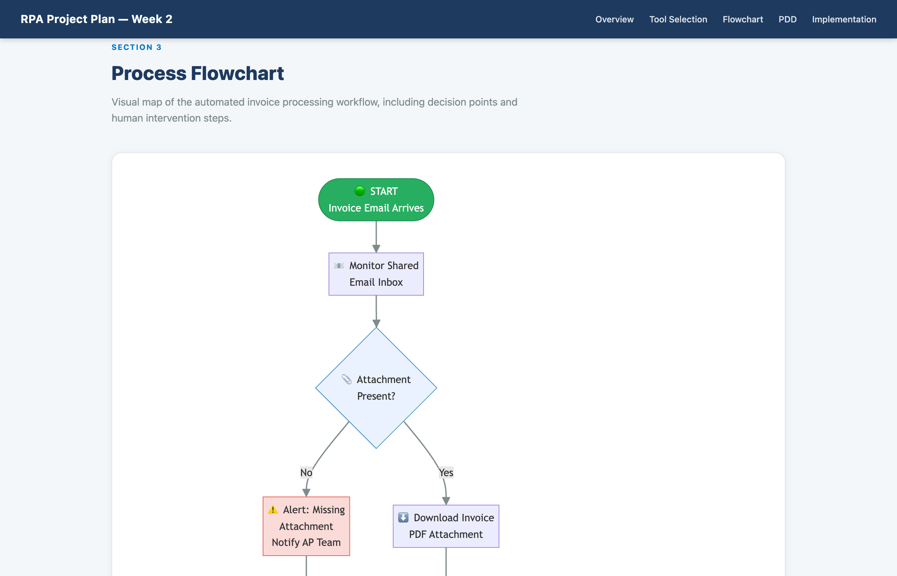
SECTION 2 — PROCESS FLOWCHART
Invoice Automation Workflow — All Paths & Decision Points
Notes:
This flowchart was generated using Mermaid.js directly inside the website — which is one of the things I'm proud of from the vibe coding process.
Let me walk you through the key decision points.
The process starts when an invoice email arrives. The first check is: does it have an attachment? If not, an alert goes to the AP team and the process ends as an exception.
If the attachment exists, the bot downloads it and runs OCR to extract the data. If extraction fails — maybe the PDF is corrupted or in a weird format — that goes to a manual queue.
Once data is extracted and validated, we hit the main business rule: is the amount over $5,000? If yes, it routes to the manager for approval via email or Teams. If the manager rejects it, we notify the vendor and log it. If approved — or if it was under $5,000 and auto-approved — the bot enters it into the accounting system, saves the record, and sends the confirmation email.
The color coding is deliberate: blue diamonds are decisions, red paths are exceptions, yellow is human involvement, and green is automated action.

Slide 6
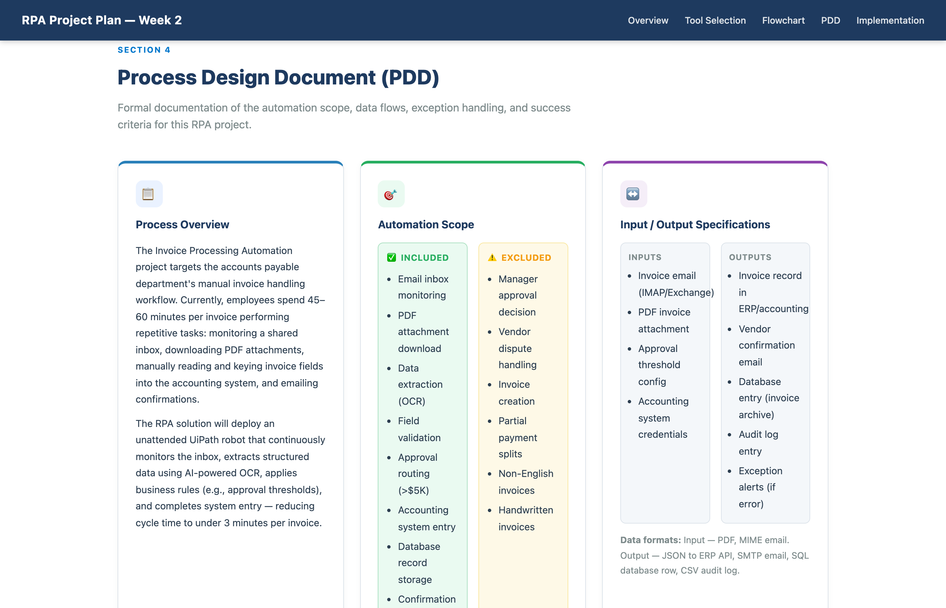
SECTION 3 — PROCESS DESIGN DOCUMENT (PDD)
Process Overview · Scope · Inputs & Outputs
Notes:
The Process Design Document is the formal blueprint for the automation — the document you'd hand to a developer to build it.
The Process Overview section captures the current state: accounts payable staff are spending 45 to 60 minutes per invoice doing tasks that are entirely repetitive and rules-based. That's the exact type of work RPA is built for.
The Scope section is important because it sets clear boundaries. What's included: everything from email monitoring through to confirmation emails. What's excluded: manager approval decisions, handling vendor disputes, processing handwritten invoices, and anything in a non-English language. Setting these boundaries protects the project from scope creep.
The Inputs and Outputs section specifies the data formats — PDF attachments and MIME email in, JSON to the ERP API, SQL database rows, and SMTP confirmation emails out. This level of specificity matters when you're actually building and testing the workflow.

Slide 7
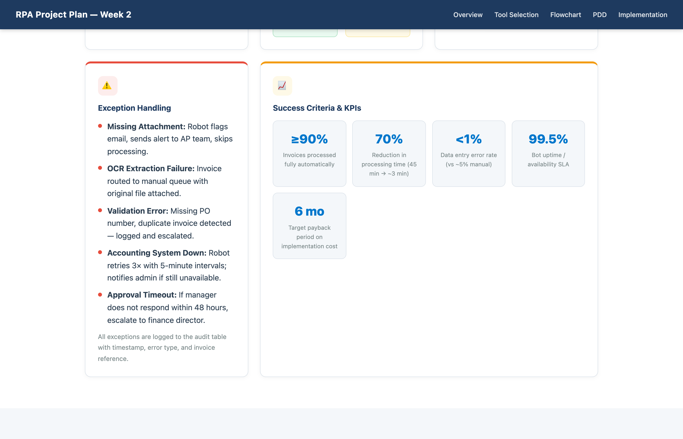
SECTION 3 — PROCESS DESIGN DOCUMENT (PDD)
Exception Handling · Success KPIs
Notes:
Exception handling is where a lot of RPA projects fail in production — so I've been deliberate about covering every realistic failure scenario.
The five exceptions I've handled are: missing attachment, OCR extraction failure, data validation errors like a missing PO number or duplicate invoice, the accounting system being unavailable, and an approval timeout where the manager doesn't respond within 48 hours.
For each one, the bot doesn't just crash — it logs the issue, sends an alert, and either retries or routes to a human. That's what makes an automation resilient.
The Success Criteria section sets measurable targets: 90% straight-through processing, 70% reduction in cycle time from 45 minutes down to around 3 minutes, a data error rate below 1%, 99.5% bot uptime, and payback within 6 months.
These aren't arbitrary numbers — they're based on typical RPA benchmarks for invoice automation projects at similar scale.

Slide 8
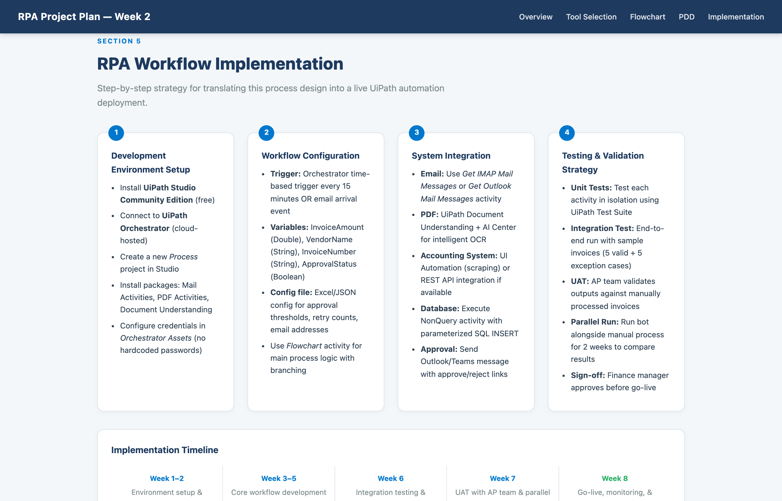
SECTION 4 — WORKFLOW IMPLEMENTATION STRATEGY
Dev Setup · Configuration · Integrations · Testing
Notes:
The implementation section translates the design into a real development plan across four areas.
Environment setup: we install UiPath Studio Community Edition, connect it to Orchestrator, and add the activity packages we need — Mail Activities, PDF Activities, and Document Understanding. Credentials are stored in Orchestrator Assets, never hardcoded in the workflow.
Workflow configuration: the bot is triggered every 15 minutes by an Orchestrator schedule, or on email arrival. Key variables like InvoiceAmount, VendorName, and ApprovalStatus are defined upfront. Business rules like the $5,000 threshold live in a config file so they can be changed without touching the code.
System integration: we connect to the email inbox using UiPath's native IMAP or Outlook activities, use Document Understanding for PDF extraction, and write to the accounting system either via UI automation or a REST API if one's available.
Testing follows a four-phase approach: unit tests for each activity, integration tests with 10 sample invoices including edge cases, user acceptance testing with the AP team, and a two-week parallel run where we compare bot results against manual processing before full go-live.

Slide 9
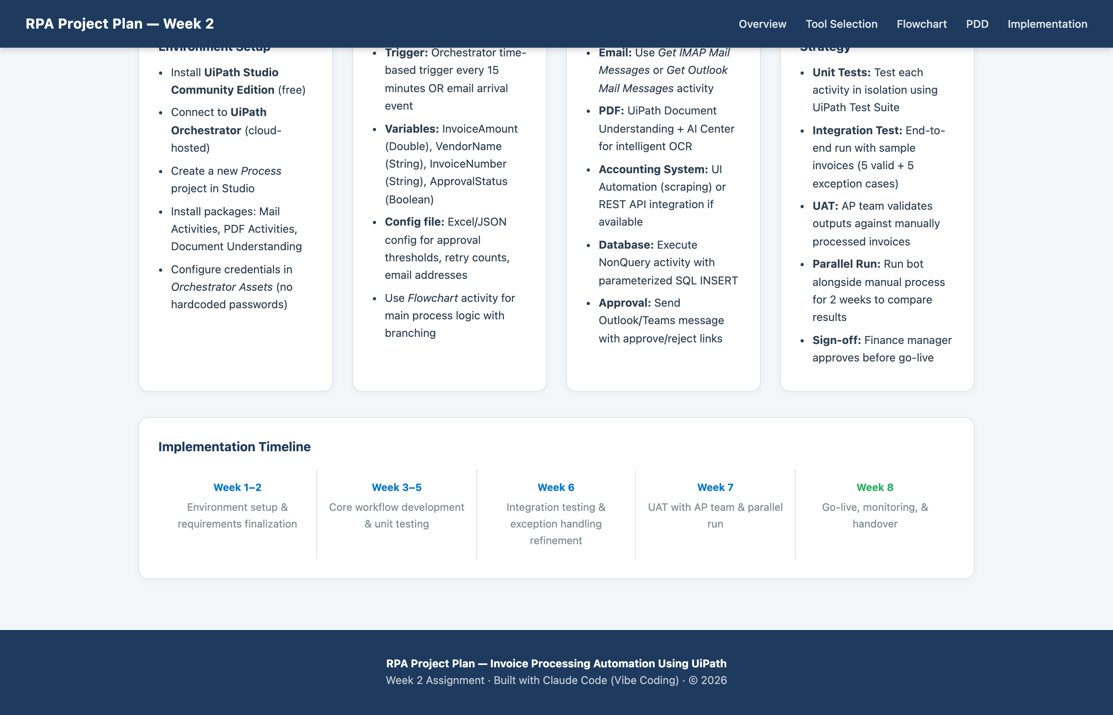
SECTION 4 — IMPLEMENTATION TIMELINE
8-Week Deployment Roadmap
Notes:
The implementation is structured as an 8-week rollout.
Weeks 1 and 2 are environment setup and requirements finalization — making sure the dev environment is configured and all stakeholders have signed off on the scope.
Weeks 3 through 5 are the core development phase — building the main workflow, unit testing each component, and refining the OCR extraction model on real invoice samples.
Week 6 is integration testing and exception handling refinement — running the bot end-to-end and stress-testing the edge cases.
Week 7 is UAT with the actual accounts payable team, plus the parallel run where we shadow manual processing.
Week 8 is go-live, monitoring setup, and handover documentation.
This is a realistic timeline for a project of this scope. It's not rushed, but it's also not padded — most RPA invoice projects of this complexity can be delivered in 6 to 10 weeks.

Slide 10
Summary & Key Takeaways
Tool Selected: UiPath — best-in-class PDF/OCR, free tier, enterprise orchestration
Process Automated: End-to-end invoice processing — 45 min → ~3 min per invoice
PDD Covers: Scope, I/O specs, 5 exception types, 5 measurable KPIs
Implementation: 8-week plan: dev → integration test → UAT → parallel run → go-live
Website: Built with Claude Code (vibe coding) — Mermaid.js flowchart + full PDD
Live Website: https://omais-eng.github.io/rpa/assignment2/index.html | GitHub: https://github.com/omais-eng/rpa
Notes:
To wrap up, let me summarize the key points of this project plan.
I selected UiPath because it's the strongest tool for PDF-heavy invoice automation, offers a free Community Edition, and includes enterprise orchestration.
The process we're automating eliminates 45 minutes of manual work per invoice, reducing it to roughly 3 minutes through straight-through processing.
The PDD documents everything a developer needs: scope boundaries, data formats, five exception scenarios with defined responses, and five measurable success criteria.
The implementation follows a structured 8-week roadmap with unit testing, integration testing, UAT, and a parallel run before go-live.
And the entire plan is presented on an interactive website built using Claude Code, demonstrating how vibe coding can produce professional, assignment-ready deliverables quickly and effectively.
Thank you — I'm happy to take any questions.

