Slide 1
VMHunt
2019072351
김정훈
Notes:
Not compiled, instead we use the compiled binary, using handler to obfuscate
Optional, but tried call and return
Context switch test program, does it actually work?
Accessed memory access, to find invariant, finding invariant, then using it to slice afterwards
Does memory address after setting global region after virtualization – it doesn’t, it stays at original
Checking memory region prior to virtualization
Which memory region access does it assume native
Outside stack is considered native stack, non compiler based – global data accessers are not technically native
Nmap and heap – accessing virtualized memory stack
We can only use previously used malloc – easy to find, to wrap
Nmap may be used prior to virtualization (malloc) frame reset – resetting VM related?? Memory?
Ldpreload , refer – malloc
Program initialization – like a constructor
Is malloc used inside or outside?
//vmbegin //vmexit between?
Mallloc may be called by a native instruction within the VM context god knows what
Invariant heap – heap is controlled by outside VM on its own must hold throughout scope
Check for malloc within heap vm region
Hard to check in or out because can be called outside context – while vmcontext is calling malloc existent
Check how many times malloc was called or inserted – checked – code in main, just do malloc , wrap vm - compile – protect – just called once
Check for sure - insert malloc inside and ouside vm region
Slicing

Slide 2
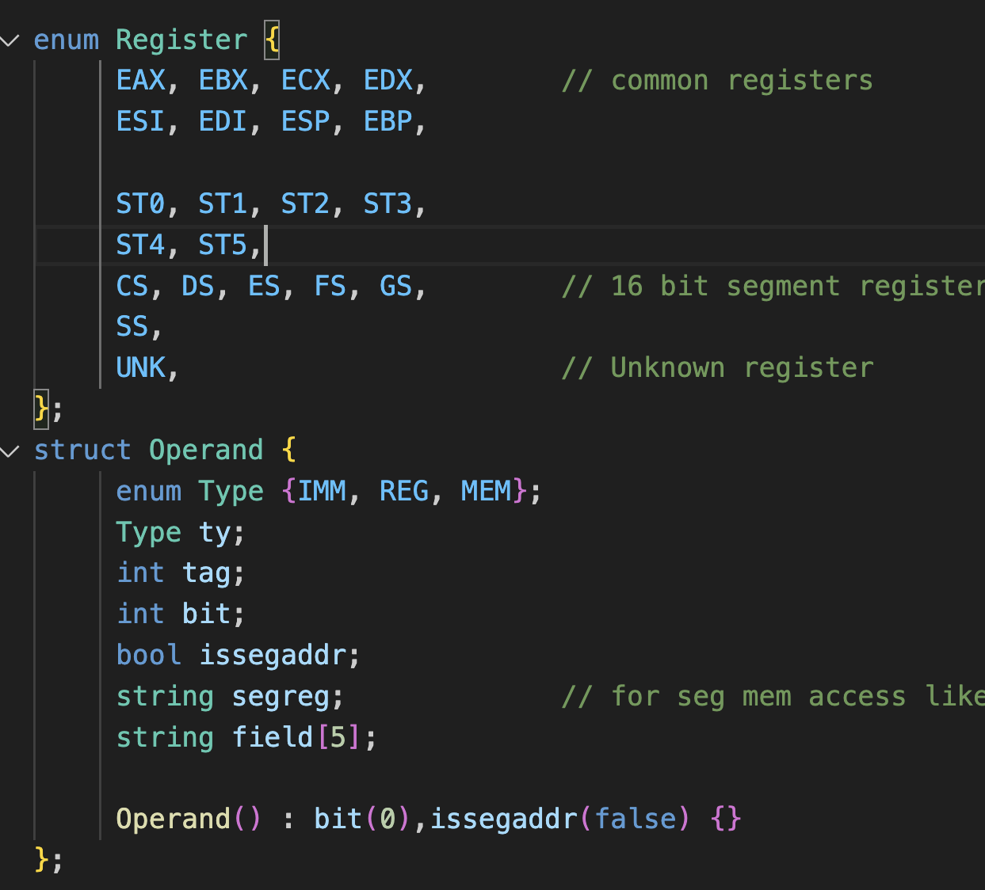
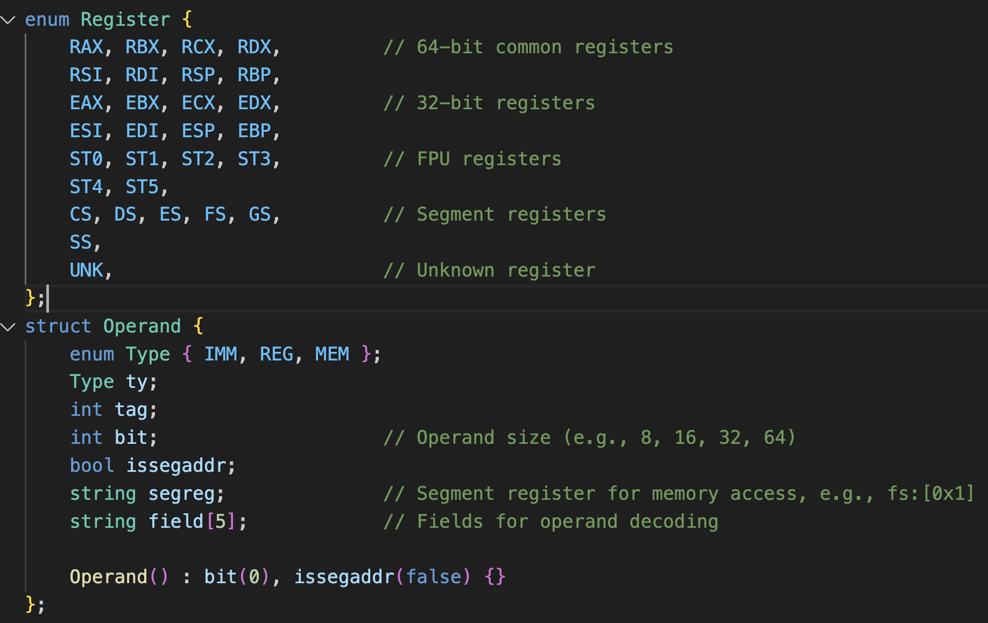
Core.hpp

Slide 3
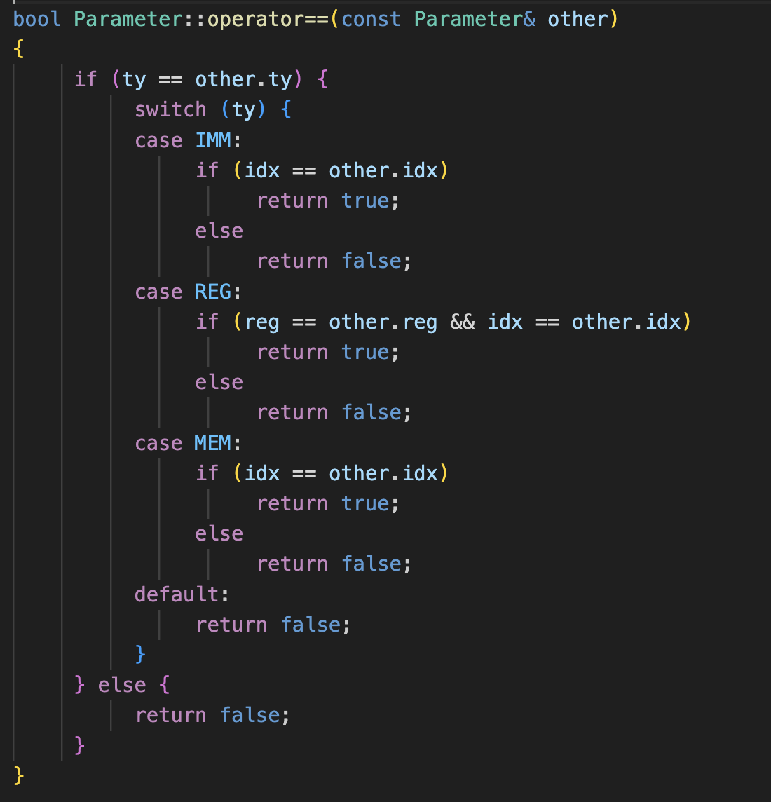
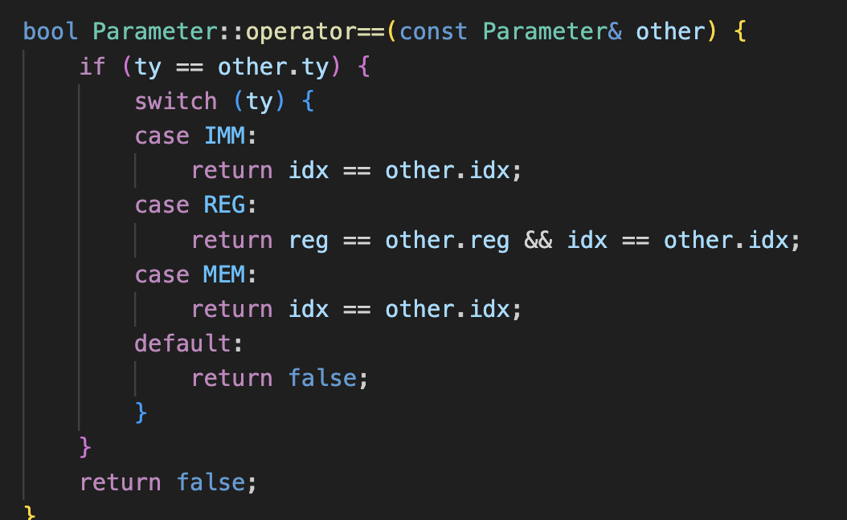
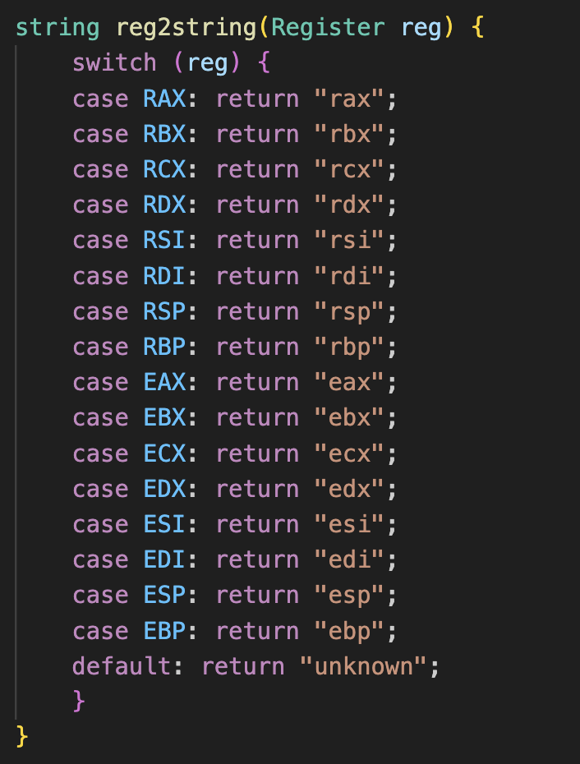
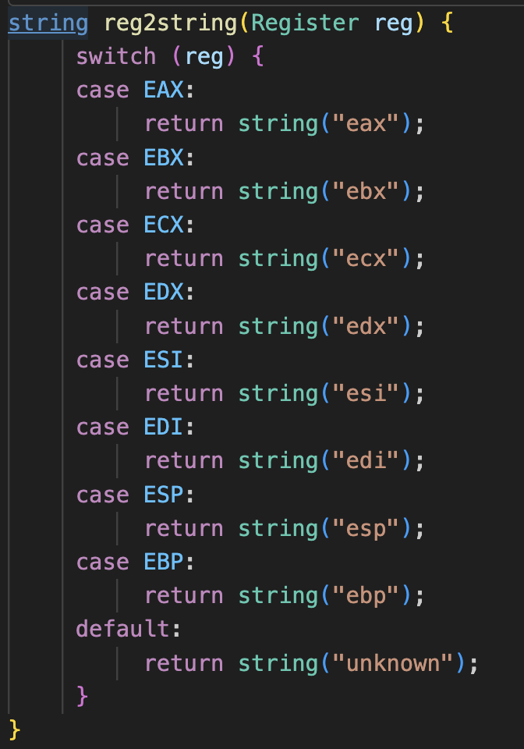
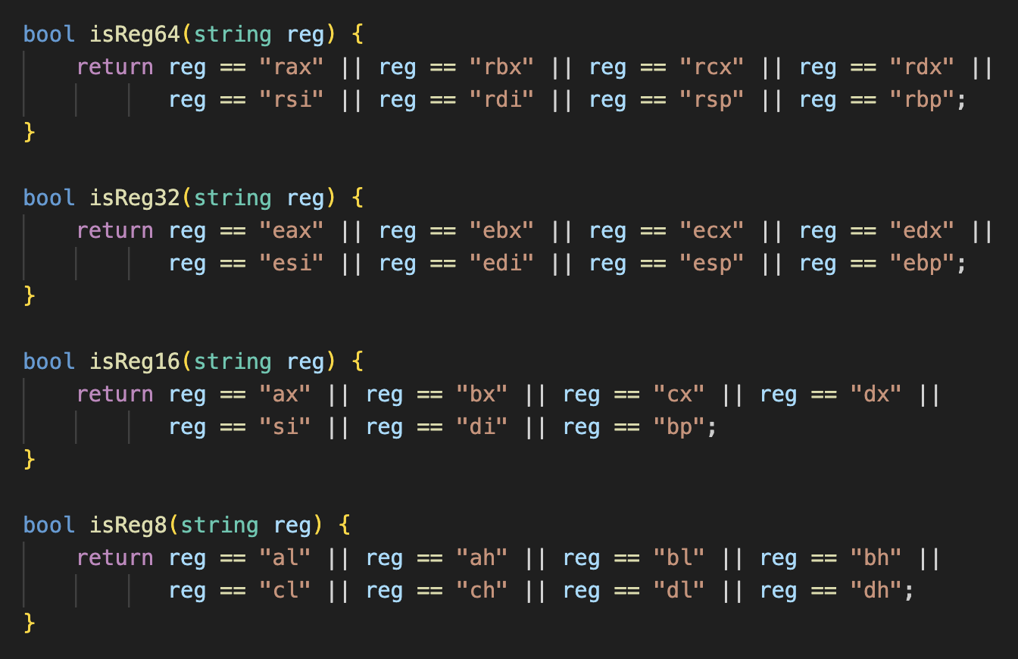
Core.cpp

Slide 4
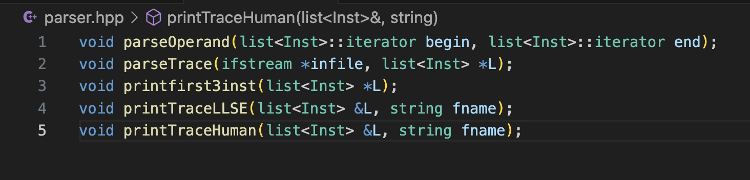
Parser.hpp

Slide 5
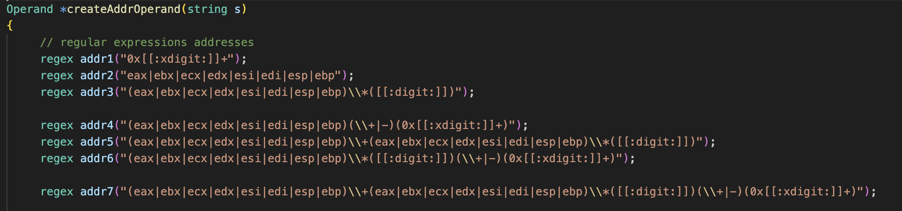
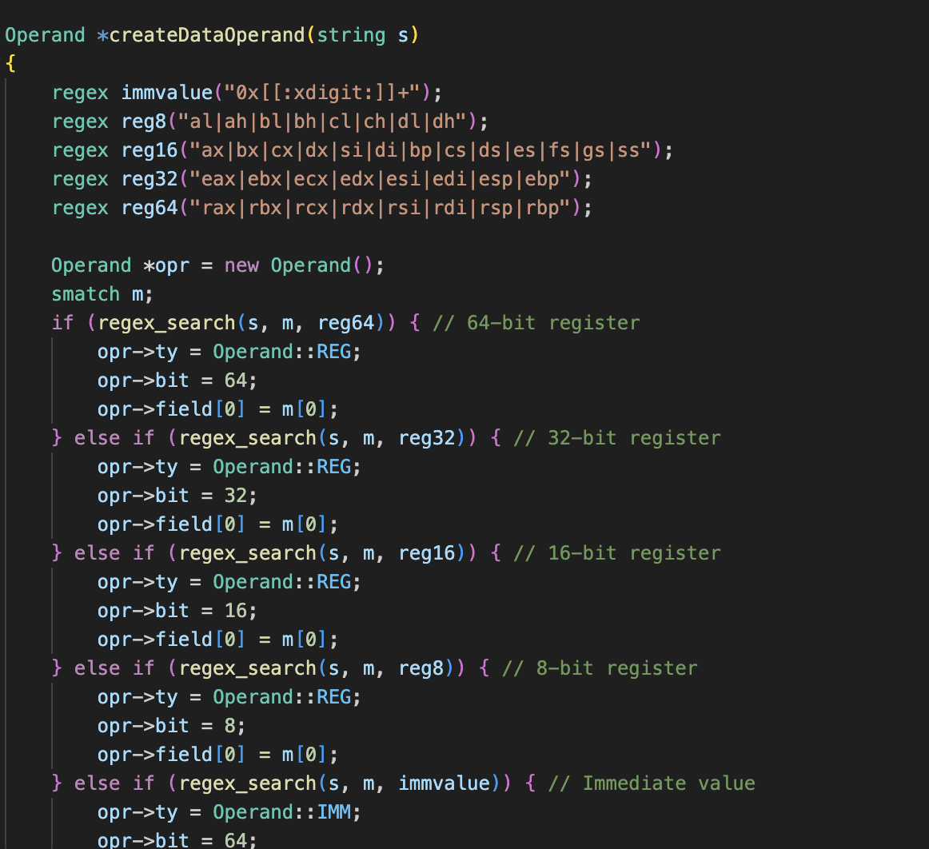
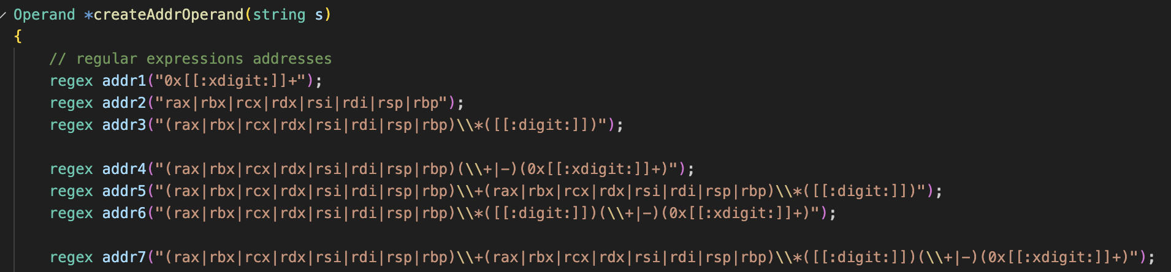
Parser.cpp

Slide 6
Key changes
Registers: Add RAX, RBX, RCX, RDX, RSI, RDI, RSP, and RBP to the Register enum.
Memory Addresses: Update to handle 64-bit memory addresses.
Immediate Values: Ensure compatibility with 64-bit immediate values.
Context Registers: Support for additional or updated context registers in 64-bit architecture. (ctxreg)
Update Memory address type: Replace ADDR32 with ADDR64 and uint32_t to uint64_t, and enture Operand and Parameter structs can handle 64 bit addressing and registers
Update debugging: updated printf format strings to %llx for 64-bit hexadecimal values
Key Modifications
Added support for 64-bit registers in regular expressions.
Updated memory-related fields to handle 64-bit addresses.
Adjusted parsing of context registers to accommodate 64-bit values.
Updated stoul to stoull for parsing 64-bit numbers.

