Slide 1


SMART INDIA HACKATHON 2026
TITLE PAGE
Problem Statement ID – SIH26072
Problem Statement Title - AIML based Nowcasting of thunderstorm and lightning using atmospheric observation including multiple radars, satellite, lightning and model data.
Theme- Disaster Management
PS Category- Software
Team ID-
Team Name - Tensor Titian
Notes:
VAJRA, SIH26072. Problem metadata transcribed from the user's SIH26072_Detailed_Technical_Analysis.md. Ministry of Earth Sciences, India Meteorological Department. Core deliverable: a local predictive model. Website and React Native app are evidence and delivery clients. NCR is the proposed first scientific pilot. The template supplied no team ID.

Slide 2
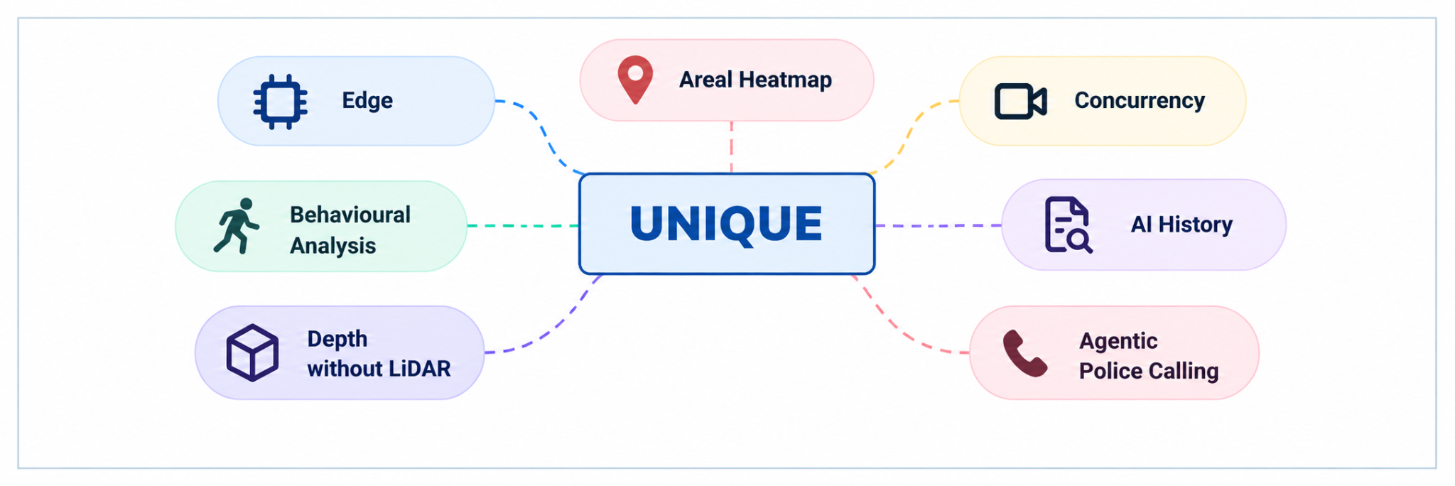
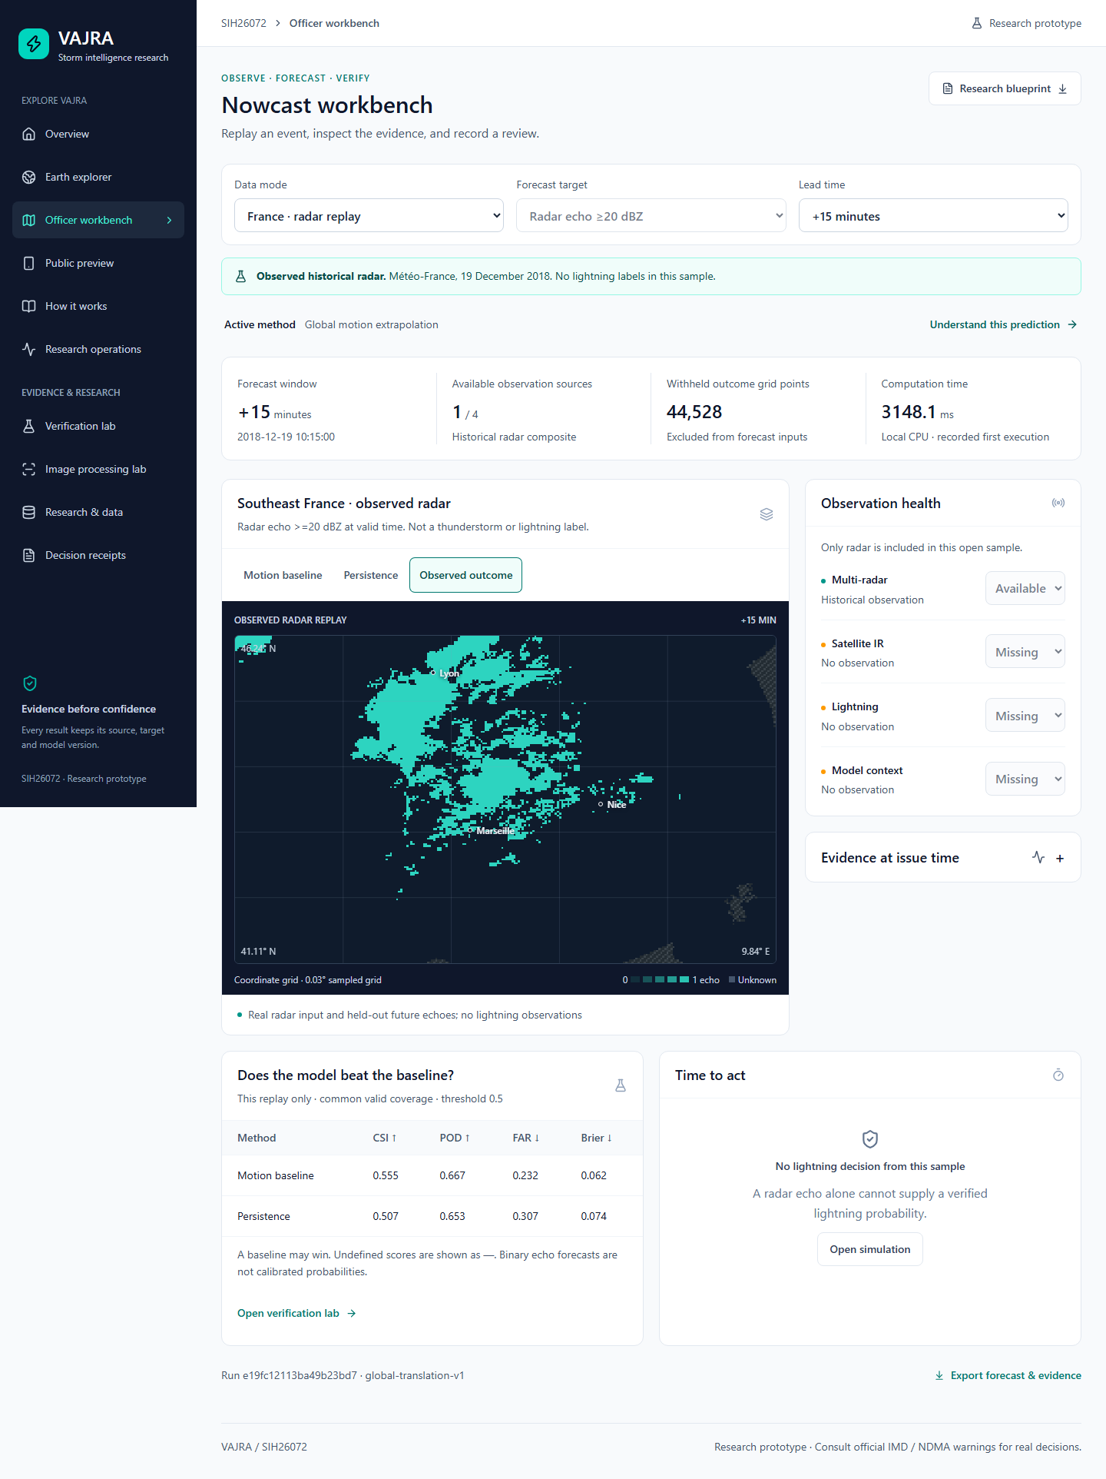
IDEA TITLE: VAJRA
Tensor Titian
Problem Definition
Accuracy and trust
Who needs it: Weather officers and people outdoors.
Problem: Storm risk can change within a broad warning area. Local decisions need recent evidence, useful lead time and clear uncertainty.
Evidence: India recorded 2,862 lightning deaths in 2020 [1]. Local forecast skill must be measured.
Cell
30-min forecast target
Onset windows
Fresh inputs
Seasonal checks
Scores
Reviewed feedback
No LLM needed
Proposed Solution
A local prediction model for the next 30 minutes.
Combine radar, INSAT, lightning and weather context.
Estimate risk and an onset window for each covered cell.
Show data age, gaps and reasons to the officer.
Review public rain reports before training use.
Research prototype. NCR accuracy is still unmeasured.
Weather observations to local guidance
Motion
Echo movement + change
Sources
Clouds
Growth + moisture
Nowcast
India
Risk + onset + evidence
French radar demo. NCR validation pending.
Labels
Lightning + rain + coverage
@SIH Idea submission- Template
Notes:
The next 30 minutes is a design target, not a demonstrated reliable lead time. Broad warnings alone do not resolve every local decision. Damini already offers advance lightning alerts, so this deck makes no superiority claim. Sources: https://www.mha.gov.in/MHA1/Par2017/pdfs/par2022-pdfs/RS27072022/1197.pdf (27 July 2022, annexure: 2,862 deaths in India in 2020); https://www.pib.gov.in/PressReleasePage.aspx?PRID=1813993 (6 April 2022, Damini). Image: actual project screenshot artifacts/observed-radar.png, historical Meteo-France radar data from 19 December 2018. It does not show NCR weather. See VALIDATION.md and data/external/meteonet_manifest.json in this repository.

Slide 3









TECHNICAL APPROACH
Tensor Titian
Weather features
Operator user flow
dBZ
Radar motion
Temporal prediction
Optical flow + persistence
Compact ConvLSTM
Lightning + onset heads
Held-out calibration
Select a region
DATA
Echo movement baseline
Officer web dashboard
1
Check coverage and source availability
IR
Satellite
Risk / reasons / data age
Observations
QC
Cloud-top evolution
Aligned
history
Delivery: planned
2
Inspect observations
Radar / IR / strikes
Time / units / masks
Accuracy before public alerts
FastAPI
Officer review
Review radar, cloud changes and data age
Update on fresh inputs
Hold when evidence is stale
Environment
Coverage + age + officer gate
Forecast + evidence API
Evidence / skill / time
CAPE / wind / humidity
30 min
5 min
API
3
Open the forecast
target horizon
onset bins
Release?
Risk, onset range and no-event chance
approved
model version
read / write
NO /
UNCERTAIN
Check the evidence
APPROVED
4
Skill, sensor gaps and explanation
Raw evidence
React Native app
Files + time + hashes
Local view / rain reports
12 Indian languages + English
Save reason
Issue alert
Approve or withhold
DB
Hold alert
5
Apply validation and authority rules
Matched + reviewed labels
file
reference
Research app
Versioned event store
record / query
Record the outcome
Forecasts / outcomes / coverage
Review and model history
Weather archive
Local guidance
6
Save issue time, location and expiry.
Raw images + numeric fields
Source and processing version
Validated service only
Match later observations for evaluation.
SQLite
Expiry + delivery record
Public model alerts remain disabled in research.
Reviewed labels
Train + test + calibrate
Approve model
Research ledger
Consented rain reports
xr
Flow
Masks
ConvLSTM
Cal
DB
CSI
Rain
Python
PyTorch
OpenCV
xarray
FastAPI
SQLite
JavaScript
React
Optical flow
QC / age
Temporal model
Calibration
Event store
Raw archive
React Native
Scorecards
IMERG
TTS / SMS
@SIH Idea submission- Template
4
@SIH Idea submission- Template
@SIH Idea submission- Template
Notes:
Proposed integrated architecture around implemented research components. Separate executable components include image motion experiments, compact ConvLSTM lightning classification, rain/first-lightning discrete-time survival heads, calibration, citizen evidence ledger, website and React Native app. Unified live sensor fusion, trusted NCR serving and authorised public alert publication remain to be established. Lightning event probabilities can use held-out calibration; timing distributions still need calibration and field validation. Five-minute bins are model targets, not source resolution. Only covered, event-free initial periods support onset predictions. Quality and age masks handle missing inputs. NWP context integration is proposed. No LLM or Jev is required. Public reports: neutral yes/no/unsure, consent, duplicate controls, closed reporting windows and independent review. Majority agreement creates a candidate weak rain-presence label, never sensor truth. Training runs remain versioned and require explicit promotion. New inputs update forecasts, not model weights. References 03-07, 09-12 and 16. https://www.mha.gov.in/MHA1/Par2017/pdfs/par2022-pdfs/RS27072022/1197.pdf
https://www.pib.gov.in/PressReleasePage.aspx?PRID=1813993
https://mausam.imd.gov.in/
https://www.mosdac.gov.in/look/DOCS/mosdac-data-guidelines_english.pdf
https://incois.gov.in/essdp/ViewMetadata?fileid=05f2bab9-054f-45cf-b77d-1eaf089252ff
https://www.earthdata.nasa.gov/data/catalog/ges-disc-gpm-3imerghh-07
https://open-meteo.com/en/docs
https://mausam.imd.gov.in/imd_latest/contents/pdf/forecasting_sop.pdf
https://arxiv.org/abs/1506.04214
https://docs.wradlib.org/en/2.0.0/notebooks/basics/wradlib_workflow.html
https://journals.ametsoc.org/view/journals/wefo/37/7/WAF-D-22-0019.1.xml
https://peerj.com/articles/6257/
https://tropmet.res.in/erpas/files/active_break_selection.php
https://doi.org/10.1016/j.pce.2025.104182
https://github.com/omansharora5/ps_2/blob/main/VALIDATION.md
https://github.com/omansharora5/ps_2/blob/main/docs/PUBLIC_VERIFICATION_GUIDE.md

Slide 4
FEASIBILITY AND VIABILITY
Tensor Titian
FEASIBILITY ANALYSIS
ACCURACY CHECKS
CHALLENGES | STRATEGY
Technical Missing or stale sensors | Quality and age masks. Preserve native resolution. Withhold a claim when coverage is unknown.
Operational False or missed alerts | Test on separate storms. Compare baselines. Check reliability and officer thresholds.
Social Privacy and biased reports | Coarse cells and consent. Deduplicate reports. Review independent corroboration.
Feasibility Data access and compute | Obtain permissions. Start with one region and a compact model. Measure cost per update.
TECHNICAL FEASIBILITY
1 Freeze available inputs
AI
Compact temporal model.
Open radar processing tools.
Indian data access needed.
No future observations in a forecast
2 Separate storm events
COMPUTE FEASIBILITY
Train, validate, calibrate, then test
Start with one region.
Reuse observing networks.
Bound queues and cache inputs.
₹
3 Compare baselines
Persistence and motion on equal cases
✓
OPERATIONAL FEASIBILITY
4 Check probabilities
Evidence for officer review.
Clear stale-data warnings.
Versioned forecast records.
Reliability, Brier, POD, FAR and CSI
5 Run a shadow pilot
PUBLIC-SERVICE FEASIBILITY
✓
Test outages and useful warning time
Local language guidance.
Consent for rain reports.
Coarse location by default.
Research gates before public model alerts
REQUIREMENTS
VIABILITY
Matched NCR observations
CPU / GPU research worker
Versioned labels + coverage
Pilot with documented Indian data rights.
Measure skill, latency and useful lead time.
Scale only after independent evaluation.
@SIH Idea submission- Template
Notes:
Accuracy plan: split by storm event and time; prevent input-arrival leakage; separate validation, calibration and untouched test events; compare persistence and motion on identical covered cohorts; report POD, false-alarm ratio, CSI, Brier, reliability and uncertainty. Evaluate onset with censoring, misses and no-event outcomes retained. Test outages, warm-top rain and dust separately. Seasonal Z-R and phase-conditioned calibration are research additions with no demonstrated NCR improvement yet. The Delhi study is prior work, not a new discovery by VAJRA. Warm-rain and dust flags are descriptive, not validated classifiers. Numeric NCR radar, aligned INSAT sequences, lightning coverage and suitable observed labels remain dependencies. Public model warnings remain disabled. Feasibility concerns shared compute and a public-service pilot, with no revenue model. Sources: https://www.mosdac.gov.in/look/DOCS/mosdac-data-guidelines_english.pdf; https://mausam.imd.gov.in/imd_latest/contents/pdf/forecasting_sop.pdf; https://tropmet.res.in/erpas/files/active_break_selection.php; https://doi.org/10.1016/j.pce.2025.104182.

Slide 5
IMPACT AND BENEFITS
Tensor Titian
Support Weather
Operators
Help Outdoor
Communities
Observations
VAJRA
Public guidance
RADAR
INSAT
RISK
+ TIME
LOCAL
ALERT
Potential impact: Bring forecast risk and sensor evidence into one review.
Potential impact: Give local guidance to farmers, schools and outdoor workers.
Radar + INSAT
Temporal model
Officer approval
Lightning labels
Risk + timing
Local language
Benefit: Shows where evidence supports action or needs caution.
Benefit: Aim for more preparation time, subject to verified skill.
Rain gauges
Quality masks
Clear expiry
Time + coverage
Measured skill
Reviewed reports
30-min forecast target
Reuse Observing
Networks
Improve Local
Preparedness
6 onset bins
of 5 minutes each
Potential impact: Combine existing radar, satellite and station data.
Potential impact: Show the place, onset window and alert expiry.
12 Indian languages
+ English
Benefit: Local language speech and reviewed feedback improve access.
2,862 lightning deaths
India, 2020 [1]
Historical need, not a
claim of lives saved
Benefit: A regional pilot can share data and compute resources.
One French radar case, 19 Dec 2018
Echo >=20 dBZ. NCR skill is unmeasured.
@SIH Idea submission- Template
Notes:
Benefits are intended pilot outcomes. We have not measured lives saved, farmer income improvement, latency improvement or carbon savings. Twelve Indian languages plus English and device TTS/SMS composer exist as prototype features; translations need review and this does not prove delivery infrastructure. Chart: recorded historical Meteo-France radar case, 19 December 2018, CSI for echoes at least 20 dBZ. Lead minutes [5,10,15,20]. Motion/translation CSI [0.710716,0.584645,0.555373,0.508291]; persistence CSI [0.637651,0.550681,0.506571,0.488428]. Source: repository VALIDATION.md and recorded historical radar evaluation. One case is not an operational accuracy estimate and is unrelated to lightning skill. Lightning deaths: 2,862 in India in 2020, MHA/NCRB parliamentary answer dated 27 July 2022, annexure https://www.mha.gov.in/MHA1/Par2017/pdfs/par2022-pdfs/RS27072022/1197.pdf.

Slide 6
RESEARCH AND REFERENCES
Tensor Titian
References
Evaluation method
01 Lightning deaths: 2,862 in 2020 (S5)
09 Temporal image model (S3)
Accuracy requires independent storm events
MHA / NCRB, Rajya Sabha (2022)
Shi et al., ConvLSTM (2015)
Official historical count for India.
Convolutional recurrence for nowcasting.
Does not estimate lives VAJRA could save.
Architecture reference, not NCR evidence.
Train / validation / calibration / test
02 Existing Indian warning service (S2)
10 Radar quality control (S3)
PIB / MoES, Damini (2022)
wradlib radar workflow
Freeze input availability and target windows.
Check phase, sensor gaps and no-event outcomes.
Damini already provides advance alerts.
Georeferencing and measurement checks.
VAJRA superiority remains unproven.
Use physical values and quality masks.
03 Indian observations (S3)
Rendered tiles cannot replace calibrated dBZ.
IMD, official data and API portal
11 Lightning before first strike (S3)
Compare baselines on the same covered cells.
Station, radar and warning information.
ProbSevere LightningCast (2022)
Numeric NCR radar access still needed.
Satellite-based probabilistic forecasting.
04 INSAT data and rights (S3)
Transfer to INSAT requires local evaluation.
Report POD, FAR, CSI, Brier and reliability.
ISRO MOSDAC data guidelines
12 Time-to-event method (S3)
Satellite observations and permitted use.
Gensheimer & Narasimhan (2019)
NCR skill unmeasured. Public model warnings disabled.
Confirm redistribution before any release.
Discrete-time survival neural network.
05 Indian lightning labels (S3)
Keep censoring and no-event outcomes.
INCOIS catalogue, IITM network
13 Active / break monsoon phase (S4)
2019 stroke location, time and attributes.
IITM, active-break selection
Metadata is not a matched training corpus.
Phase-aware calibration is a hypothesis.
Synthetic lightning smoke
Network coverage is required for negatives.
Use only phase information known at issue.
Observed-data gate | NCR status
Radar sequences | Pending
INSAT matching | Pending
Lightning coverage | Pending
Local field skill | Unmeasured
06 Supplemental rain labels (S3)
Sparse phase data need a pooled fallback.
30 September 2026, 20 training steps
NASA GPM IMERG V07
14 Seasonal Z-R in Delhi (S4)
Half-hourly rain estimates at 0.1 degree.
Delhi radar study (2025)
Brier | 0.2361
Baseline | 0.2158
Skill | -0.0939
Test events | 2
Check latency and quality before use.
Local Z-R calibration has prior research.
Not independent street-scale gauge truth.
Fit on training gauges and test separately.
07 Environmental model inputs (S3)
No claim of an unpublished first for Delhi.
Open-Meteo forecast API
15 Reproducible project measurements (S5-6)
CAPE, humidity, wind and model rain.
VAJRA repository, VALIDATION.md
Forecast context, not observed rain truth.
French radar case and synthetic smoke only.
08 Operational forecast context (S4)
16 Verification and weak labels (S3-6)
IMD forecasting SOP
VAJRA public verification guide
Warning practice and forecast definitions.
Equal cohorts, calibration and reviewed reports.
Two synthetic test events. Baseline wins.
Compare only matched windows and areas.
No majority-to-truth or automatic promotion.
@SIH Idea submission- Template
Notes:
Sources and limitations:
01 Lightning deaths: 2,862 in 2020 (S5)
MHA / NCRB, Rajya Sabha (2022) Official historical count for India. Does not estimate lives VAJRA could save.
https://www.mha.gov.in/MHA1/Par2017/pdfs/par2022-pdfs/RS27072022/1197.pdf
02 Existing Indian warning service (S2)
PIB / MoES, Damini (2022) Damini already provides advance alerts. VAJRA superiority remains unproven.
https://www.pib.gov.in/PressReleasePage.aspx?PRID=1813993
03 Indian observations (S3)
IMD, official data and API portal Station, radar and warning information. Numeric NCR radar access still needed.
https://mausam.imd.gov.in/
04 INSAT data and rights (S3)
ISRO MOSDAC data guidelines Satellite observations and permitted use. Confirm redistribution before any release.
https://www.mosdac.gov.in/look/DOCS/mosdac-data-guidelines_english.pdf
05 Indian lightning labels (S3)
INCOIS catalogue, IITM network 2019 stroke location, time and attributes. Metadata is not a matched training corpus. Network coverage is required for negatives.
https://incois.gov.in/essdp/ViewMetadata?fileid=05f2bab9-054f-45cf-b77d-1eaf089252ff
06 Supplemental rain labels (S3)
NASA GPM IMERG V07 Half-hourly rain estimates at 0.1 degree. Check latency and quality before use. Not independent street-scale gauge truth.
https://www.earthdata.nasa.gov/data/catalog/ges-disc-gpm-3imerghh-07
07 Environmental model inputs (S3)
Open-Meteo forecast API CAPE, humidity, wind and model rain. Forecast context, not observed rain truth.
https://open-meteo.com/en/docs
08 Operational forecast context (S4)
IMD forecasting SOP Warning practice and forecast definitions. Compare only matched windows and areas.
https://mausam.imd.gov.in/imd_latest/contents/pdf/forecasting_sop.pdf
09 Temporal image model (S3)
Shi et al., ConvLSTM (2015) Convolutional recurrence for nowcasting. Architecture reference, not NCR evidence.
https://arxiv.org/abs/1506.04214
10 Radar quality control (S3)
wradlib radar workflow Georeferencing and measurement checks. Use physical values and quality masks. Rendered tiles cannot replace calibrated dBZ.
https://docs.wradlib.org/en/2.0.0/notebooks/basics/wradlib_workflow.html
11 Lightning before first strike (S3)
ProbSevere LightningCast (2022) Satellite-based probabilistic forecasting. Transfer to INSAT requires local evaluation.
https://journals.ametsoc.org/view/journals/wefo/37/7/WAF-D-22-0019.1.xml
12 Time-to-event method (S3)
Gensheimer & Narasimhan (2019) Discrete-time survival neural network. Keep censoring and no-event outcomes.
https://peerj.com/articles/6257/
13 Active / break monsoon phase (S4)
IITM, active-break selection Phase-aware calibration is a hypothesis. Use only phase information known at issue. Sparse phase data need a pooled fallback.
https://tropmet.res.in/erpas/files/active_break_selection.php
14 Seasonal Z-R in Delhi (S4)
Delhi radar study (2025) Local Z-R calibration has prior research. Fit on training gauges and test separately. No claim of an unpublished first for Delhi.
https://doi.org/10.1016/j.pce.2025.104182
15 Reproducible project measurements (S5-6)
VAJRA repository, VALIDATION.md French radar case and synthetic smoke only.
https://github.com/omansharora5/ps_2/blob/main/VALIDATION.md
16 Verification and weak labels (S3-6)
VAJRA public verification guide Equal cohorts, calibration and reviewed reports. No majority-to-truth or automatic promotion.
https://github.com/omansharora5/ps_2/blob/main/docs/PUBLIC_VERIFICATION_GUIDE.md
Synthetic smoke: artifacts/regional-research/d95852635db7d3a663ea160588729f78a59c61607c0e300d5d377777bee46cbc/report.json. 20 training steps, 2 synthetic test events. Calibrated lightning Brier 0.23609189291330068; climatology Brier 0.2158203125; Brier skill -0.09392804680189992. Lower Brier is better; this model loses to the baseline. These are computation checks and do not validate lightning forecasts. The NCR status table distinguishes missing matched observations and unmeasured field skill. No operational IMD comparison has been established.

