Slide 1

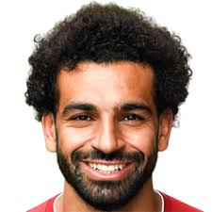
Face recognition tests
This is an example of how Face recognition system works:
Step 1:
we take a training photo of Mohammed Salah as a reference to be uploaded and stored on the system .

Slide 2
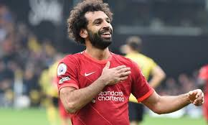
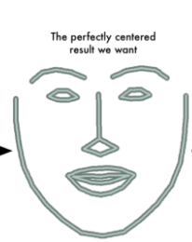
Step 2: Tilted To Frontal Image
The frontal and tilted images of the same person are completely different for the network.
Therefore, we use dilp library to find the facial landmarks and warps it so the system can understand it.

Slide 3
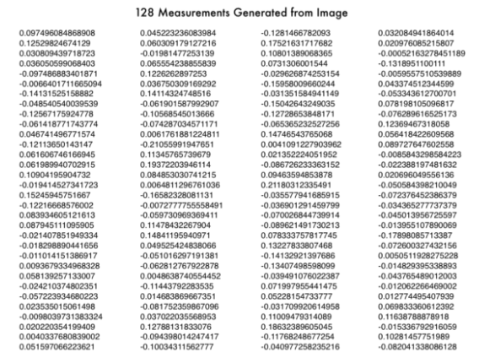
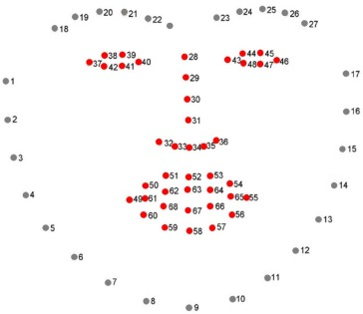
Step 3: Encoding Features with HOG
The Histogram of Oriented Gradients or in short HOG create a simplified version of the image.
The HOG measures the features of the face by generating 128 points of the face.
The 128 measurement points is used define a person and differentiate between different people as well.( but how?)

Slide 4
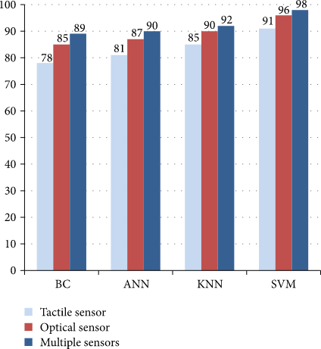
Step 4 : choosing a Machine learning method
KNN
SVM
DC
ANN

Slide 5
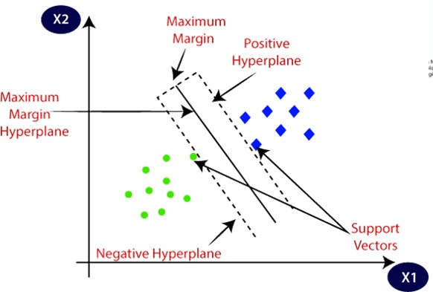
Step 4: The SVM
The SVM is the Support Vector Machine .
SVM is one of the most popular Supervise algorithms, which is used for Classification.
The goal of the SVM algorithm is to choose the extreme points/vectors that help in creating the hyperplane.
-

Slide 6
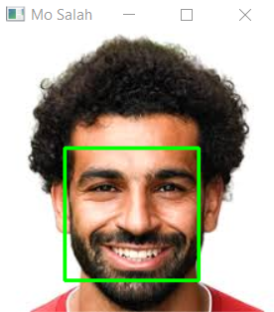
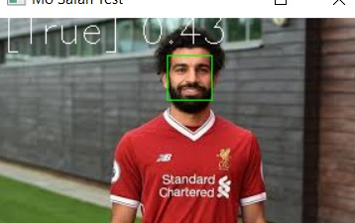
Step 4: SVM
Running this classifier takes milliseconds to find result , differentiate and find the matches between the two photos.

Slide 7
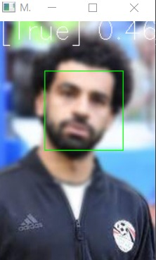
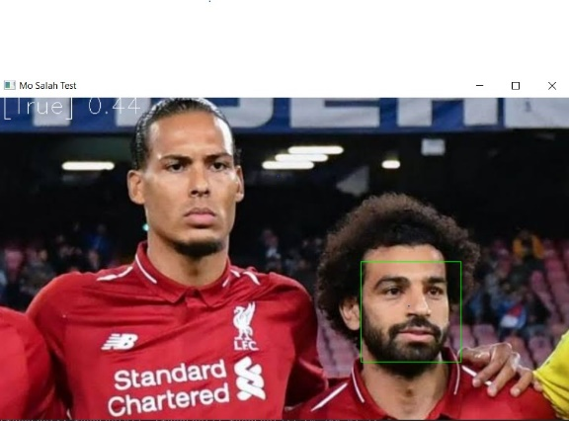
Multiple Tests
Blurry Image:
Here we used another test photo of Mohamed Salah but blurry or pixeled and the result came as true .
Different faces in one Image:
We put another photo with another player and the system detected Mo Salah’s face and can recognized him successfully .

Slide 8
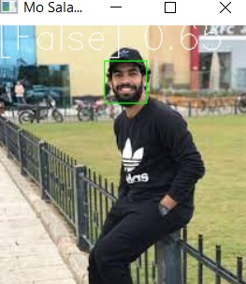
Multiple Tests
Close features:
last, we added a photo of Nasr Salah who is
Salah’s brother as the have very close face features and the result came as false.
Now let’s Move to another point.

