Slide 1
MACHINE LEARNING · CLASSIFICATION PROJECT
Diabetes Risk Prediction
Predicting Low, Moderate, and High diabetes risk from clinical,
demographic, and lifestyle data using five classification models
Low Risk
Moderate Risk
High Risk
Dataset: 15,000 patient records · 19 features · 5 models compared

Slide 2
OVERVIEW
Project Workflow
An end-to-end supervised learning pipeline, from raw records to a compared, evaluated set of five classifiers.
1
Load Data
2
Explore (EDA)
3
Clean
15,000 rows × 19 columns loaded from CSV
→
Boxplots, class balance, correlation heatmap
→
Drop irrelevant cols, handle nulls, dedupe
4
Engineer Features
5
Encode & Scale
6
Train & Evaluate
Pulse pressure, sugar interaction term
→
One-hot / ordinal encoding, RobustScaler
→
5 models scored on accuracy, precision, recall, F1
Diabetes Risk Prediction
2

Slide 3
THE DATA
Dataset Overview
15,000
patient records
19
original columns
Sample Patient Record
Age
47
3
risk classes
0
duplicate rows
Gender
Female
BMI
26.5
Family history of diabetes
Yes
Feature Categories
Physical activity
Sedentary
Demographic
Fasting blood sugar
178 mg/dL
age, gender, city, income bracket
HbA1c level
7.3%
Clinical
Blood pressure
146 / 90
BMI, fasting blood sugar, HbA1c, blood pressure, waist circumference
Lifestyle
Waist circumference
107.1 cm
physical activity, diet type, smoking & alcohol use, sleep, stress
Diabetes risk (target)
Low
Target
diabetes_risk — Low / Moderate / High
Diabetes Risk Prediction
3

Slide 4
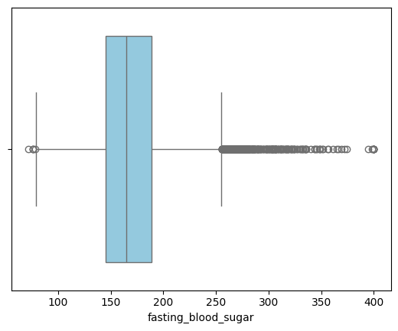
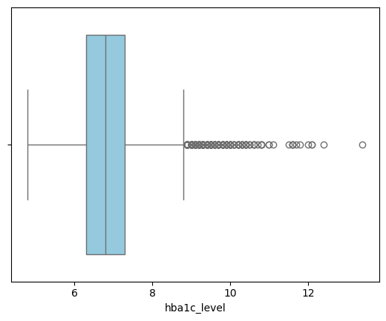
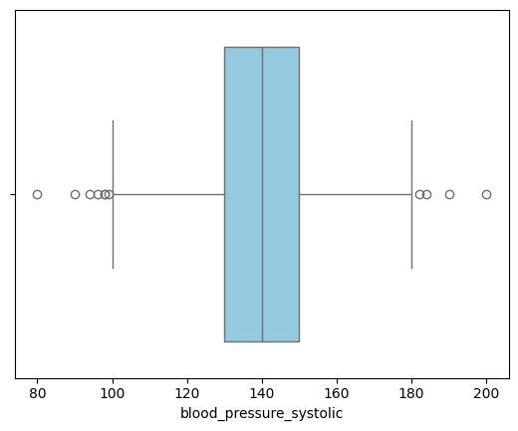
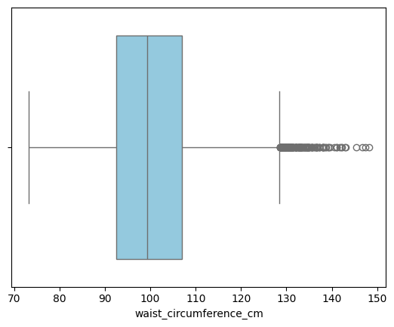
EXPLORATORY DATA ANALYSIS
Outlier Detection
Boxplots of four key clinical variables reveal right-skewed distributions with a meaningful share of high-end outliers.
Fasting Blood Sugar
HbA1c Level
High-value outliers stretch to ~400 mg/dL
Elevated-tail outliers above ~9%
Systolic Blood Pressure
Waist Circumference (cm)
Wide spread with upper outliers near 200
Fairly symmetric, few outliers
Diabetes Risk Prediction
4

Slide 5
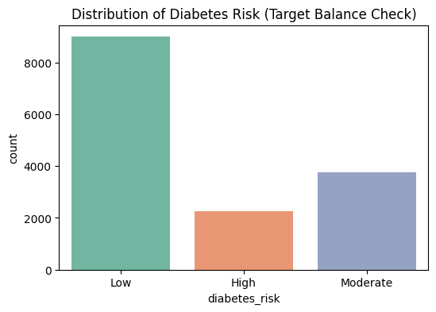
EXPLORATORY DATA ANALYSIS
Target Class Distribution
A Clear Class Imbalance
Low risk dominates the dataset, which will bias models toward predicting the majority class unless addressed.
Low Risk
9,000 patients
60%
Moderate Risk
3,750 patients
25%
High Risk
2,250 patients
15%
Diabetes Risk Prediction
5

Slide 6
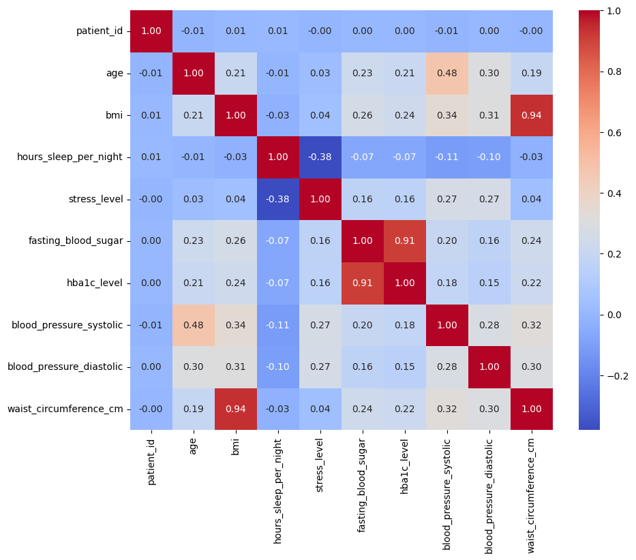
EXPLORATORY DATA ANALYSIS
Feature Correlation Analysis
Notable Relationships
BMI ↔ Waist circumference
0.94
Near-perfect — both capture body composition
Fasting blood sugar ↔ HbA1c
0.91
Expected — both reflect glycemic control
Age ↔ Systolic BP
0.48
Moderate — blood pressure rises with age
Sleep hours ↔ Stress level
-0.38
Moderate negative — more stress, less sleep
Diabetes Risk Prediction
6

Slide 7
PREPROCESSING
Data Cleaning
Columns Dropped
Missing Values & Duplicates
✕
patient_id
✓
smoking_status
identifier — no predictive value
472 missing → rows dropped (dropna)
✕
city
✓
Remaining nulls
high-cardinality, low signal
Removed via df.dropna() after column drops
✕
income_bracket
✓
Duplicate rows
463 missing values
0 found — no deduplication needed
✕
alcohol_consumption
3,788 missing values (25%+)
Net Effect
Dataset reduced from 19 columns to 15 usable columns; rows with remaining nulls dropped, leaving a clean, duplicate-free table ready for feature engineering and encoding.
Diabetes Risk Prediction
7

Slide 8
PREPROCESSING
Feature Engineering & Encoding
New Engineered Features
pulse_pressure
sugar_interaction
= blood_pressure_systolic − blood_pressure_diastolic
= fasting_blood_sugar × hba1c_level
Captures arterial stiffness, a cardiovascular signal linked to metabolic risk.
An interaction term amplifying the joint signal of two highly-correlated glucose markers.
Encoding & Scaling
One-Hot Encoding
gender, family_history_diabetes, diet_type, smoking_status
Ordinal Encoding
physical_activity_level (Sedentary → Moderate → Active)
RobustScaler
Applied to all numeric features — resilient to the outliers seen in EDA
Fit on the training split only, then applied to the test split — preventing data leakage. Split: 80% train / 20% test (random_state = 42).
Diabetes Risk Prediction
8

Slide 9
MODELING
Modeling & Evaluation Setup
Five classification algorithms are trained on the same 80/20 split and scored on identical metrics for a fair comparison.
LR
KNN
SVM
DT
RF
Logistic Regression
K-Nearest Neighbors
Support Vector Machine
Decision Tree
Random Forest
Linear baseline model
k = 5 neighbors
RBF kernel
Single tree classifier
Ensemble of trees
Evaluation Metrics
Accuracy
Precision (macro)
Recall (macro)
F1-score (macro)
Confusion Matrix
Macro-averaging treats all three risk classes equally — important given the class imbalance seen earlier.
Diabetes Risk Prediction
9

Slide 10
RESULTS
Model Performance Comparison
Model | Accuracy | Precision (macro) | Recall (macro) | F1-score (macro)
Logistic Regression | 79.35% | 75.10% | 72.46% | 73.62%
SVM | 79.53% | 76.33% | 71.69% | 73.59%
Random Forest | 79.08% | 74.69% | 72.00% | 73.20%
KNN | 75.02% | 68.08% | 66.55% | 67.22%
Decision Tree | 72.37% | 65.65% | 64.99% | 65.30%
SVM edges out on accuracy and precision; Logistic Regression leads on recall and F1 — both are the strongest, closely-matched overall performers.
Highlighted values indicate the top score for that metric
Diabetes Risk Prediction
10

Slide 11
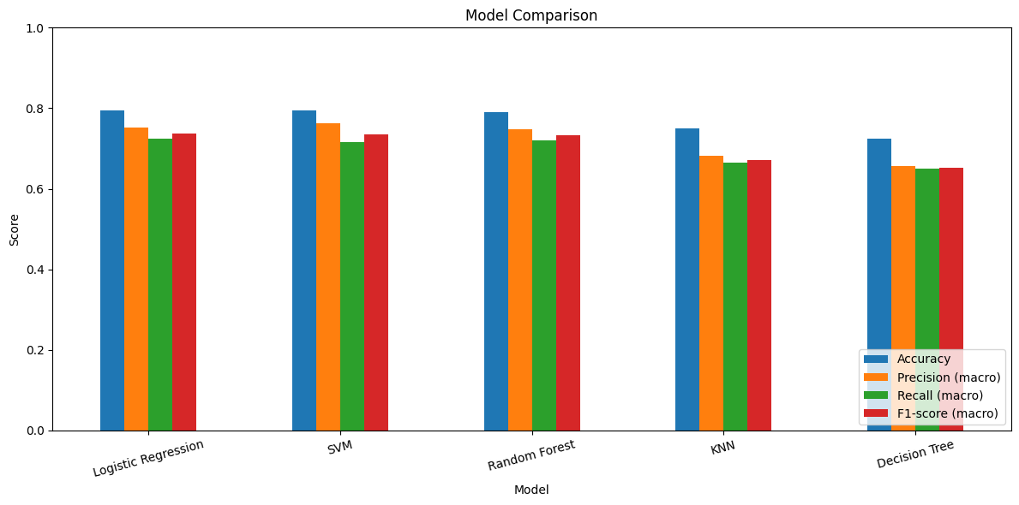
RESULTS
Model Comparison — Visual
All four macro-averaged metrics, side by side for each of the five models.
Diabetes Risk Prediction
11

Slide 12
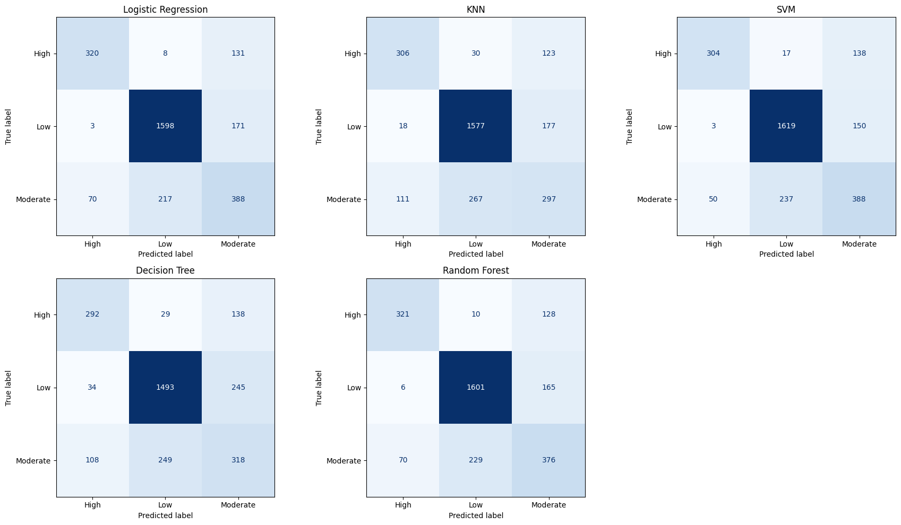
RESULTS
Confusion Matrices
Predicted vs. true risk class for every model on the held-out test set (n = 2,906).
Diabetes Risk Prediction
12

Slide 13
RESULTS DEEP DIVE
Per-Class Performance
F1-score by risk class for the top three models — the Moderate class is consistently the hardest to classify.
High Risk
Low Risk
Moderate Risk
Logistic Regression
Logistic Regression
Logistic Regression
0.75
0.89
0.57
SVM
SVM
SVM
0.75
0.89
0.57
Random Forest
Random Forest
Random Forest
0.75
0.89
0.56
F1-score shown for each model. Low risk (majority class) is predicted best; Moderate risk sits between the other two classes and is hardest to separate.
Diabetes Risk Prediction
13

Slide 14
CONCLUSION
Key Insights
Best overall performers
SVM (79.5% accuracy) and Logistic Regression (73.6% macro F1) lead a tightly clustered top three that also includes Random Forest.
Class imbalance drives results
With 60% of records labeled Low risk, every model predicts that class most reliably (F1 ≈ 0.87–0.89).
Moderate risk is the blind spot
F1-scores for Moderate risk fall to 0.46–0.57 across all models — it overlaps with both neighboring classes.
Simpler models underperform
KNN and Decision Tree trail by 4–7 accuracy points, suggesting the decision boundaries are not simply local or axis-aligned.
Diabetes Risk Prediction
14

Slide 15
Thank You
Diabetes Risk Prediction — a five-model classification study on 15,000 patient records
Questions & Discussion

