Slide 1
Computer Vision Sign Language Recognition Project
Omar AlHamaydeh

Slide 2
Introduction
This project focuses on developing a robust system for detecting and interpreting sign language using LSTM deep learning models implemented in Python.
By concentrating on the dynamic gestures of sign languages, the system is designed to provide real-time translation, revolutionizing interaction for individuals with hearing impairments.

Slide 3
Problem Statement
Sign language detection is crucial due to its profound social impact and technical complexity.
This project tackles the challenge of interpreting nuanced gestures using computer vision, enhancing both accessibility and inclusivity.

Slide 4
Significance and Relevance
Accessibility: Approximately 466 million people globally have disabling hearing loss. An automated detection system could significantly enhance their digital and social interactions.
Technical Challenge: Recognizing complex gesture patterns and temporal dependencies in sign language poses a significant challenge in action recognition.
Innovation in HCI: By facilitating real-time interaction between deaf users and computer systems, this project aims to transform educational, social, and professional landscapes.

Slide 5
Literature Review
1. "Natural Language-Assisted Sign Language Recognition" by Ronglai Zuo, Fangyun Wei, and Brian Mak
- Focus: Enhancing the performance of sign language recognition (SLR) systems through the integration of semantic information from natural languages.
- Key Findings: The inclusion of semantic information significantly improves the model's ability to differentiate between similar signs and achieves state-of-the-art results.
2. "Distilling Cross-Temporal Contexts for Continuous Sign Language Recognition" by Guo et al.
- Focus: Addressing the challenge of recognizing continuous sign language through enhanced understanding of temporal contexts.
- Key Findings: Demonstrates superior accuracy and efficiency compared to existing methods, making significant advancements in continuous sign language recognition.
3. "Learning to Estimate 3D Hand Pose from Single RGB Images" by Zimmermann and Brox
- Focus: Developing a method for 3D hand pose estimation using only single RGB cameras, a shift from traditional depth cameras or multi-camera systems.
- Key Findings: Achieves promising results across various datasets, showcasing the potential for broader applications beyond sign language recognition.
4. "BlazePose: On-device Real-time Body Pose Tracking" by Valentin Bazarevsky and colleagues from Google Research
- Focus: Creating a real-time body pose estimation model optimized for mobile devices.
Key Findings: Performs efficiently on standard mobile devices, suitable for applications requiring immediate feedback such as fitness tracking and augmented reality.
Here’s a concise summary for the "SubUNets" paper, complementing the summaries of other key research papers in your literature review:
5. “SubUNets: End-to-End Hand Shape and Continuous Sign Language Recognition" by Necati Cihan Camgoz et al.
- Focus: Enhancing the recognition of hand shapes and continuous sign language using an integrated deep learning approach.
- Key Findings: Achieves superior performance in hand-shape recognition and competitive results in continuous sign language recognition without the need for explicit prior segmentation or alignment of gestures.

Slide 6
Methodology
The methodology revolves around using LSTM networks for their ability to handle long sequences and remember patterns, which is crucial for action recognition tasks.
The project will employ Python for implementing the LSTM models and focus on preprocessing video data to improve model training and validation.

Slide 7
Implementation
Library Installation and Setup
Installation of required libraries such as TensorFlow, OpenCV, MediaPipe, and others for image processing and machine learning.
Import essential Python modules for image manipulation, array computations, and visualization.
MediaPipe Holistic Model Utilization
Using MediaPipe Holistic for real-time pose, face, and hand landmarks detection.
Functions mediapipe_detection and draw_styled_landmarks handle the processing and visualization of keypoints.
Keypoint Detection and Extraction
Extraction of keypoints for pose, face, and hands using MediaPipe, which are critical for training the machine learning model.
The keypoints include x, y, z coordinates and visibility, which are flattened and concatenated for each frame.

Slide 8
Implementation
Data Collection Setup
"Setting up a data structure to save keypoints from different gestures (e.g., 'hello', 'thanks', 'iloveyou') recorded in sequences for model training."
"Using a video capture setup to record sequences of sign language gestures, storing them as NumPy arrays."
Model Training
"Developing an LSTM-based neural network to learn from temporal sequences of keypoints. The model structure includes multiple LSTM layers followed by Dense layers for classification."
"Training involves processing sequences of keypoints to classify different sign language gestures."
Real-Time Sign Language Detection
"Implementing a real-time detection system that captures video frames, processes them through the trained model, and displays the detected sign language gesture."
"Utilization of a sliding window approach to continuously predict gestures from video streams."
Visualization and User Interface
"Using OpenCV to display the real-time video feed with overlaid predictions and probabilities for better user interaction."
"Providing visual feedback by highlighting recognized gestures and displaying them on screen."

Slide 9
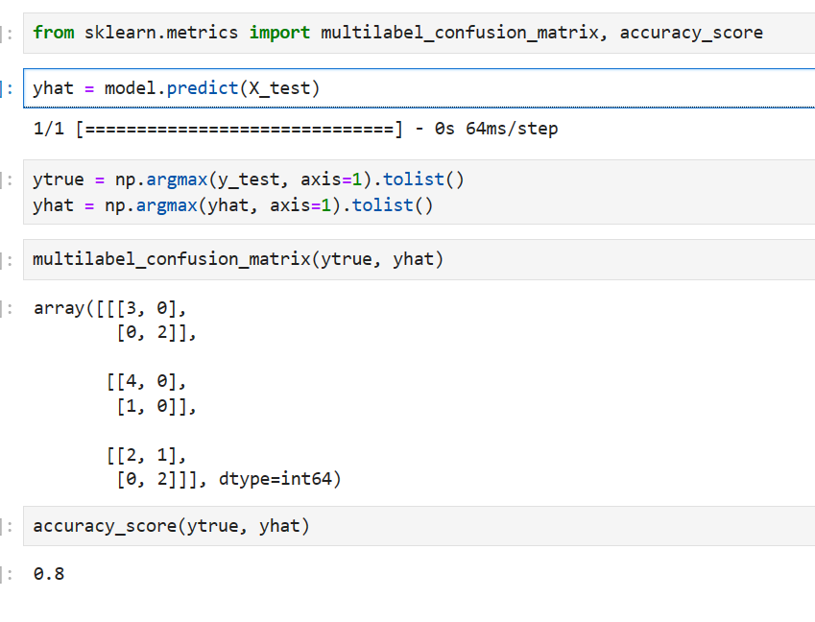
Your Results

Slide 10
Discussion
Analysis of Confusion Matrix:
First Class (e.g., 'hello'):
True Positives (TP): 3 - The model correctly identified the gesture 'hello' three times.
False Negatives (FN): 2 - The model missed 'hello' two times when it was the correct label.
This indicates a fairly reliable detection for 'hello,' but improvements can be made in reducing false negatives.
Second Class (e.g., 'thanks'):
True Positives (TP): 4 - The model correctly identified 'thanks' four times.
False Positives (FP): 0 - There were no instances where 'thanks' was incorrectly predicted when it was not the actual gesture.
This shows strong performance in identifying 'thanks' with no false alarms.
Third Class (e.g., 'iloveyou'):
True Positives (TP): 2 - Correctly identified 'iloveyou' twice.
False Positives (FP): 1 - Incorrectly identified 'iloveyou' once when it was not the actual gesture.
False Negatives (FN): 2 - Missed 'iloveyou' twice when it was the correct label.
Performance for 'iloveyou' shows that the model struggles both with false positives and false negatives, suggesting a need for model refinement for this gesture.

Slide 11
Work Division
I did it all.

Slide 12
Demonstration

