Slide 1
Network Pentest

Slide 2
Agenda
Presentation Title

Slide 3
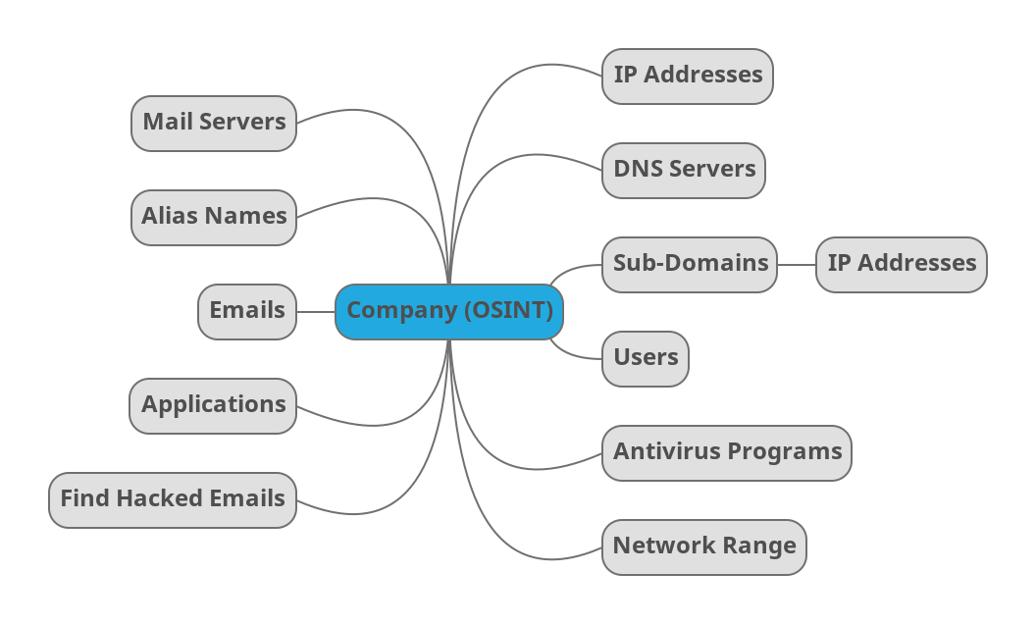
Open Source Intelligence Gathering (OSINT)

Slide 4
General Enumeration
dig +noall +answer microsoft.com NS
dig +noall +answer microsoft.com A
dig +noall +answer microsoft.com MX
dig +noall +answer microsoft.com ANY
dig +noall +answer emp.iu.edu.sa ANY
dnsrecon -d microsoft.com
dnsrecon -d microsoft.com -n “8.8.8.8 | 8.8.4.4”

Slide 5
Zone Transfer
dig +noall +answer microsoft.com NS
dig +noall +answer @ns1.msft.net microsoft.com AXFR
dig +noall +answer @ns2.msft.net microsoft.com AXFR
dig +noall +answer @ns3.msft.net microsoft.com AXFR
dig +noall +answer @ns4.msft.net microsoft.com AXFR
dig +noall +answer zonetransfer.me NS
dig +noall +answer @nsztm1.digi.ninja zonetransfer.me AXFR
dig +noall +answer @nsztm2.digi.ninja zonetransfer.me AXFR
dnsrecon -d microsoft.com -t axfr
dnsrecon -d zonetransfer.me -t axfr

Slide 6
Find Sub-Domains
Google Dorks
TheHarvester
sublister
amass
subfinder
assetfinder
find-domains
security trails
crt.sh

Slide 7
Maltego Tool
Make a recon on tesla.com
Task make on hackerone.com

Slide 8
Brute force
dnsrecon -t brt -d microsoft.com -D file.txt

Slide 9
Find emails
Google Dorks
site:example.com "@example.com"
intext:"email" OR "contact" site:example.com
filetype:xls OR filetype:csv "@example.com“
Hunter.io
Shodan -----> temp emails (http://imail.edu.vn/-https://etempmail.com/-emailnator.com)

Slide 10
Script to dump email from hunter.io
import requests
API_KEY = "c6c2e9139bba1d41021ed4a61f9e9878e3058450"
DOMAIN = “tesla.com"
url = f"https://api.hunter.io/v2/domain-search?domain={DOMAIN}&api_key={API_KEY}"
response = requests.get(url)
data = response.json()
for email in data.get("data", {}).get("emails", []):
print(email["value"], "-", email.get("position"), "-", email.get("confidence"))

Slide 11
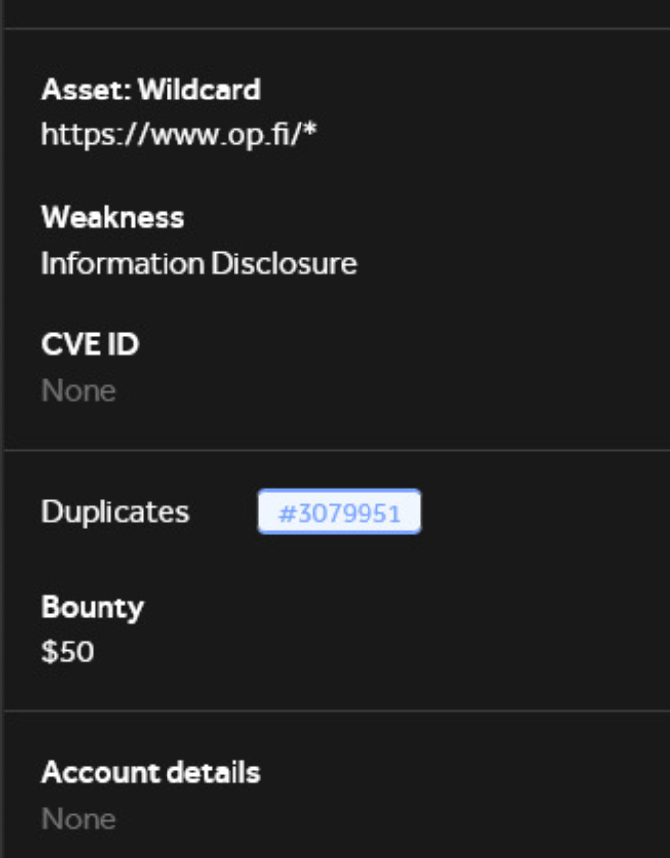
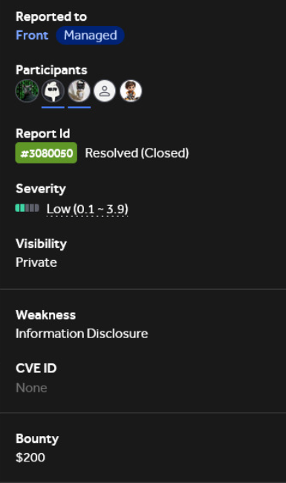
Hacked Email
breachdirectory.org
demo.darkentry.net
intelx.io
Dehashed
haveibeenpwned.com
11

Slide 12
Applications
Whatweb Tool
Wappalyzer
builtwith.com
nmap -sV --script=http-enum example.com
Google Dorks
Metadata Analysis
Metagoofil

Slide 13
Find Antivirus Programs
Headers Missconfiguration
X-Powered-By
X-AV-Detected
Shodan http.favicon.hash:123456 antivirus
cache_snoop

Slide 14
Tasks
2 tasks
1.Full recon on microsoft.com
2.find the AV with cache snoop

Slide 15




Thank you

