Slide 1
Credit Card Fraud Detection

Slide 2

The Team
Umar
Data Scientist

Slide 3
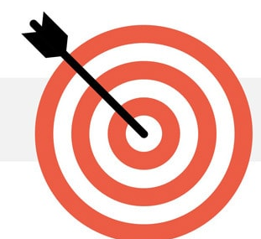
Presentation Objectives
01
02
03
Take you through the steps and accomplishments of the project
Show you the workability of the chosen models
Gain feedback on how to fine tune the model to meet your business needs

Slide 4
Our Approach
Introduction
The Architecture
Analytical Insights
Demo Streamlit App
Recommendation
Project context
Problem statement
Architectural choices
Exploratory data analysis
Feature engineering
Model Selection
Results
App dashboard
Improvements
Next step

Slide 5
What is a Credit Card Fraud?
Credit card fraud refers to the unauthorized use of someone's credit card or credit card information to make fraudulent transactions. It is a prevalent form of financial fraud that can result in significant financial losses for individuals, businesses, and financial institutions.
Notes:
Financial statement fraud involves falsifying financial statements to pretend the company more profitable than it is, increase the stock prices, avoid payment of the taxes, or get a bank loan or in this case guarantees.

Slide 6
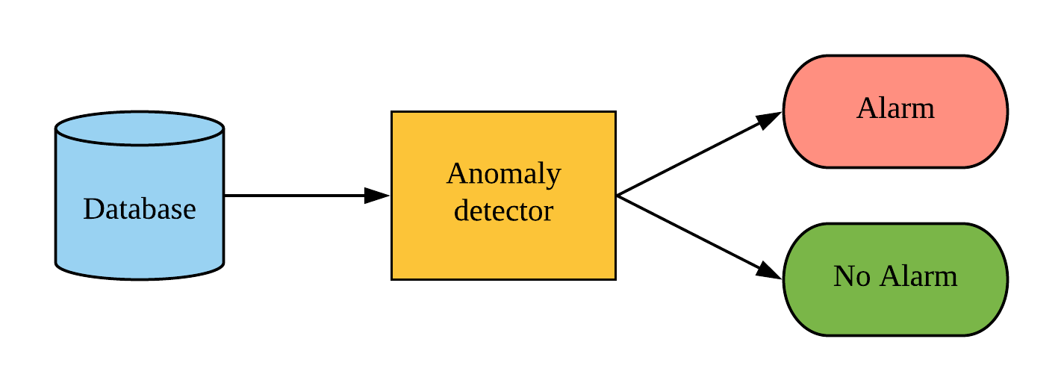
Problem Statement
This model flags fraudulent transactions

Slide 7
284,807
The Dataset
Transactions

Slide 8

The Architecture

Slide 9
The Architectural Choices
Data Engineering pipeline
Data Transformation pipeline
Machine Learning Model pipeline
Case Management system
Insurer Database
Output Layer
Explored data
Transformed Data
Pickle Machine Learning Model
Flag Suspicious Cases
Notes:
Financial Statement: Industry; Financial Type; Financial Date; Dim Facility Key. Data Engineering: Extract data from database; Aggregate and manipulate data.
Data transformation: Extract key features from data; Dealing with zero valued features; Categorical data conversion; Numerical data preparation
Machine Learning: Train, test, validation, data split; Build, optimize different ML models; Compare ML models based on key business metrics.
Case Management System: Send risk score for each case to the reviewer, Flag anomaly

Slide 10

Exploratory Data Analysis

Slide 11
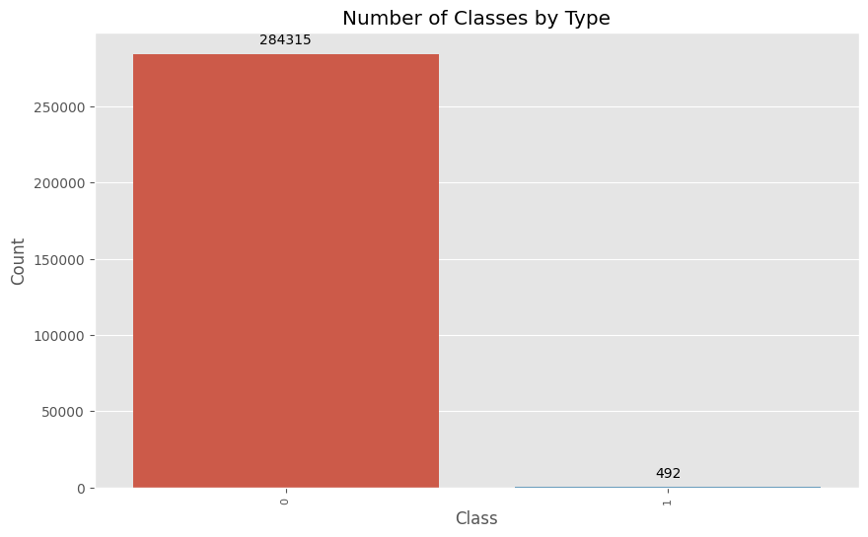
A look at the Class Data Distribution

Slide 12
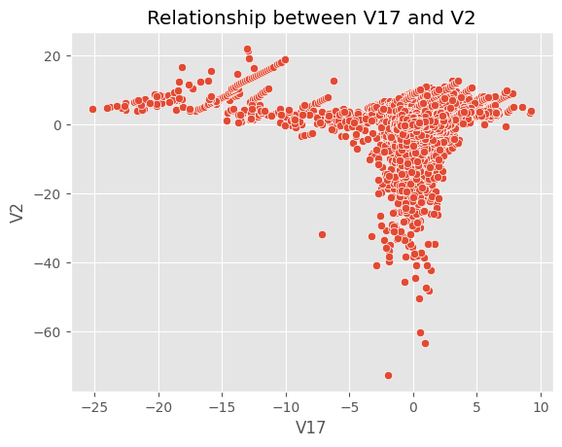
A look at some Relationships

Slide 13
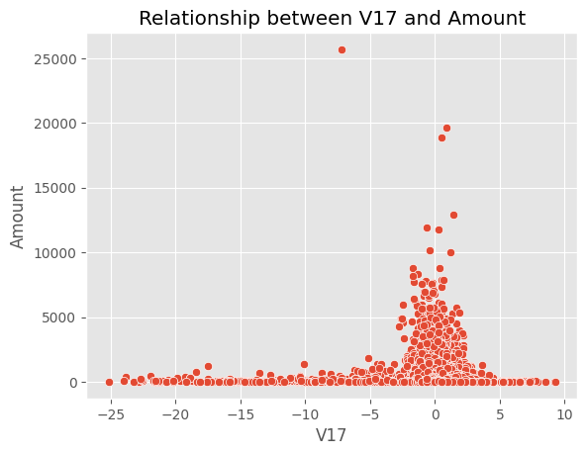
A look at some Relationships

Slide 14
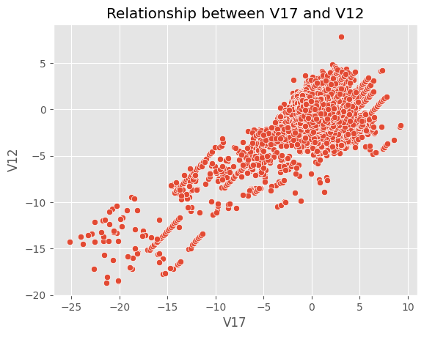
A look at some Relationships

Slide 15
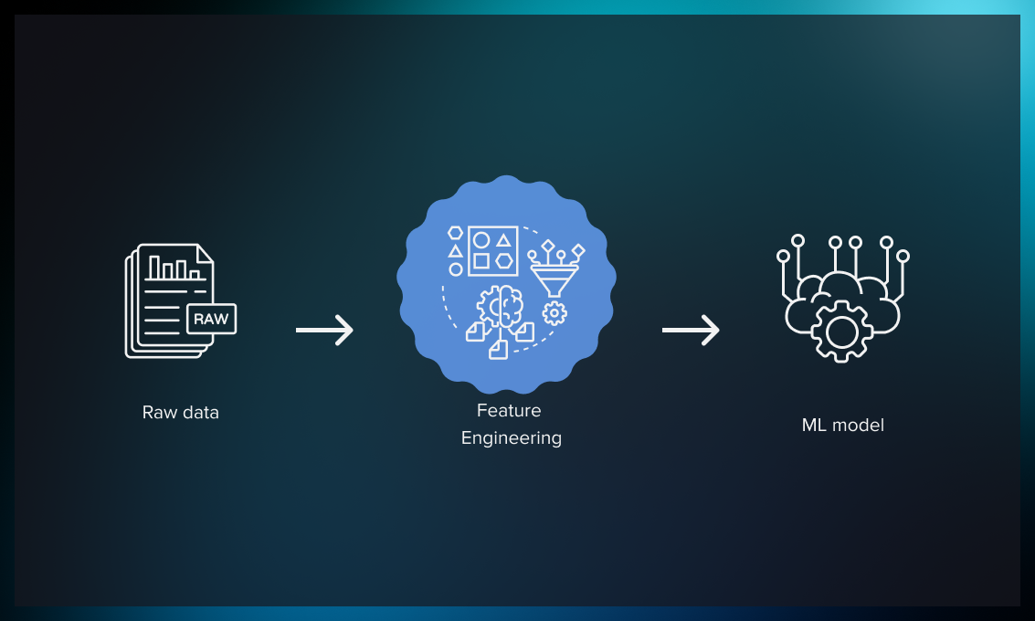
Feature Engineering
Creating new features to enable machine learning optimisation

Slide 16
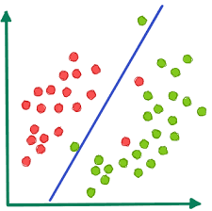
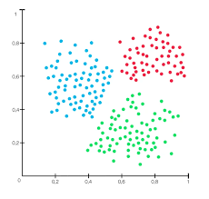
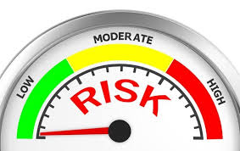
Machine Learning Approach
Supervised Learning - Classification
Train the model to determine if the financial statement will default or not.
Low point: Discover just the same type of anomalies i.e. similar fraud
Unsupervised Learning Clustering
Detect anomaly based on the patterns from clustering.
Risk Score Measurement
Use algorithms that assess and rank the probability of the financial statement being a fraud
Note: Helps reviewer know the probabilistic fact of how likely the statement is fraudulent or not .
Notes:
Supervised: Detect upcoming anomalies by using the model trained;
Risk Score Measurement: Helps reviewer know why the financial statement was flagged and the probabilistic fact of how likely the statement is fraudulent or not .

Slide 17
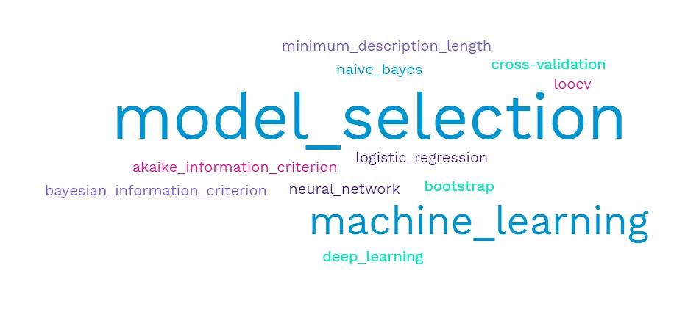
Model Selection

Slide 18
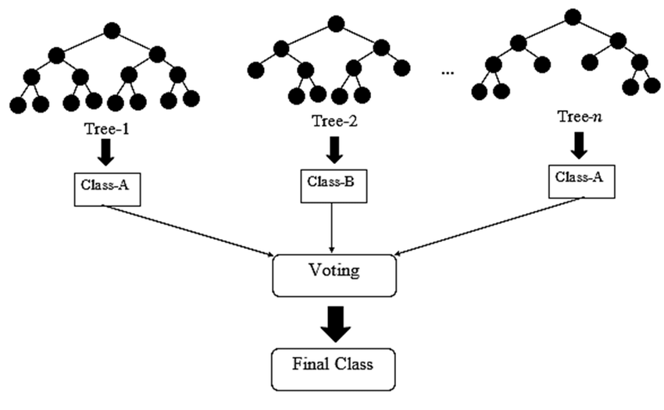
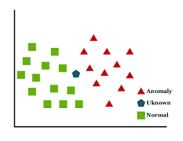
Supervised (Classification) Algorithms
Random Forest Classifier
K-Nearest Neighbours Classifier
Here, a group of models is trained on different subsets of the dataset, and the final output is generated by collating the outputs of all the different models. The base model is a decision tree.
KNN identifies anomalies by finding the k nearest neighbors of a data point and then looking for data points that are far away from their k nearest neighbors
Notes:
Random forest advantages: Versatile uses, Easy-to-understand hyperparameters, Classifier doesn't overfit with enough trees.; Disadv: More trees slow down model, Can’t describe relationships within data.
KNN advantage: Easy to implement, easy to adapt, fewer hyperparameter. Disadv: does not scale, prone to overfitting

Slide 19
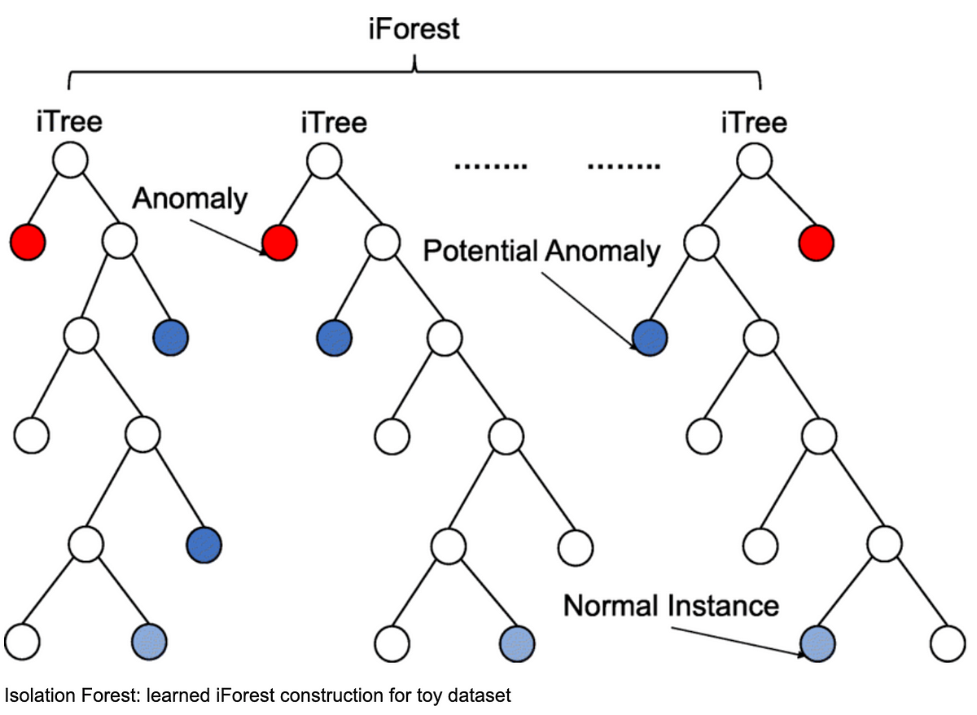
Unsupervised Algorithms
Isolation Forest Classifier
A model-based outlier detection method that attempts to isolate anomalies from the rest of the data using an ensemble of decision trees.
Notes:
Isolation Forest assigns an anomaly score to data points based on how easy they are to separate from the rest of the data. The easier a data point is isolated from the majority of the data, the more likely it is to be an anomaly
IF: Will return a score bound between 0 - 1 where the values closer to 1 are considered Anomalous and the values that are <0.5 are considered to be "normal"
An outlier is any data point which differs greatly from the rest of the observations in a dataset. outliers exist because perhaps an analyst made an error in the data entry, or the machine threw up an error in measurement, or the outlier could even be intentional

Slide 20
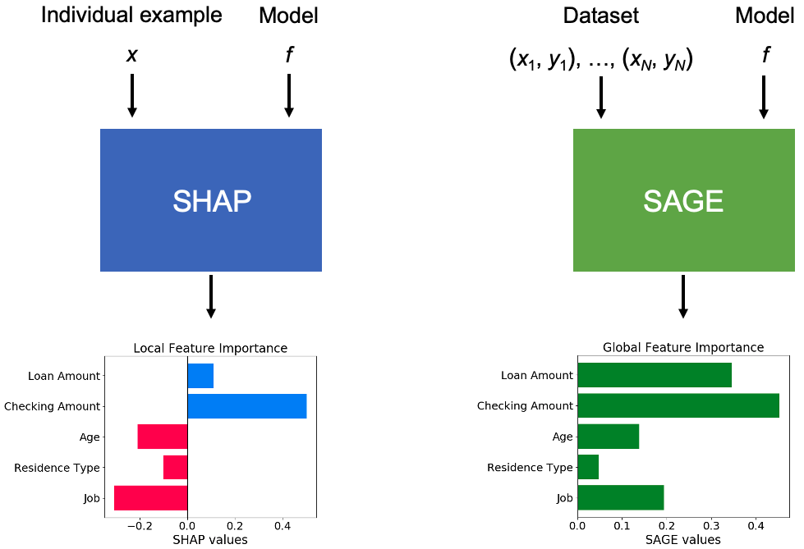
Explanation Model/Probability Technique
SHapley Additive exPlanations ( SHAP)
An explanation model use for the output of the Isolation Forest. The explanation values it provides tells the effect of the value of a feature of a given data point on its associated anomaly score.
A method of financial statement analysis in which each line item is listed as a percentage of a base figure within the statement.
Notes:
the SHAP values of all features sum up to explain why the prediction was different from the baseline.Anomaly:
The LoOP is local density outlier detection method, scores are normalized to the range [0–1]

Slide 21

Result

Slide 22
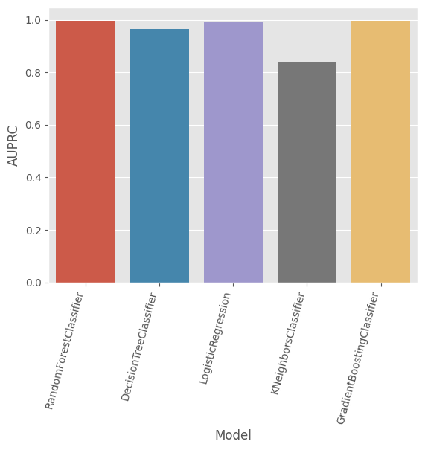
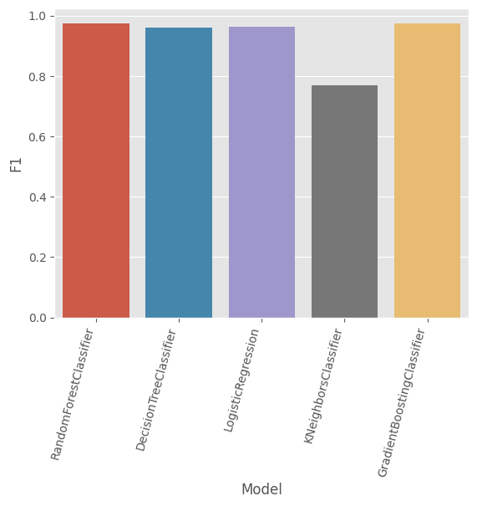
Supervised Learning Results
AUPRC Distribution
FI Distribution
Unsupervised Learning Clustering
Clustering segments the financial statement into different groups, label the transactions within each group based on anomaly detection
Note: Frauds need to be rare. Discover many types of anomalies.
Notes:
F1 score is a machine learning evaluation metric that measures a model's accuracy. It combines the precision and recall scores of a model. Scores lies between 0 and 1, one being the most accurate.
The testing accuracy and F1-score measures are used for performance evaluation. Accuracy is the ratio of the number of correct predictions to the total number of input samples; Precision is the ratio of correctly predicted positive observations to the total predicted positive observations; Recall, or sensitivity, is the ratio of correctly predicted positive observations to all the observations in the actual class
A machine learning model is a program that can find patterns or make decisions from a previously unseen dataset. Machine learning models are created from machine learning algorithms, which are trained using either labeled, unlabeled, or mixed data.

Slide 23
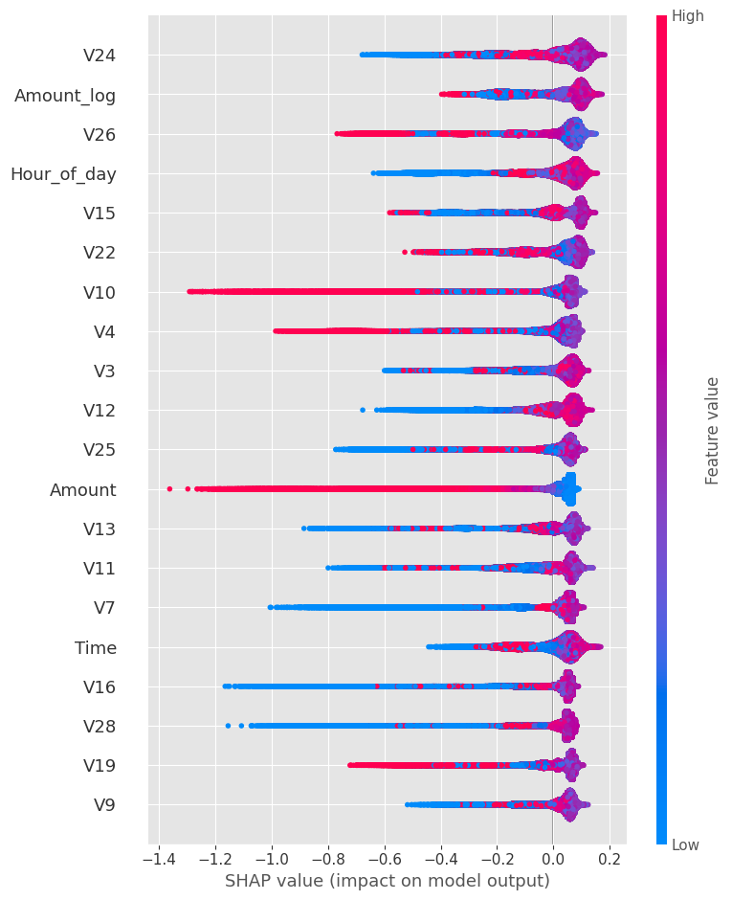
Unsupervised Learning Results
SHAP Value (impact on model output)
The summary plot shows that high values of some variables show anomalous observations while lower values are normal items.
Notes:
From this plot, the impact of a particular variable on anomaly detection is observed. Taking Distributable Reserves, CL_InstalmentSaleLiabilty or CL_BankOverdraft as an example. The summary plot says that high values of that variables show anomalous observations while lower values are normal items.

Slide 24
StreamLit App Demo

Slide 25
Conclusion

Slide 26

Business Values
Early Warning System
Improved Risk Assessment
Fraud Detection and Prevention
Reduced Fraud Rates
Reduced Financial Losses
Competitive Advantage
Data-Driven Decision Making
Notes:
Prioritizing fraud detection and prevention, increases revenue and business growth.
Preventing chargebacks means you retain more revenue, avoid damage to your brand and reputation, avoid threshold breaches, and reduce administrative hassle

Slide 27
Limitations
The framework is not robust to changes in the data distribution.
The project only evaluated the framework on a single dataset of financial statements.
The framework can generate false positive. This means that it may incorrectly identify a legitimate financial statement as anomalous.
Notes:
It is not clear how well the framework would perform on other datasets.
If the data distribution changes, the framework may not be able to detect fraud as effectively.
This can lead to inconvenience and frustration for customers.

Slide 28
Recommendations
Expanding the dataset
Incorporating more features
Collaboration with industry experts and regulatory bodies

Slide 29

