Slide 1


Customer Churn Prediction
An End-to-End Machine Learning Solution for Telecom Customer Retention
_______________________________________________
Presenter's Name: 5aliha 3la Allah Team
Date : 9 July 2026
DEPI Final Project | AI & Data science Track Microsoft data engineering | July 2026
Powered by LightGBM · 999,999 Customers · Streamlit Dashboard

Slide 2
Project Idea
The Problem
9.9%
Churn Rate
999K
Customers
Customer churn costs telecom companies millions annually. Identifying at-risk customers before they leave is critical for business survival.
Our Solution
A complete ML pipeline that predicts which customers will churn, giving the business time to intervene with targeted retention strategies.
Unique Value
End-to-end: from raw data to a live Streamlit dashboard. Real predictions on 1 million customers with explainable risk factors.
32
Features
4
ML Models
LightGBM
Best Model Selected

Slide 3
Project Wireframe — Streamlit Dashboard
📈 Page 2 — EDA
Churn distribution chart
Churn by contract type
Complaints vs satisfaction analysis
🤖 Page 3 — Prediction
9 input sliders
Real-time LightGBM prediction
Risk probability + factors
📊 Page 1 — Overview
4 KPI metric cards
Total customers, churn rate, retained
Key insights summary
📊 Page 1 — Overview
4 KPI metric cards
Total customers, churn rate, retained
Key insights summary
User Journey
Enter Customer Data → Click Run Prediction → View Churn Probability → Review Risk Factors → Take Action
Tech Stack: Streamlit 1.40 · LightGBM · Matplotlib · Python 3.11 · Custom Dark CSS Theme
🎨 Design Principles
Dark professional theme (#070b14)
Inter font — clean & modern
Color-coded risk: Red = High, Green = Low
⚡ Key Features
Real-time prediction — no page reload
Automatic risk factor detection
Cached data loading for performance

Slide 4
End Users + Key Features
Primary Users
📱 Business Analysts
Monitor churn KPIs
Identify high-risk segments
Track retention campaigns
👨‍💼 Customer Success Teams
View at-risk customers
Prioritize outreach calls
Reduce churn proactively
📊 Data Scientists
Evaluate model performance
Analyze feature importance
Retrain on new data
🏢 C-Level Executives
High-level churn overview
Revenue impact estimates
Strategic retention decisions
Key Features that Address User Needs
🔮 Real-Time Prediction
Input any customer profile
Get instant churn probability
Actionable risk factors shown
📊 Visual Analytics
4 EDA charts on dashboard
Contract, complaints, satisfaction
Churn distribution overview
🗄️ SQL Integration
Full SQL Server database
5 business intelligence queries
High-risk customer identification

Slide 5
Data Structure
Dataset Overview
999K
Rows
32
Columns
9.9%
Churn Rate
5
Missing Cols
👤 Demographics
age, gender, education
marital_status, dependents
annual_income, credit_score
💰 Financial
monthlycharges, totalcharges
payment_method, late_payments
paperless_billing
📡 Services
has_phone/internet_service
has_online_security/backup
has_tech_support, streaming
📊 Behavior
num_complaints
customer_satisfaction
days_since_last_interaction
avg_monthly_gb
Preprocessing: Missing values filled with Median · Ordinal + One-Hot Encoding · StandardScaler · 80/20 Train-Test Split · class_weight=balanced

Slide 6
Programming Languages + Frameworks
🐍 Python 3.14.1
Primary language for all tasks
Data processing, ML, dashboard
Jupyter Notebooks + VS Code
📊 Data & ML Libraries
Pandas, NumPy — data manipulation
Scikit-learn — preprocessing + metrics
LightGBM, XGBoost — ML models
Imbalanced-learn — SMOTE
📈 Visualization
Matplotlib — custom charts
Seaborn — statistical plots
Streamlit — web dashboard
Custom dark CSS theme
🗄️ Database
Microsoft SQL Server 16.0
pyodbc — Python connection
5 BI analytical queries
customer_churn database
🔧 Tools & DevOps
VS Code + Jupyter Notebooks
joblib — model serialization
requirements.txt dependency mgmt
🚀 Deployment
Streamlit 1.40.2 — web app
localhost:8501 — local server
lgbm_model.pkl — saved model
scaler.pkl — fitted scaler
pandas 2.2.3 · numpy 2.1.3 · scikit-learn 1.5.2 · lightgbm 4.5.0 · xgboost 2.1.3 · streamlit 1.40.2 · pyodbc 5.2.0 · joblib 1.4.2

Slide 7
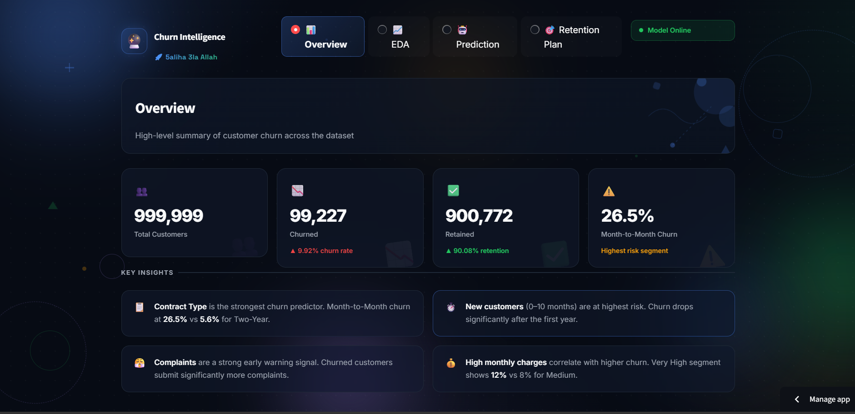

Live at: Streamlit
3 interactive pages — Overview, EDA, Prediction
Real-time LightGBM predictions
Custom dark professional UI
Tested on 200,000 customers

Slide 8
Project Deliverables
📓 Notebooks (5 files)
01 — Data Preprocessing
02 — Model Training
03 — Model Evaluation
04 — Data Analysis (EDA)
05 — SQL Analysis
📊 Reports (5 PDFs)
Data Engineering Report
EDA Report (with charts)
SQL Analysis Report
Streamlit & Power BI Dashboards Report
Project Documentation
🤖 Models & Data
lgbm_model.pkl — trained model
scaler.pkl — fitted scaler
clean_data.csv — processed
customer_churn.csv — raw data
churn.db — SQL database
💻 Application
streamlit_app.py — dashboard
Power BI — dashboard
Overview + EDA + Prediction
Dark professional UI
Real-time LightGBM inference
🗄️ Database Files
schema.sql — table design
load_data.py — CSV to DB
5 SQL query files
customer_churn SQL Server DB
📁 Project Files
README.md — full documentation
requirements.txt — dependencies
Structured folder organization
All deliverables submitted and organized under: customer-churn-project/ with data/, notebooks/, database/, models/, app/, reports/ folders

Slide 9
Project Team + Roles
🧹 Data Engineer
Omar Mahmoud Ramadan
ID: 21052575
Preprocessing, Encoding, Scaling, Pipeline
🤖 Data Scientist
Hassan Ashraf Hassan
ID: 21004408
ML Models, Evaluation, Feature Importance
📊 Data Analyst
Ahmed Moustafa Elsayed
ID: 21096982
EDA, Visualizations, Streamlit Dashboard, Prediction Interface
🗄️ SQL Engineer
Mahmoud Ahmed Metwally
ID: 21040864
Database Design, Queries, SQL Server
🛠️ Collaboration Tools
VS Code — development IDE
Git — version control
Jupyter Notebooks — analysis
Discord — communication
Methodology: Agile sprints · Each member owns their deliverable · Cross-team data handoffs · Peer code review

Slide 10
Thank You!
Customer Churn Prediction — 5aliha 3la Allah Team
Questions & Feedback Welcome
DEPI Final Project | AI & Data science Track Microsoft Data Engineering | July 2026

