Slide 1
Recursive tracing
Consider the following recursive method:
public static int mystery(int n) {
if (n < 10) {
return n;
} else {
int a = n / 10;
int b = n % 10;
return mystery(a + b);
}
}
What is the result of the following call?
mystery(648)

Slide 2
A recursive trace
mystery(648):
int a = 648 / 10; // 64
int b = 648 % 10; // 8
return mystery(a + b); // mystery(72)
mystery(72):
int a = 72 / 10; // 7
int b = 72 % 10; // 2
return mystery(a + b); // mystery(9)
mystery(9):
return 9;
Notes:
9

Slide 3
Recursive tracing 2
Consider the following recursive method:
public static int mystery(int n) {
if (n < 10) {
return (10 * n) + n;
} else {
int a = mystery(n / 10);
int b = mystery(n % 10);
return (100 * a) + b;
}
}
What is the result of the following call?
mystery(348)
Notes:
stutter

Slide 4
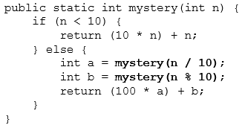
A recursive trace 2
mystery(348)
int a = mystery(34);
int a = mystery(3);
return (10 * 3) + 3; // 33
int b = mystery(4);
return (10 * 4) + 4; // 44
return (100 * 33) + 44; // 3344
int b = mystery(8);
return (10 * 8) + 8; // 88
return (100 * 3344) + 88; // 334488
What is this method really doing?

