Slide 1
Building Java Programs Chapter 11
Java Collections Framework
Copyright (c) Pearson 2013. All rights reserved.

Slide 2
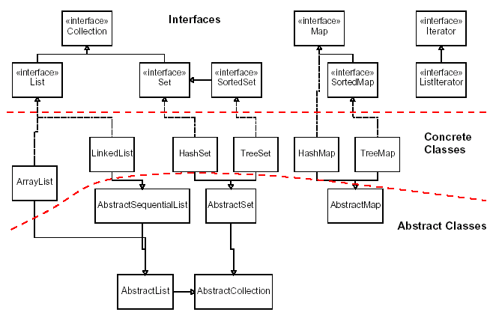
Java collections framework

Slide 3
MAp ADT

Slide 4
Maps vs. sets
A set is like a map from elements to boolean values.
Set: Is "Marty" found in the set? (true/false)
Map: What is "Marty" 's phone number?
"Marty"
Set
true
false
"Marty"
Map
"206-685-2181"

Slide 5
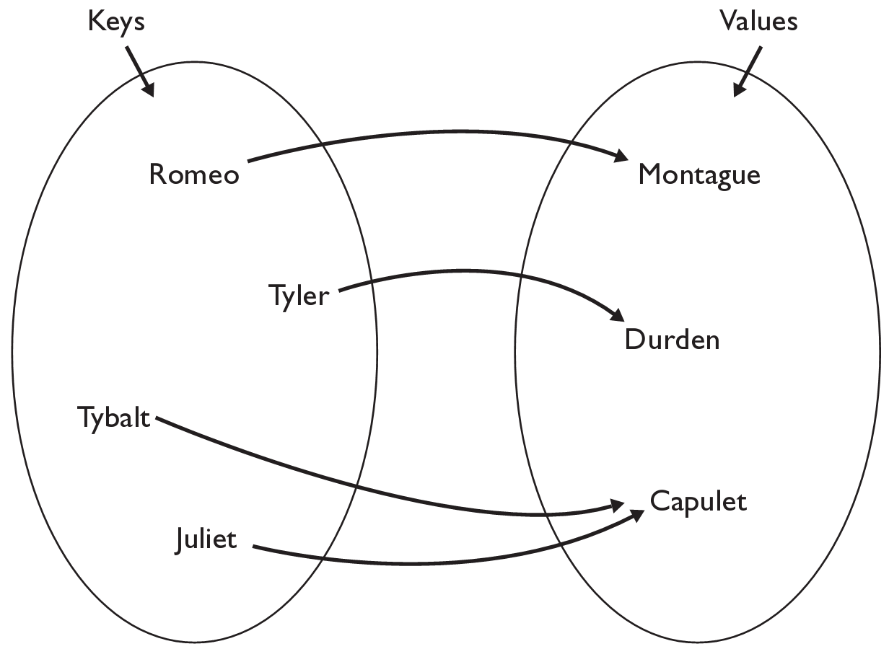
The Map ADT
map: Holds a set of unique keys and a collection of values, where each key is associated with one value.
a.k.a. "dictionary", "associative array", "hash"
basic map operations:
put(key, value ): Adds a mapping from a key to a value.
get(key ): Retrieves the value mapped to the key.
remove(key ): Removes the given key and its mapped value.
myMap.get("Juliet") returns "Capulet"

Slide 6
A visualization of maps.
A good way to think of a map is a sort of pseudo-array.
An array where you get to pick both the index and the data inside the array.
Imagine a map where the keys are names and the values are extension numbers.
Key | Mary | Bob | Sue | Fred | Kay | Vera
Value | 4615 | 4358 | 4684 | 6484 | 6543 | 4584

Slide 7
Map implementation
in Java, maps are represented by Map interface in java.util
Map is implemented by the HashMap and TreeMap classes
HashMap: implemented using an array called a "hash table"; extremely fast: O(1) ; keys are stored in unpredictable order
TreeMap: implemented as a linked "binary tree" structure; very fast: O(log N) ; keys are stored in sorted order
A map requires 2 type parameters: one for keys, one for values.

Slide 8
Map Examples
Creating a map
Map<String, Integer> ages = new HashMap<String, Integer>();
Map<String, Integer> IDs = new TreeMap<String, Integer>();
Map<Integer, Double> grades = new HashMap<Integer, Double>();
Map<String, String> patterns = new TreeMap<String, String>();
Map<MyClass, MyClass2> x = new HashMap<MyClass, MyClass>();
Map<Integer, Set<Students> > roster =
new TreeMap<Integer, Set<Students> >();

Slide 9
Map methods
put(key, value) | adds a mapping from the given key to the given value; if the key already exists, replaces its value with the given one
get(key) | returns the value mapped to the given key (null if not found)
containsKey(key) | returns true if the map contains a mapping for the given key
remove(key) | removes any existing mapping for the given key
clear() | removes all key/value pairs from the map
size() | returns the number of key/value pairs in the map
isEmpty() | returns true if the map's size is 0
toString() | returns a string such as "{a=90, d=60, c=70}"

Slide 10
Map methods
keySet() | returns a set of all keys in the map
values() | returns a collection of all values in the map
putAll(map) | adds all key/value pairs from the given map to this map
equals(map) | returns true if given map has the same mappings as this one

Slide 11
Using maps
A map allows you to get from one half of a pair to the other.
Remembers one piece of information about every index (key).
Later, we can supply only the key and get back the related value:
Allows us to ask: What is Marty's phone number?
// key value
put("Marty", "206-685-2181")
Map
Map
get("Marty")
"206-685-2181"

Slide 12
keySet and values
keySet method returns a Set of all keys in the map
can loop over the keys in a foreach loop
can get each key's associated value by calling get on the map
values method returns a collection of all values in the map
can loop over the values in a for/each loop
no easy way to get from a value to its associated key(s)

Slide 13
How to go through a map.
Map<String, Integer> ages = new HashMap<String, Integer>();
ages.put("Marty", 19);
ages.put("Geneva", 2);
ages.put("Vicki", 57);
for (String name : ages.keySet())
{
int age = ages.get(name);
System.out.println(name + " -> " + age);
}

Slide 14
How to go change a map
Map<String, Integer> ages = new HashMap<String, Integer>();
ages.put("Marty", 19);
ages.put("Geneva", 2);
ages.put("Vicki", 57);
// How do we add 10 to all the ages?
for (String name : ages.keySet())
{
ages.put(name, ages.get(name) + 10);
}

Slide 15
Problem: opposite mapping
It is legal to have a map of sets, a list of lists, etc.
Suppose we want to keep track of each students GPA by name.
Map<String, Double> stuGpa = new HashMap<String, Double>();
stuGpa.put("Jared", 3.6);
stuGpa.put("Alyssa", 4.0);
stuGpa.put("Steve", 2.9);
stuGpa.put("Stef", 3.6);
stuGpa.put("Rob", 2.9);
...
System.out.println("Jared's GPA is " +
stuGpa.get("Jared")); // 3.6
This doesn't let us easily ask which students got a given GPA.
How would we structure a map for that?

Slide 16
Reversing a map
We can reverse the mapping to be from GPAs to names.
Map<Double, String> taGpa = new HashMap<Double, String>();
stuGpa.put(3.6, "Jared");
stuGpa.put(4.0, "Alyssa");
stuGpa.put(2.9, "Steve");
stuGpa.put(3.6, "Stef");
stuGpa.put(2.9, "Rob");
...
System.out.println("Who got a 3.6? " +
stuGpa.get(3.6)); // ???
What's wrong with this solution?
More than one TA can have the same GPA.
The map will store only the last mapping we add.

Slide 17
Proper map reversal
Really each GPA maps to a collection of people.
Map<Double, Set<String>> taGpa =
new HashMap<Double, Set<String>>();
stuGpa.put(3.6, new TreeSet<String>());
stuGpa.get(3.6).add("Jared");
stuGpa.put(4.0, new TreeSet<String>());
stuGpa.get(4.0).add("Alyssa");
stuGpa.put(2.9, new TreeSet<String>());
stuGpa.get(2.9).add("Steve");
stuGpa.get(3.6).add("Stef");
stuGpa.get(2.9).add("Rob");
...
System.out.println("Who got a 3.6? " +
stuGpa.get(3.6));
// [Jared, Stef]
must be careful to initialize the set for a given GPA before adding

Slide 18
How to count
public static void count(List<String> myList)
{
Map<String, Integer> countMap = new HashMap<String, Integer>();
for (String x: myList)
{
if (countMap.contains(x)
countMap.put(x, countMap.get(x) + 1);
else
countMap.put(x, 0);
}

