Slide 1

How a Machine Learned to Recognize Human Emotions
By: Omar Ozgur

Slide 2

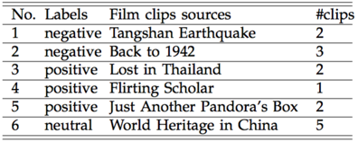
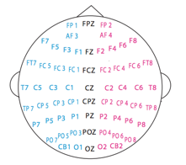
The Study
A study done at Shanghai Jiao Tong University
15 students watched 15 videos
62 electrodes recorded brain activity
Students rated clips as positive, negative, or neutral
Level of emotional arousal was rated between 1 and 5

Slide 3
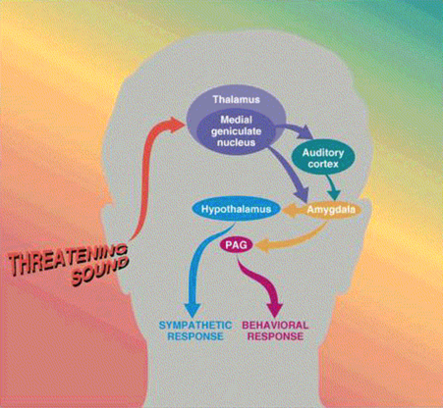
The Idea
The researchers used knowledge based on the field of affective neuroscience, which involves the study of neural patterns associated with emotions
Studies have shown that specific brain structures, such as those of the limbic system, are linked to a human’s emotional state

Slide 4

Feature Extraction
5 Brainwaves: Alpha, Beta, Delta, Theta, Gamma
Brainwaves were used to determine features that would be useful for emotion recognition
6 Features that were analyzed:
Power spectral density (PSD)
Differential entropy (DE)
Differential asymmetry (DASM)
Rational asymmetry (RASM)
Asymmetry (ASM)
Differential caudality (DCAU)

Slide 5

Emotion Recognition
Supervised learning is a machine-learning technique that uses pre-labelled data to train an algorithm
The researchers built used software that attempts to “learn” in similar ways as humans
Emotion recognition was done through the use of a feedforward neural network

Slide 6

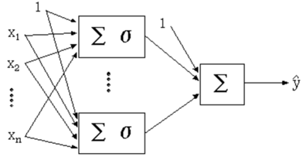

Neural Networks
A neural network typically transmits data through layers of “neurons”
At each neuron, a weighted summation is performed on incoming data, and an activation function (typically a sigmoid function) is applied
A final weighted summation is performed at the output neuron to produce a result

Slide 7

Neural Networks (Cont.)
At first, the neural network may give seemingly random results
The network must be trained by comparing results to desired outputs
By adjusting the weight matrix, the weighted sums at each neuron are also adjusted
After sufficient training, the neural network can give consistently accurate results

Slide 8
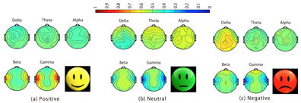
Results
The machine-learning algorithm in this study was able to categorize emotions with approximately 80% accuracy
The team plans to further train the algorithm to gauge emotions in individuals of different ages and genders

Slide 9

Worldwide Applications
Trained algorithms have been shown to solve problems and analyze patterns much more efficiently than most humans
Machine-learning has profound impacts on the study of topics such as:
Human behavior
Medicine
System security
Economic analysis
The continued development of machine-learning techniques will allow for quicker analysis and resolution of complex problems in the world

Slide 10
References
[1] Peng, Y., Wang, S., Long, X., Lu, B. (2013). “Discriminative graph regularized extreme learning machine and its application to face recognition”. Science Direct. doi:10.1016/j.neucom.2013.12.065
[2] Emerging Technology From the arXiv (2016). “How One Intelligent Machine Learned to Recognize Human Emotions”. MIT Technology Review. Retrieved from http://www.technologyreview.com/view/545986/how-one-intelligent-machine-learned-to-recognize-human-emotions/
[3] Zheng, W., Zhu, J., Lu, B. (2016). “Identifying Stable Patterns over Time for Emotion Recognition from EEG”. Cornel University Library. Retrieved from http://arxiv.org/pdf/1601.02197v1.pdf
[4] “Neural Networks Documentation”. Wolfram Mathematica Documentation Center. Retrieved from http://reference.wolfram.com/applications/neuralnetworks/NeuralNetworkTheory/2.5.1.html
Image sources:
http://cdn.tinybuddha.com/wp-content/uploads/2015/06/Emotions.png
http://www.icon2s.com/wp-content/uploads/2014/08/Seo-blue-video-marketing-icon.png
http://png.clipart.me/graphics/thumbs/169/head-with-a-heart-beat-icon_169630502.jpg
https://www.seoclerk.com/pics/322221-1IIVpT1422549531.png
http://reference.wolfram.com/applications/neuralnetworks/NeuralNetworkTheory/2.5.1.html
http://icons.iconarchive.com/icons/graphicloads/flat-finance/256/ideas-icon.png
http://www.technologyreview.com/sites/default/files/styles/view_body_embed/public/images/Emotional%20states.PNG?itok=wY5oDBua
http://www.clker.com/cliparts/N/v/x/U/2/W/simple-globe-hi.png
http://arxiv.org/pdf/1601.02197v1.pdf

