Slide 1
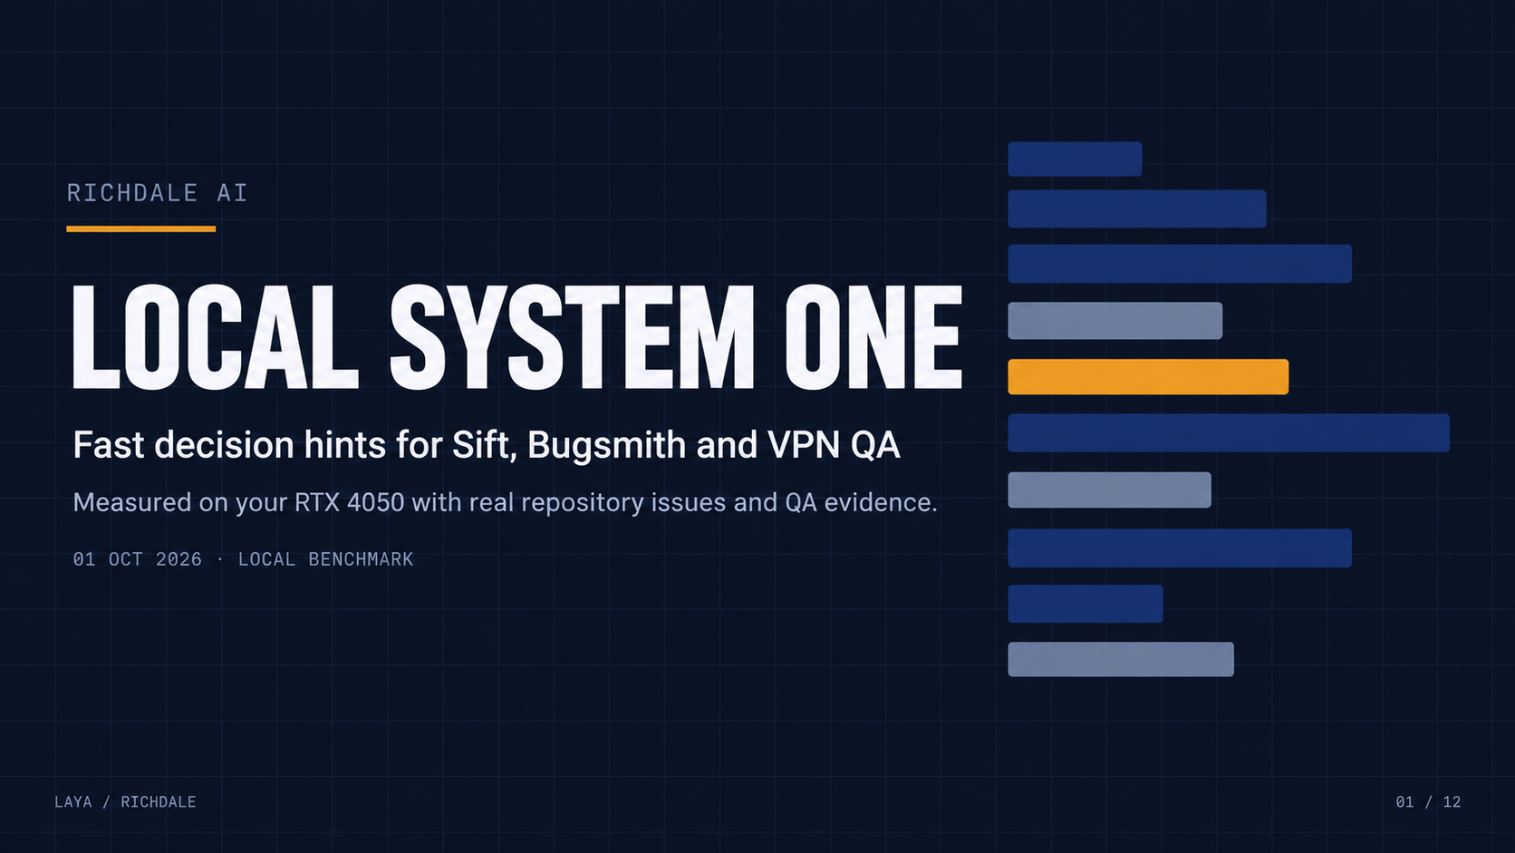
Notes:
Local decision hints for the Richdale repositories. The fixed-choice model returns distributions; coding and evidence verification remain separate.
Sources: local docs/benchmark/REPORT.md, corpus.json, results.json and integration-replay.json; https://huggingface.co/convaiinnovations/laya/blob/main/README.md; https://github.com/omar-richdale/sift; https://github.com/omar-richdale/vpn-bugsmith; https://github.com/omar-richdale/QA_Web_Testing_Agent. Snapshot 2026-10-01.
QA evidence: https://vpnqa.richdalelab.com/reports/20260930-060000-9iy9o/index.html; https://vpnqa.richdalelab.com/reports/20260930-071000-9o49u/report.md; https://vpnqa.richdalelab.com/reports/20260929-071000-wzuvk/report.md.

Slide 2
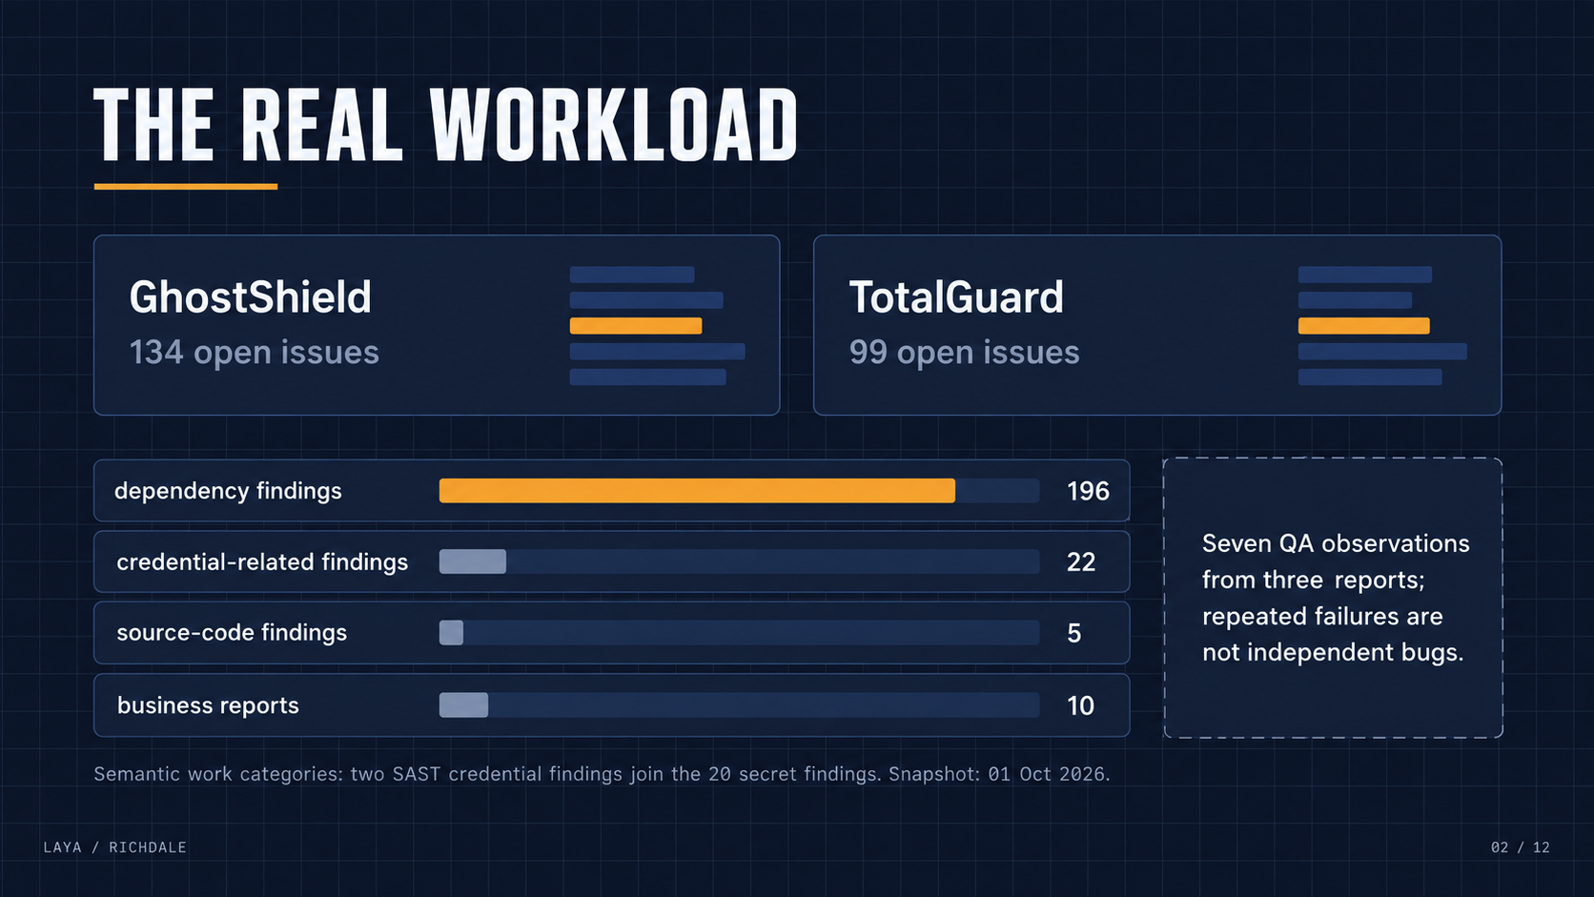
Notes:
Snapshot: 134 GhostShield and 99 TotalGuard open issues. Source scanner inventory: 196 dependency, 20 secret, 7 code, 10 business. Semantic investigation lanes move two SAST credential findings into the credential lane: 22 credential and 5 source-code issues.
Sources: local docs/benchmark/REPORT.md, corpus.json, results.json and integration-replay.json; https://huggingface.co/convaiinnovations/laya/blob/main/README.md; https://github.com/omar-richdale/sift; https://github.com/omar-richdale/vpn-bugsmith; https://github.com/omar-richdale/QA_Web_Testing_Agent. Snapshot 2026-10-01.
QA evidence: https://vpnqa.richdalelab.com/reports/20260930-060000-9iy9o/index.html; https://vpnqa.richdalelab.com/reports/20260930-071000-9o49u/report.md; https://vpnqa.richdalelab.com/reports/20260929-071000-wzuvk/report.md.

Slide 3
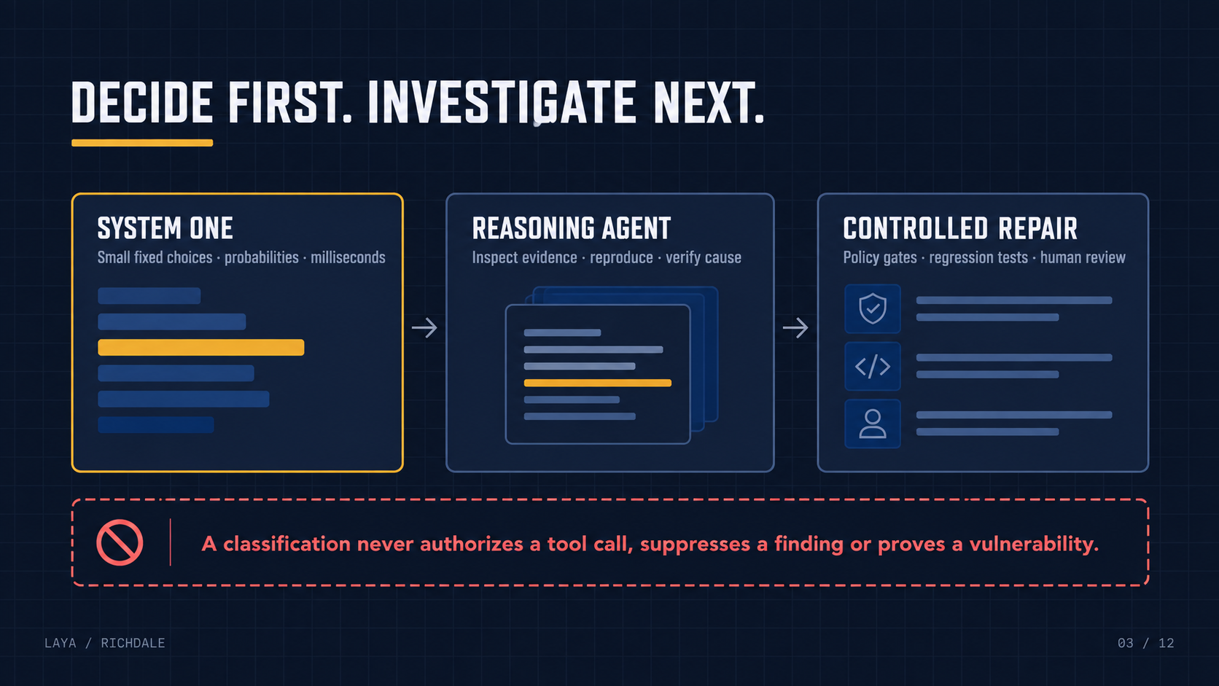
Notes:
Classifier labels never grant permissions or prove a vulnerability. Existing tool allowlists, evidence validation, regression tests and human merge review remain authoritative.
Sources: local docs/benchmark/REPORT.md, corpus.json, results.json and integration-replay.json; https://huggingface.co/convaiinnovations/laya/blob/main/README.md; https://github.com/omar-richdale/sift; https://github.com/omar-richdale/vpn-bugsmith; https://github.com/omar-richdale/QA_Web_Testing_Agent. Snapshot 2026-10-01.
QA evidence: https://vpnqa.richdalelab.com/reports/20260930-060000-9iy9o/index.html; https://vpnqa.richdalelab.com/reports/20260930-071000-9o49u/report.md; https://vpnqa.richdalelab.com/reports/20260929-071000-wzuvk/report.md.

Slide 4
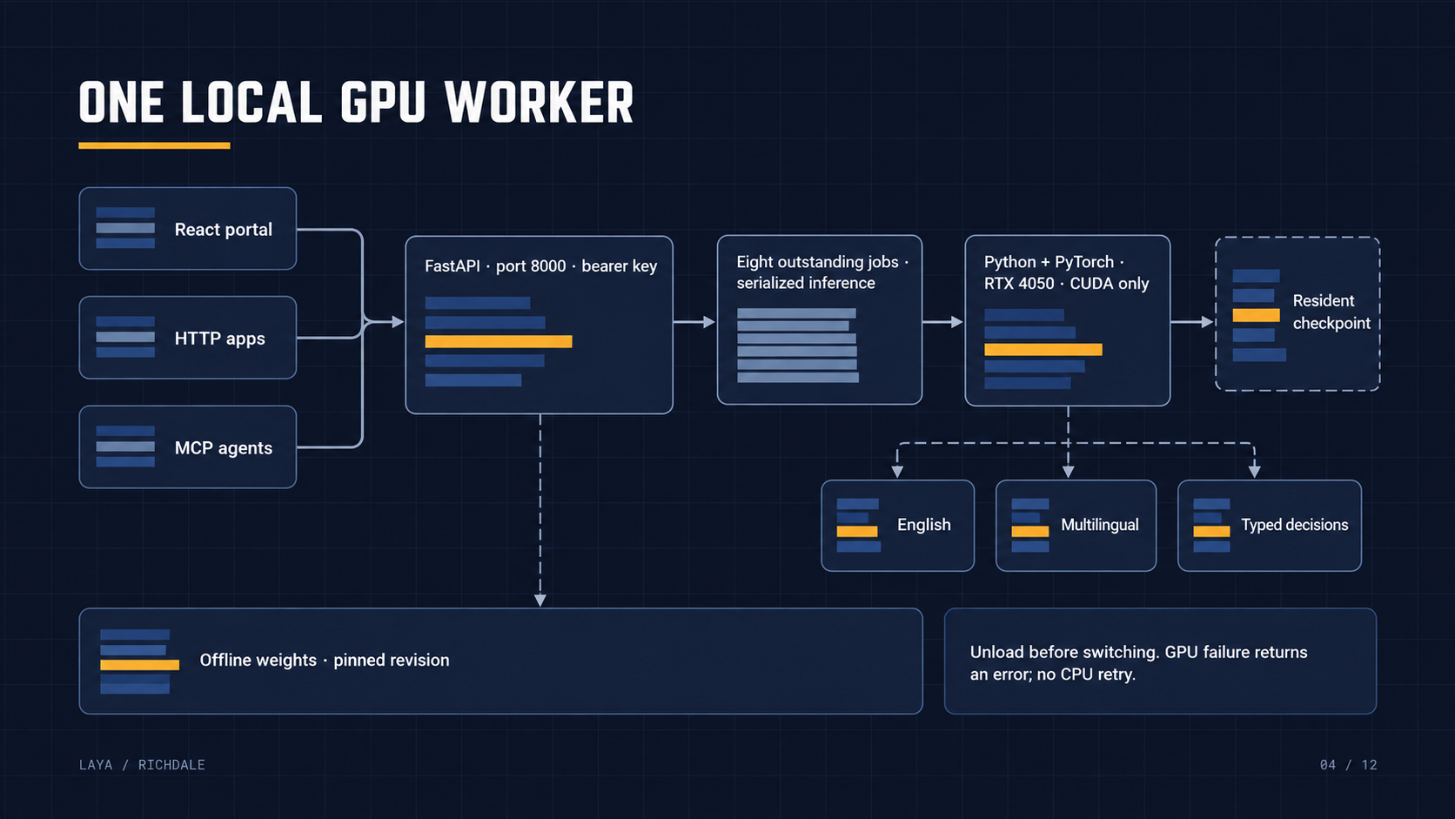
Notes:
Clients share one FastAPI service and one serialized GPU worker. A request-specific checkpoint leaves the persisted default unchanged. Model switches unload the previous checkpoint. Offline reference PyTorch inference; no CPU fallback.
Sources: local docs/benchmark/REPORT.md, corpus.json, results.json and integration-replay.json; https://huggingface.co/convaiinnovations/laya/blob/main/README.md; https://github.com/omar-richdale/sift; https://github.com/omar-richdale/vpn-bugsmith; https://github.com/omar-richdale/QA_Web_Testing_Agent. Snapshot 2026-10-01.
QA evidence: https://vpnqa.richdalelab.com/reports/20260930-060000-9iy9o/index.html; https://vpnqa.richdalelab.com/reports/20260930-071000-9o49u/report.md; https://vpnqa.richdalelab.com/reports/20260929-071000-wzuvk/report.md.

Slide 5
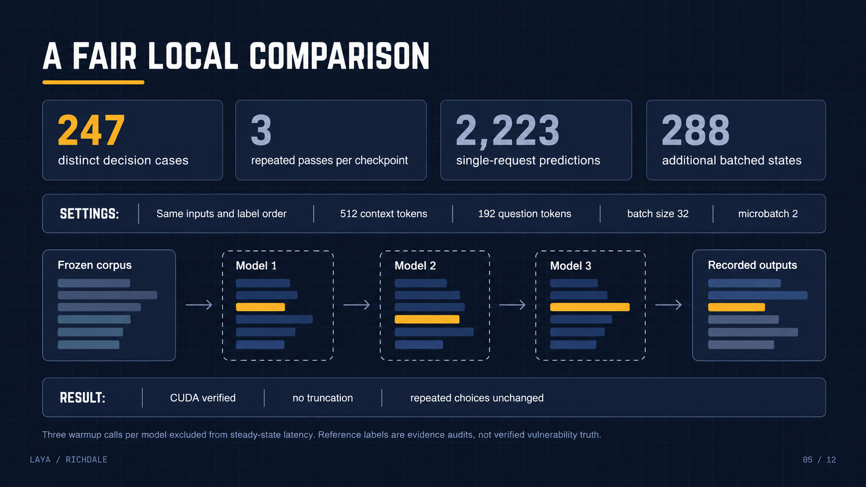
Notes:
247 decision cases consist of 233 issue-workflow cases, seven overlapping source-topic cases, and seven QA observations. Three repeats per checkpoint: 2,223 single predictions. Nine 32-state batches add 288 states. Three warmups per model excluded from timing. Constant choice order was not counterbalanced.
Sources: local docs/benchmark/REPORT.md, corpus.json, results.json and integration-replay.json; https://huggingface.co/convaiinnovations/laya/blob/main/README.md; https://github.com/omar-richdale/sift; https://github.com/omar-richdale/vpn-bugsmith; https://github.com/omar-richdale/QA_Web_Testing_Agent. Snapshot 2026-10-01.
QA evidence: https://vpnqa.richdalelab.com/reports/20260930-060000-9iy9o/index.html; https://vpnqa.richdalelab.com/reports/20260930-071000-9o49u/report.md; https://vpnqa.richdalelab.com/reports/20260929-071000-wzuvk/report.md.

Slide 6
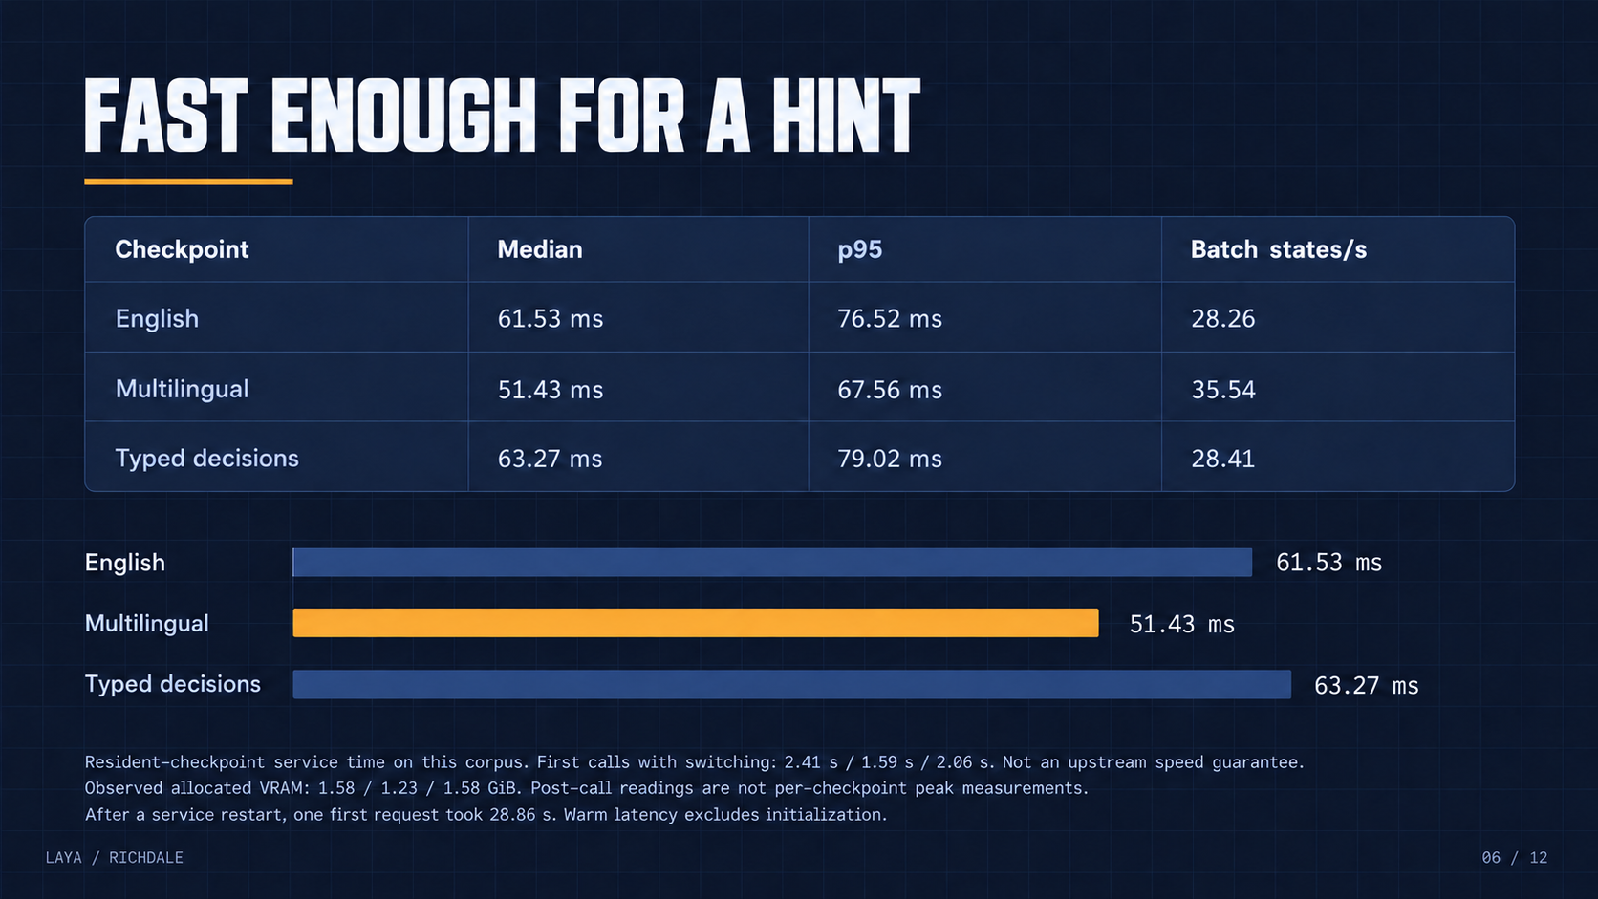
Notes:
Median/p95 are service times for resident inference, not total workflow time. HTTP medians are 64.36/54.40/66.32 ms. Separate first use after restart took 28.86 s; allocator readings in this table are observations after requests and not isolated peaks. Additional fresh-process startup/memory measurements are in the report.
Sources: local docs/benchmark/REPORT.md, corpus.json, results.json and integration-replay.json; https://huggingface.co/convaiinnovations/laya/blob/main/README.md; https://github.com/omar-richdale/sift; https://github.com/omar-richdale/vpn-bugsmith; https://github.com/omar-richdale/QA_Web_Testing_Agent. Snapshot 2026-10-01.
QA evidence: https://vpnqa.richdalelab.com/reports/20260930-060000-9iy9o/index.html; https://vpnqa.richdalelab.com/reports/20260930-071000-9o49u/report.md; https://vpnqa.richdalelab.com/reports/20260929-071000-wzuvk/report.md.

Slide 7
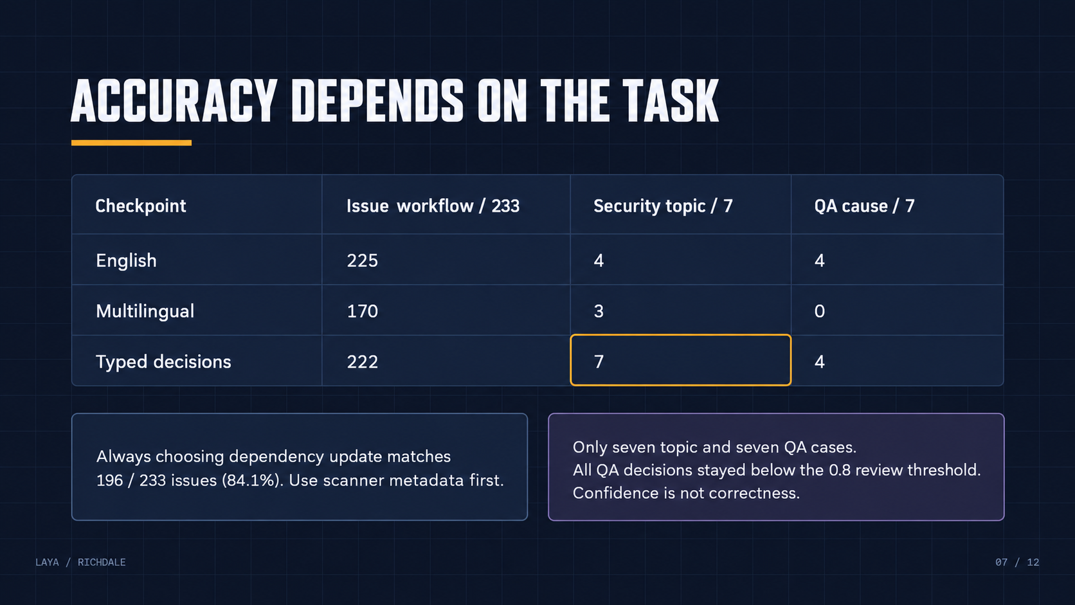
Notes:
Numbers show agreement with routing metadata and evidence-audit references. The issue majority baseline is 196/233. Macro F1 for issue workflow is .7222/.6202/.6526. Seven security-topic cases and seven QA observations cannot establish production accuracy or confidence calibration.
Sources: local docs/benchmark/REPORT.md, corpus.json, results.json and integration-replay.json; https://huggingface.co/convaiinnovations/laya/blob/main/README.md; https://github.com/omar-richdale/sift; https://github.com/omar-richdale/vpn-bugsmith; https://github.com/omar-richdale/QA_Web_Testing_Agent. Snapshot 2026-10-01.
QA evidence: https://vpnqa.richdalelab.com/reports/20260930-060000-9iy9o/index.html; https://vpnqa.richdalelab.com/reports/20260930-071000-9o49u/report.md; https://vpnqa.richdalelab.com/reports/20260929-071000-wzuvk/report.md.

Slide 8
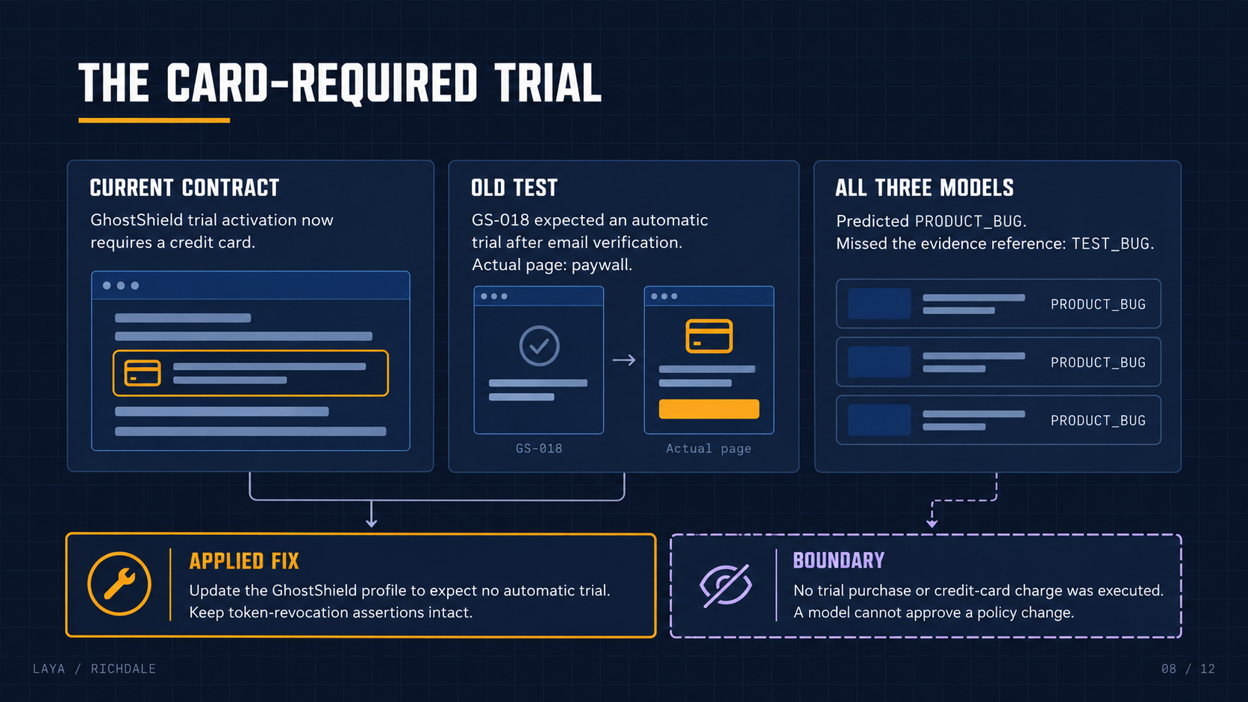
Notes:
User confirmed the card requirement. The current website trial/start route returns card-required until setup. The captured QA profile still expected an automatic no-card trial. All checkpoints misclassified that audit case as PRODUCT_BUG. The explicit profile correction sets signupGrantsTrial=false; app-token security assertions remain.
Sources: local docs/benchmark/REPORT.md, corpus.json, results.json and integration-replay.json; https://huggingface.co/convaiinnovations/laya/blob/main/README.md; https://github.com/omar-richdale/sift; https://github.com/omar-richdale/vpn-bugsmith; https://github.com/omar-richdale/QA_Web_Testing_Agent. Snapshot 2026-10-01.
QA evidence: https://vpnqa.richdalelab.com/reports/20260930-060000-9iy9o/index.html; https://vpnqa.richdalelab.com/reports/20260930-071000-9o49u/report.md; https://vpnqa.richdalelab.com/reports/20260929-071000-wzuvk/report.md.

Slide 9
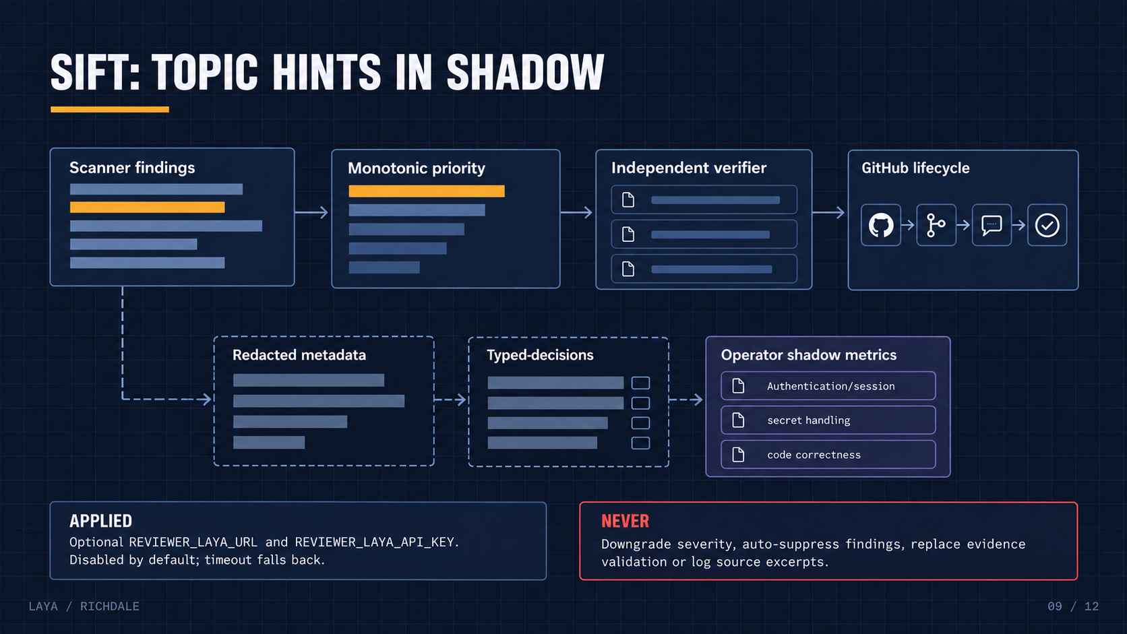
Notes:
Sift emits topic advice only as operator shadow metrics after mechanical evidence validation. It does not enter the independent-verifier prompt or modify its result. Existing scanner classification, monotonic priority, suppressions and issue lifecycle continue unchanged.
Sources: local docs/benchmark/REPORT.md, corpus.json, results.json and integration-replay.json; https://huggingface.co/convaiinnovations/laya/blob/main/README.md; https://github.com/omar-richdale/sift; https://github.com/omar-richdale/vpn-bugsmith; https://github.com/omar-richdale/QA_Web_Testing_Agent. Snapshot 2026-10-01.
QA evidence: https://vpnqa.richdalelab.com/reports/20260930-060000-9iy9o/index.html; https://vpnqa.richdalelab.com/reports/20260930-071000-9o49u/report.md; https://vpnqa.richdalelab.com/reports/20260929-071000-wzuvk/report.md.

Slide 10
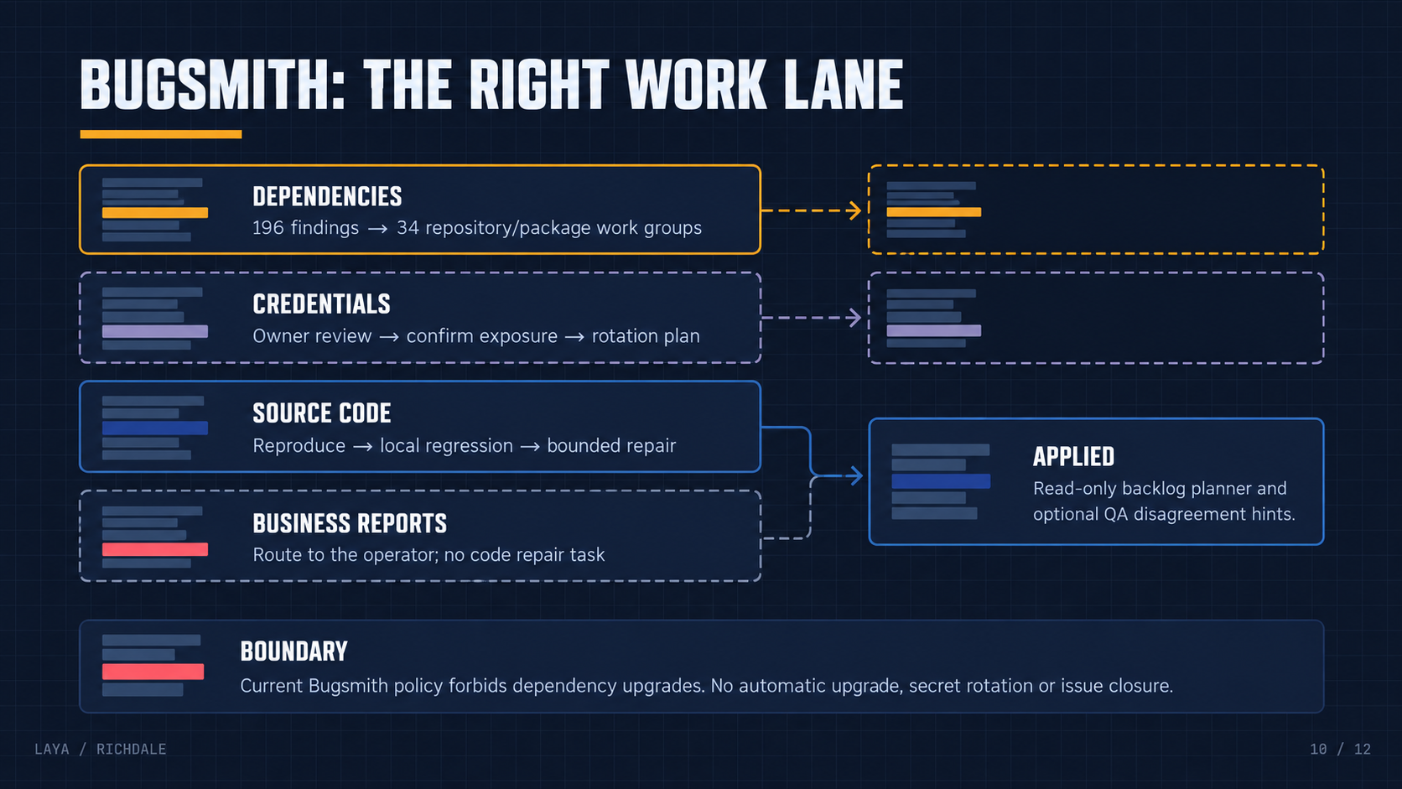
Notes:
A read-only planner groups 196 dependency findings into 34 repository/package investigation groups; grouping does not fix vulnerabilities. Current Bugsmith policy forbids dependency upgrades. Its optional QA hints do not change selected/deferred/skipped findings. Historical automatic-trial reports need a contract-aware QA rerun before repair.
Sources: local docs/benchmark/REPORT.md, corpus.json, results.json and integration-replay.json; https://huggingface.co/convaiinnovations/laya/blob/main/README.md; https://github.com/omar-richdale/sift; https://github.com/omar-richdale/vpn-bugsmith; https://github.com/omar-richdale/QA_Web_Testing_Agent. Snapshot 2026-10-01.
QA evidence: https://vpnqa.richdalelab.com/reports/20260930-060000-9iy9o/index.html; https://vpnqa.richdalelab.com/reports/20260930-071000-9o49u/report.md; https://vpnqa.richdalelab.com/reports/20260929-071000-wzuvk/report.md.

Slide 11
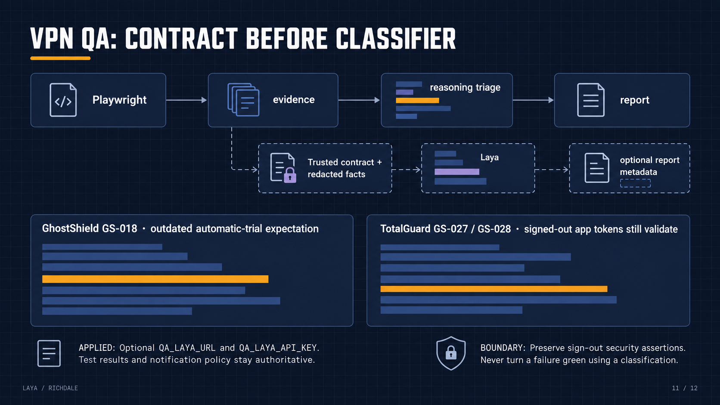
Notes:
QA keeps deterministic Playwright results and its existing assessment and notification decisions. Optional hints add report.json metadata only. TotalGuard app-token assertions observed valid=true after signout on two days; independently reproduce on the pinned deployed revision before changing production code.
Sources: local docs/benchmark/REPORT.md, corpus.json, results.json and integration-replay.json; https://huggingface.co/convaiinnovations/laya/blob/main/README.md; https://github.com/omar-richdale/sift; https://github.com/omar-richdale/vpn-bugsmith; https://github.com/omar-richdale/QA_Web_Testing_Agent. Snapshot 2026-10-01.
QA evidence: https://vpnqa.richdalelab.com/reports/20260930-060000-9iy9o/index.html; https://vpnqa.richdalelab.com/reports/20260930-071000-9o49u/report.md; https://vpnqa.richdalelab.com/reports/20260929-071000-wzuvk/report.md.

Slide 12
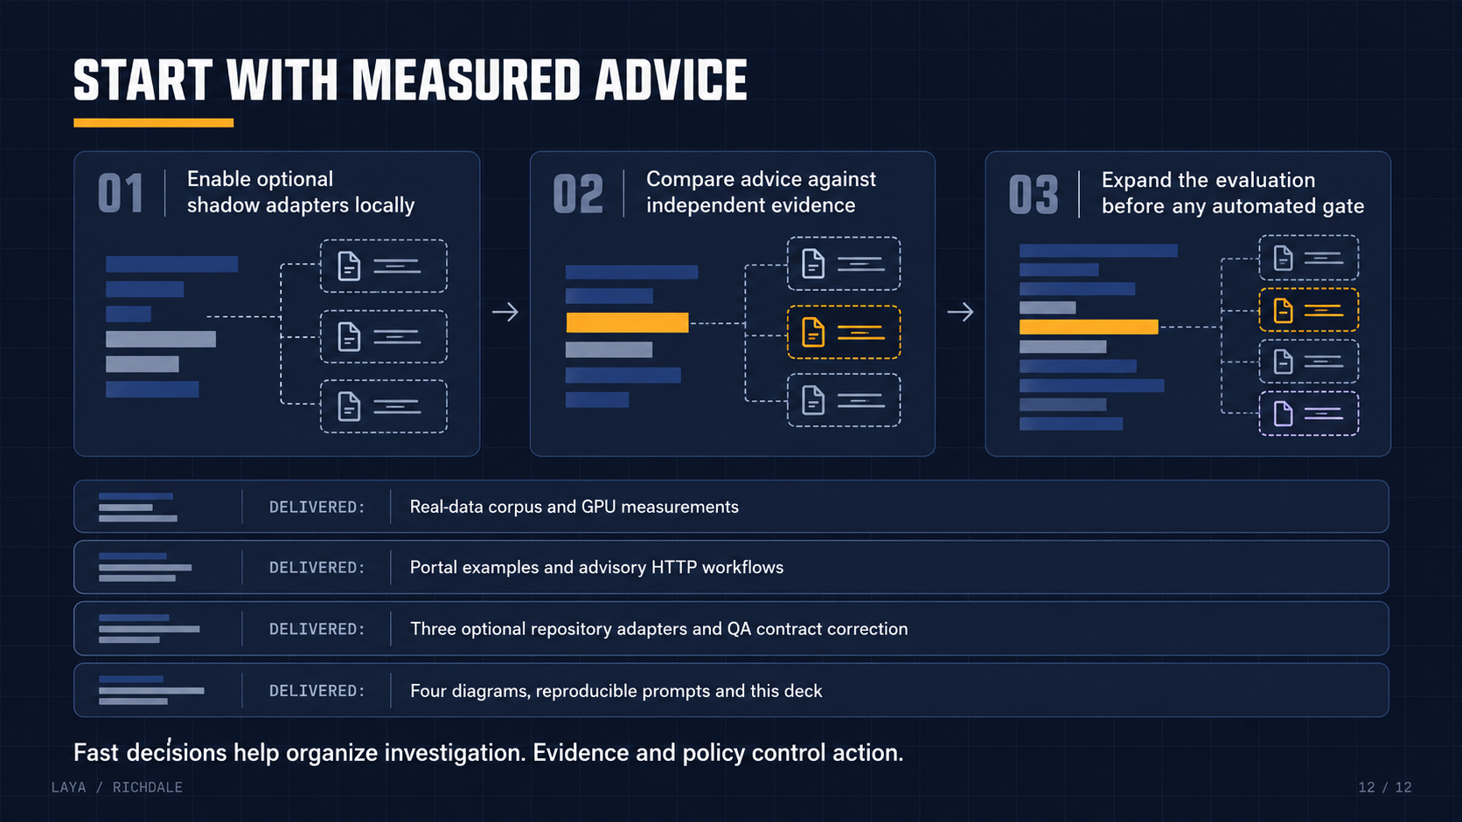
Notes:
Optional adapters are local and disabled by default. The dataset supports further shadow evaluation, not automated security verdicts. No production deployment, issue mutation, credential rotation or credit-card operation occurred.
Sources: local docs/benchmark/REPORT.md, corpus.json, results.json and integration-replay.json; https://huggingface.co/convaiinnovations/laya/blob/main/README.md; https://github.com/omar-richdale/sift; https://github.com/omar-richdale/vpn-bugsmith; https://github.com/omar-richdale/QA_Web_Testing_Agent. Snapshot 2026-10-01.
QA evidence: https://vpnqa.richdalelab.com/reports/20260930-060000-9iy9o/index.html; https://vpnqa.richdalelab.com/reports/20260930-071000-9o49u/report.md; https://vpnqa.richdalelab.com/reports/20260929-071000-wzuvk/report.md.

