Slide 1


Digital Freelancer: Managing Freelancing Projects
Project: Working with a Mock Client

Slide 2

How to use this Template
We have provided these slides as a guide to ensure that you submit all the required components to successfully complete your project.
When presenting your project, please only think of this as a guide. We encouraged you to use creative freedom when making changes as long as the required information is present.
Before submitting your project, don’t forget to:
Delete this and all of the other example slides
Convert your slide deck into a PDF
Confirm that all required screenshots are added
Remove this slide

Slide 3
Part 1
Project Listing

Slide 4
Project Listing:
For this portion of the project, you may either:
Use one of the provided project listings
Find your own project listing on the freelancer marketplace.

Slide 5
Project Listing (Provided):
Read each of the provided project listings and select one to work on:
You will be provided a mock project listing from a prospective client.
It’s your responsibility to read and understand the content of the listing in order to compile your first message to the client.
Imagine that you have at least one year of experience in the field described in the listing.
Note: You may need to your own research to respond to the client. You won’t always know every single technology a client is requesting, so it’s good to get into the habit of doing some initial research.

Slide 6
Project Listing (Own):
You may also find your own project listing to use in this project instead of the three provided. Using the freelancer marketplace of your choice, please pick a project listing that includes the following requirements:
Project listing must be in English.
It must be a project in a relevant technical field.
The listing must be at least a paragraph, and have a clear deliverable and description of work.

Slide 7
Sample Project Listing #1: Web Development
Web application development support needed for healthcare application.
Posted 2 hours ago
Hourly: $35.00 - $65.00 Based on experience.
Project Time: 3 months, 25 hours a week.
Project Description:
We are a web development company working with a healthcare client looking to connect patients directly with their doctors. We need someone to be able to take PSD mockup files from our designer and convert them into custom code using HTML, CSS, and JavaScript. We have not decided on which JavaScript library to use, but will be open to working with the one you’re most familiar with. We have the designs for 10 pages and will need them to be completed in 3 months. We are open to working with all levels of experience, but the pay will be adjusted based on your experience.

Slide 8
Sample Project Listing #2: Digital Marketing
Email Marketer for Annual Fundraising Event.
Posted 2 days ago
Hourly: $30.00 - $40.00.
Project Time: 1 month, 10 - 15 hours a week.
Project Description:
We are looking for someone to create a drip email campaign to help us sell tickets for our annual fundraising event for our non-profit. This would require audience segmentation, custom email creation, and call-to-action development. We are to reach our goal of 700 tickets sold. We haven’t decided on the best tool to do this yet and would be open to your recommendations. Serious inquiries only.

Slide 9
Sample Project Listing #3: Data Analyst
Seeking experienced Data Analyst to build dashboard for local insurance company.
Posted 1 week ago
Hourly: $90.00 Based on experience.
Project Time: 1 year, 20 hours a week.
Project Description:
I have taken over a local car insurance company from my parents and have inherited hundreds of Excel spreadsheets with past and current customer information. I need help organizing this data and creating a dashboard to allow me to filter the data and create reports as needed. I would also need guidance on how to transfer the data to the tool of your choice. Looking forward to working together!

Slide 10
Part 2
Expression of Interest

Slide 11
Expression of Interest
Write an initial expression of interest (EoI) to the client:
Now that you’ve understood what the client is asking for, it’s time for you to reach out to them.
Write out an EoI message addressing their requirements as well as how you can help them.
This message will be their first impression of how you communicate with them, so it is good to be professional.
Please keep word limit between 200 - 300 words.

Slide 12
Expression of Interest (Provided)
Which Sample Project Listing did you select to respond to?
Answer: 1
Please type your initial response to the client below. This should be between 200 - 300 words.
Expression of Interest:
Hi Mr. Daniel, congrats on launching your website for healthcare, you are looking for someone to convert PSD files to custom code using HTML, CSS, and JavaScript.
I am a Fullstack developer more than 1 year experience in field and worked for more than 10 clients in different countries and done more than 10 projects,you can view them through my github :https://github.com/omar-sherif9992. I will use libraries like jQuery and AngularJs in Conversion process, and it has more advantages like earn more money and increased customer retention.
I will complete design 10 pages in 3 months, Happy to communicate with you.

Slide 13
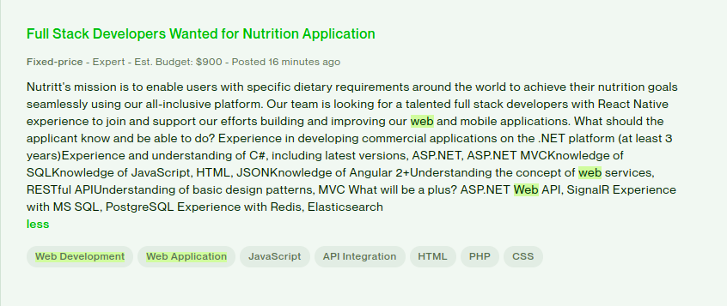
Expression of Interest (Own)
Please paste the screenshot of the project listing you found on the freelancer marketplace you wish to respond to below:
Paste screenshot here

Slide 14
Expression of Interest (Own)
Please type your initial response to the client below. This should be between 200 - 300 words.
Expression of Interest:
Hi Mr. Daniel, you are looking for someone to spread mission of the app across is your all-inclusive platform to custom code using ASP.NET, ASP.NET MVCKnowledge of SQLKnowledge of JavaScript, HTML, JSONKnowledge of Angular.
I am a Fullstack developer more than 1 year experience in field and worked for more than 10 clients in different countries and done already more than 10 creative projects,you can view them through my github :https://github.com/omar-sherif9992, I will use libraries like jQuery and AngularJs ,and I am acknowledged with design patterns and fully experienced with ASP .net and SQL Queries, and RESTful API.
I will join your team for 3 months, Happy to communicate with you .

Slide 15
Part 3
Project Management Process

Slide 16
Project Management Process
Set up a project management process, create a Trello board with outlined project milestones.
For the purpose of this project, we’ll be using Trello as our choice of project management tool.
You can create a free Trello board by going to https://trello.com/
The board that you’ll use needs to be public in order to be graded.
You’ll need to create 5 milestone columns for the project (with required action items).
3 of the columns should be specific to the development, review, and payment process.
Each action item in a milestone listed requires at least a due date, a description, and a checklist.

Slide 17
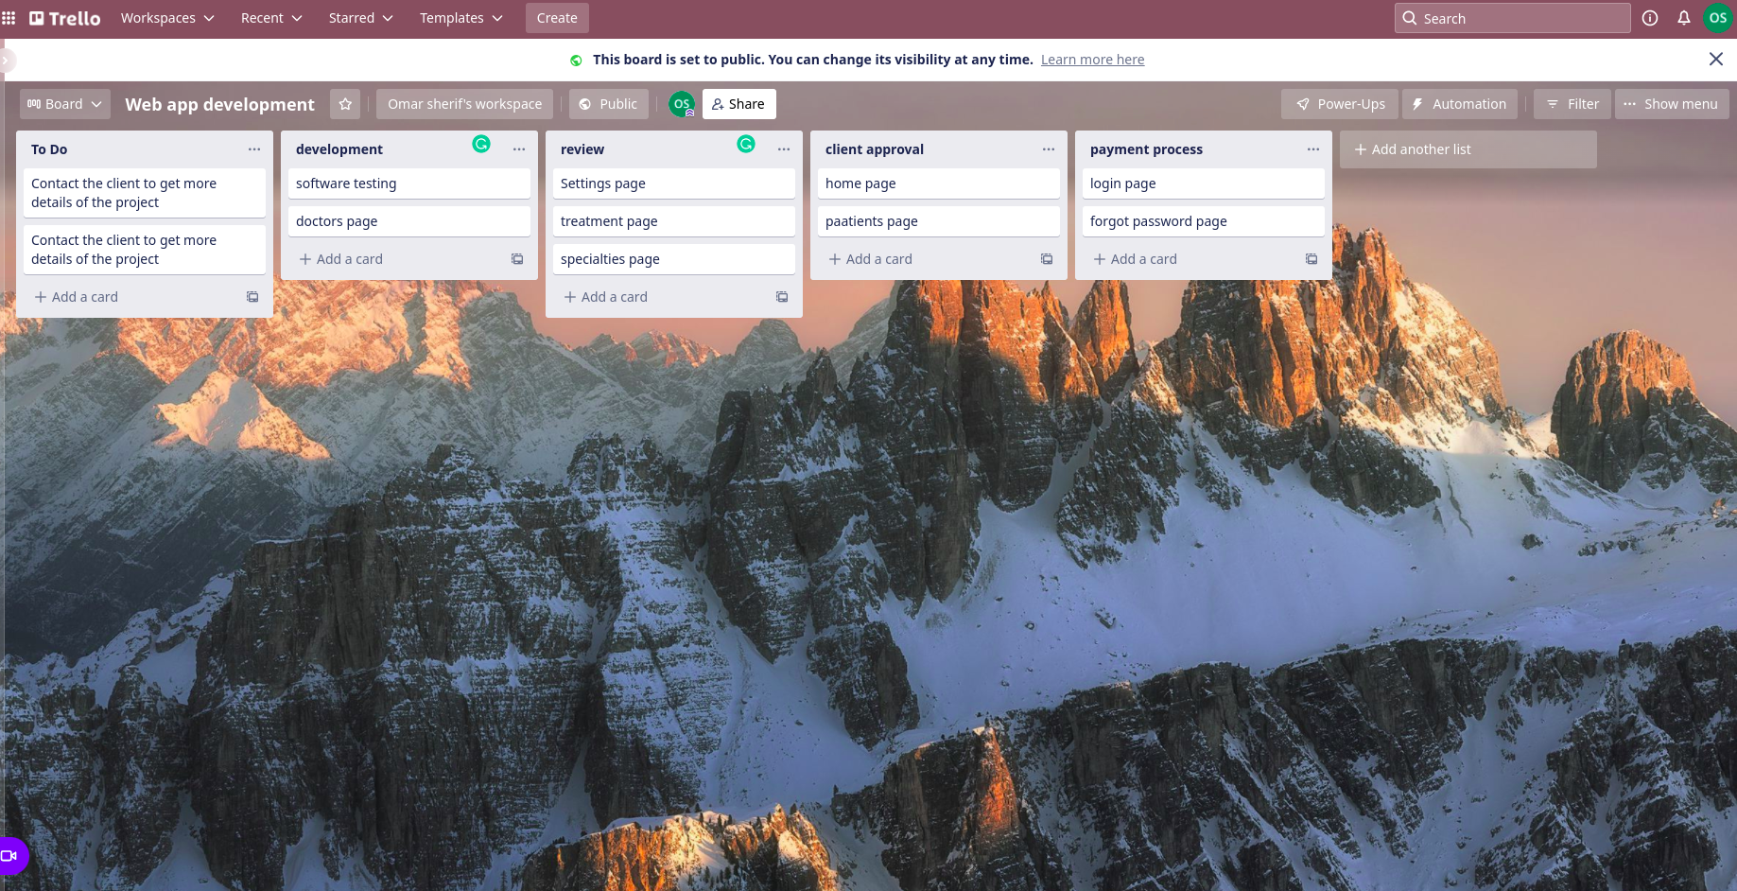
Trello Board
Please include the following information for your Trello board:
A link to your public Trello board should be provided here:
https://trello.com/b/IXPifAWO/web-app-development
Include a screenshot of the board below:
Paste screenshot here

Slide 18
Part 4
Invoice and Payment Options

Slide 19
Invoice and Payment Options
Invoice the client by using a provided invoicing template. The following items need to be included:
Name and address of the freelancer
Name and address of the client/recipient
Invoice number, date issued, and date of when payment is due
Itemized services rendered, as well as amount of hours worked, with cost of work done per hour, and the total cost per service based on the hours worked and hourly rate for the service.
Total cost of all work performed.
Payment options including what payment methods are accepted and how the client can pay for services rendered

Slide 20
[Your Full Name or Your Company Name] [Your Address or Address Your Company is Registered to] Invoice
Recipient:
[Web Dev Company]
[Giza, Egypt]
Invoice #: 3253
Date issued: 27/01/2022
Date due: 27/04/2022
Services Rendered (Continue on next page)
Service | Description of Work Done | Hours Spent | Amount Per Hour | Total
Take files and sort it | The company decided to contact us and give us the files | 5 hr. | 35 $ | 175 $
Analyze the data in the files | Performing data analysis and data extraction | 6 hr. | 35 $ | 210 $
Working on the first 5 pages | Convert from HTML to code | 10 hr. | 35 $ | 350 $
Work on the remaining 5 pages | [Clear description of service provided, be as specific as possible] | 10 hr. | 35 $ | 350 $

Slide 21
[Your Full Name or Your Company Name] [Your Address or Address Your Company is Registered to] Invoice
Services Rendered (continued)
Service | Description of Work Done | Hours Spent | Amount Per Hour | Total
Last review | The completion of the whole project and the mission of the company. | 6 hr. | 35$ | 210$
Total Payment Due: [1295 $ ]
Payment Options:
I will get paid for the money by means of the two:
PayPal
Bank account
A/C: 25AB-72SD
Bank: Ahli Bank

