Slide 1
Presentation
Project Charter
Project name: The salaries of laptops
Project sponsor: Microsoft company
Project manager: Eng/ Omar Nasr mohamed
Purpose of The project: helping citizens to know the salary of most laptops in the markets
Business case:
the application is used to make people aware of laptops prices and tell them about the changes that occurring every day for prices and The app also display laptops for sale and facilitates the buyer's access to the sellers and the app creates private chat between them and this app was funded by the microsoft company.
And the users of the application can communicate with each other to face the greed of the merchants by boycott the products therefore it will reduce the market monopoly,
And we made a strong servers that can bear the big group of people who will use the app and provides good service and achieve the aim of our app.
The application also supports Android and IOS , And we predict the success of the application in a few weeks after it's launch, Hoping you like it and enjoy our other applications .
And there is a computer version of this application we work on it in the recent time and support more services and with a different design .
The application also suggests the best types of laptops in terms of price, capabilities and materials and there is an advantage in the application where the user chooses the price, capabilities, and type of company, and the application displays all the available suggestions through his search .

Slide 2
Key deliverables
The salary of products that will work on
windows ( desktop application)
Mobile application for android and IOS
Web page
Project milestones
Dates of meetings: There will be 6 meetings every Sunday of the week.
Requirements review : Requirements specifications are complete, correct, approved and suitable. By 30/10/2021.
Project cost 250 thousands’s egyption pound per month.

Slide 3
project resources
1-mycrosoft company
Markets and shop owners for commercial and malls-2
We can use electronic store owners and market managers-3
4-We can find out the origin of prices and prices of laptops and computers from the same factories
-5-High prices can be eliminated by building and building state-owned shops under the supervision of the government
6-By building government markets, we can learn about new prices that are not manipulated by traders
-We can also monitor foreign markets by appointing government employees7
8-We can create a website where the consumer can identify all versions of all companies producing electronic devices and also know their original prices
9-We can also, through the website, educate the consumer with all the necessary information that he must know to purchase any electronic device
-10-You must provide the customer with all the information about the electronic device that he wants to buy, and he must know what the device is and what its capabilities are,
as well as the hardware and what are the capabilities of the hardware that he will buy.
11-We can get some information by using some famous sites such as Amazon and Souq.

Slide 4
budget
1-We need five employees with a monthly salary of 3000 in each market to market products and educate the consumer and provide him with more information about electronic devices in order to avoid the bad of electronic devices
2-Every day we need a car to move between the markets at a cost of 300 pounds per day if it costs 9000 pounds per mounth.
3-We need a display screen to display prices at a cost of 10000 pounds
-4-We need to rent stores to display our products at a monthly cost of 5000 pounds per store. We want 5 stores in at least five different governorates to expand the scope of awareness and trade.
5-We need a contract with a shipping company and move the devices between all the stores in the different governorates, at a cost of 2500 pounds per month.
6-the total cost of the project is 15,000 pounds for employees, 10,000 pounds for display screens, 9000 pounds for surveillance cars, shop rents, and 2,500 pounds for the shipping company, bringing the total monthly cost to250 thousands’s egyption pounds..
constraints
If a buyer has an account, then he needs to type inthe username .and password
.Buyer needs to sign in
.Buyer selects quantitative page
.Buyer selects products
.Buyer selects features or aspects with preferences
Buyer enters a budget or price

Slide 5
Assumptions
Resources – people, materials, or facilities needed to complete the project
Delivery – what’s intended to be delivered.
Budget – estimated cost of the project
Finances – funding to complete the project
Scope – the scope of the what’s to be delivered
Schedule: tasks, durations, and dependencies needed to complete the project
Methodology – the approach you’ll take to completing the project.
Technology – this could cover software development, platforms, environments, and infrastructure
Architecture and design – architecture and design approach your team will use.
High level risks
A failure of one of the systems,which leads to an ambalance inthe prices of products.
The cost of the program is more than the specified cost.
Lack of required efficiency from one of the team or the program.
Not satisfying the user enough.
Using the requirements incorrectly leads to wrong results.
Not excuting the program on time.
There are wrongs in the prices of the products.

Slide 6
Project scope
Product Scope Description:
1-it is an application you use to know laptop price.
2-it is an application you use to know Best place to sell computer.
3-If you are confused in choosing your device, we will recommend the best devices at the best prices.
4-You will be the first to know, the application will inform you of the latest offers and discounts.
Project acceptance criteries:
The laptop can be used significantly in many fields for example:
1-Digital issues solutions
2-Storage and decline information
3-Control for equipment
4-Design of images and documents
5-Entertainment
6-Communicate among people
7-Education
8-Business labor
In addition to the laptop represents an effective increase in the communication with others “such as e-mail” and social communication sites , and can be used to increase trade cooperation between companies and various institutions and the participation of documents and designs and a lot of tasks in practical life.

Slide 7
Project deliverables:
The project plan is to display the prices of laptops, the best types, and the locations in which they are located.
Also save money and time in finding the perfect device.
Project Exclusions
The size of the program will be short approximately 24MB and also the time execution so short about 2ms, so anyone can use it in a weak device or PCs.
The goal of the program is to sales and buys laptop and its accessories with feasible price and quantifibale
The performance and the quality is high.
project Constraints:
Time to end .
All the budgets .
All the requirements are founded.
The project was completed on time.
Project Assumptions:
all the Budgets are estimated.
all performance requirments and resources are exists and perfect.
This application can run only on The IOS and Android operating system.
tasks, durations, and dependance needed to complete the project..

Slide 8
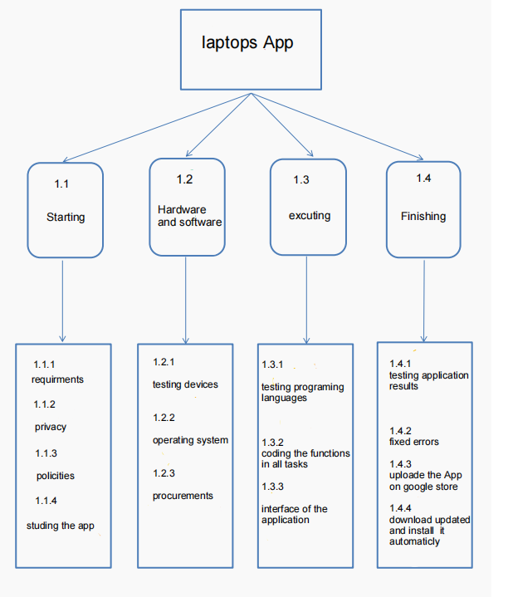
WBS

Slide 9
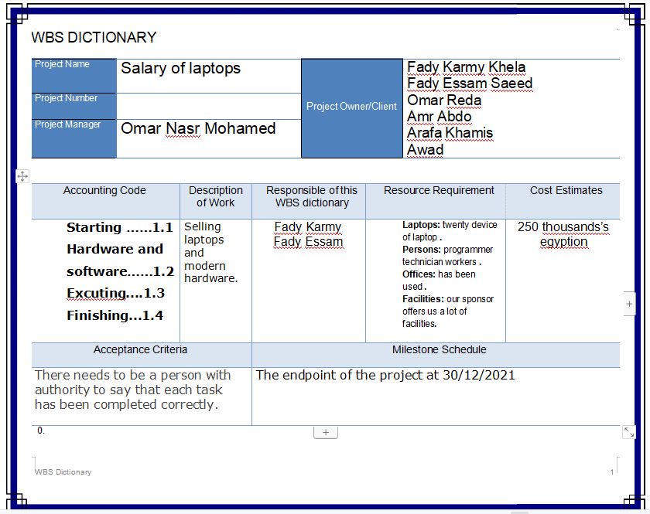
WBS Dictionary

Slide 10
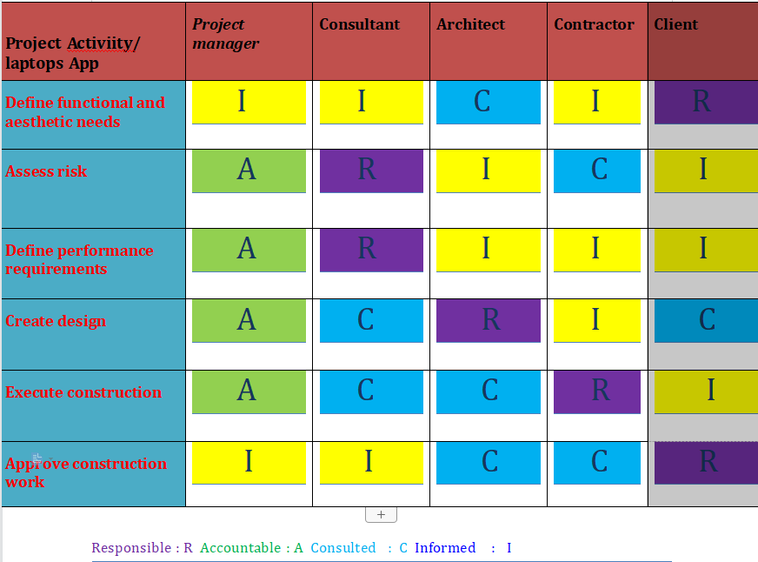
Responsibility matrix

Slide 11
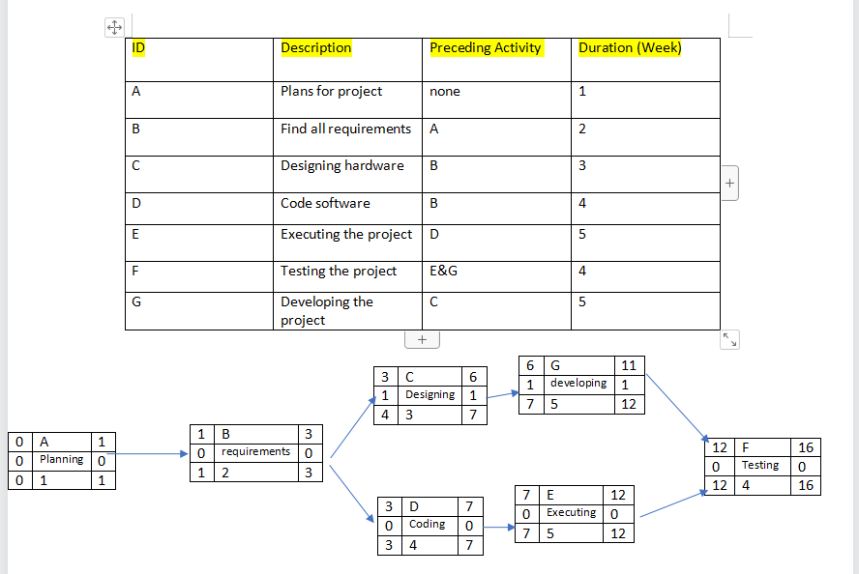
Project Network

Slide 12
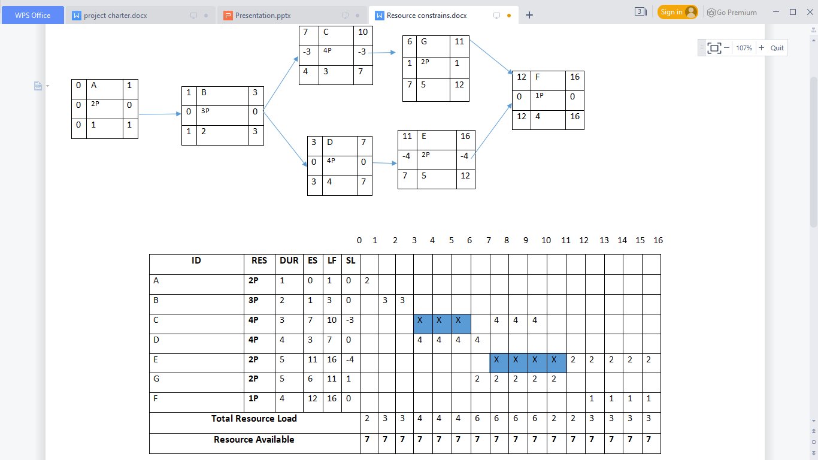
Resource constrains

Slide 13
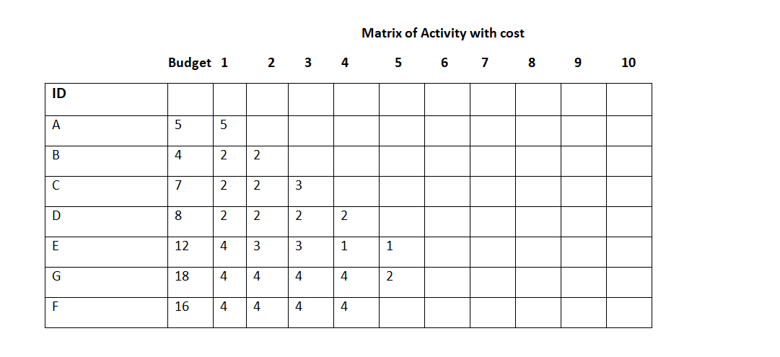
Budget Baseline

Slide 14
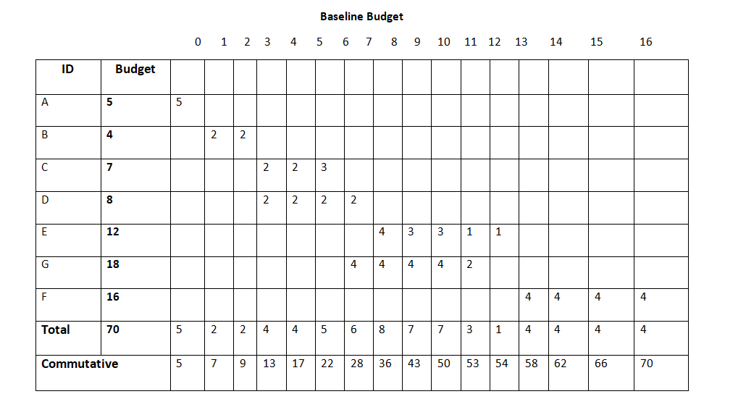
Budget Baseline

Slide 15
Risk Management
What are the risks that can face your project?
How to deal with these risks?
Interruption of the Internet
➢The company’s management is ready in the event of an internet outage, it establishes the company offline and is easily accessible to customers.
Hackers
➢Appointing and employing information security experts in the company to confront hackers.
One of our employee leave the company
➢The company hires more employees than the company needs and another solution As a company, make employees love to work. The company offers more advantages than any competing company.
Another competitive company make the same technology with better quality than us
➢This is a good thing because this situation will give me a strong incentive to work and learn modern technological skills for me as a company and also for employees because I give them what makes them love their company.
Damage in the receivers
➢Our company is based on providing electronic services, thus increasing the chances of advertisements on the site, and this will increase profits.
Not to satisfy the users of product
There is always communication between the company and customers. I collect feedback and try to work on problems that the customer did not like.

Slide 16
Demostrate how to montior your project?
Create a Project Outline
Working with team members to create a project outline can be a great way of tracking project progress. Each member of the team can give input for setting up realistic project goals and learn what’s expected of them individually and as part of a group.
Establish Goals and Milestones
When considering how to track the progress of a project, it’s good to consider a worker’s specific skill set first. Measuring progress can look very different from person to person and project to project.
Check in Regularly
When considering how to track the progress of a project, never underestimate the importance of checking in.
Ask How You Can Help
There are many ways a project manager can help workers feel less stressed or overwhelmed by tasks.
Establish Clear Deadlines
Keeping the end goal in sight is always helpful for measuring progress. Being clear about deadlines can help workers stay on track and complete tasks without getting overly stressed or overwhelmed.

