Slide 1

NOVA
RETAIL MARKETS
Retail Performance &
Business Intelligence Analysis
239.4M SAR
79.4M SAR
33%
89.9%
Total Revenue
Total Profit
Profit Margin
Completion Rate
Prepared by the Data & Analytics Team

Slide 2




Financial Performance
A snapshot of overall business health
239.4M SAR
79.4M SAR
33%
1,995 SAR
89.9%
Total Revenue
Total Profit
Overall Profit Margin
Average Order Value
Completed Order Rate
Key Takeaway
The business achieved strong profitability with a healthy 33% profit margin while maintaining a high order completion rate. The average customer order value indicates strong purchasing power across the customer base.
Nova Retail Markets
2

Slide 3


Product Performance
Profit by category shows where the real margin comes from
Highest Margin — 34.7%
Beauty & Personal Care, Books & Stationery
Lowest Margin — 31.1%
Toys & Games
Margins stayed relatively stable across categories, even as revenue varied.
Nova Retail Markets
3

Slide 4
Store Performance
Branch comparison: revenue and profit
Khobar Branch
Top performer — leads in both revenue and profit. A strong benchmark for other locations.
Performance across branches is relatively balanced overall — no single store is significantly underperforming.
Nova Retail Markets
4

Slide 5


Discount Analysis
Do discounts pay off?
Higher discounts did not generate higher sales volume.
Recommendation
Larger discounts reduced overall profitability.
Replace broad discounts with targeted promotions based on customer behavior, product category, or seasonal campaigns to protect profit margins.
Broad discount campaigns are not delivering sufficient business value.
Nova Retail Markets
5

Slide 6
Recommendations
Actions based on the analysis
1
Keep enough inventory for high-performing categories such as Sports & Outdoors.
2
Improve low-performing categories by reviewing pricing and marketing strategies.
3
Use targeted discounts for specific customer groups or products instead of offering discounts to everyone.
4
Increase inventory, schedule additional staff, and plan marketing campaigns before the July–December peak season.
5
Use Khobar Branch as a benchmark for other stores by applying its successful practices where possible.
6
Continuously monitor monthly sales trends to quickly adjust inventory, staffing, and promotions.
Nova Retail Markets
6

Slide 7
Sales Trend
Continuous growth with a clear seasonal peak
Key Observations
Sales reached their highest level in July 2025 (11M SAR).
January 2023 recorded the lowest sales (145K SAR).
Sales were strongest between July and December — a clear peak season.
Nova Retail Markets
7

Slide 8
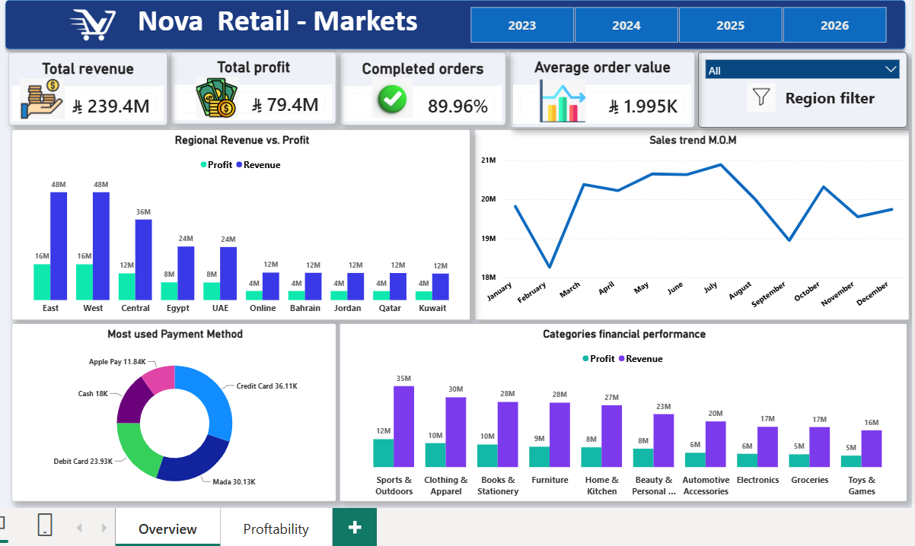
Dashboard Overview
Live Power BI dashboard — Nova Retail Markets
Nova Retail Markets — Data-Driven Growth
8

Slide 9
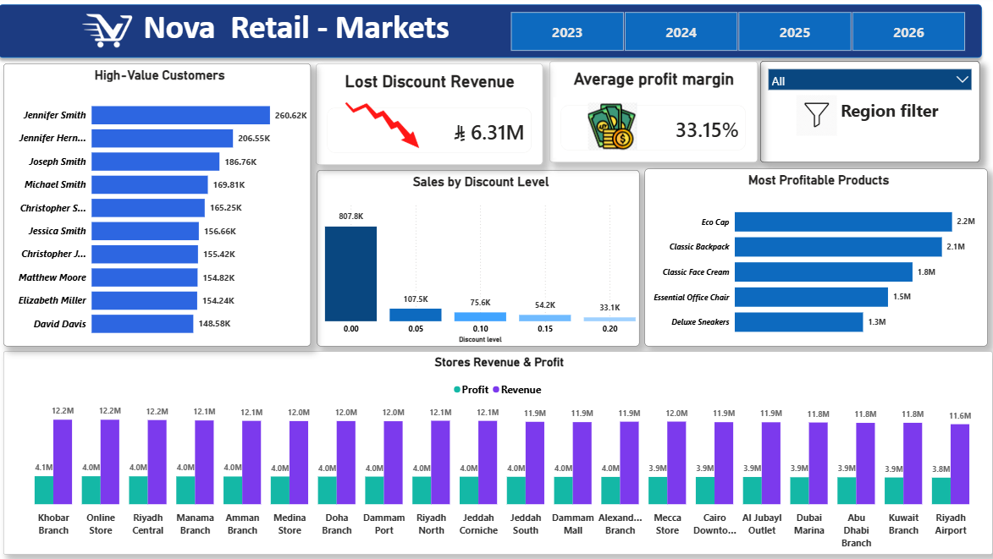
Profitability Dashboard
Customers, discounts & store-level profitability
Nova Retail Markets — Data-Driven Growth
9

