Slide 1
K-nearest Neighbor

Slide 2
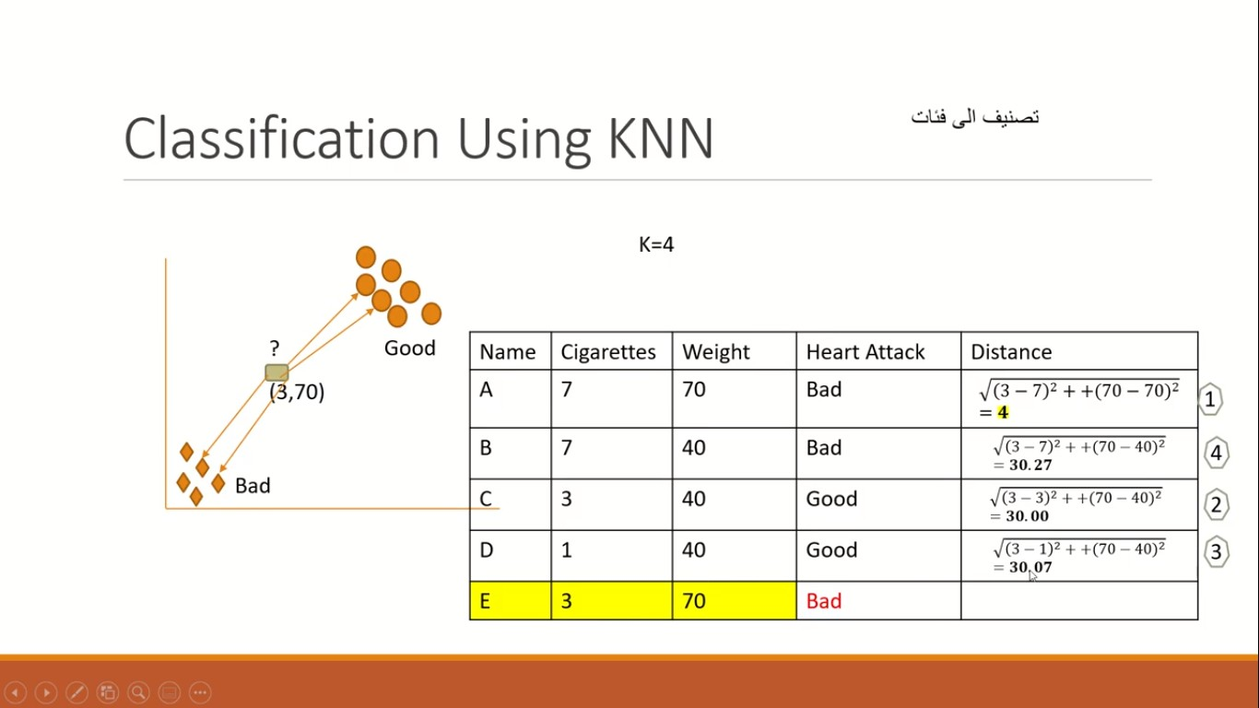

Slide 3
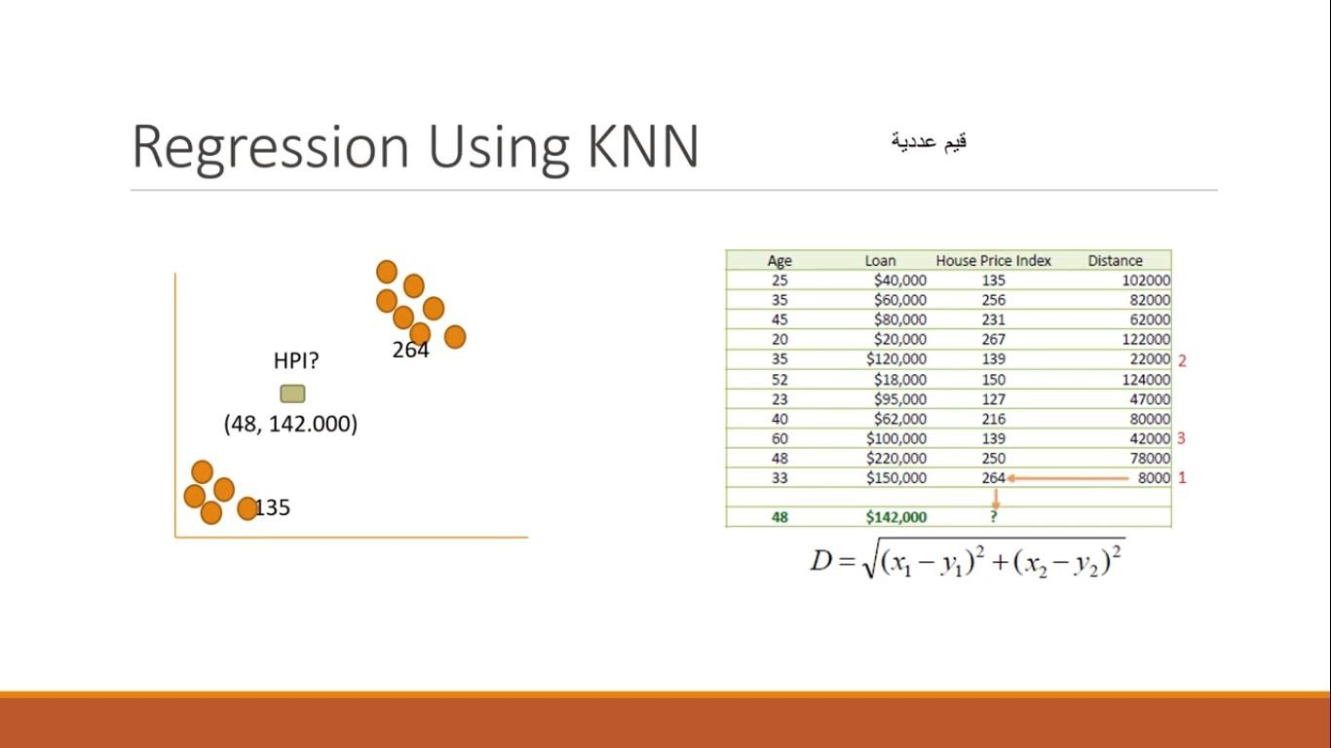

Slide 4
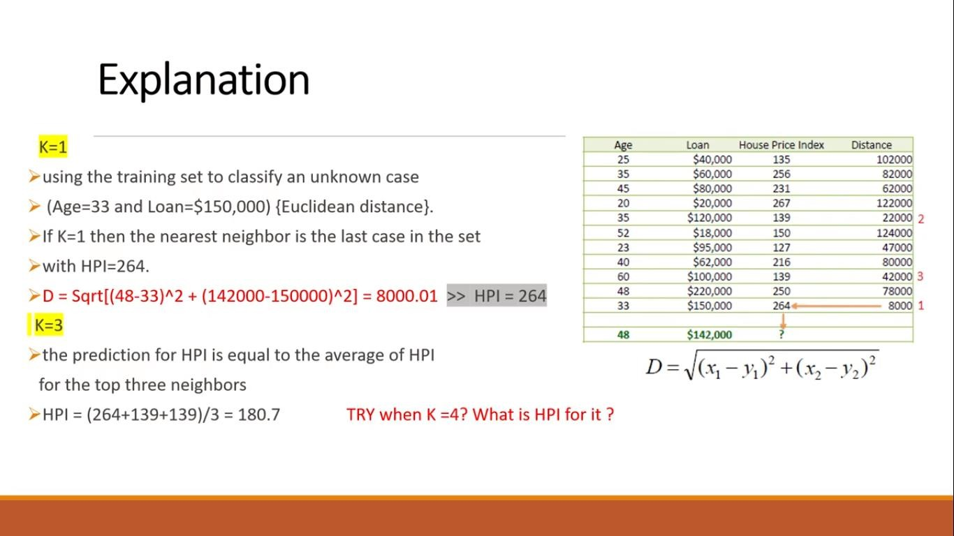

Slide 5
KNN pros and cons
Pros
No Training Period: KNN is called Lazy Learner (Instance based learning).
new data can be added seamlessly which will not impact the accuracy of the algorithm.
KNN is very easy to implement, There are only two parameters required to implement KNN
i.e. the value of K and the distance function (e.g. Euclidean or Manhattan etc.)
Cons
Does not work well with large dataset:
Does not work well with high dimensions
Need feature scaling: We need to do feature scaling (standardization and normalization)
Sensitive to noisy data, missing values.

Slide 6
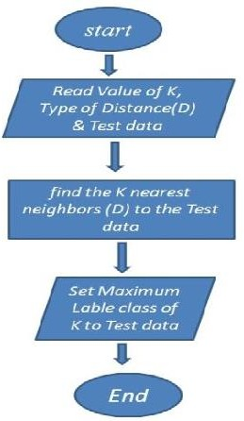
Flow chart for KNN

