Slide 1





Machine Learning with Python

Slide 2
Agenda
What is Machine Learning
Supervised Learning
Regression
Classification
Unsupervised Learning
Clustering
Dimension Reduction
Model Selection & Evaluation
Cross Validation
Hyperparameter Tuning
Feature Selection
Intro to Deep Learning

Slide 3
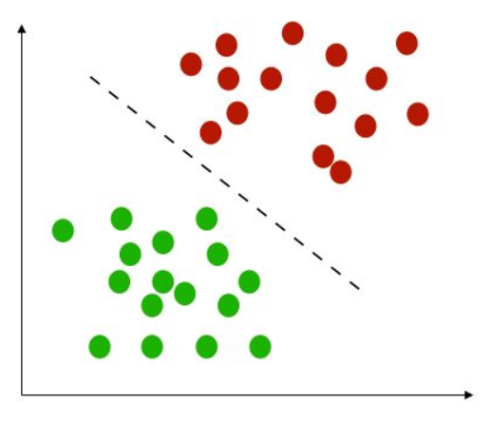



Classification
Classification specifies the class to which data elements belong to and is best used when the output has finite and discrete values. It predicts a class for an input variable as well.
For example,
it can be used to classify the animal in an image, it’s either a cat or a dog.
Email spam detection
Face classification
Patient has cancer or not
Fraud detection
…

Slide 4
Classification Types
1- Binary classification refers to those classification tasks that have two class labels.
Email spam detection (spam or not).
Churn prediction (churn or not).
Patient has cancer or not
2 - Multi-class classification refers to those classification tasks that have more than two class labels.
Face classification.
Plant species classification.
Emotion detection

Slide 5
Classification
Logistic Regression
K-Nearest Neighbors (KNN)
Naive Bayes
SVM
Decision Trees
Evaluating Model Performance

Slide 6
Classification
Logistic Regression
K-Nearest Neighbors (KNN)
Naive Bayes
SVM
Decision Trees
Evaluating Model Performance

Slide 7
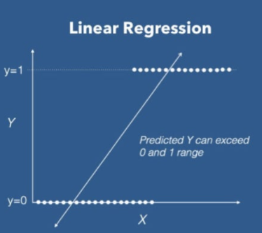
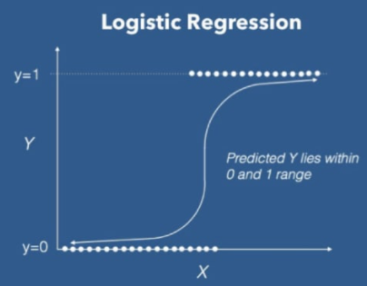
Why Apply Logistic Regression?
It is similar to Linear Regression. The only difference is that Linear Regression is used for solving Regression problems, whereas Logistic regression is used for solving the classification problems/Categorical problems.
Linear regression doesn’t give a good fit line for the problems having only two values
It will give less accuracy while prediction because it will fail to cover the datasets.
For the best fit of categorical datasets, a Curve is being required which is being possible with the help of Logistic Regression, as it uses a Sigmoid function to make predictions

Slide 8
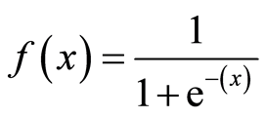
Mathematics of Logistic Regression
The main reason for using the Logistic Regression curve is because of being calculated using a Sigmoid Function (also known as Logistic Function because being used in logistic regression)
This the mathematical function which is having the ‘S – Shaped curve’. The value of the Sigmoid Function always lies between 0 and 1, which is why it’s being deployed to solve categorical problems having two possible values.

Slide 9
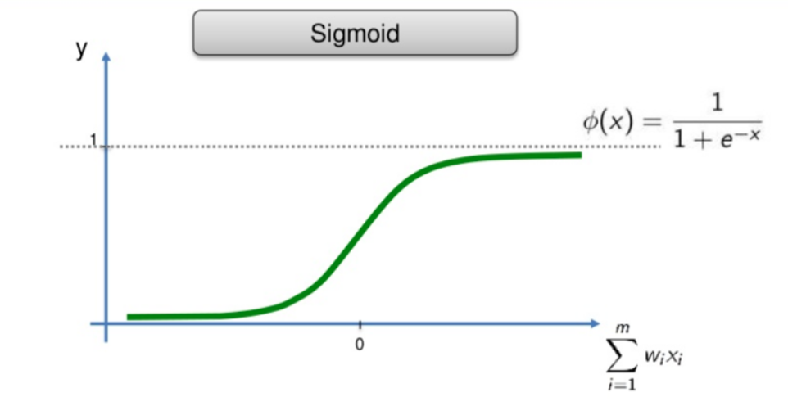
Mathematics of Logistic Regression

Slide 10
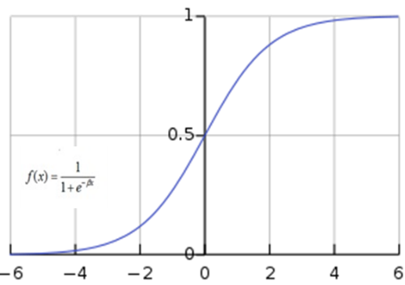
Mathematics of Logistic Regression
Logistic Regression deploys the sigmoid function to make predictions in the case of Categorical values.
It sets a Threshold point value, which is mostly being set as 0.5, which, when being exceeded by the predicted output of the Logistic curve, gives respective predicted output in form of which category the dataset belongs
For Example:
In the case of the Diabetes prediction Model, if the output exceeds the threshold point, prediction output will be given as Yes for Diabetes otherwise No, if the value is below the cutoff point

Slide 11
Cost Function
we can’t use the same cost function RMSE as we did for linear regression. Why?
Because RMSE outputs values while logistic regression outputs probability then converted to “1” or “0”
Instead of Mean Squared Error, we use a cost function called Cross-Entropy, also known as Log Loss. Cross-entropy loss can be divided into two separate cost functions: one for y=1 and one for y=0.

Slide 12


Cost Function
The cross entropy(log loss) cost function
To understand the cost function, let us try having class 0 or class 1:

Slide 13

Cost Function
Now how do we reduce the cost value. this can be done by using Gradient Descent. The main goal of Gradient descent is to minimize the cost value. i.e. min J(θ).
Now to minimize our cost function we need to run the gradient descent function on each parameter i.e.

Slide 14
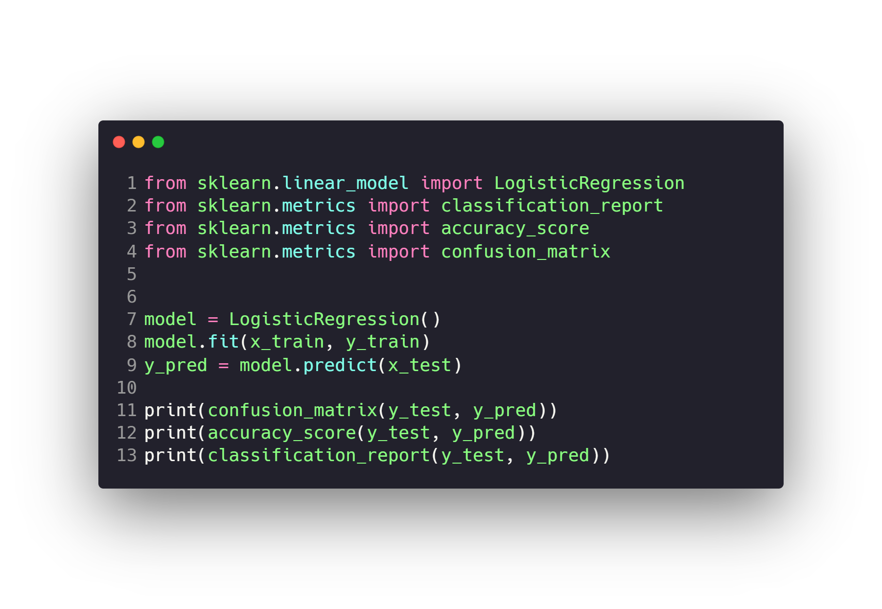
Logistic Regression

Slide 15
Questions ?!

