Slide 1





Machine Learning with Python

Slide 2
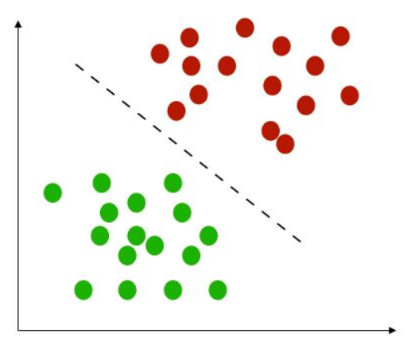

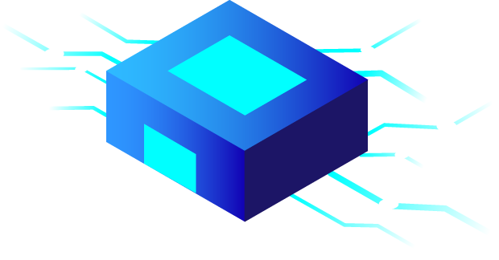
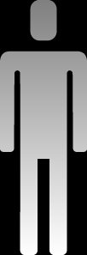
Classification
Logistic Regression
K-Nearest Neighbors (KNN)
Naive Bayes
SVM
Decision Trees
Evaluating Model Performance

Slide 3
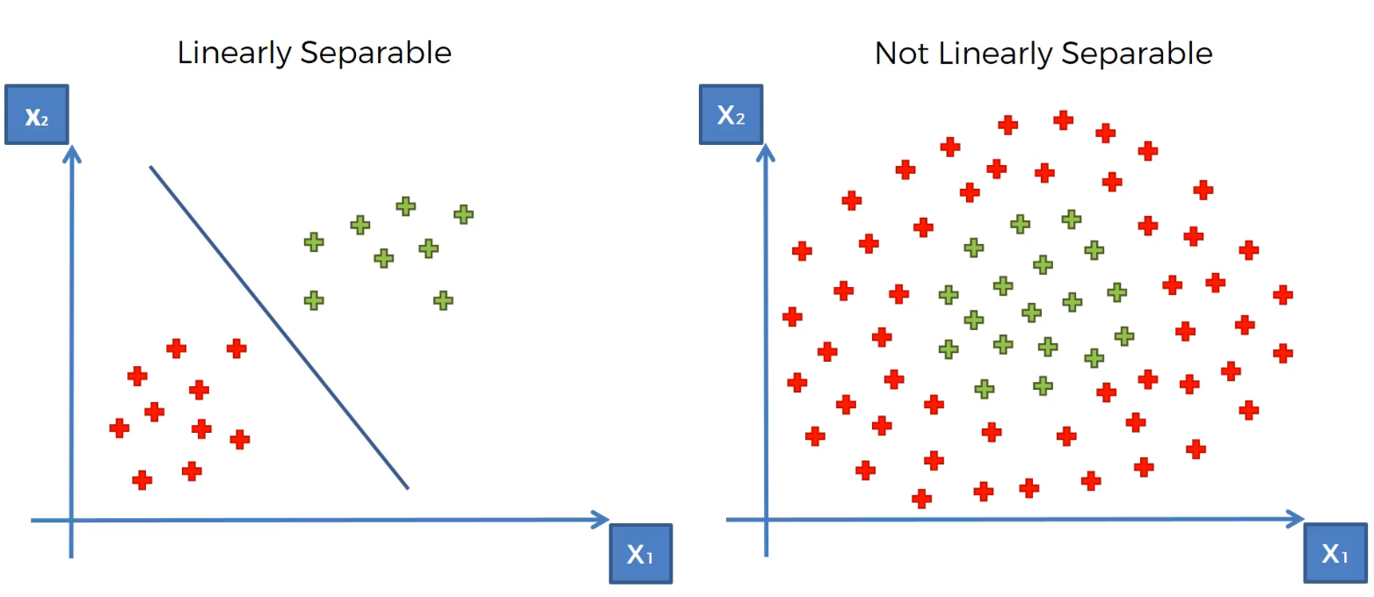
SVM (Support Vector Machine) in 2D

Slide 4
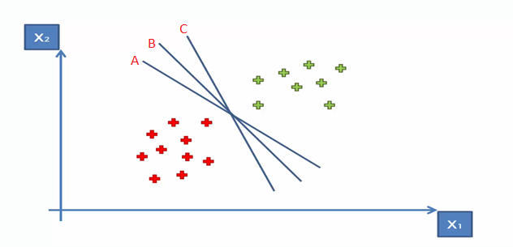
SVM (Support Vector Machine)
There is a lot of possible solutions for drawing a hyperplane separate between classes but which one is best,
To get maximum margin SVM can choose it easily as it sometime called “Maximum Margin Classifier” , so here
B is the best line.

Slide 5
SVM (Support Vector Machine)
1- Choose the closest points to the line from both
classes. These points are called support vectors.
2- Compute the distance between these support
vectors and the candidate line where we call this
distance as margin.
3- The line that maximizes the margin between ALL
the points and the line is the best separator.
Hence line B is the best separator among the 3 lines.

Slide 6
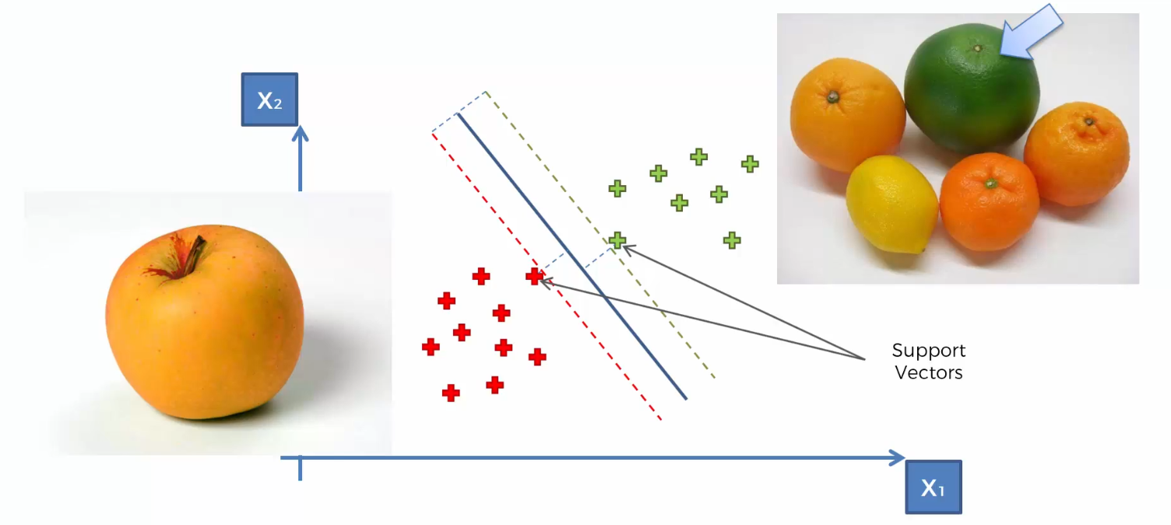
SVM (Support Vector Machine)
Support vectors: are data points that lie close to hyperplane that are the most difficult to classify which also decide which Hyperplane to choose
Only support vectors decides the decision boundary in SVM

Slide 7
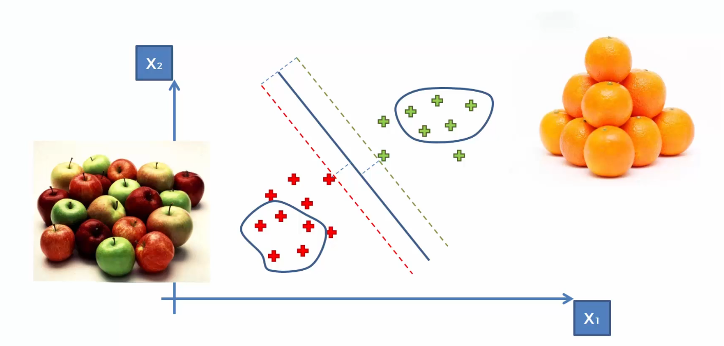
SVM (Support Vector Machine)

Slide 8
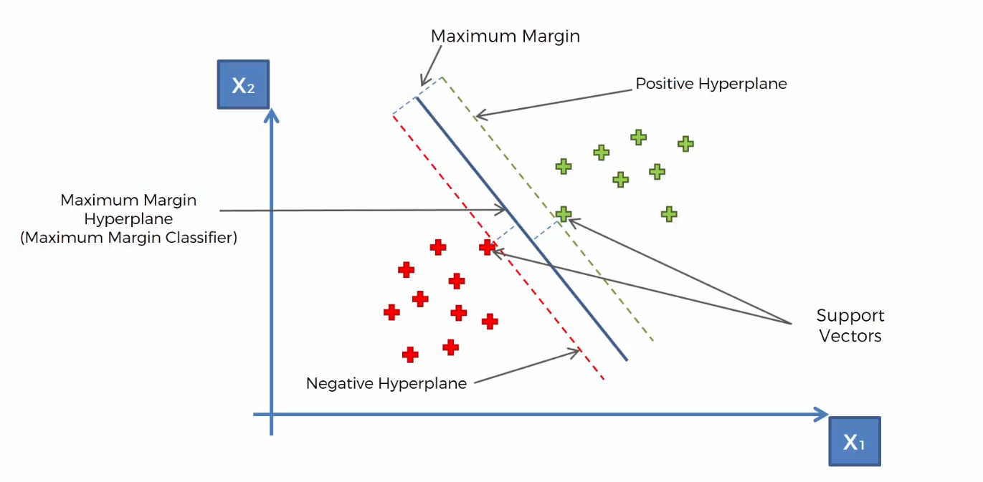
Support vectors
• Support vectors are the data points that lie closest to the decision surface (or hyperplane)
• They are the data points most difficult to classify
• They have direct bearing on the optimum location of the decision surface
Moving a support vector moves the decision boundary
Moving the other vectors has no effect

Slide 9
SVM:
Define the hyperplanes H such that: w•xi +b ≥ +1 when yi =+1 w•xi +b ≤ -1 when yi = –1
H1 and H2 are the planes: H1: w•xi +b = +1 &&& H2: w•xi +b = –1
The points on the planes H1 and H2 are the tips of the Support Vectors
The plane H0 is the median in between H1 and H2 , where H0: w•xi +b =0
d+ = the shortest distance to the closest positive point
d- = the shortest distance to the closest negative point
The margin (gutter) of a separating hyperplane is d+ + d–.
W
Y=W.Ẋ + b = 1
d+
+
+
d-
H1
-
-
H0
Y=W.Ẋ + b =0
Y=W.Ẋ + b = -1
H2

Slide 10
SVM idea
Maximum margin is the distance between H1 and H2 as both represent straight line so we can subtract the straight-line equations to get maximum margin
SVM has to find the optimal hyper plane (H0) between classes with maximum margin taking into consideration they must be perpendicular and bisect each other
H1 equation : W.Ẋ1 + b = 1, constraints for + samples , y=+1
H2 equation : W.Ẋ2 + b = -1, constraints for - samples , y=-1
Wx1-wx2=2 → W(X1-X2)=2
Margin can be Perpendicular by dividing by ||w||:
So: margin = w/||w||(x1-x2)= 2/||w||
Consider SVM as a minimizing problem , so maximize 2/||W|| is same as minimizing |W|/2
So, margin will equal to 1/2 ||W||^2

Slide 11
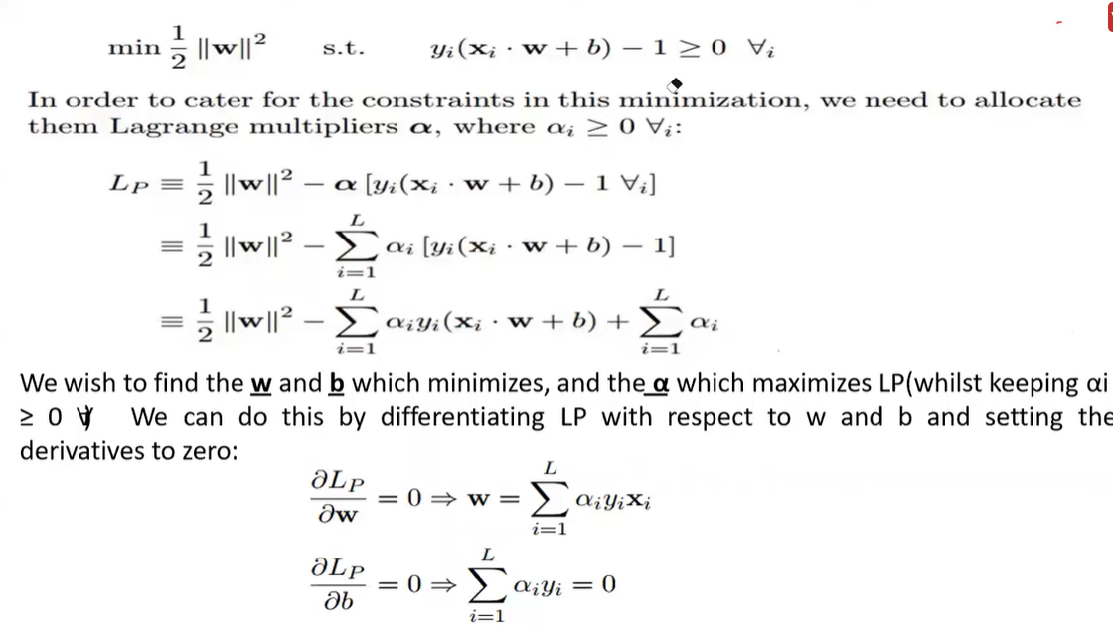

Slide 12
Error
Now Our Error will come from two errors:
1- Margin Error
2- Misclassification Error
Error = C * Misclassification Error + Margin Error

Slide 13
Linear SVM cost function:
With a very large value of C (like no regularization), this large margin classifier will be very sensitive to outliers
the ideal decision boundary should be like black line, by adding the blue triangle (outlier), with a vey big C, the decision boundary will shift to the blue line to satisfy the rule of large margin
The smaller the value of C, the more sensitive the algorithm is to the training data (higher variance and lower bias).
The larger the value of C, the less sensitive the algorithm is to the training data (lower variance and higher bias).
large C
Small C

Slide 14
Linear SVM cost function:
C also plays a role to adjust the width of margin which enables margin violation, When C is small, the margin is wider
The pink data points have violated the margin. It is especially useful when dealing with non-separable dataset
This is how regularization impact the choice of decision boundary that make the algorithm work for non-linearly separable dataset with tolerance of data points who are misclassified or have margin violation.
Small C

Slide 15
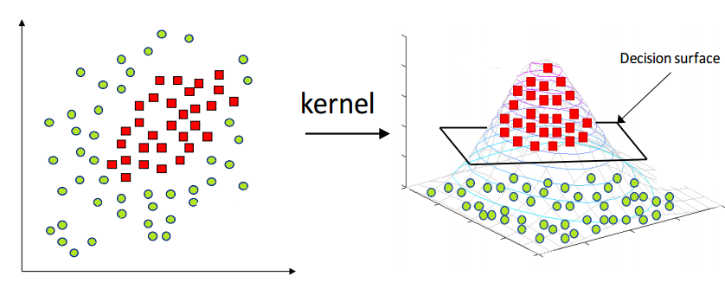
Nonlinear separable data
We will use kernel trick we will convert to higher dimension with plane as seprator

Slide 16
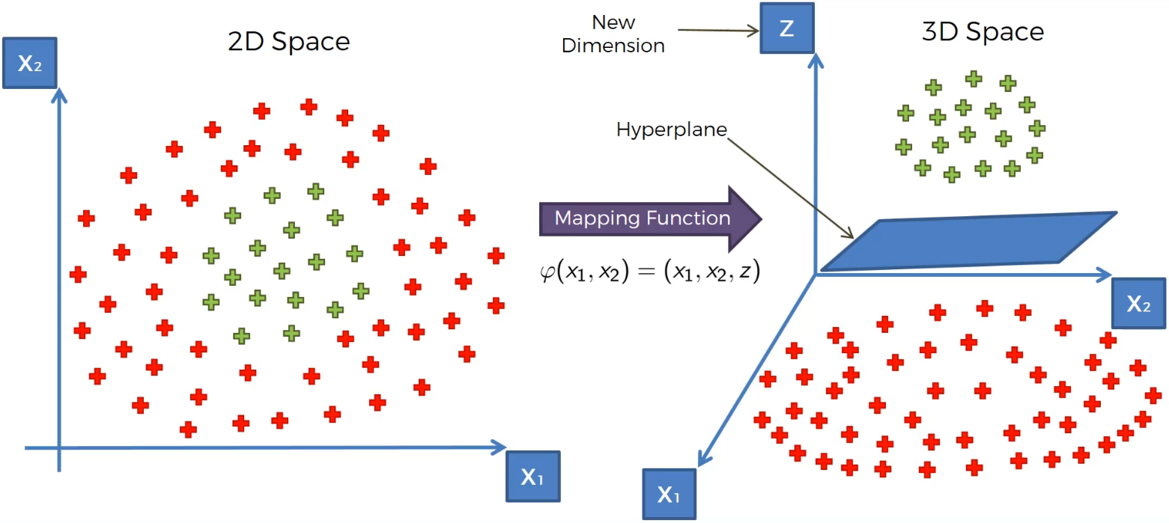
SVM (Support Vector Machine)

Slide 17
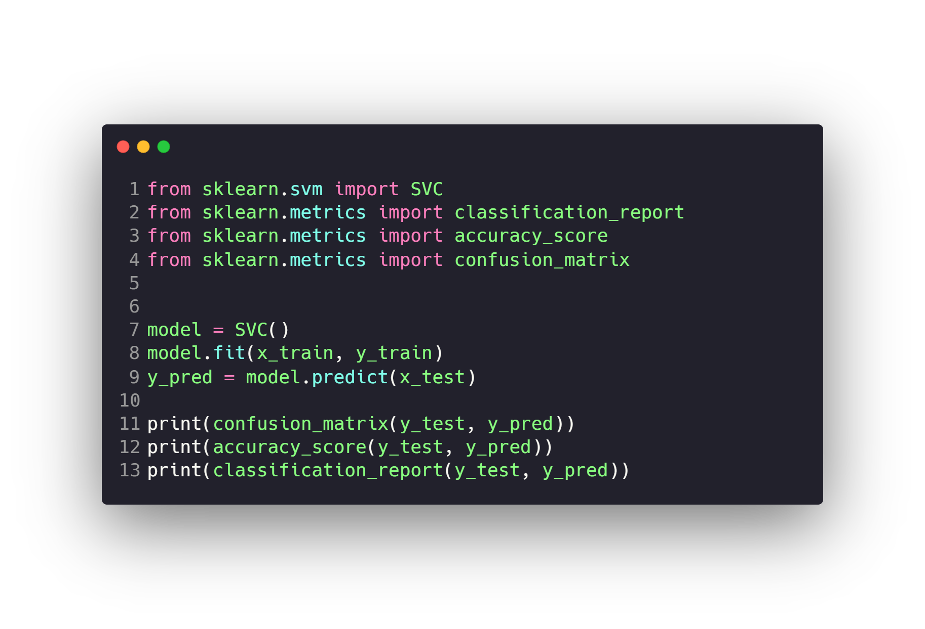
SVM (Support Vector Machine)

Slide 18
Questions ?!

