Slide 1





Machine Learning with Python

Slide 2
Agenda
What is Machine Learning
Supervised Learning
Regression
Classification
Unsupervised Learning
Clustering
Dimension Reduction
Model Selection & Evaluation
Cross Validation
Feature Selection

Slide 3
Classification Evaluation Metrics:

Slide 4
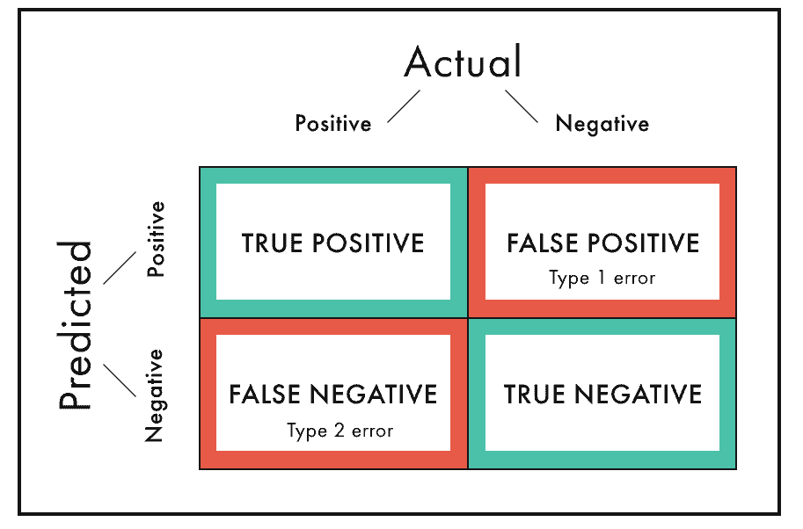
Confusion Matrix:
A confusion matrix is a table that is often used to describe the performance of a classifier on a set of test data for which the true values are known.
Let's now define the most basic terms, which are whole numbers (not rates):
True positives (TP): These are cases in which we predicted +ve and are +ve.
True negatives (TN): We predicted -ve, and they are –ve.
False positives (FP): We predicted +ve, but they are –ve "Type I error.")
False negatives (FN): We predicted -ve, but they are +ve. (Also known as a "Type II error.")

Slide 5
Confusion Matrix:
The name stems from the fact that it makes it easy to see whether the model is confusing two classes (i.e., commonly mislabeling one as another).
We use confusion matrix to calculate the other metrics.

Slide 6
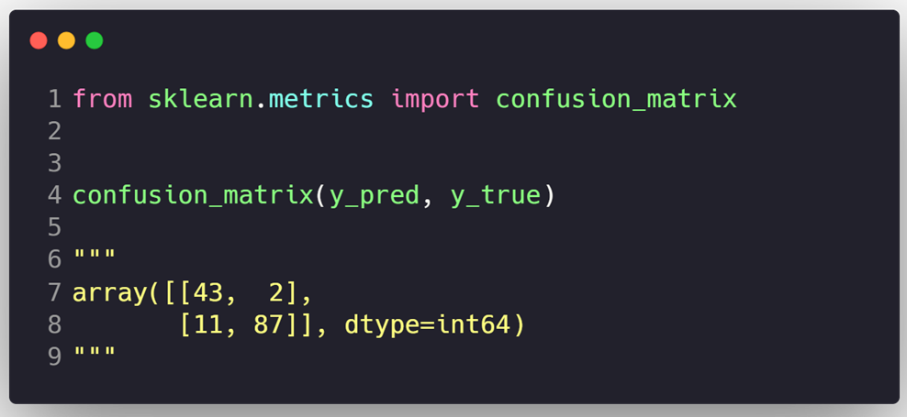
Confusion Matrix Code:

Slide 7

For the below confusion matrix, what is the count of False Negatives?
A) 53272
B) 1077
C) 1307
D) 4344

Slide 8

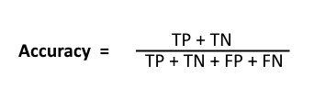
Accuracy
Accuracy is the typical classification metric.
It is easy to understand.
Easily suited for binary as well as a multiclass classification problem.
Accuracy = (TP+TN)/(TP+FP+FN+TN)
It’s the ratio of the true predicted values over all the values.
When to use?
Accuracy is a valid choice of evaluation for classification problems which are well balanced and not skewed or No class imbalance.

Slide 9
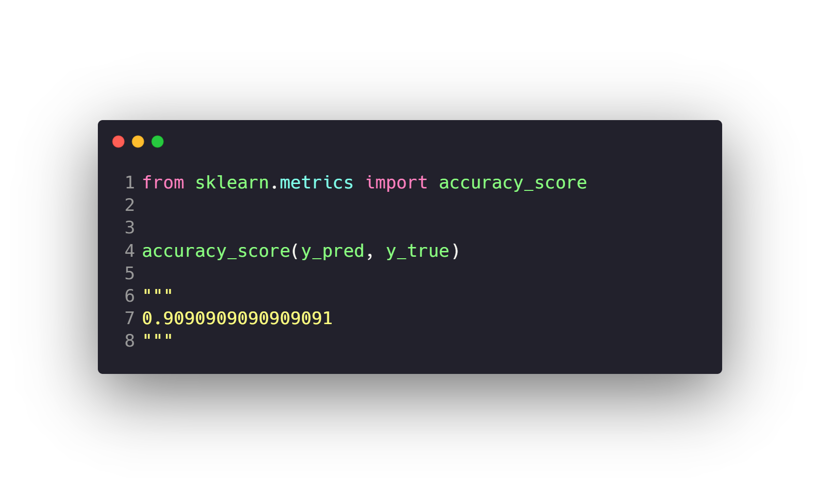



Evaluating Model Performance (Accuracy)

Slide 10
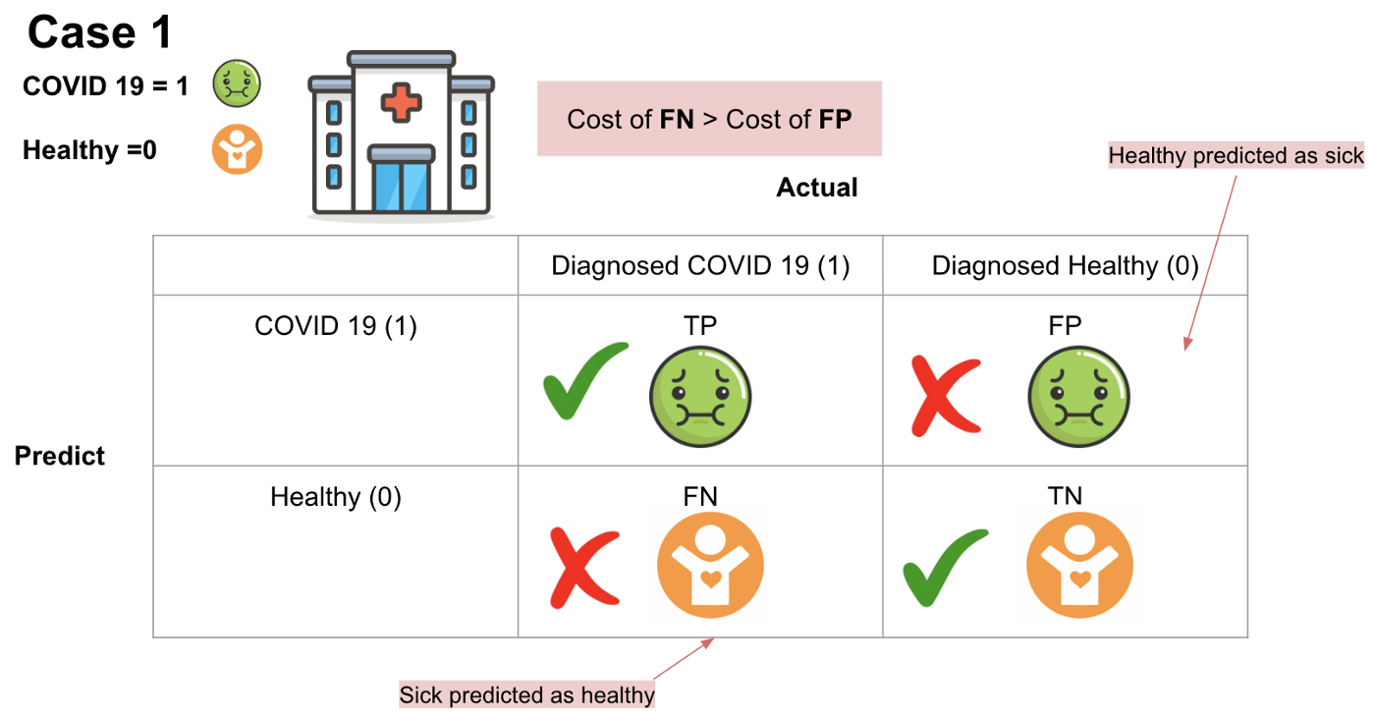
Evaluating Model Performance (Recall or Sensitivity)
TP will be that the COVID 19 residents diagnosed with COVID-19.
TN will be that healthy residents are with good health.
FP will be that those actually healthy residents are predicted as COVID 19 residents.
FN will be that those actual COVID 19 residents are predicted as the healthy residents.
which scenario do you think will have the highest cost?
Imagine that if we predict COVID-19 residents as healthy patients and they do not need to quarantine, there would be a massive number of COVID-19 infections. The cost of false negatives is much higher than the cost of false positives.

Slide 11
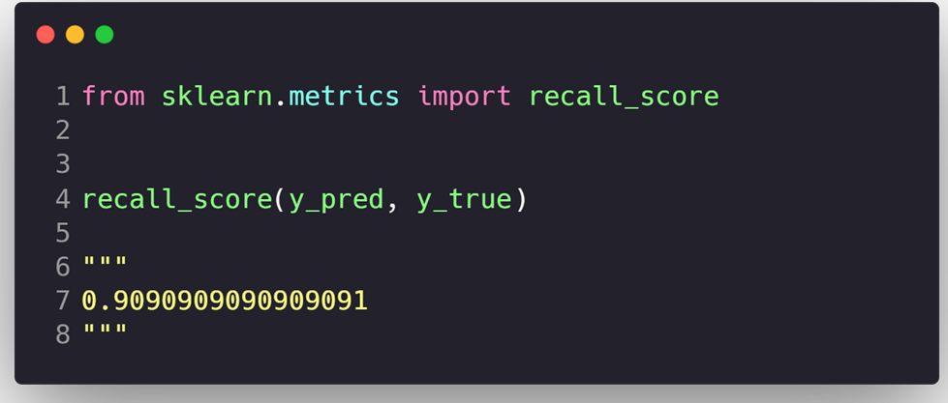
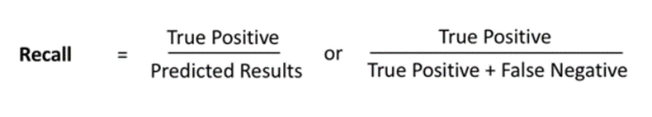
Recall or Sensitivity:
Another very useful measure is recall, which answers a different question: what proportion of Actual Positives is correctly classified.
Recall = (TP)/(TP+FN)
Recall is a valid choice of evaluation metric when we want to capture as many positives as possible
Low recall: the more false Negatives the model predicts, the lower the recall

Slide 12
From this confusion matrix what is the recall:
A) 0.7
B) 0.8
C) 0.9
D) 0.95

Slide 13
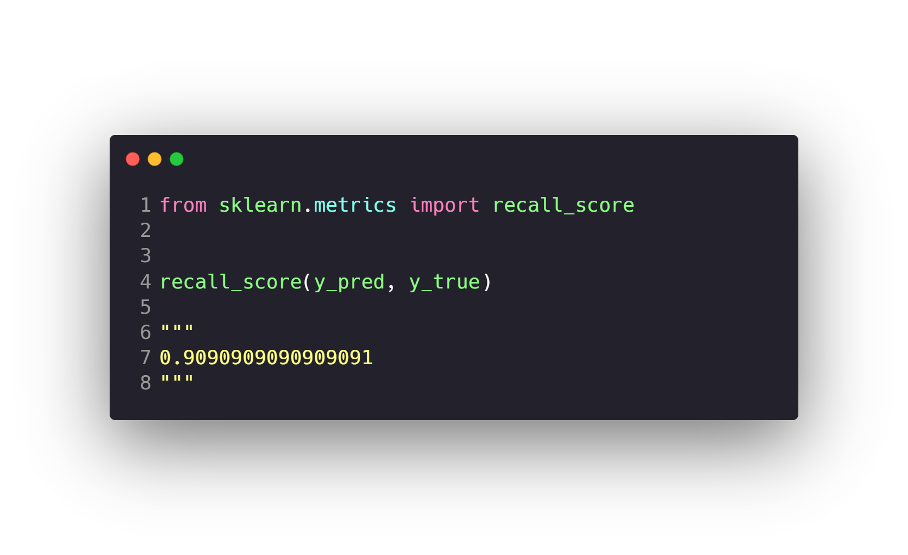
Evaluating Model Performance (Recall or Sensitivity)

Slide 14
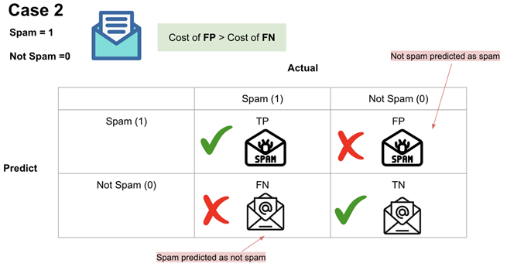
Precision
In the case of protected/spam email classification:
TP will be that spam emails are placed in the spam folder.
TN will be that important emails are received.
FP will be that important emails are placed in the spam folder.
FN will be that spam emails are received.
which scenario do you think will have the highest cost?
Well, since missing important emails will clearly be more of a problem than receiving spam, we can say that in this case, FP will have a higher cost than FN.

Slide 15
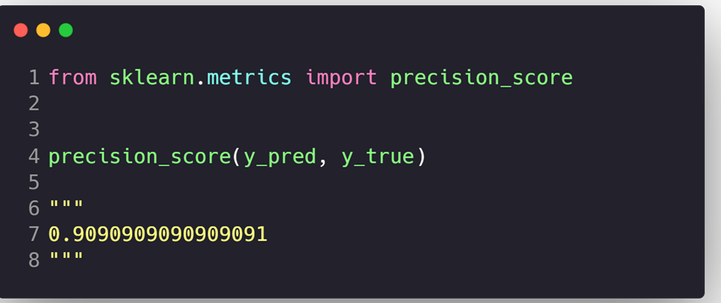
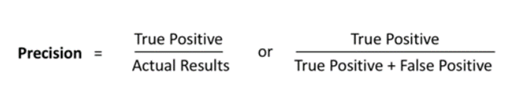
Precision:
What proportion of Predicted Positives is truly Positive.
Precision = (TP)/(TP+FP)
When to use?
Precision is a valid choice of evaluation metric when we want to be very sure of our prediction.
It’s a ratio of True Positives to all the positives predicted by the model.
Low precision: the more False positives the model predicts, the lower the precision.

Slide 16
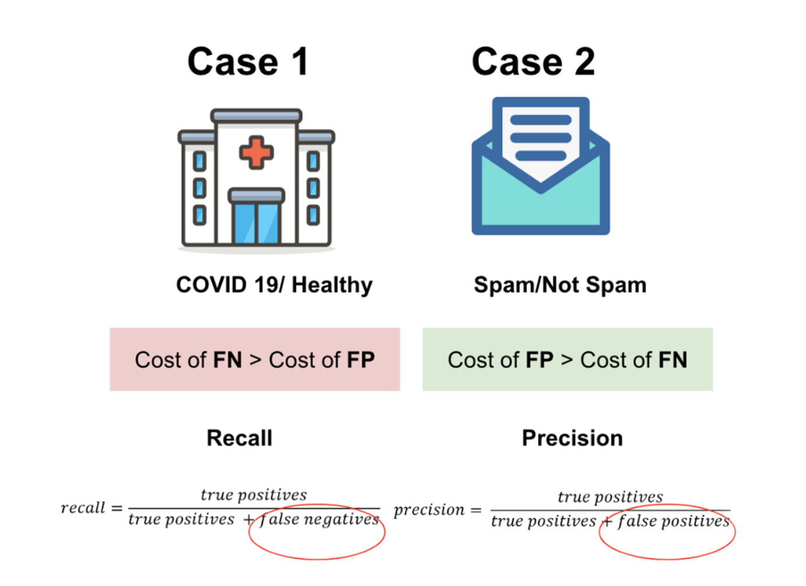

Slide 17
Precision is :
A) What proportion of actual Positives is truly positive.
B) What proportion of predicted positives is truly positive.
C) What proportion of truly positives is predicted negative.
D) What proportion of predicted negative is truly negative.

Slide 18
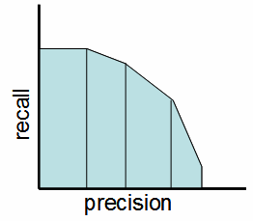
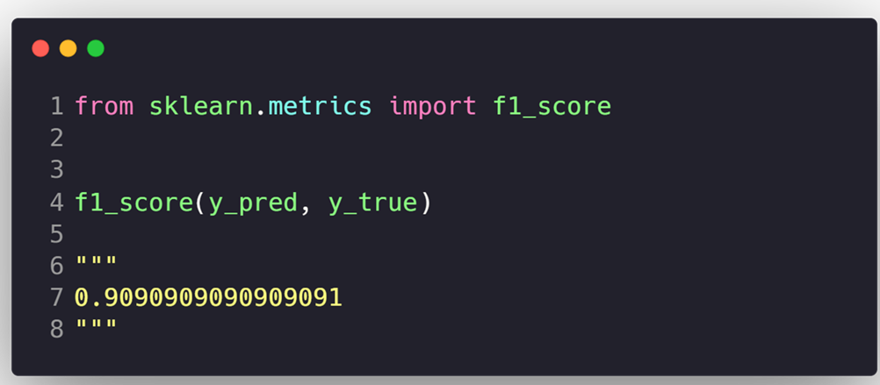
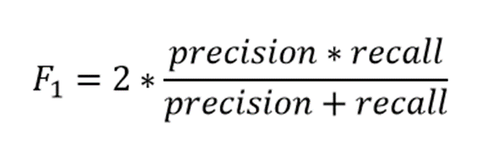
F-1 Score
F-Score called the Harmonic mean of precision and recall.
F-Score provides a single score that balances both the concerns of precision and recall in one number.
When to use?
We want to have a model with both good precision and recall.
A good F1 score means that you have low false positives and low false negatives.
An F1 score is considered perfect when it’s 1, while the model is a total failure when it’s 0.

Slide 19
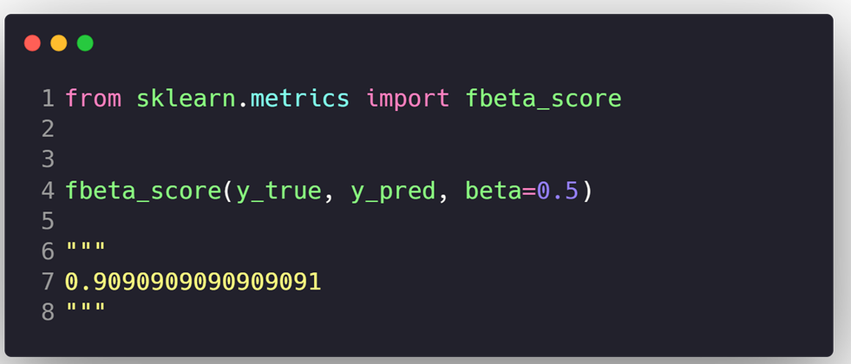
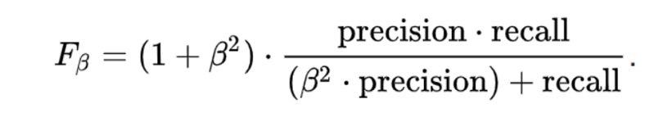
F-beta Score:
The main problem with the F1 score is that it gives equal weight to precision and recall.
We might want to have more recall or more precision.
To solve this, we use F-beta Score.
Generalization of F-Score where beta is a parameter to weight the result of the precision or recall.
Beta = 0.5 to focus more on precision, It’s called F-0.5 Score.
Beta = 2 to focus more on recall, It’s called F-2 Score.
Beta value should be used depending on your domain knowledge business case.

Slide 20
Problem with F-1 score is :
A) It gives more weight to the recall.
B) It gives more weight to precision.
C) It gives equal weight to precision and recall.
D) It’s the harmonic mean of precision and recall.

Slide 21
Agenda
What is Machine Learning
Supervised Learning
Regression
Classification
Unsupervised Learning
Clustering
Dimension Reduction
Model Selection & Evaluation
Cross Validation
Feature Selection

Slide 22
Cross Validation with K-Fold
Why we use Cross Validation
Cross Validation uses Stratified technique to make sure the distribution of the categorical target is the same in every fold.
More “efficient” use of data as every observation is used for both training and testing.
Reduce overfitting and the model achieve the generalization.

Slide 23
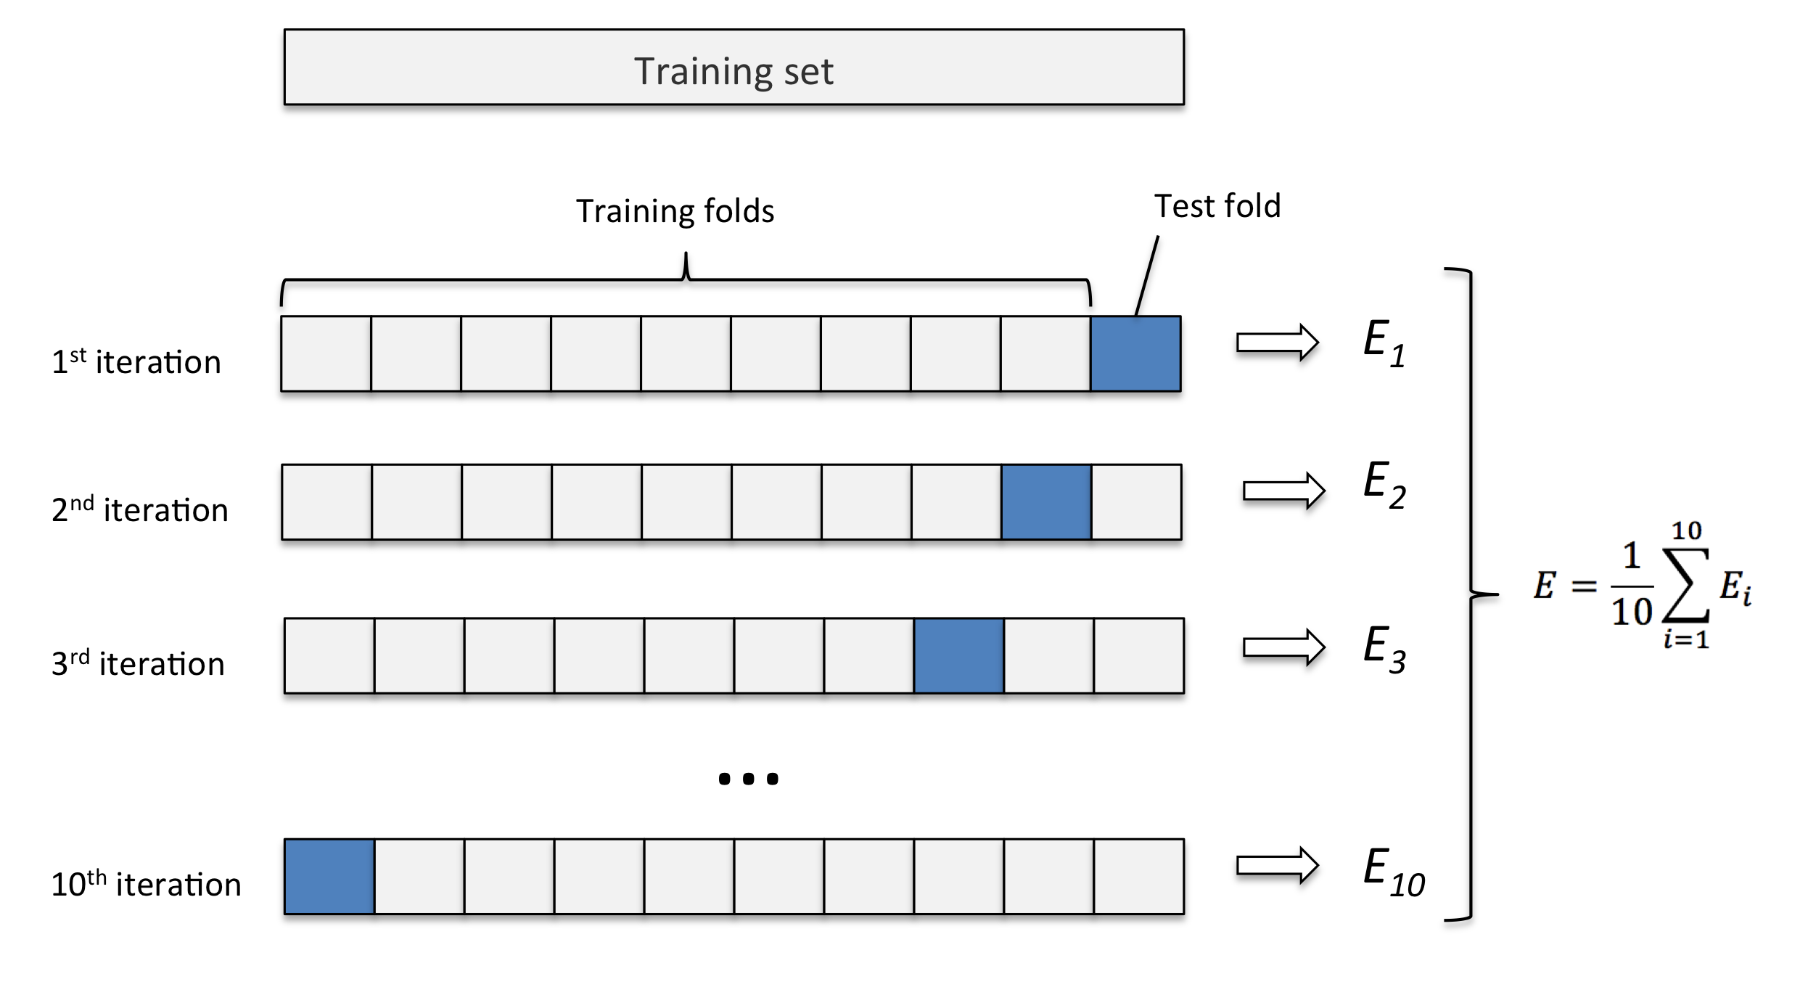
Cross Validation with K-Fold

Slide 24
Questions ?!

