Slide 1





Machine Learning with Python

Slide 2
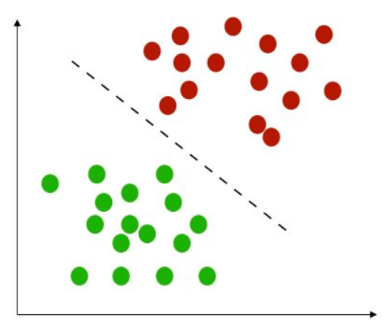



Classification
Logistic Regression
K-Nearest Neighbors (KNN)
Naive Bayes
SVM
Decision Trees
Evaluating Model Performance

Slide 3

Bayes’ Theorem

Slide 4
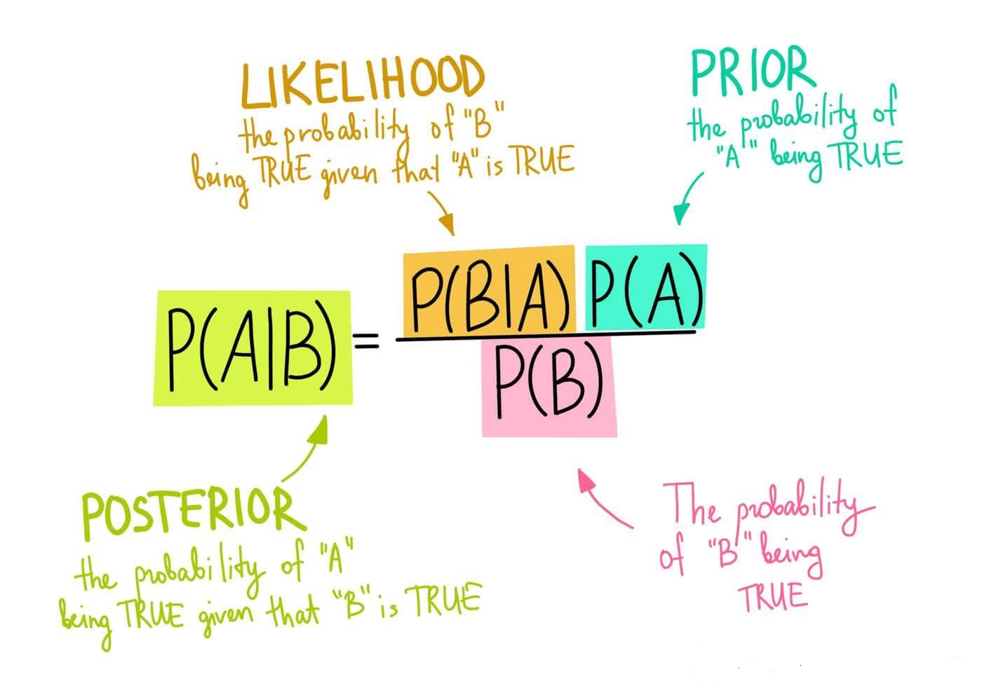
Bayes’ Theorem:
P(A|B )is the probability (A) given (B) which is what we want to calculate.
The vertical bars (|) in a probability term denote a conditional probability.
P(B|A) is the probability of the event, given that the hypothesis is true(Likelihood).
P(A) is the prior probability of the hypothesis before any event has taken place.
P(B) is the probability of the event
Event A & Event B are independent.
Probability attaches to possible results, likelihood attaches to hypotheses

Slide 5
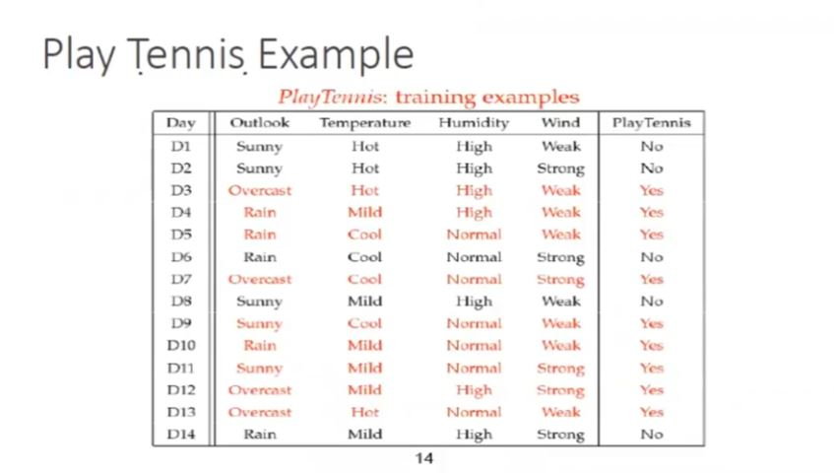
Tennis Example

Slide 6
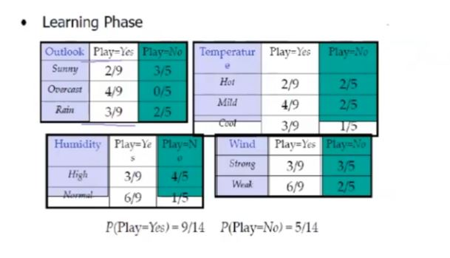
Tennis Example

Slide 7
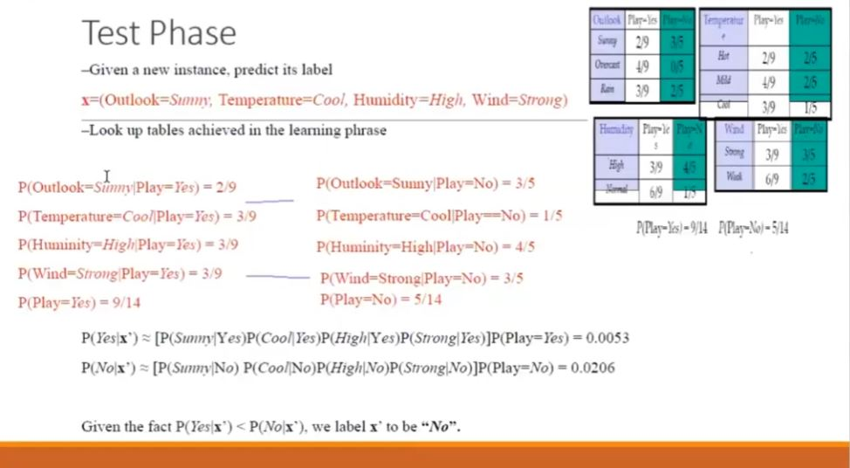
Tennis Example

Slide 8
Questions ?!

