Slide 1
Analysis of Forest Fire Detection
Satellite Data from Greece (2015-2025)
Notes:
Good morning. Today I will present an analysis of forest fire detection data from Greece spanning 2015 to 2025. This study examines 36,004 fire detections recorded by satellite systems, analyzing temporal patterns, geographic distribution, and meteorological correlations.

Slide 2
Project Overview
Research Objectives
Analyze spatial and temporal patterns of forest fire detections in Greece
Identify correlation between fire activity and meteorological conditions
Develop insights for fire prevention and early warning systems
Data Source
MODIS and VIIRS satellite fire detection products
36,004 individual fire detection records
10-year observation period with full geospatial coverage
Notes:
This research focuses on understanding fire patterns across Greece. We use satellite data which is ideal because it provides continuous monitoring over large geographic areas without ground infrastructure. The dataset includes all recorded fire detections with associated thermal, temporal, and meteorological information.

Slide 3
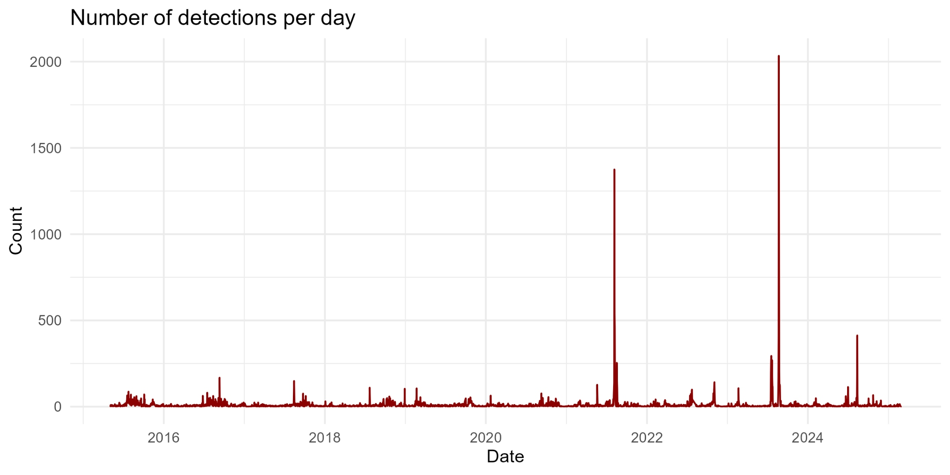
Dataset Overview and Temporal Distribution
Total Detections: 36,004 records
Time Period: May 2015 to February 2025
Geographic Coverage
Latitude: 34.96 to 41.75 North
Longitude: 19.66 to 28.23 East
Temporal Patterns
Monthly average: 305 detections
Peak month: August 2023 with 4,372 events
Significant inter-annual variability
Notes:
As shown in the time series, fire detections follow clear seasonal patterns with dramatic peaks during summer months, particularly in 2023 which was an exceptional year. The baseline activity outside fire season remains relatively low, typically under 50 detections per day.

Slide 4
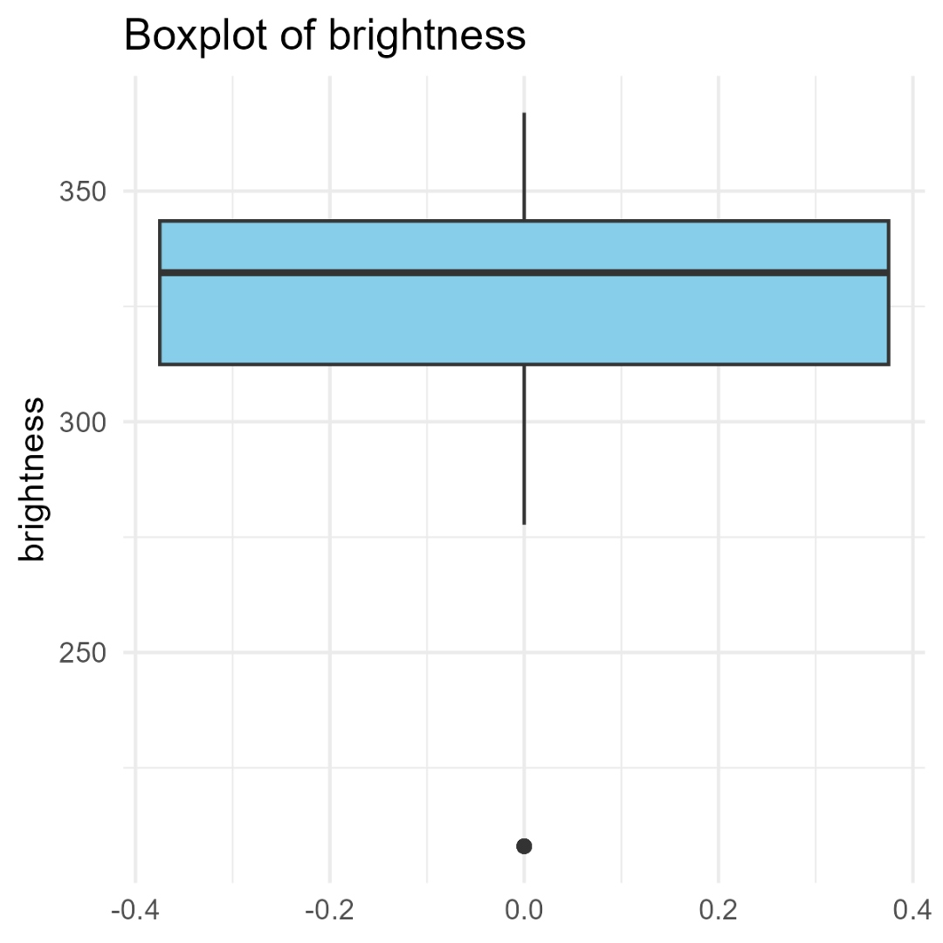
Thermal Characteristics of Detected Fires
Brightness Temperature
Mean: 330.4 Kelvin
Range: 208.0 to 367.0 K
Standard deviation: 19.9 K
Indicates surface temperature of fire
Fire Radiative Power
Mean: 12.9 megawatts
Range: 0.0 to 939.8 MW
Highly variable with fire intensity
Notes:
The boxplot shows brightness is concentrated in a tight distribution between 310 and 345 Kelvin, which is typical for active fires. The distribution confirms that most detections represent genuine fire activity. The few outliers at lower temperatures may indicate false positives or marginal detections.

Slide 5
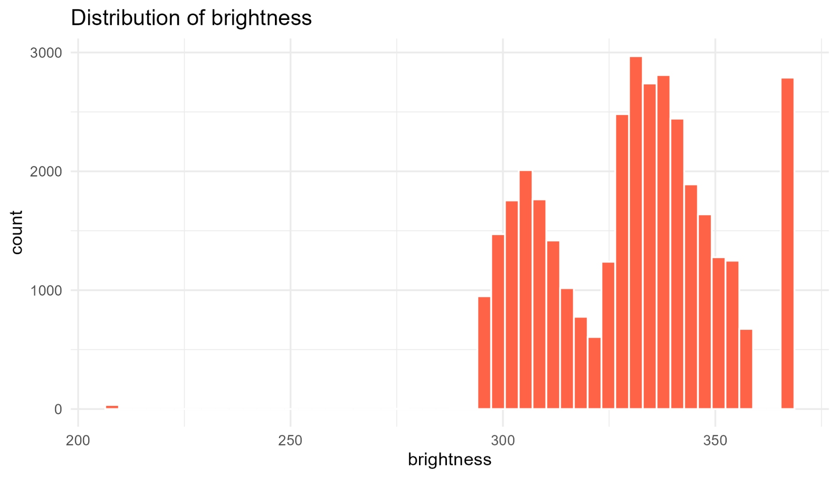
Distribution Analysis of Brightness Values
Distribution Shape
Bimodal distribution observed
Primary peak around 320-340 Kelvin
Secondary peak near 360 Kelvin
Indicates different fire intensities
Statistical Properties
Median: 332.3 Kelvin
Mean: 330.4 Kelvin
Relatively symmetric around peak
Notes:
The histogram reveals that while most fires cluster in the 310 to 340 Kelvin range, a secondary population exists at higher temperatures around 360 Kelvin. This bimodality may reflect differences in fire type or intensity. The distribution is suitable for statistical analysis.

Slide 6
Detection Confidence Assessment
Confidence Distribution
High confidence: 2,477 detections (6.9%)
Medium confidence: 1,988 detections (5.5%)
Low confidence: 31,539 detections (87.6%)
Interpretation
Majority of detections have low confidence scores
Typical for satellite fire detection systems
Requires integration with other data sources
Reliable for trend analysis and pattern identification
Notes:
The confidence distribution is not unusual for satellite systems. The algorithm prioritizes sensitivity, detecting potential fires even with moderate certainty. For operational use, these low-confidence detections should be validated against ground reports or auxiliary data before emergency response.

Slide 7
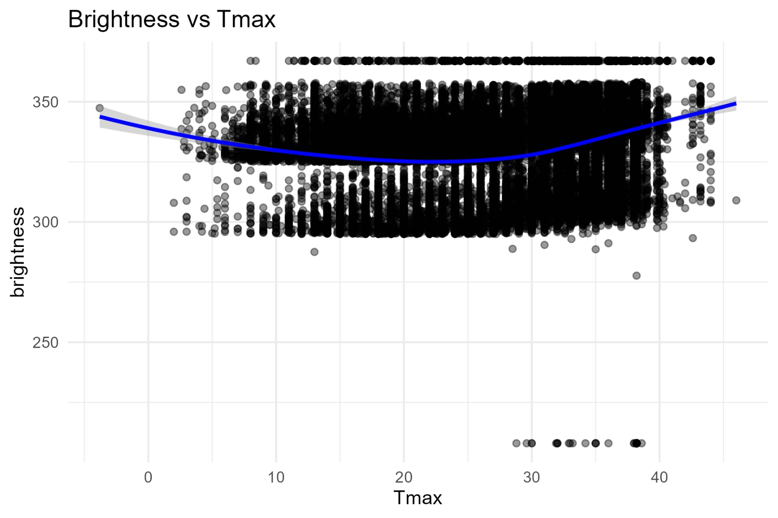
Meteorological Context
Temperature
Average: 22.2 degrees Celsius
Minimum mean: 16.1 degrees Celsius
Maximum mean: 28.2 degrees Celsius
Precipitation
Average: 0.1 millimeters
Inverse correlation with fire activity
Maximum recorded: 55.3 millimeters
Wind Speed
Average: 11.3 meters per second
Maximum: 50.6 meters per second
Key factor in fire propagation
Notes:
The scatter plot demonstrates the relationship between maximum temperature and fire brightness. While there is considerable scatter, a general trend shows fires occurring across a wide temperature range, confirming that temperature alone does not determine fire presence but rather creates conditions favorable for fire spread.

Slide 8
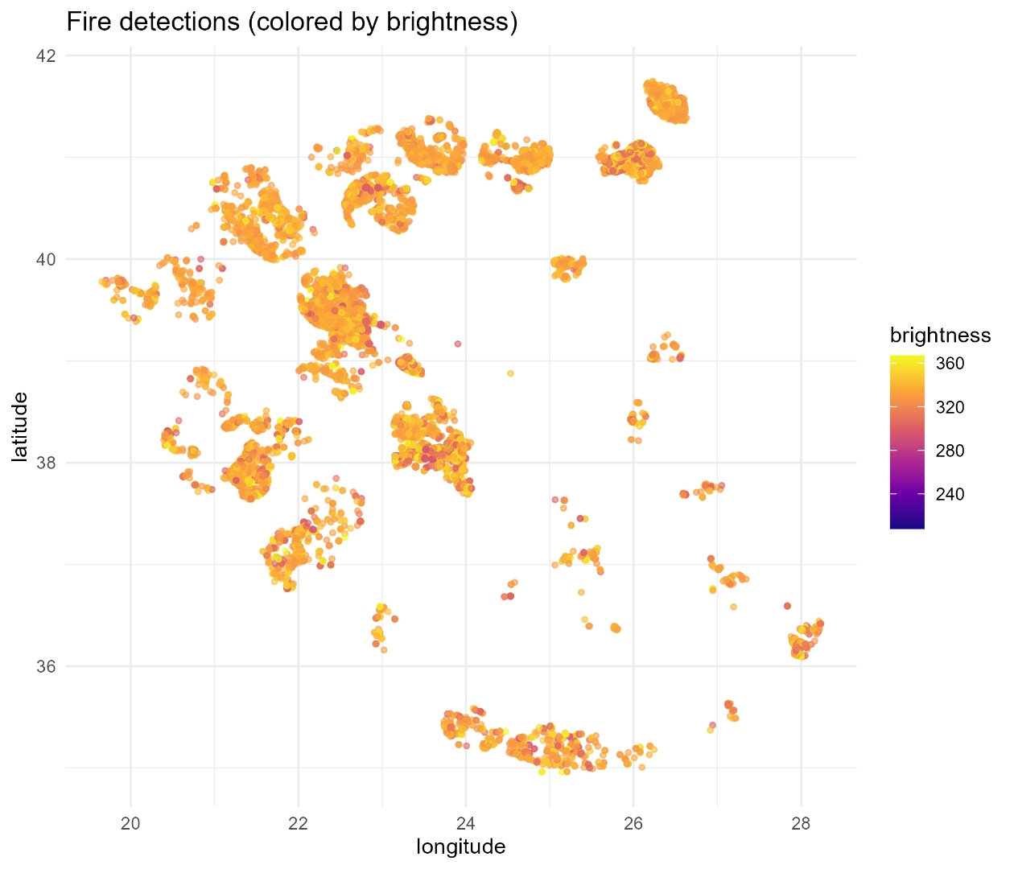
Geographic Distribution and Hotspots
Concentration Areas
Central Greece: latitude 38.1 to 38.6 North
Attica and Boeotia regions dominant
Eastern Peloponnese secondary hotspot
Characteristics
Corresponds to populated and forested regions
Mediterranean climate with dry summers
Historically high fire activity zone
Notes:
The spatial map reveals clustering in central-eastern Greece where we see consistent high-brightness detections. These regions combine factors that promote fire: dense vegetation, warm and dry summers, and significant human population providing ignition sources.

Slide 9
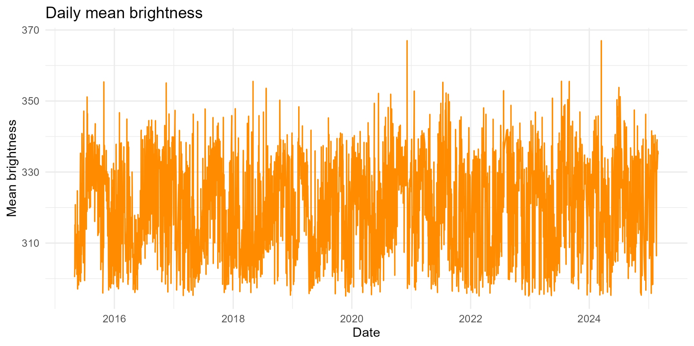
Long-term Temporal Trends
Seasonality
Clear annual cycle with summer peaks
Highest activity: June through September
Winter minimum: December through February
Correlation with precipitation deficit
Long-term Pattern
2023 marked exceptional fire year
General increasing trend observed
2024 showed elevated activity continuation
Notes:
The daily mean brightness plot shows pronounced seasonal variation with regular oscillations corresponding to the calendar year. Notice the elevated baseline in recent years, particularly 2023, suggesting either increasing fire frequency or detection sensitivity. The consistency of the seasonal pattern indicates robust, predictable behavior suitable for forecasting.

Slide 10
Correlation Analysis Between Variables
Key Correlations
Brightness and Fire Radiative Power: 0.34 (moderate positive)
Tmax and Tavg: 0.97 (very strong positive)
Wind Speed and Tavg: 0.43 (moderate positive)
Precipitation and Tavg: -0.03 (negligible)
Implications
Brightness is moderately linked to fire intensity
Temperature variables are strongly intercorrelated
Wind speed independently affects conditions
Multi-factor approach needed for fire prediction
Notes:
The correlation matrix indicates that no single meteorological variable strongly predicts fire occurrence. This suggests that fire detection requires consideration of multiple environmental factors. The moderate positive correlation between temperature variables confirms the strong seasonal component of fire activity.

Slide 11
Summary Statistics
Brightness
Mean: 330.37 Kelvin, Standard Deviation: 19.93
Median: 332.32 Kelvin
Fire Radiative Power
Mean: 12.90 megawatts, Standard Deviation: 32.34
Median: 3.74 megawatts
Temperature Variables
Average Temperature: 22.21°C, Min: 16.15°C, Max: 28.23°C
All measurements within expected range for Greece
Other Variables
Precipitation: mean 0.10mm, Wind: 11.32 m/s
No missing values across complete dataset
Notes:
These summary statistics confirm the integrity of our dataset with complete records across all variables. The relatively low standard deviations in brightness compared to Fire Radiative Power indicate that while fire location is consistently detected, fire intensity varies considerably, reflecting the diversity of fire types and sizes.

Slide 12
Key Findings and Conclusions
Main Discoveries
Strong seasonal cycle with June-September concentration
Year 2023 was exceptional with unprecedented detections
Geographic concentration in central-eastern Greece
Multiple meteorological factors influence fire activity
Recommendations
Intensify monitoring resources during summer months
Implement automated early warning systems
Integrate meteorological forecasts for fire risk assessment
Share data with civil protection authorities for response planning
Notes:
Our analysis demonstrates that forest fires in Greece follow predictable seasonal and geographic patterns. The strong temporal signature allows for targeted prevention efforts during high-risk periods. The geographic concentration enables focused resource allocation to vulnerable regions.

Slide 13
Conclusion
Thank you for your attention. Questions?
Notes:
This concludes the presentation. The data clearly shows that while forest fires pose a persistent threat in Greece, their patterns are sufficiently regular to support evidence-based prevention and response strategies. I am happy to discuss any aspects of the analysis in detail.

