Slide 1
Albasha Restaurant Website & Admin System
Developed by Hassan Krecht – Professional Laravel Solution

Slide 2
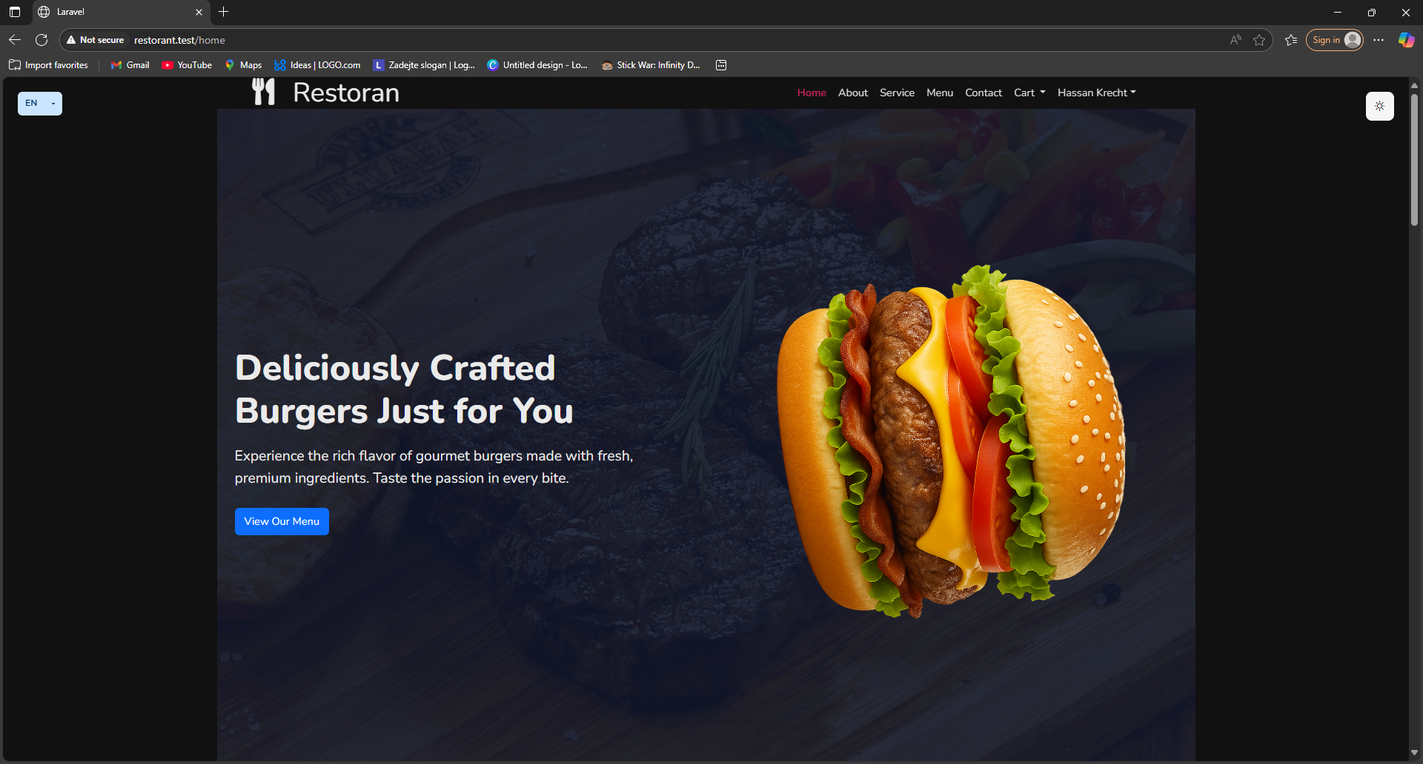
Homepage Navigation
Elegant homepage with banner, navigation, and responsive menu.

Slide 3
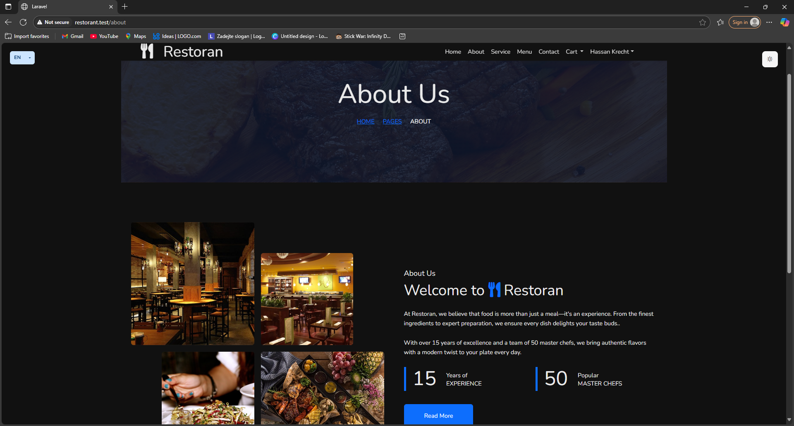
About Page
Displays the restaurant story, values, and mission to build customer trust.

Slide 4
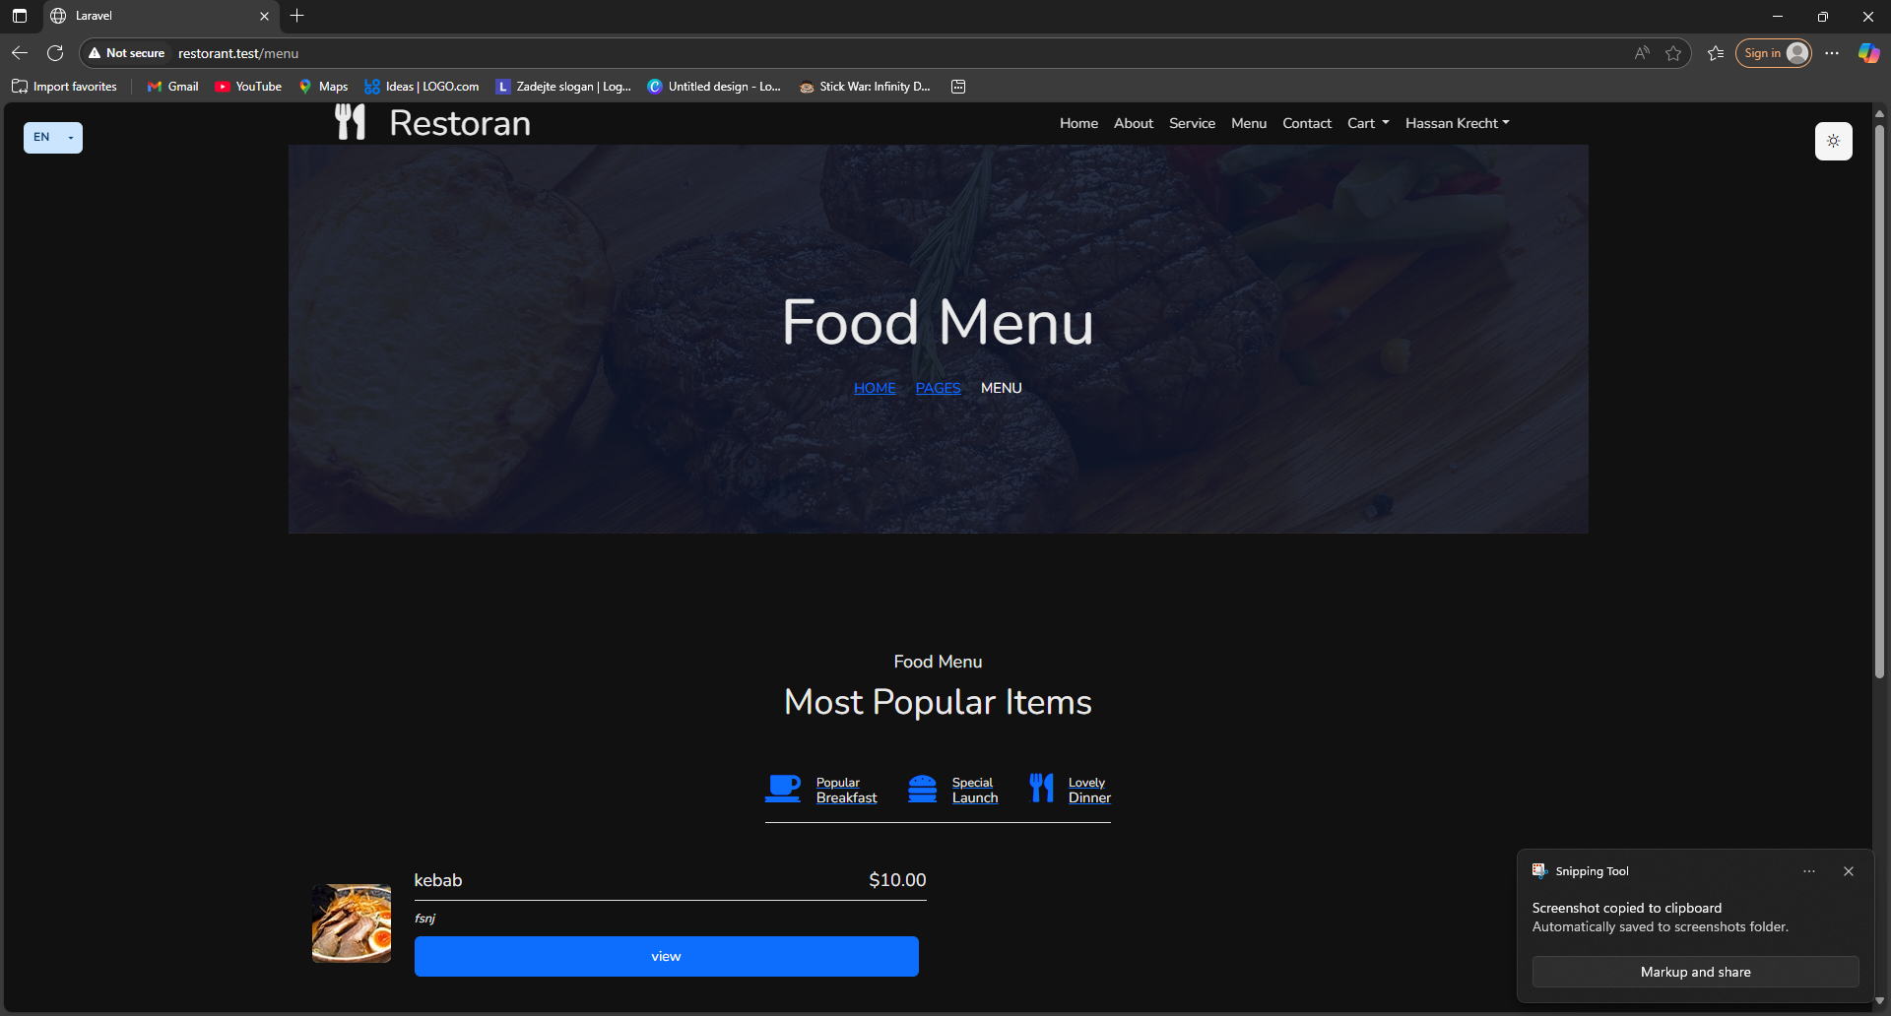
Menu Page
Showcases all meals with details, prices, and categories.

Slide 5
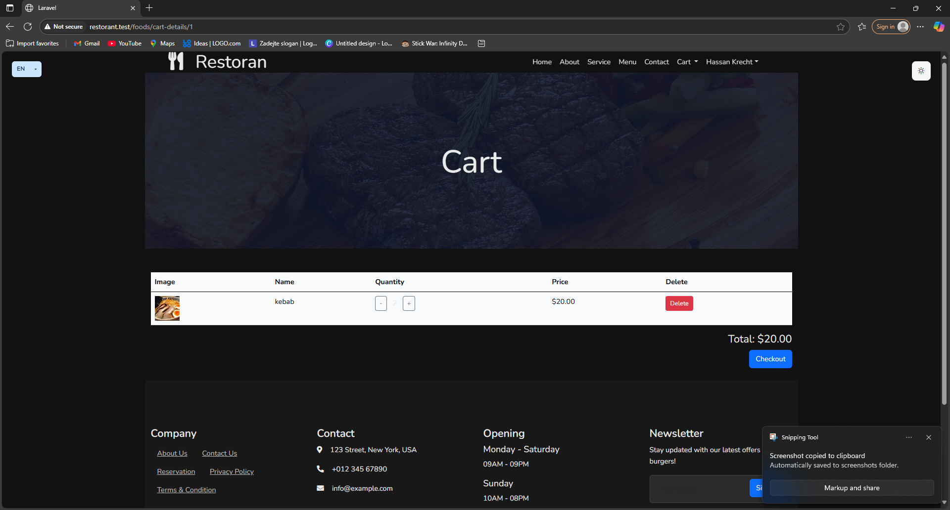
Cart & Order Detail
Users can review items in the cart and proceed to checkout.

Slide 6
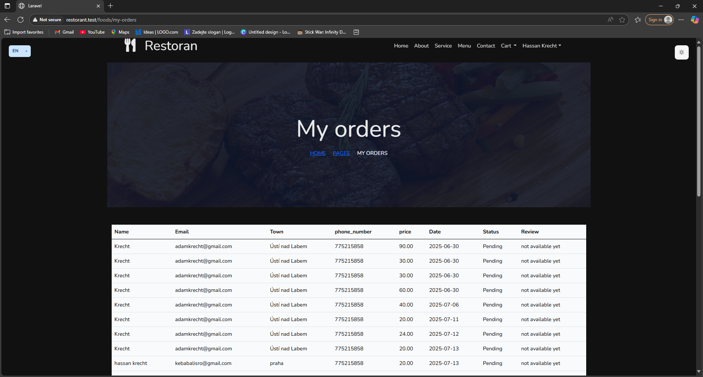
My Orders
Users can track all their past and current orders with status updates.

Slide 7
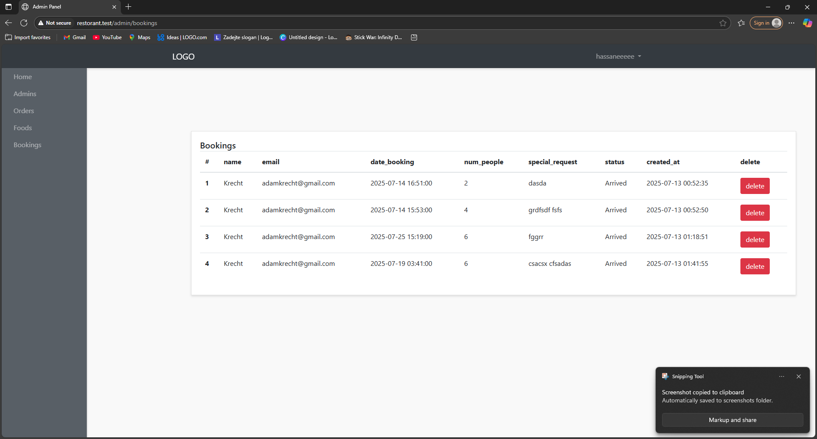
Reservation Page
Simple table booking system with form inputs and status display.

Slide 8
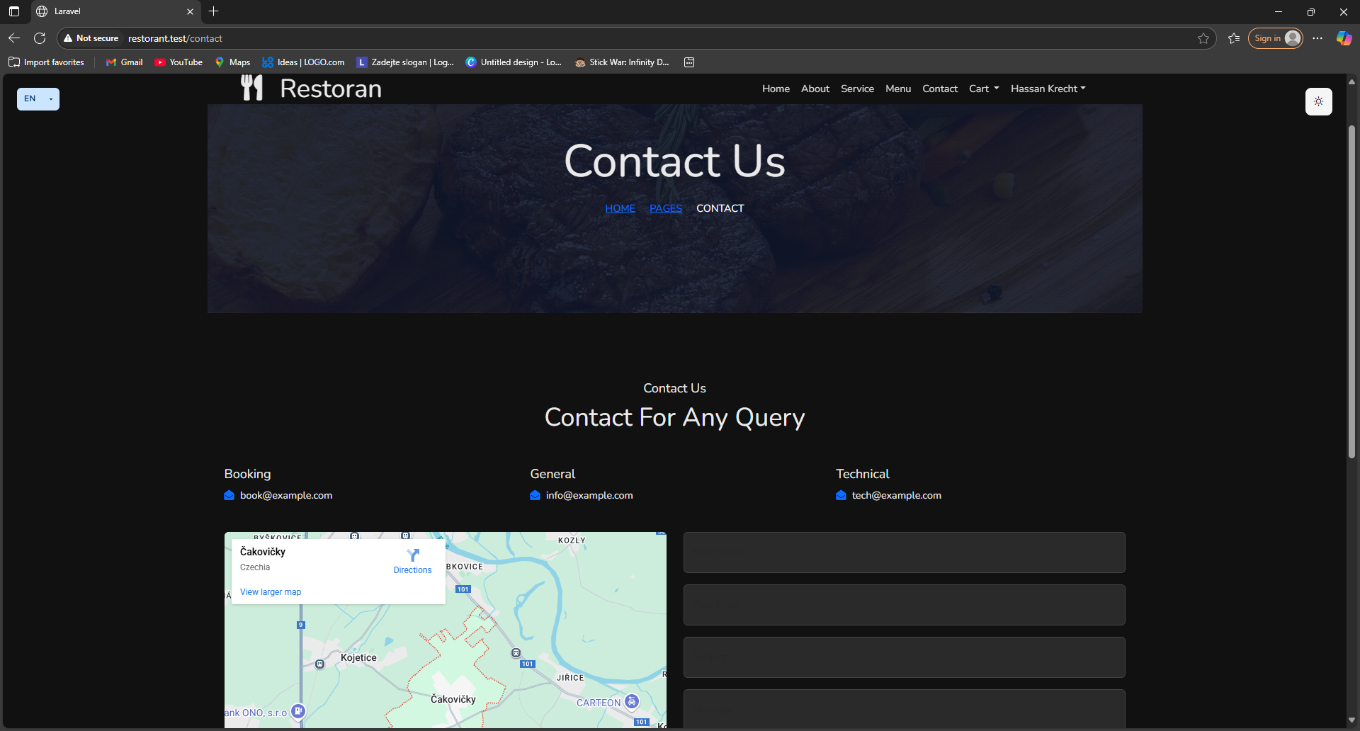
Contact Page
Customers can reach out with questions or feedback through this section.

Slide 9
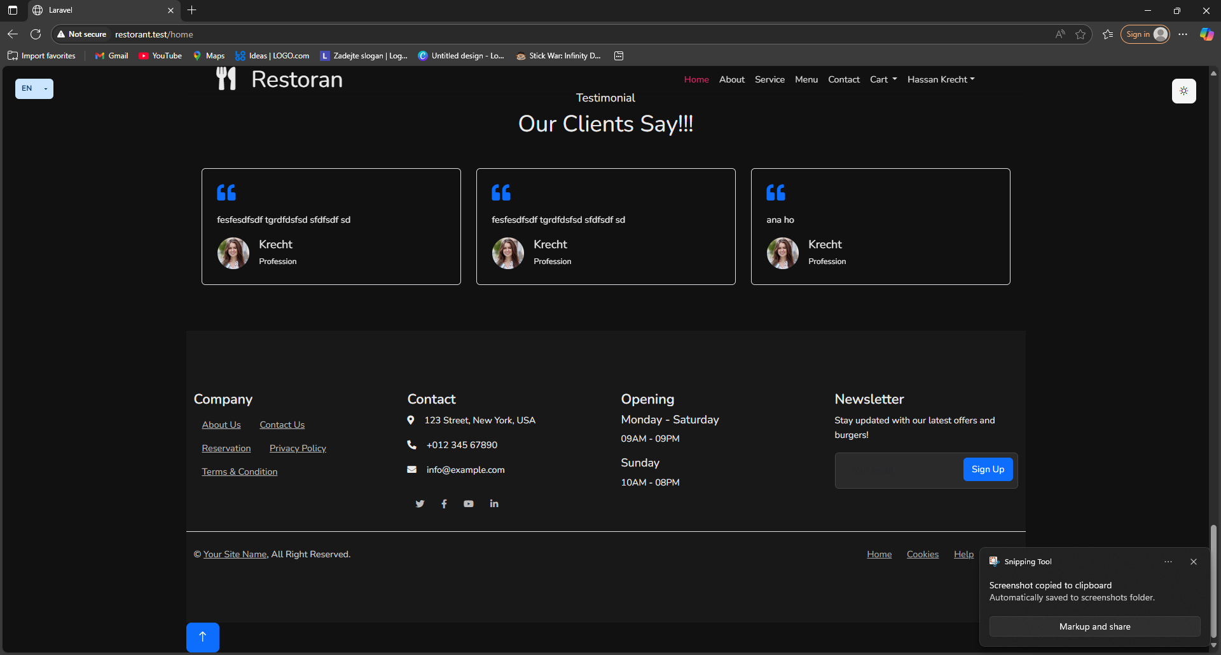
User Reviews
Clients leave reviews/testimonials for dishes and services.

Slide 10
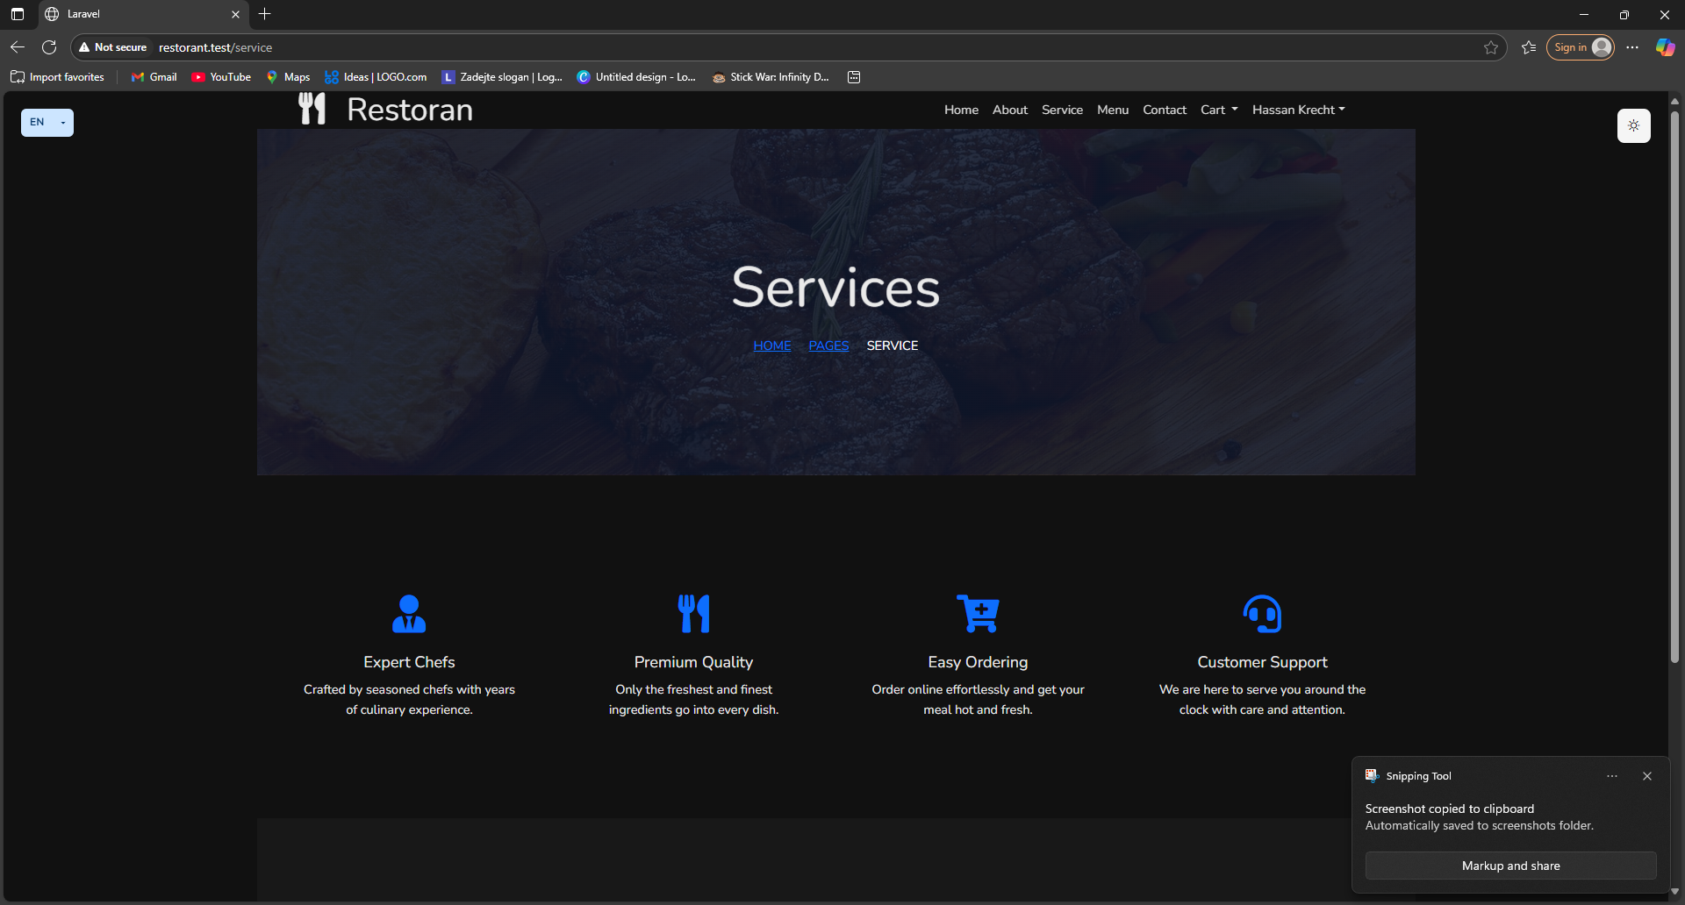
Service Page
Highlights core services: expert chefs, quality food, fast delivery, and support.

Slide 11
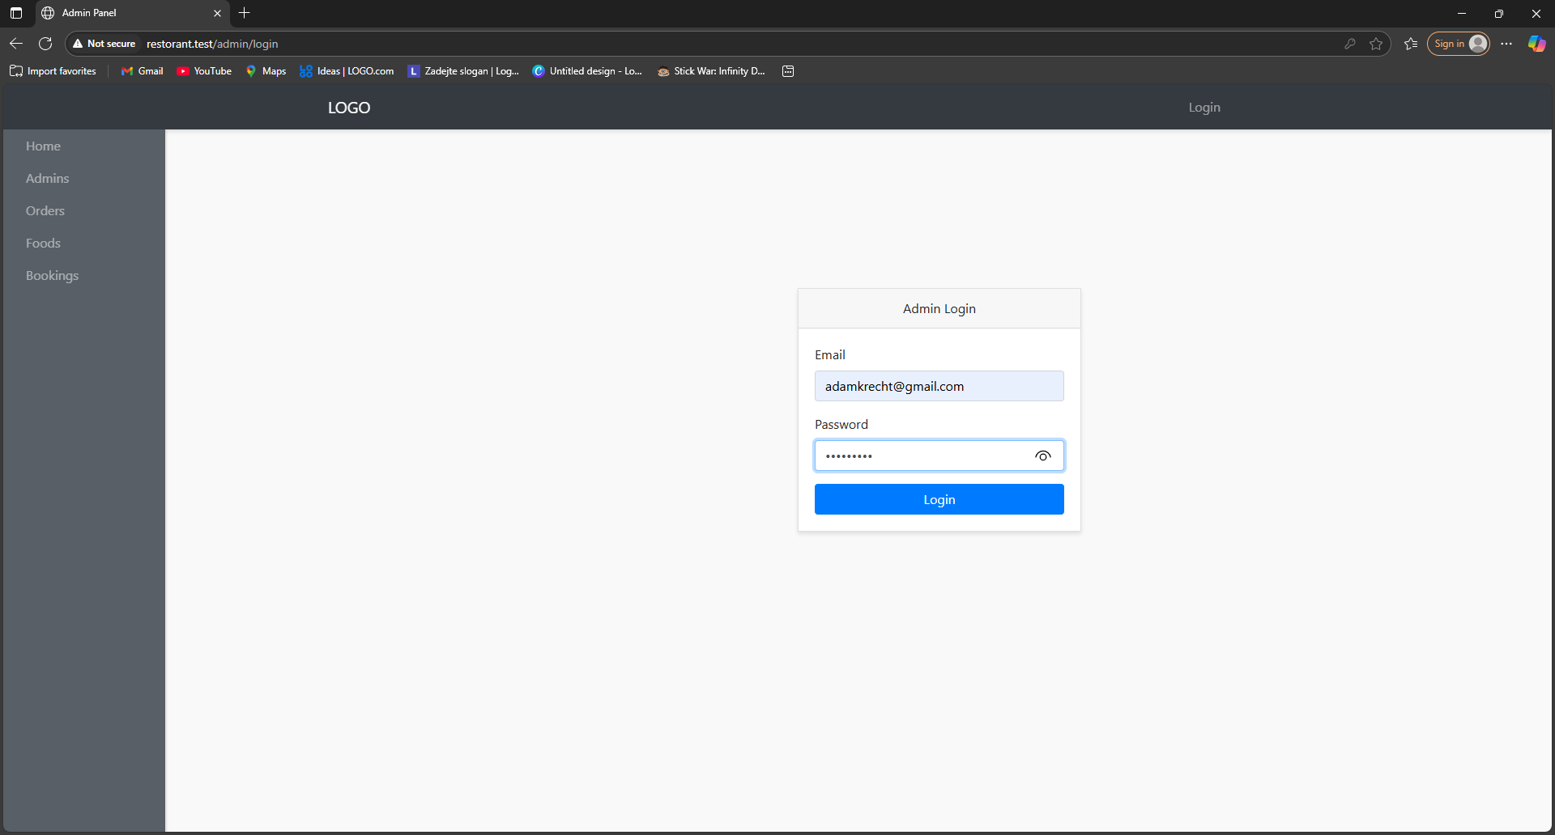
Admin Login
Secure login for admin access to the dashboard and management.

Slide 12
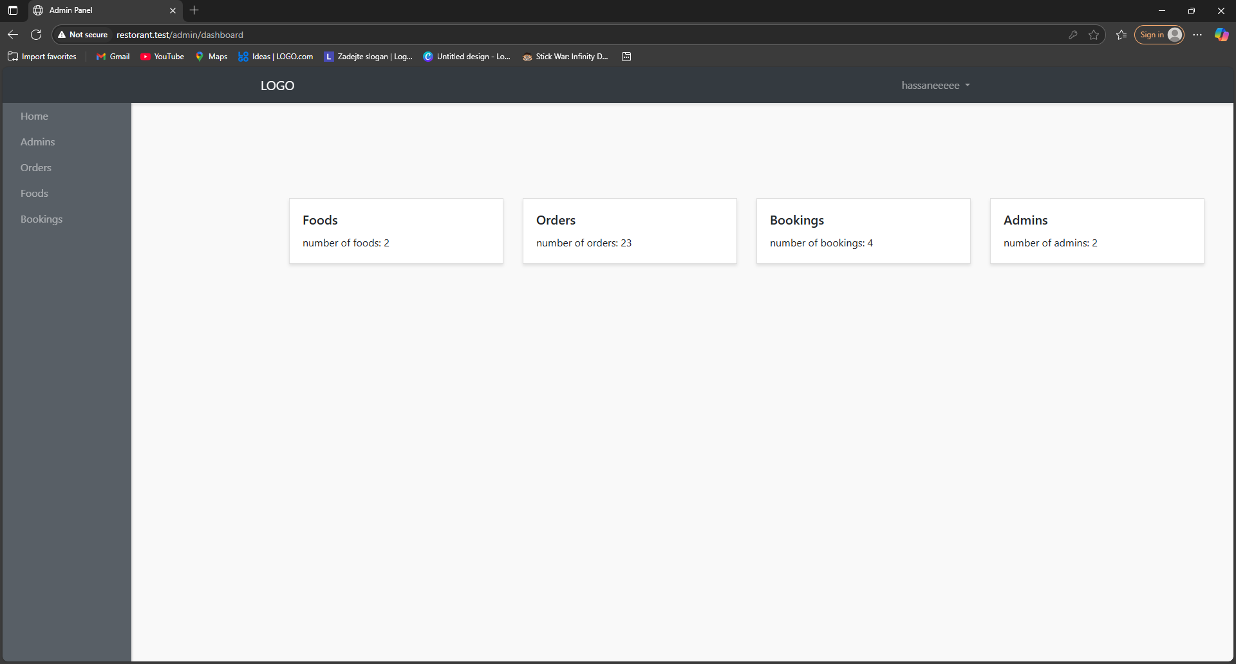
Admin Dashboard
The control center for managing all sections: foods, orders, users, and admins.

Slide 13
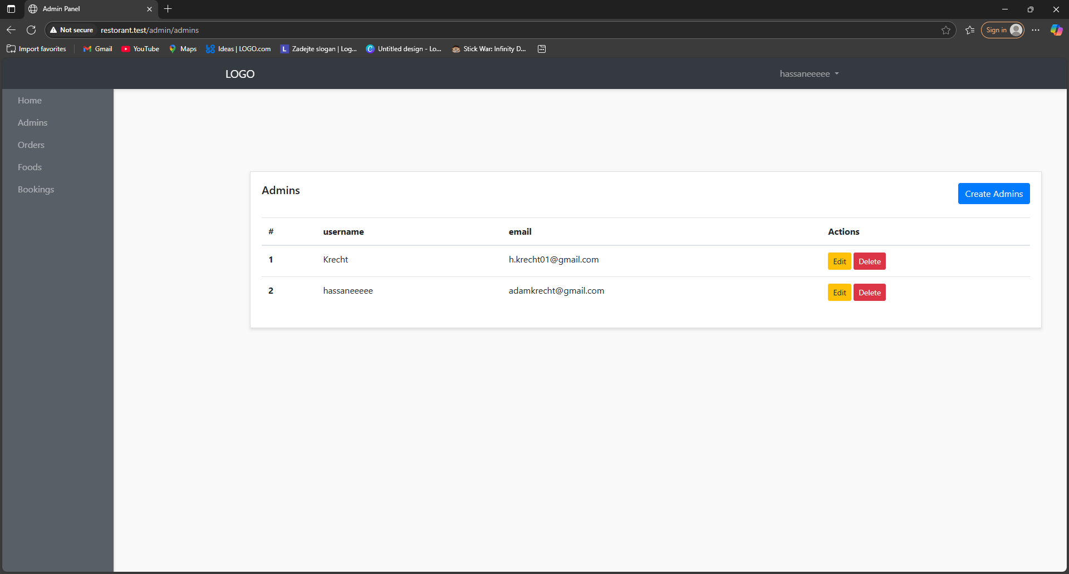
Edit/Add Products
Admins can add, edit, or delete food items easily.

Slide 14
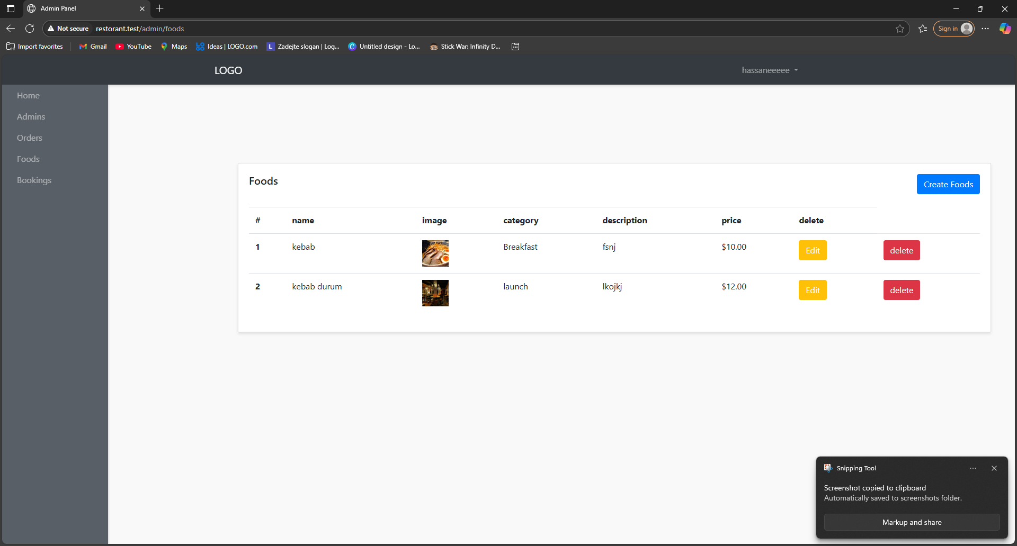
Manage Orders
Full control of customer orders: edit status, cancel, or remove.

Slide 15
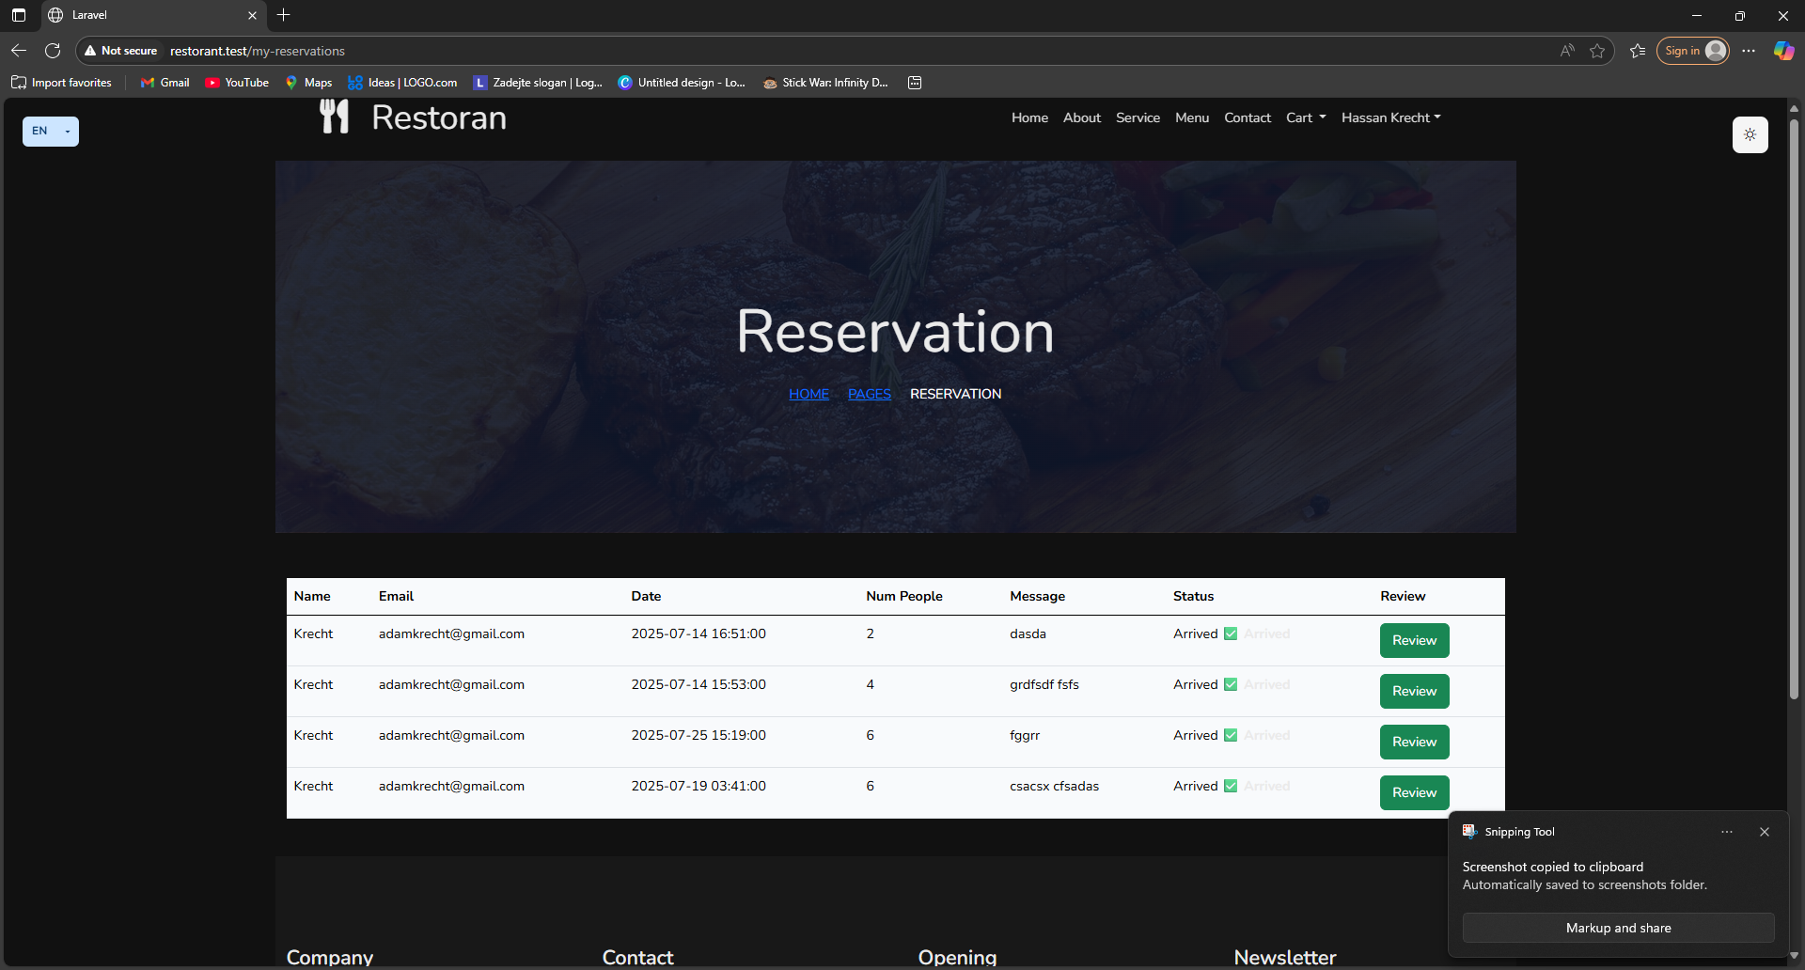
Manage Reservations
Admins can view and delete reservations with details.

Slide 16
Why Choose This System?
This Laravel-based system provides full control for restaurants, from menu to orders to reservations. Flexible, modern, multilingual-ready, and developed by Hassan Krecht for businesses that demand results.

